Slide 1

Project 2 Design
PREDICTION FOR H-1B
& PERM

Slide 2

Context of the Project
·Immigration Services has been closed for months and applications for both h1b and green card are affected.
Overall Goal?
· Help applicants to predict the results.

Slide 3
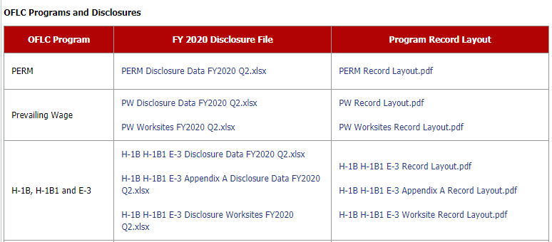
Dataset we will use
·Source: Public data from
US Department of Labor in 2020
· Over Two Hundreds columns
(state, job, wage, violation,
employer and other personal information.)
· Highly imbalanced data
· Most of features are categorical.

Slide 4
What we will do with the data
·Main issue: Still large mount of features after data cleaning.
· One option to handle this is using techniques like Elastic Net regularization, PCA or feature selection algorithms (like backward/forward selection)
· Less interpretability.

Slide 5
What we will do with the data
Education
Employer name
EMPLOYER
· Another option:
First we group the features with high correlations. Then do
feature engineering separately.
· More interpretability. But also more time-consuming.
Employer
state
WAGE
JOB
Applicants
Job title
Wage level
Prevailing wage
Soc code
VIOLATION
Wage
source
Full time

Slide 6
How to validate our answers
-If we use resampled data, mainly focus on AUC/ROC curves on different models.
-If not, since the dataset is highly imbalanced, we may focus on precision-recall.

Slide 7

Questions to be answered
-What features/requirements are more important for applicants
-Mainly offer a predictive answer with a user interface.

Slide 8

Schedule
1-2 Weeks
-H1B part
3-4 Weeks
-PERM part
1-2 Weeks
-Final results and UI

