Slide 1

Project 2 Update 1
PREDICTION FOR H-1B
& PERM
Liang Xue, Yichun Sun

Slide 2

Context of the Project
·Immigration Services has been closed for months and applications for both h1b and green card are affected.
Overall Goal?
· Help applicants to predict the results.

Slide 3
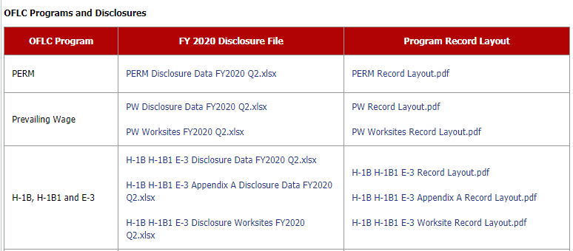
Dataset we will use
Source: Public data from US Department of Labor in past 5 years
Over Two Hundreds columns (state, job, wage, violation, employer and other personal information.)

Slide 4
Dataset we will use
Year | Data | Size
2019 | H-1B FY2019.xlsx | 283MB
2018 | H-1B FY2018.xlsx | 169MB
2017 | H1B FY2017.xlsx | 164MB
2016 | H1B FY2016.xlsx | 137MB
2015 | H1B FY2015.xlsx | 144MB
Read excel to pandas
568s for reading xlsx to dataframe
Transform excel to csv, then read to pandas
475s for excel to csv (one-off process)
30s to read csv to dataframe (iteratively)

Slide 5
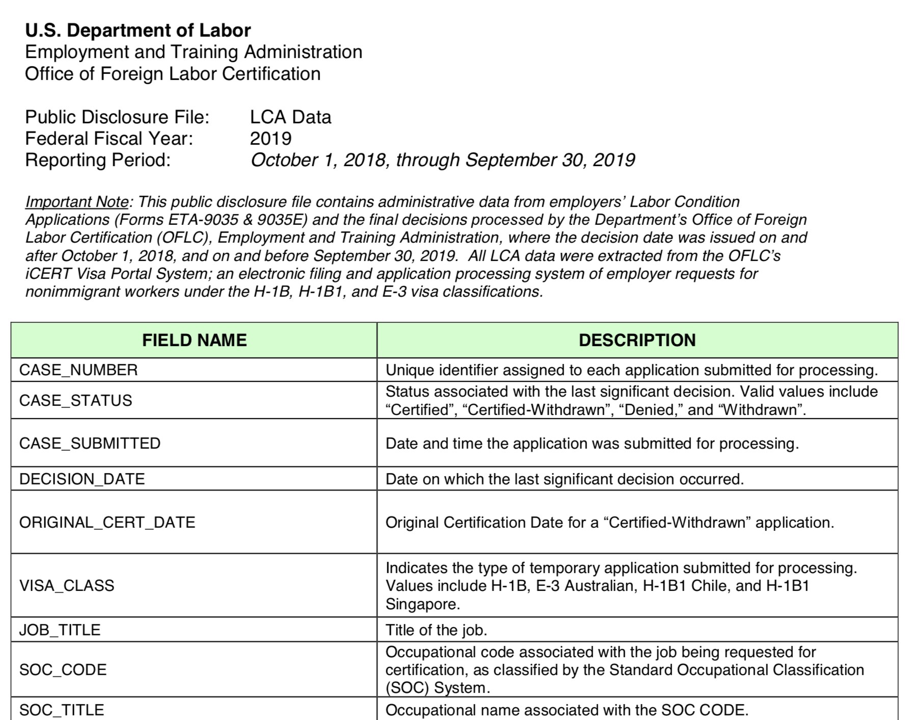
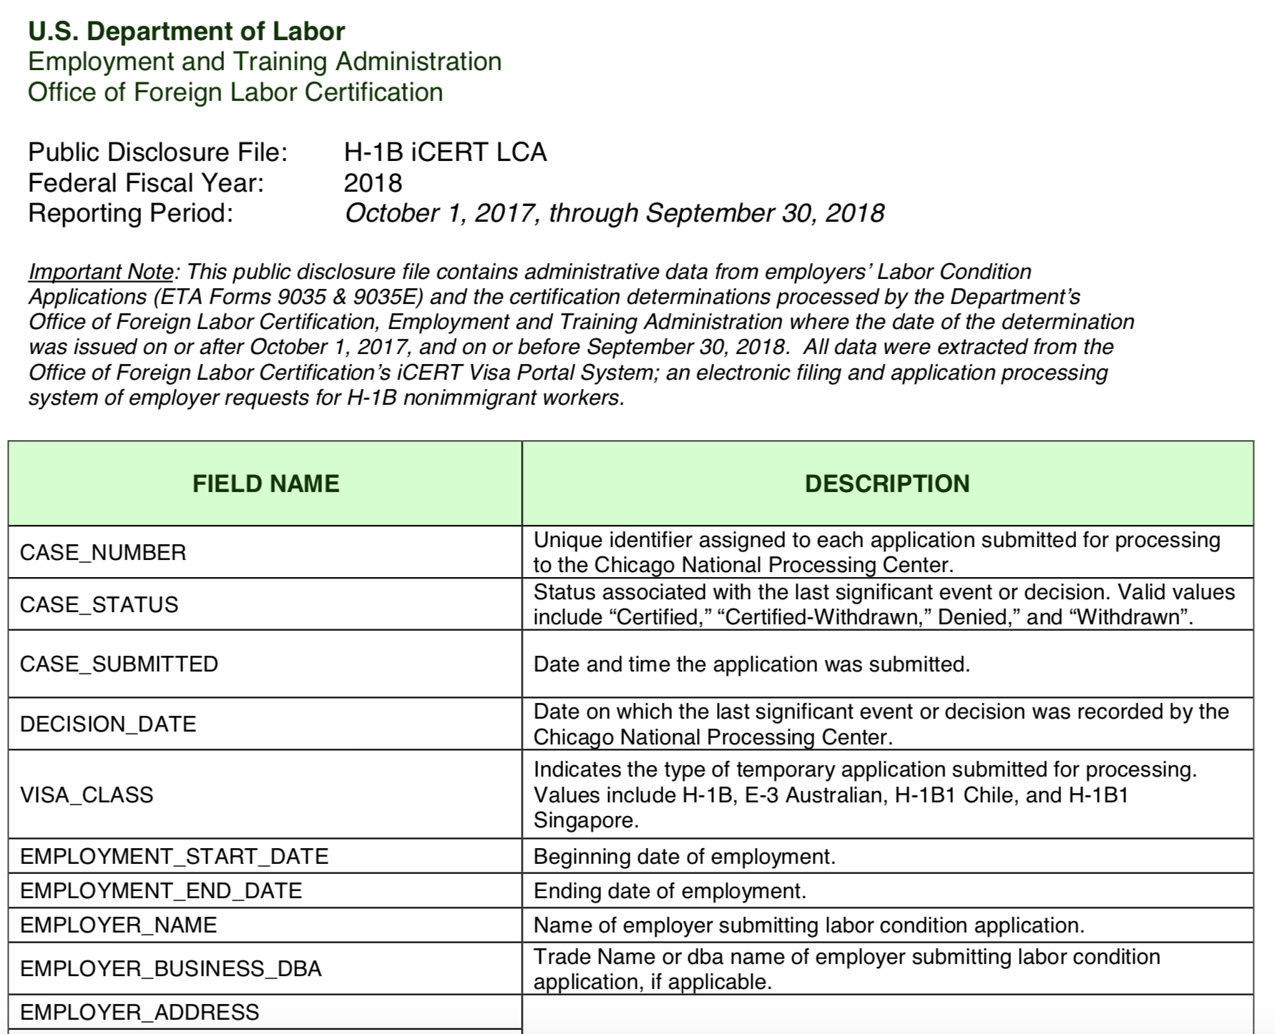
Dataset we will use
Different Data structure for each year (2015-2019)
2019
2018

Slide 6
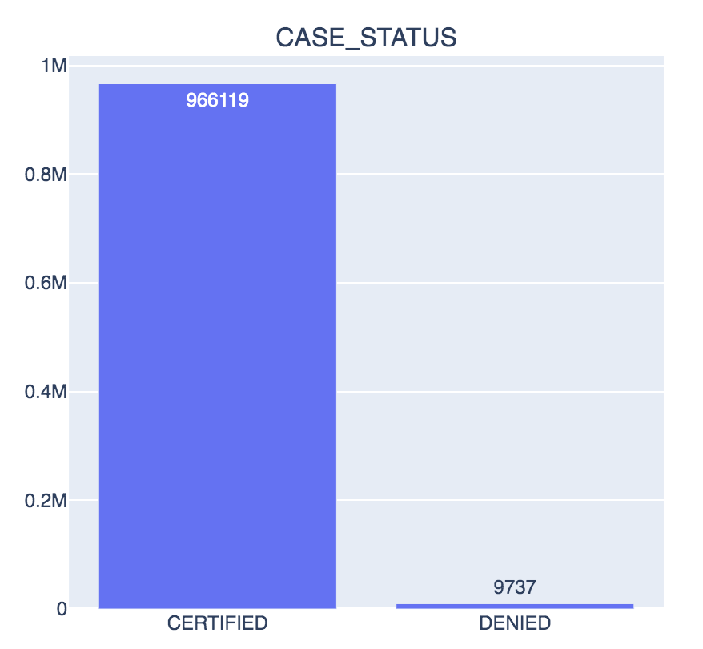
Challenge on the datasets
Large number of features after data cleaning
EDA and feature engineering
Highly imbalanced data
Sampling
SMOTE
Most of features are categorical
Modeling choices

Slide 7
feature engineering
Education
Employer name
First we group the features with high correlations. Then do
feature engineering separately.
More interpretability. But also more time-consuming.
EMPLOYER
Employer
state
WAGE
JOB
Applicants
Job title
Wage level
Prevailing wage
Soc code
VIOLATION
Wage
source
Full time

Slide 8
How to validate our answers
Modeling using 2019 data
Validation on unseen recent data 2020
ROC-AUC
Precision-recall
Utility
What requirements are more important for applicants
Mainly offer a predictive answer with a user interface.

Slide 9

Project roadmap
Week | Work
1-2 | H1B EDA & Features
3-4 | PERM EDA & Features
5 | Modeling
6 - end | UI

