Slide 1
YIDLUG Topic: SOLID
The Principles of Object oriented design
Yitzchok gottlieb Software developer at goflow commerce

Slide 2
Object oriented design concepts
Object/Class – A tight coupling or association of the data with the methods that act on the data.
Information hiding – The ability to protect some components of the object from external entities.
Inheritance – The ability for a class to extend or override functionality of another class
Interface - The ability to defer the implementation of a method.
Polymorphism - The ability to replace an object with a sub object.

Slide 3
What is solid?
S.O.L.I.D. is a collection of best-practice object-oriented design principles that you can apply for design to accomplish various desirable goals like lose-coupling, higher maintainability, etc.
These principles were pioneered and first collected into a written work by Robert ‘Uncle Bob’ Martin.

Slide 4
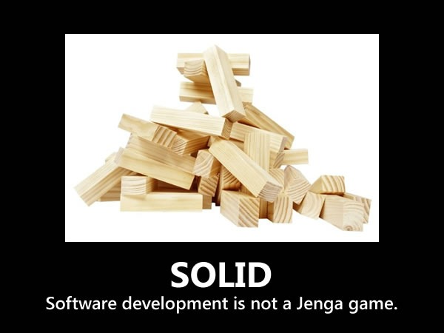

Slide 5
S.O.L.I.D. design principles
SRP – Single Responsibility Principle
OCP – Open Closed Principle
LSP – Liskov Substitution Principle
ISP – Interface Segregation Principle
DIP – Dependency Inversion Principle
Let’s check them out…

Slide 6
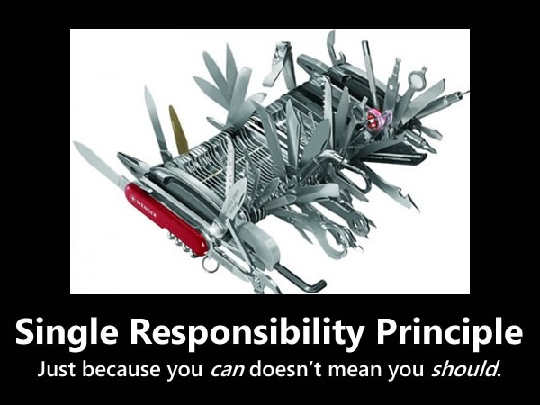

Slide 7
S.R.P. - Single Responsibility Principle
A class should have one, and only one, reason to change.

Slide 8
This leads to higher quality code
Because the code is
More readable, that is easier to understand
Less error prone
Robust
Testable
Maintainable

Slide 9
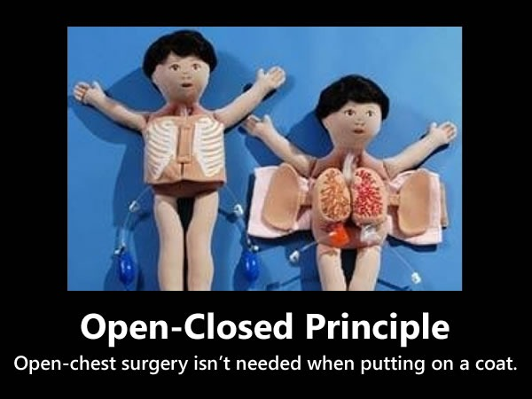

Slide 10
O.C.P - Open Closed Principle
You should be able to extend a class behavior, without modifying it.

Slide 11
The code should be “Open for Extension” and “Closed for Modification”

Slide 12
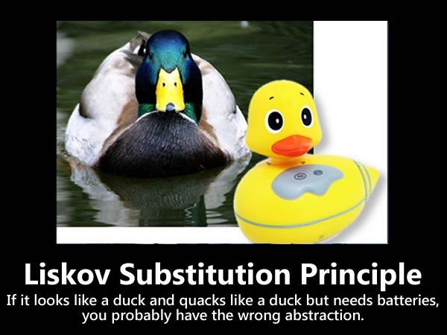

Slide 13
L.S.P - Liskov Substitution Principle A.K.A. Design by contract
Derived classes must be substitutable for their base classes.

Slide 14
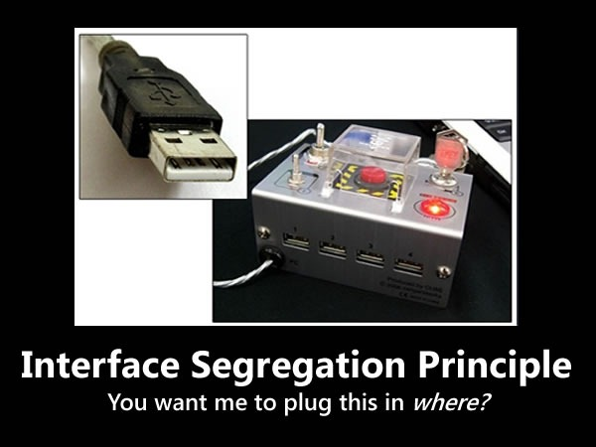

Slide 15
I.S.P - Interface Segregation Principle (Interface Pollution)
Make fine-grained interfaces that are client specific.

Slide 16
Clients shouldn’t be forced to implement interfaces they don’t use.

Slide 17
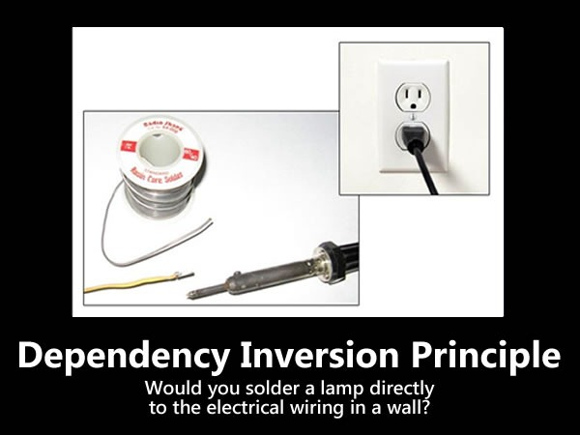

Slide 18
D.I.P - Dependency Inversion Principle
Depend on abstractions, not on concretions

Slide 19
High level modules should not depend upon low level modules. Both should depend upon abstractions.
Abstractions should not depend upon details. Details should depend upon abstractions

