Slide 1
ist 263
Intro to JavaScript

Slide 2
Agenda
What is JavaScript?
How do you use it?
1st JavaScript Program
Event Handling

Slide 3
What is Javascript

Slide 4
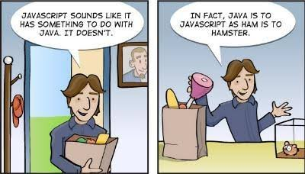

Slide 5
JavaScript is a scripting or programming language that allows you to implement complex features on web pages
Just like CSS and HTML JavaScript is interpreted in by your browser.

Slide 6
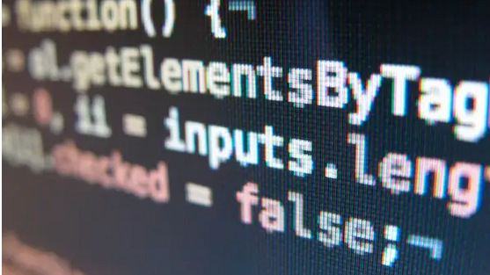
Most Popular Programming Language in the World
according to github https://www.businessinsider.com/most-popular-programming-languages-github-2019-11#1-javascript-10

Slide 7
What is JavaScript Used For?
Suggestions as you type (https://www.google.com/)
Validation on Forms (https://apply.commonapp.org/login)
Dropdown navigation (https://soe.syr.edu/)
Accordion navigation on mobile aka hamburger nav (https://www.syracuse.edu)
Show or hide info with click of more button ()
Slideshows (https://www.everson.org/)
Much more!!!

Slide 8
How do you Use it?

Slide 9

Types of JavaScript
Embedded JavaScript (can be anywhere in HTML)
External JavaScript

Slide 10
How do you make a JavaScript file?
You only need to make a JavaScript file for external JavaScript
It is a text file just like .html and .css
Use .js as the file extension

Slide 11
1st JavaScript Program

Slide 12
Pointers
JavaScript is case sensitive
Comments
// single line
/* multiple line */

Slide 13
Hello World Program

Slide 14
Event Handling

Slide 15
What are events?
Actions that happen in the browser like:
The page loading
A user clicking on something

Slide 16
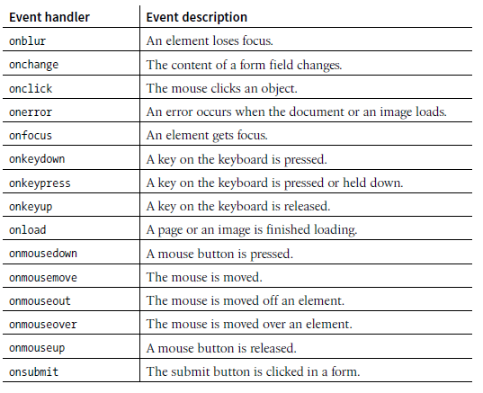

Slide 17
How to use events
Use them as an HTML attribute

Slide 18
Functions

Slide 19

A JavaScript function is a block of JavaScript code, that can be executed when "called" for.

