Slide 1
Chapter 10: Natural Language Processing
Spark for Data Scientists

Slide 2
Chapter Objectives
In this chapter, we will:
Explore unstructured text
Use NLTK & Spark pipeline transformation to process natural language
Visualize natural language with Word Clouds
Explore how to monitor and optimize Spark

Slide 3
Chapter Concepts
Natural Language
Optimizations
Chapter Summary

Slide 4
Natural Language Processing
Processing free form text is not as simple as a formatted table structured object
You need to break the natural language up into pieces and fix variations in the wording to try to standardize it an extract meaning
There are many different types of transformations you can do to text and they vary depending on the text and what you're trying to do with the results
Generally though, it comes down to some common steps:
break the text up into sentences and words
fix the words by adjust everything to the same case
remove punctuation
standardize word variations to the root word
remove insignificant words
find natural word groupings that make up a phrase
determine the overall sentiment of the words

Slide 5
NLTK
NLTK stands for Natural Language Tool Kit and is a comprehensive python package with lots of functions to manipulate text
It is a stand alone python package but it works in a distributed mode on Spark RDD's
Install it as normal pip install nltk
Import it as normal import nltk
Let's explore the features and examples in Jupyter

Slide 6
Spark Text Processing
Spark also has some of its own text processing features
Found in pyspark.ml.features
Tokenizer breaks up a document into words
RegexTokenizer allows more control
StopWordsRemover removes insignificant words
HashingTF transforms takes a set of words and vectorizes them
IDF rescales the numbers in the vector to de-emphasize words that occur a lot in the entire corpus
Usually just follow a common recipe to fix up a dataframe into the shape you need for ML operations by putting the various steps into a pipeline

Slide 7
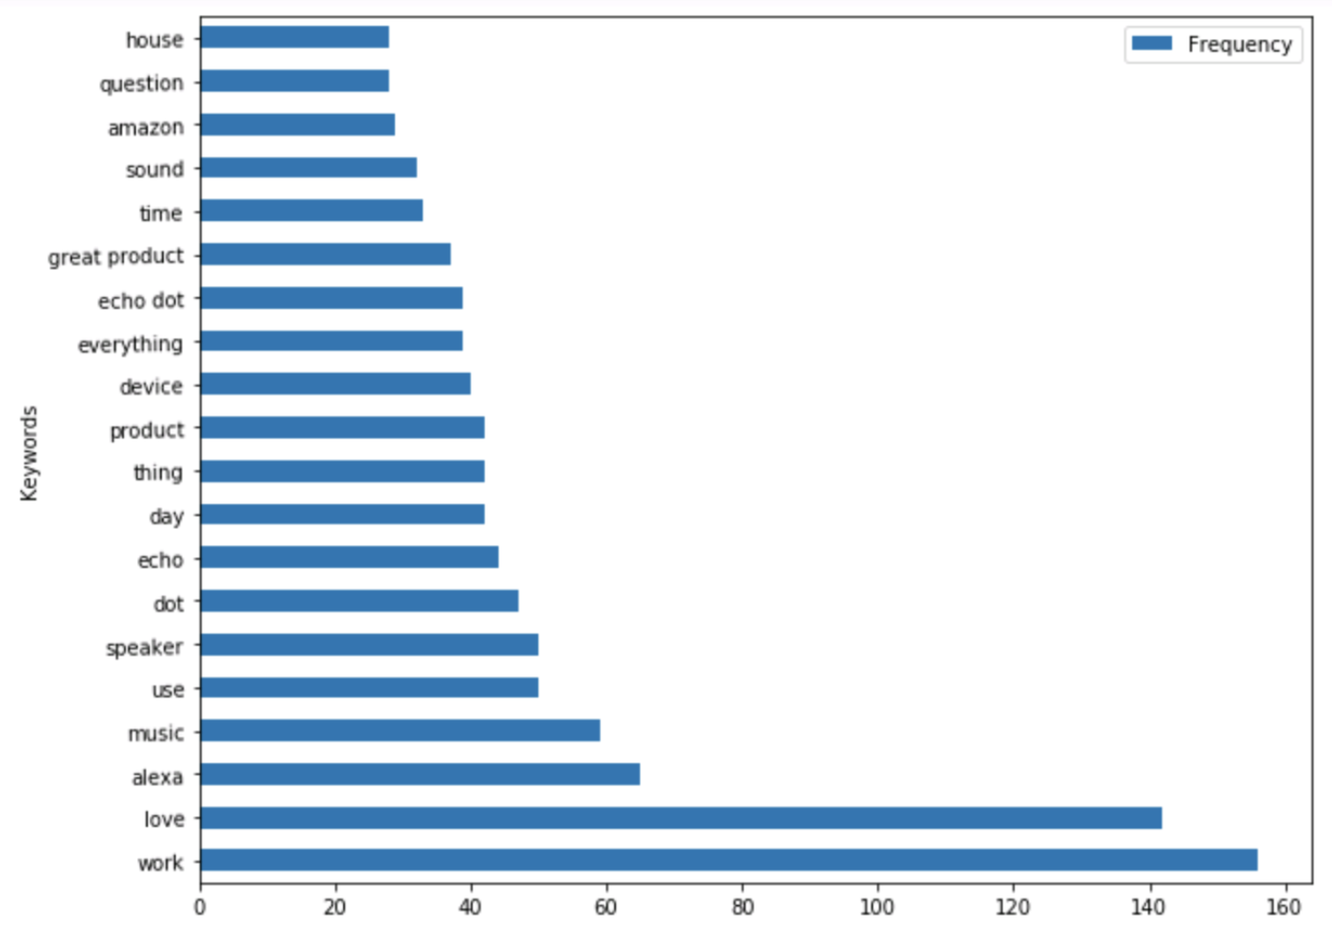

Word Cloud
Word Clouds and other charts can be made from the results of the text processing by bringing the small DataFrame results back to the driver

Slide 8
Chapter Concepts
Natural Language
Optimizations
Chapter Summary

Slide 9
Monitoring
You can monitor the Spark processes by navigating in a browser to the address of the cluster and port 4040
locahost:4040
You will see various tabs where you can watch the progress of
Jobs
Stages
See what objects are cached
Get an overview of the environment
See the nodes that are executing

Slide 10
Caching
Because an RDD is a lazy evaluation of a chain of transformations, each time you do an action on that RDD or DataFrame, it recalculates everything from the very beginning
This can cause performance problems if you want to do several different actions to the same set of data
Caching is the answer. It allows you to pin the results of an RDD in the cluster for the duration of the session or until you manually release it
You can cache to either memory or disk or a combination of the two
You also have control over how many redundant copies it stores and whether it should store it as
deserialized which takes more memory but less CPU
serialized Java object which is more memory efficient but uses more CPU
There are two methods persist and cache which is simply a shorthand for persist with the default option of memory only
To remove a cached object use unpersist

Slide 11
Broadcast Variables
It is also sometimes desirable to keep a copy of a variable on each node instead of passing it around each time it receives instructions to do a new task
This is useful if you need to pass around something like a reference table to each node
Broadcast variables allow you to accomplish this
lookupTable = sc.broadcast([1, 2, 3])
lookupTable.value → [1, 2, 3]

Slide 12
Accumulators
Sometimes you want to create a counter that is global to the entire process
Using a regular Python variable would not scale out to the cluster level, so you need a special way to handle this, so that each node can contribute to one global counter
There is an accumulator method on the spark context meant just for this
counter = sc.accumulator(0)
def fun2(x):
global counter
counter += x
x0.foreach(fun2)
print (counter.value)

Slide 13
Chapter Concepts
Natural Language
Optimizations
Chapter Summary

Slide 14
Chapter Summary
In this chapter, we have:
Explored unstructured text
Used NLTK & Spark pipeline transformation to process natural language
Visualized natural language with Word Clouds
Explored how to monitor and optimize Spark

