Slide 1
Chapter 1: Introduction to HDFS & Spark
Spark Program

Slide 2
Chapter Objectives
In this chapter, we will:
Learn about the Hadoop Distributed Files System (HDFS)
Run a standalone instance of HDFS
Create directories and files in HDFS
Review the history of Apache Spark
Look at the architecture and components of Apache Spark
Load files into RDD
Process RDD using actions and transformation

Slide 3
About HDFS—I
The Hadoop Distributed File System (HDFS) is the main storage used by Hadoop MapReduce applications
Distributed, POSIX-like file system
Designed to run on commodity hardware
Scales to clusters composed of thousands of nodes
Highly fault tolerant
Automatically detects hardware faults
Supports quick recovery
Implemented in Java
Can be used as a standalone general purpose file system
Designed for storing and reading very large files (>TB)
Supports high throughput read and writes
Write once, read many
Aimed at batch processing
Default block size is 128MB
Does not support random insertion or modification of data
Appending/truncating data is possible

Slide 4
About HDFS—II
HDFS is used either directly or indirectly by many Big Data and NoSQL applications including:
Hadoop
Spark
HBase
Pig
Hive
Others

Slide 5
Core HDFS Services
HDFS is implemented as several services which are usually deployed on a cluster of machines
Referred to as an HDFS cluster
Arranged in a controller/worker architecture
Core HDFS services include:
NameNode (controller) stores file system metadata
DataNode (worker) stores file data (data blocks)
The NameNode is the master server located on one node
Implements a POSIX-like hierarchical file system with '/' as the root directory
Enforces read/write permissions on files and directories
Tracks the location of the data blocks for each file
The DataNode is the worker server located on each node
Handles read and write requests from HDFS clients
Performs block creation, deletion, and replication as instructed by the NameNode

Slide 6
Start Jupyter
To start Jupyter open a terminal window and type the following commands:
start-notebook
Once it is finished, copy the URL and paste it into a browser

Slide 7
Start Hadoop
To start Hadoop on the VM
Open a terminal window and type the following commands:
start-hadoop
jps
From a command line or in the Jupyter notebook, try the following commands:
hdfs
hdfs dfs
hdfs dfs –ls /
hdfs dfs –put /class/datasets/northwind/CSV/categories /
hadoop fs –ls /
Take a look at ~/.bashrc
Some handy aliases were added to make this easier
hls /
hput /class/datasets/northwind/CSV/regions /

Slide 8
Introduction to Apache Spark
Apache Spark is a computing engine that can be used for large-scale data processing
Spark 2 can perform between 10X and 100X faster than Hadoop’s default computing engine (MapReduce)
Created by Matei Zaharia at UC Berkley in 2009
Donated to Apache Software Foundation in 2013
Apache Spark has seen immense growth over the past several years
Spark functionality includes the ability to:
Perform iterative processing
Work with structured data via SQL
Support Hive Query Language (HQL)
Interact with it via a command-line shell
Support near real-time processing using in-memory data structure
See https://spark.apache.org/

Slide 9
Introduction to Apache Spark (continued)
Apache Spark provides high-level APIs in Java, Scala, Python, and R and has an optimized engine that supports general execution graphs
Two important use cases for Apache Spark are data processing and AI
Spark unifies data processing and AI by providing a powerful in-memory execution engine
It also offers popular AI frameworks and libraries such as TensorFlow, R, and SciKit-Learn

Slide 10
Speed
Run computations in memory
Apache Spark has an advanced DAG execution engine that supports acyclic data flow and in-memory computing
100 times faster in-memory and 10 times faster even when running on a disk than MapReduce

Slide 11
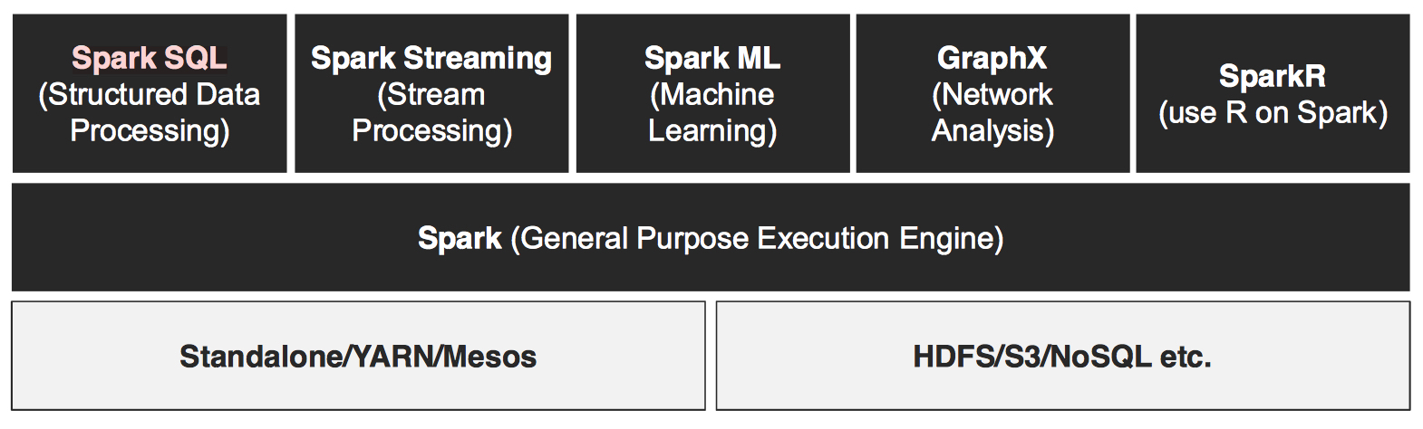
Spark Components

Slide 12
Spark Core
Spark Core is the underlying general execution engine for the Spark platform, all other functionality is built on top of it
Provides distributed task dispatching, scheduling, and basic IO functionalities exposed through an application programming interface centered on the RDD, which is Spark’s primary programming abstraction

Slide 13
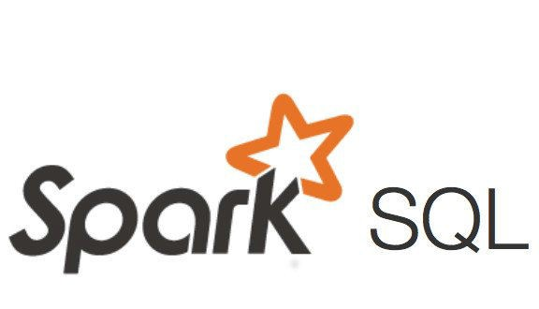
Spark SQL
Spark package designed for working with structured data which is built on top of Spark Core
Provides an SQL-like interface for working with structured data
More and more Spark workflow is moving towards Spark SQL

Slide 14

Spark Streaming
Running on top of Spark, Spark Streaming provides an API for manipulating data streams that closely match the Spark Core’s RDD API
Enables powerful interactive and analytical applications across both streaming and historical data while inheriting Spark’s ease of use and fault tolerance characteristics

Slide 15

Spark MLlib
Built on top of Spark, MLlib is a scalable machine learning library that delivers both high-quality algorithms and blazing speed
Usable in Java, Scala, and Python as part of Spark applications
Consists of common learning algorithms and utilities including classification, regression, clustering, collaborative filtering, and dimensionality reduction, etc.

Slide 16
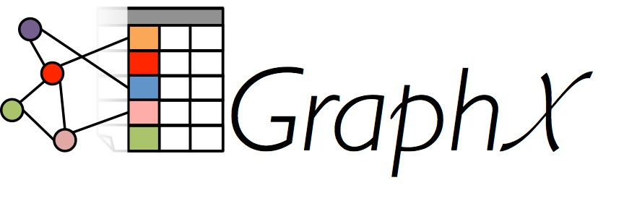
GraphX
A graph computation engine built on top of Spark that enables users to interactively create, transform, and reason about graph-structured data at scale
Extends the Spark RDD by introducing a new graph abstraction
A directed multigraph with properties attached to each vertex and edge

Slide 17
Spark Application Top-Down View
Spark executes applications
Either in local, stand-alone mode, or as a cluster
Spark applications have one driver and one or more executors
Drivers and executors run as Java processes
Drivers assign tasks to the executors
Executors run tasks on Resilient Distributed Datasets (RDDs)
Executors send results to the driver
Drivers include:
Spark Shell
PySpark—the Python shell
Spark Shell—the Scala shell
Custom program
Written in Python, Java, R, or Scala

Slide 18
Resilient Distributed Datasets (RDDs)
RDDs represent the core data construct of Spark
RDDs are immutable
RDDs are fault tolerant (resilient)
When nodes or tasks fail, RDDs are reconstructed on other nodes
RDDs are split into partitions and can be distributed to any executor
RDDs can contain any kind of data
Prefer data that can be partitioned
RDDs are objects that support two categories of operations
Transformations
Create new RDDs from existing RDDs
Always return RDDs
Lazily evaluated
Actions
Start computations
Return results to the driver
Save results to disk
Never return RDDs

Slide 19
Resilient Distributed Datasets (RDDs)
RDDs do not hold an entire dataset in memory for the duration of processing
They are much more like a pipeline that starts loading files into memory and immediately processing the transformation sequence
As data is transformed and no longer needed it is released from memory making it available for more data
It is possible to cache RDD's in memory if reuse of existing transformations is needed, but the tradeoff is that it uses more memory to save CPU and I/O costs for reprocessing
Whether caching is a good idea or not depends on many factors

Slide 20
Spark Application Flow
Spark applications tend to have a similar flow
Create a Spark context
Automatically provided in the shells via the variable sc but must create it manually when writing a custom program outside the shell
Import data as RDDs
Transform and perform actions on RDDs
Export results
Spark applications are not declarative in nature, however, they are still coded at a high level of abstraction
In contrast, tasks are at a very low level of abstraction
Tasks are not created by programmers, rather they are created at runtime by Spark

Slide 21
Drivers and Executors
Spark applications consist of a driver process and a set of executor processes
The driver process runs your main() function, sits on a node in the cluster, and is responsible for three things:
Maintaining information about the Spark application
Responding to a user’s program or input
Analyzing, distributing, and scheduling work across the executors (defined momentarily)
The driver process is absolutely essential—it’s the heart of a Spark application and maintains all relevant information during the lifetime of the application
The executors are responsible for actually executing the work that the driver assigns them. This means, each executor is responsible for only two things:
Executing code assigned to it by the driver, and
Reporting the state of the computation, on that executor, back to the driver node

Slide 22

Spark’s Basic Architecture
The cluster manager controls physical machines and allocates resources to Spark applications
This can be one of several core cluster managers: Spark’s standalone cluster manager, YARN, or Mesos
This means that there can be multiple Spark applications running on a cluster at the same time

Slide 23
Start PySpark
To start PySpark on the VM:
Open a terminal window or the notebook and run the following commands:
cd /class
pyspark
sc
spark
x = sc.textFile('datasets/text/shakespeare.txt')
x.count()
x.take(10)
To write a Python program from scratch, you have to initialize sc and spark variables manually
initspark.py is a helper module written so that you can copy and use in your own scripts
from initspark import *
sc, spark, conf = initspark()
sc, spark, conf = initspark(appname = 'appname', servername = 'sparkservername', cassandra = 'cassandra)

Slide 24
Load Data
The sc object is the Spark context and allows you to call methods to load and manipulate data
x = sc.parallelize(range(1, 11)) x.collect() x.take(5) sc.textFile('hdfs://localhost:9000/categories').collect()
Load a local file sc.textFile('file:///class/datasets/northwind/CSV/categories/categories.csv')
Load a local folder
sc.textFile('file:///class/datasets/northwind/CSV/categories')
Load a HDFS folder
cat = sc.textFile('hdfs://localhost:9000/categories')

Slide 25
Actions and Transformations
Once you have an RDD, you can invoke methods on it
Methods can either be:
A transformation which is lazy evaluated and is only run when an action is called
An action which causes it to do some work and possibly return data back to the client or write it to disk
Transformations can be chained together to create multiple operations on the data but none are executed until an action is called. This allows the entire chain of transformations to be internally optimized by Spark before execution
Once an action fires, a subsequent action redoes all the work from the beginning, no data is cached unless you tell it to
Transformations can also be either:
Narrow: can operate on the data in a single node like a map operation in MapReduce
Wide: requires data with the same key to be shuffled around to the same nodes, like a reduce operation in MapReduce

Slide 26
Processing Data
The data is loaded into an RDD (Resilient Distributed DataFrame)
Very similar to a Python list except it is spread across many nodes in the cluster
Has many built-in methods to process the data
Loading data from a text file basically creates a list of strings
Some useful actions to look at the data are:
rdd.collect() - returns the entire RDD as a Python list to the client
rdd.count() - returns a count of how many items are in the RDD
rdd.take(x) - returns x number of items from the RDD as a list
rdd.takeOrdered(x, key=function) – returns x rows of an RDD after sorting it first using a function
rdd.top(x, key=function) - returns the opposite of takeOrdered
rdd.takeSample(replacement, count, seed) - returns a sample of a larger data set
rdd.foreach(function) - executes the function once for each element of the RDD

Slide 27
Saving Data
There are a lot of methods to save data to different formats
rdd.saveAsTextFile() – saves the RDD as a plain text file
rdd.saveAsHadoopFile() – saves the RDD as a key/value pair file suitable for Hadoop
rdd.saveAsSequenceFile() – saves the RDD as a Hadoop sequence file
rdd.saveAsPickleFile() – saves the RDD as a Python pickle file
Typically, most of these are no longer used in favor of DataFrame write options which are more rich

Slide 28
Transformations
Transformations are used to create a recipe of changes you want to make to the data
String parsing, data conversion, calculations
Filtering
Matching
Sorting
Aggregating
Some useful transformations:
Narrow transformations
rdd.map() – applies a function to each element of the RDD
rdd.flatMap() – applies a function and flattens the elements
rdd.filter() – applies a function to determine if an element is returned
Wide transformations
rdd.sort() – orders the RDD
rdd.groupBy() – accumulates items with a key into a tuple of the key and list of the items
rdd.reduce() – runs a function on items for a key to return an aggregated value
rdd.join() – matches elements in one RDD to another

Slide 29
Lambda
Many actions and transformations take a function as a parameter to allow customization of how the method works
You could pass it a function name if you have one defined, but in many cases the functions are trivial
Python allows you to create a function on the fly that can be passed as a parameter without the need to create the function in advance
If all you need to do is create a simple function that takes one or more parameters and return a calculation that can be done in a single statement, then a lambda is a good choice
def isEven(x): return x % 2 isEven = lambda x : x % 2
rdd.filter(isEven) rdd.filter(lambda x: x % 2) sc.parallelize(range(1, 11)).sortBy(lambda x : (x % 2, x))

Slide 30
Project
The creditcard.csv dataset provides sample data on credit card transactions.
Load the file into HDFS
Load the file into an RDD
Parse the file into a tuple or namedtuple or dictionary
Make sure to convert columns to the right data types
You can ignore any columns you don’t need for the solution
Filter the data to show only transactions made by women
Calculate the amount spent in each city

Slide 31
Chapter Summary
In this chapter, we have:
Learned about the Hadoop Distributed Files System (HDFS)
Ran a standalone instance of HDFS
Created directories and files in HDFS
Reviewed the history of Apache Spark
Looked at the architecture and components of Apache Spark
Loaded files into RDD
Processed RDD using actions and transformation

