Slide 1
Chapter 6: Spark Streaming
Spark for Big Data Processing

Slide 2
Chapter Objectives
In this chapter, we will:
Understand the special processing needs for the high velocity data under Spark’s streaming architecture
Explore various streaming data sources

Slide 3
Introduction to Spark Streaming
Spark Streaming is an extension of the core API
Provides high-throughput stream processing of live data
Built on Spark’s fault-tolerant and highly scalable architecture
Support for a wide variety of data sources
File systems, TCP Sockets, Kafka, Flume, Twitter, Kinesis, and ZeroMQ
Implement custom Receivers to integrate arbitrary data sources
Streams can be processed using complex algorithms
Designed and implemented using:
Spark transformations and actions
Sliding window operations
The other extension APIs for SQL, Machine Learning, R, and GraphX
Processed data can be pushed out to:
File systems, databases, live dashboards, etc.

Slide 4
Discretized Streams and RDDs
Live input streams are divided into batches of data items
Known as discretized streams
Spark’s high-level abstraction is called a DStream
The batching interval is specified when the DStream is created
A new RDD is generated every interval for the batch of collected data
Spark operations are then applied to the RDD
Windowed DStream instances will contain multiple RDDs
A configurable number of historical RDDs from earlier batches
Spark operations are applied to their aggregate
Input streams are obtained from Receivers
Built-in or custom classes for generating a DStreams from data sources
Received data is reliably stored in Spark’s memory for processing
Spark provides two categories of supported streaming sources
Basic sources include: file and socket streams
Advanced sources include: Kafka, Flume, Kinesis, Twitter, etc.

Slide 5
Obtaining a DStream
Applications must create a StreamingContext
Can use an existing SparkContext or SparkConf instance
At least two threads must be specified for the Worker/Executor and Receiver
Specify the batch interval
val streamingContext = new StreamingContext(sparkContext.getConf(), Seconds(1))
val linesDS = streamingContext.textFileStream("/tmp/data/logs")
val ucLinesDS = linesDS.map( l => l.toUpperCase() )
ucLinesDS.print() // display 10 entries
// begin stream processing // operate for 2 mins
streamingContext.start()
streamingContext.awaitTerminationOrTimeout(120000)
streamingContext.stop()
Notes:
Once a StreamingContext has been stopped, it cannot be restarted
Calling stop() on StreamingContext also stops the SparkContext
Can be prevented by calling stop(false)
A SparkContext can create multiple StreamingContext instances

Slide 6
Setting the Batch Rate
Applications should be able to process data as fast as it is being received
The batch rate is specified when the StreamingContext is instantiated
The batch processing time should be less than the specified batch interval
Start with a longer than expected batch interval
Monitor the processing time and then reduce the batch interval
Processing times can be monitored
Many useful streaming statistics are reported in the Web UI
The driver log files contain a “Total delay” entry
Momentary delays may be acceptable
As long as the delay reduces back to an appropriate value
Caused by temporary increases in the data rate
Sustained delays will accumulate over time
The application will not be able to keep up and may become unstable
The level of processing parallelism can also be increased

Slide 7
DStream Transformations
The following transformations are available on DStream instances: map(), flatMap(), filter(), reduce(), reduceByKey(), count(),
countByKey(), cogroup(), and join()
These operate in exactly the same way as the standard RDD equivalents
transform()
Applies any RDD to RDD operation not exposed by the DStream API
union()
Combines multiple DStream instances of the same type
updateStateByKey()
Maintains arbitrary state while continuously updating it with new stream data
Must define a state object
Provides a function to update the state object
repartition()
Alters the level of parallelism by creating more or fewer DStream partitions

Slide 8
DStream Output Operations
Output operations trigger the execution of any pending transformations
They behave like RDD actions
print()
Prints the first 10 elements of each RDD in a DStream at the driver
Currently, DStream instances provided three save operations
Filenames are generated using the time with a prefix and optional suffix
Provided as arguments
prefix-TIME_IN_MS.suffix
saveAsTextFiles()
saveAsObjectFiles()
Save the DStream as serialized Java SequenceFile
Values only, keys are serialized as NullWriteable
saveAsHadoopFiles()
Requires a Hadoop OutputFormat
The DStream must contain(key, value)pairs

Slide 9
File Streams
fileStream() monitors a file system directory
Called on a StreamingContext instance
Delegates to an underlying Hadoop InputFormat
Files must be created in, or copied/moved to the monitored directory
If required, existing files can be processed at start-up
File names starting with '.' are ignored
A generic file name filter can be specified
The textFileStream() method delegates to a TextInputFormat
For full details, view the Spark Scala API documentation
val lines = ssc.fileStream[LongWritable, Text, TextInputFormat]("/httpd/logs")
val theSame = ssc.textFileStream("/httpd/logs")
// stream VideoRecording objects from all sequence files in the /home/movies
// directory excluding all other file types, include existing files at start-up //
val films = ssc.fileStream[Text, VideoRecording, SequenceFileInputFormat](
"/home/movies", _.getName().endsWith(".seq"), true)

Slide 10
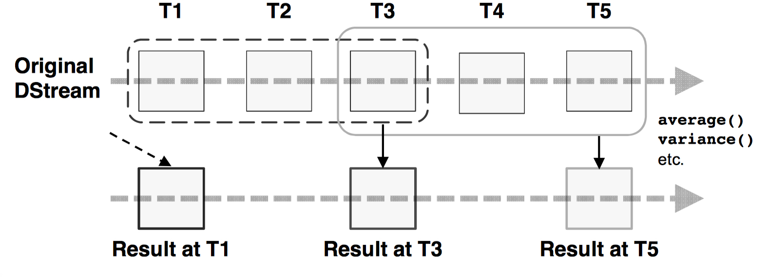
Window Operations
Spark Streaming also provides an API for Window computations
As the window slides over a source DStream
Operations are applied to the aggregate of RDDs that fall within the window
Window operators must specify two parameters
Window length: the duration of the window
Sliding interval: the number of intervals to advance the window

Slide 11
Window Transformations
Spark provides the following windowed transformations
Each requires a window length and slide interval
window()
Returns DStream based on the window length and slide interval
countByWindow()
Counts the number of elements in the window
countByValueAndWindow()
Expects a DStream of (key, value) pairs
Returns a new DStream of (key, long) pairs in the window
reduceByWindow() and reduceByKeyAndWindow()
Applies a reducing function to the values or (key, values) in the window
The operation of reduceByKeyAndWindow() can be optimized
As a window slides, the reduced value can be calculated incrementally
An inverse-reduce function can be specified to remove old values
New values are then amalgamated by the reduce function

Slide 12
Advanced Streaming Sources
Spark supports a number of advanced streaming sources
Not part of the core Spark API and require additional libraries
Apache Kafka
A distributed publish-subscribe messaging system written in Scala
Designed to be fast, scalable, and robust
Originally developed by LinkedIn and became open source in 2011
Apache Flume
Highly available distributed service for collecting and aggregating data
Designed to handle very large quantities of data
Originally developed by Cloudera
Amazon Kinesis
Commercial EC2 service for collecting and processing stream-based data
Highly scalable and designed for used by real-time applications
Provide a Kinesis Client Library (KCL) under the Amazon Software License
Twitter

Slide 13
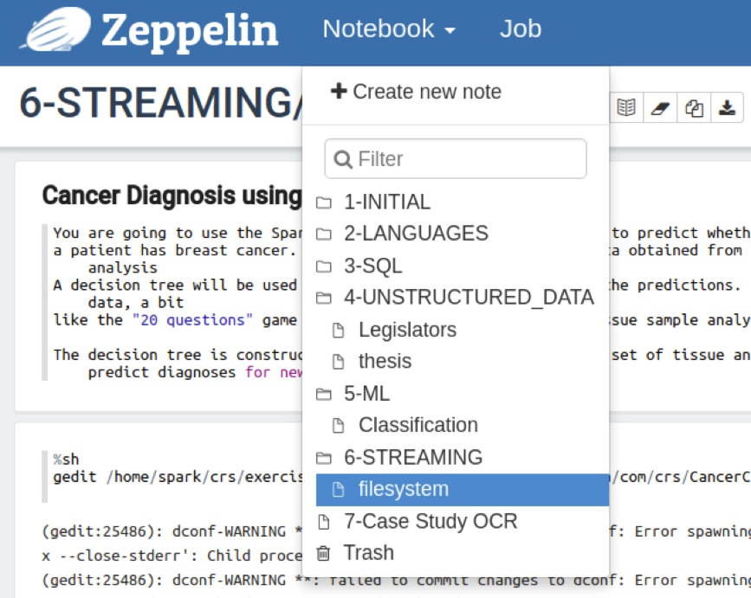
Exercise: Streaming
30 mins
Execute the notebook shown above
How long will it keep streaming? What is the stop condition?

Slide 14
Chapter Summary
In this chapter, we have:
Learned the special processing needs for the high velocity data under Spark’s streaming architecture
Explored various streaming data sources

