Slide 1

E-BJUT
One-Stop eCampus Information Portal

Slide 2
Intro

Slide 3

Pain Points
Information Overloaded (Useless News Feed)

Slide 4

Pain Points
Split personal life with campus things
Tell feelings
Academia/Tech Info Exchange

Slide 5

Pain Points
Lost & Found
  Difficult to communicate
  Waste of time

Slide 6
Pain Points
Second-hand transaction
  Shop in School Library
    Unfair deals
  WeChat Group
    Lots of limitations

Slide 7
Features

Slide 8

Custom News Feed
Smart Filter: Keywords or Category
In-App Preview

Slide 9

Moments/Forum
Richmedia
Waterfalls flow

Slide 10

Lost & Found
Wide Coverage
PM (Personal Message)

Slide 11

Second-hand Transactions
Wide platform
Keywords Subscription

Slide 12
Marketing Research
eBJUT
User-friendly design
Fast iteration
Instant push notification
Cross-platform
Internal access available
Competitor
× Non-user-friendly design
× Waiting for regulation verify
× Lack of push notification
× Non-cross-platform
× Internet required

Slide 13
Framework

Slide 14
Division of Work
Member | Work
Tianze Wen | Front-end Dev, Mobile App Dev (Android Client)
Xicheng Li | DBA, AppOps, Back-end Dev (NewsFeed)
Xingren Wang | Back-end Dev (Moments, Forum)
Xinyun Fang | Back-end Dev (Lost & Found, Second-hand Transaction)
Yiwen Shang | Back-end Dev (Accounts), Front-end Dev

Slide 15



Front-end
+ Webview
Developed by
Dart language

Slide 16
Front-end
Material Design
Cross-platform: iOS / Android
Hot reload

Slide 17
Front-end
Html5
CSS3
JavaScript

Slide 18
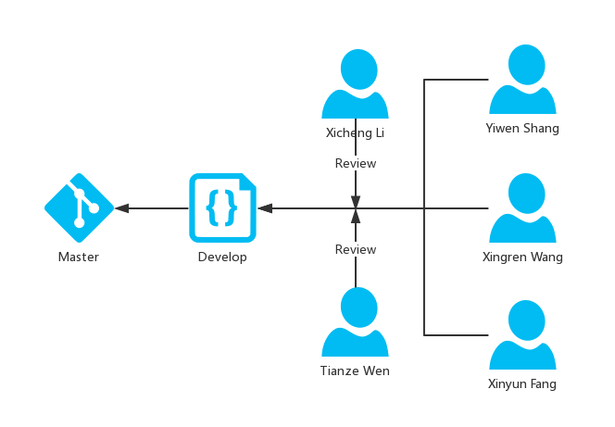
Teamwork

Slide 19
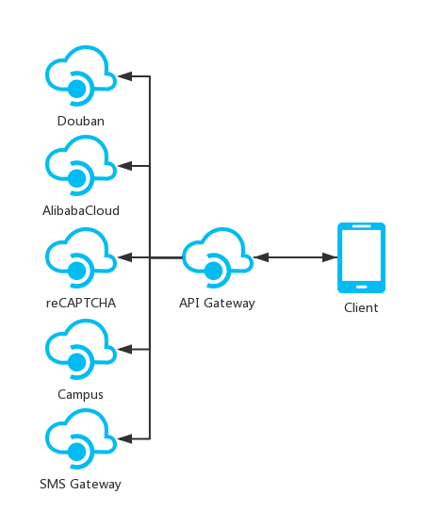
Service
Google Books

Slide 20
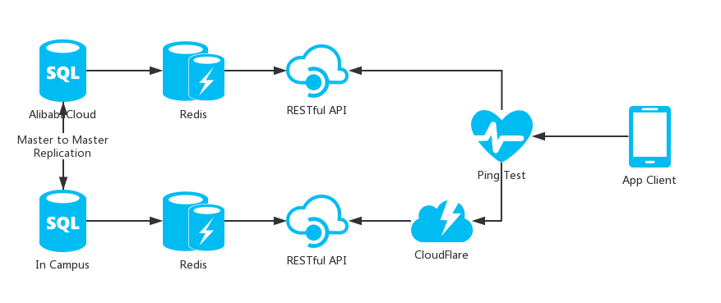
Service

Slide 21

SLA
HAProxy & Keepalived on L4 / L7
Master-to-Master Replications of MySQL
Front CDN by CloudFlare
99.999%

Slide 22


Security & Authentication
WAF powered by ModSecurity
Regex expressions
SaaS Security Audit
bCrypt Hash
Google reCAPTCHA

Slide 23
Reference
Firewall by Dinosoft Labs from the Noun Project.
Key, Clock, Yelp, Flag, Filter, Loop, Flower from IcoMoon.
Forum by Alibaba from IconFont.
Lost item from FlatIcon.
Microsoft Azure Icons from Microsoft Azure.

Slide 24
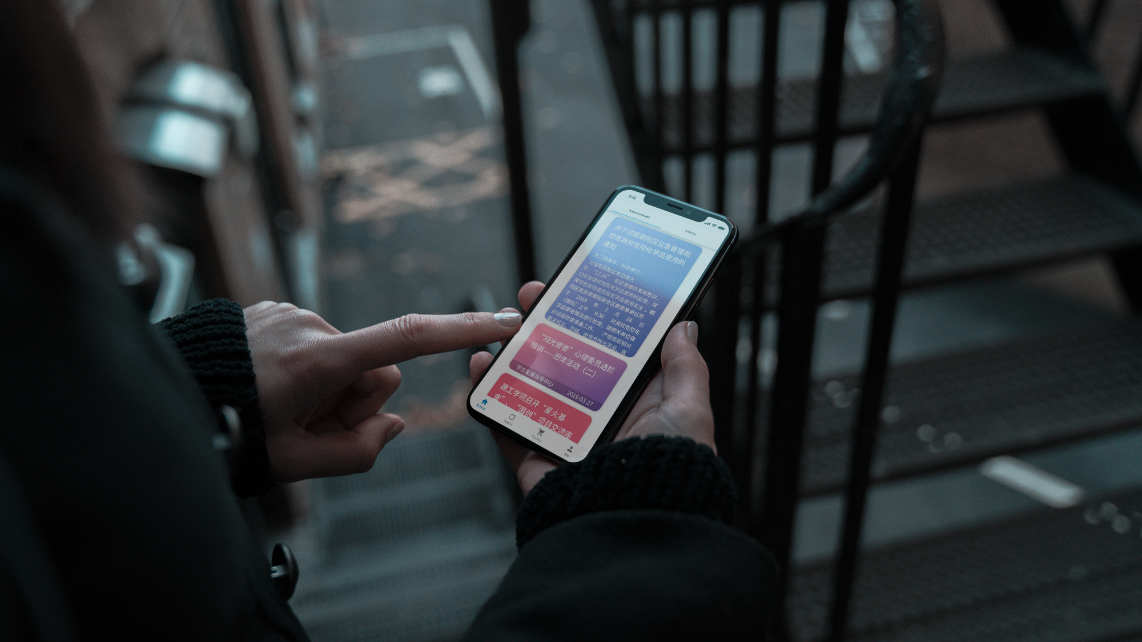

Thanks

