Slide 1

Scalable and Efficient Serving and Analysis of Geospatial Data
Yiwen Wang
11 October 2017
Notes:
^{Time} 45% big 45% 1 10% 2&3

Slide 2
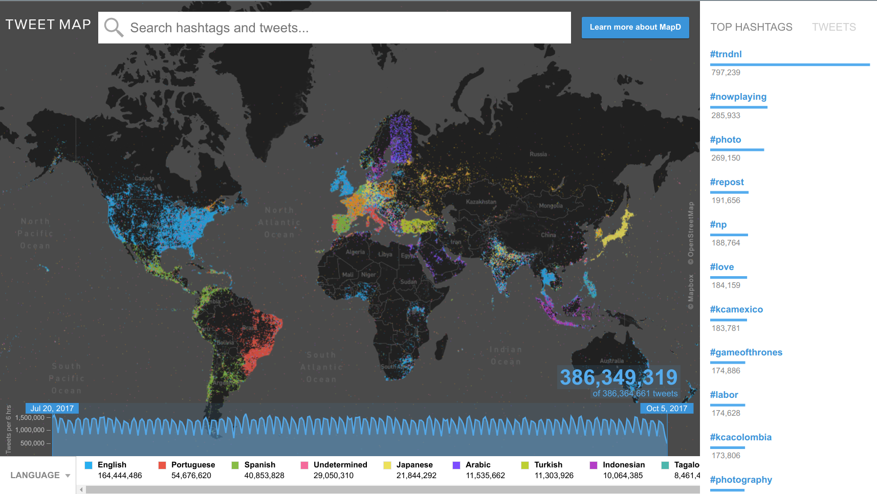
Widely Used Geospatial Data
Social computing
Data-driven precision agriculture

Slide 3
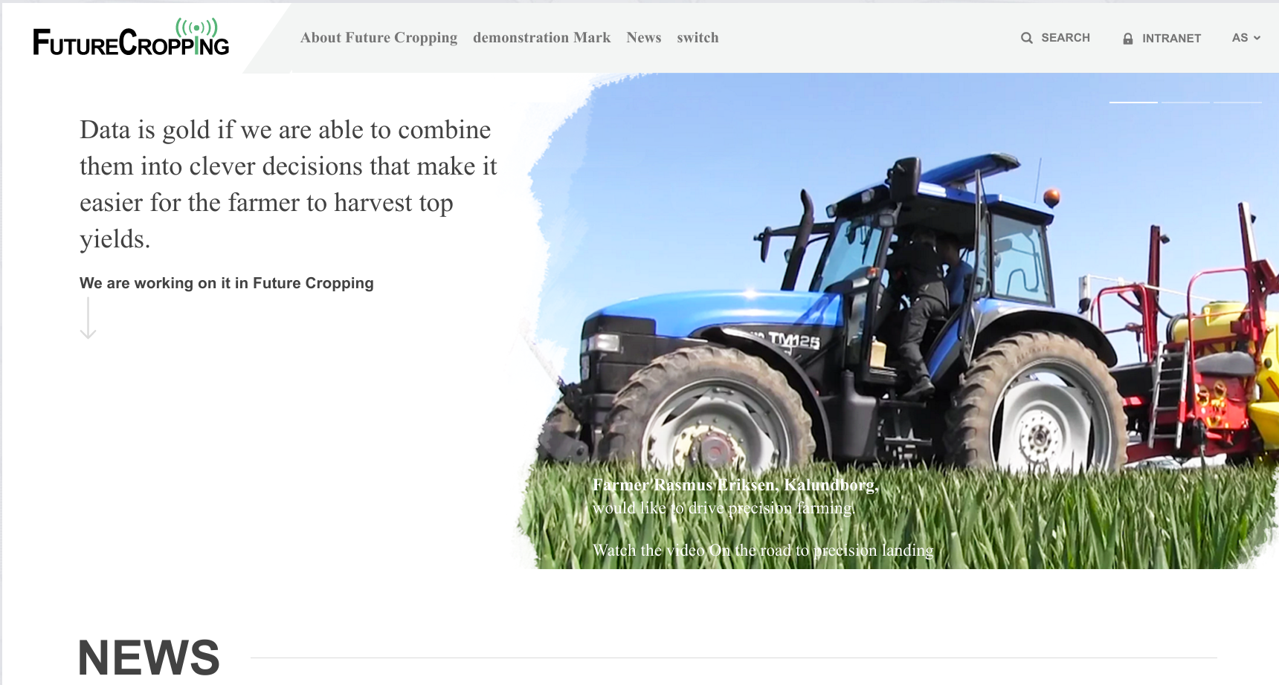
Future Cropping

Slide 4
Usage Challenges of Geospatial Data
Varied formats and properties .
Connection to specific hardware.
Large amount of requests simultaneously.
The lack of a infrastructure for storing, retrieving and analyzing the geospatial data.

Slide 5
Related Works
GeoNode
- Increasing users.
- Larger dataset.
- More frequent update.
- Lack of analytial services
->Large latency and low efficiency.
->The need for scalable support.
General caches.
Redis | Memcached…
Geospatial caches.
Geowebcache.
GeoMesa.
SpatialHadoop/Hadoop-GIS/ESRI GIS Tools for Haddop.
Web Interface
Data Manager
(GeoServer)
Data Storage
(PostGIS)

Slide 6
Related Works
GeoNode
- Increasing users.
- Larger dataset.
- More frequent update.
- Lack of analytial services
More frequent update
->Interatcive data-intensive problems.
Not clear how to best integrate analytical services with these systems.
Web Interface
Data Manager
(GeoServer)
Data Storage
(PostGIS)

Slide 7
Motivation
Increasing user requests+size and number of dataset
->Large latency and low efficiency.
More frequent update
->Interatcive data-intensive problems.
Integrate analytical services with systems.
Develop a system for geospatial data.
complete
, scalable
and analytical
, efficient

Slide 8
Expected Features
Complete function and achieve scalability.
Low latency and increase efficiency.
Easy to manage and maintain scalability, fully consistency.
Integrate with analytical services.

Slide 9
Project Description
Complete function and achieve scalability.
Low latency and increase efficiency.
Easy to manage and maintain scalability, fully consistency.
Integrate with analytical services.
- Develop an extension cache of services WFS/WCS on multi-core that can be ”drop-in”.
- Explore the architecture of interactive geospatial data services based on the emerging paradigm of actor database systems.
- Explore suitable and helpful analytical services in our own new system.
- Integration into the Future Cropping.

Slide 10
Vecstra System Architecture
Extend geospatial cache support efficient services WCS/WFS.
CLIENT_0
GeoServer/PostGIS
CLIENT_1
VECSTRA
.
.
.
HTTP
HANDLER
WFS
WCS
CACHEs
VECTOR
RASTER
CLIENT_n

Slide 11
SUB1: Data Partitioning for Multi-core Caches
Expanding dataset.
Achieving scalability.
Data skew.
Effective data partitioning is critical for task parallelization, load balancing, and directly affects system performance.

Slide 12
SUB1: Data Partitioning for Multi-core Caches
Balanced loading.
Optimized loading for skewed data.
C1 C2 Cn C1 C2 Cn
(C1&&C2&&...&&Cn)
C1 C2 Cn C1 C2 Cn
C1 C2 Cn C1 C2 Cn
C1 C2 Cn C1 C2 Cn
CACHE_1
CACHEs
CACHE_2
.
.
.
CACHE_n

Slide 13
SUB2: Efficient Detection of Geometries Intersection
S1: MBR filtering
True / False / Not certain
S2: Polygon refining
-hundreds points per geometry.
-reads all or most points.

Slide 14
Vecstra System Architecture
CLIENT_0
GeoServer/PostGIS
CLIENT_1
VECSTRA
.
.
.
HTTP
HANDLER
WFS
WCS
CACHEs
VECTOR
RASTER
CLIENT_n

Slide 15
Vecstra Based on Actor Database Systems.
More prevalent update.
→Interactive data-intensive problems.
Systems keep expanding.
→problem to keep durability, functionality, consistency in traditional architecture.
It is difficult to maintain Vecstra scalable, fully consistent in the face of a write-intensive work-load.

Slide 16
Vecstra Based on Actor Database Systems.
Explore the architecture of interactive geospatial data services based on the emerging paradigm of actor database systems.
Relation between back-end server and caches?
Traditional or new architecture?
(Caches + Traditional DB)->Actor database systems.
A new algorithm to handle data distribution.

Slide 17
Analytical Services Research in Vecstra
It is not clear how to best integrate analytical services with these systems.
Not to add/plug-in, but for suitable analytical services research in our own new system.

Slide 18
Analytical Services Research in Vecstra
Data analytical services of the geospatial system, e.g., outliers detection, multi-objective optimization, etc..

Slide 19
Schedule for the PhD Project
July 2017-Jun 2018 | Vecstra system build with sub-problems solved. 1st paper. 50% ECTS.
July 2018-Jun 2019 | Vecstra based on actor database systems. 2nd paper. 25% ECTS. Environment change.
July 2019-Jun 2020 | Analytical services research in Vecstra. 3rd paper. 25% ECTS. PhD dissertation.

Slide 20
Summary
Vecstra system build with sub-problems solved.
To provide efficient geospatial services by implement WFS/WCS on mulit-core caches.
To find an optimized data partitioning and distribution on caches.
To explore a more efficient geometries intersection detection way.
Vecstra based on actor database systems.
To explore an architecture of vecstra that maintain a scalable, fully consistent system in the face of a write-intensive work-load.
Analytical services research in Vecstra.
To integrate analytical services in geospatial system while retaining their data serving functionality.

