Slide 1
Perl Brown Bag
Regular Expressions
Matching
Substitution
Shaun Griffith
April 10, 2006

Slide 2

Agenda
Regular Expressions
Matches
Substitutions

Slide 3
Regular Expressions
Computer Science gives us the term Regular Expression, the topic concerned with deciding if a given string matches a pattern.
“Regular” refers to a type of formal language. It turns out that Perl’s regular expressions aren’t regular.
What does that mean? Perl is more powerful than regular expressions. (But we still call them regexes.)
Regular expressions are used in compilers, parsers, password checkers, web form checkers, and of course datalog yield reporters.

Slide 4

Meta Characters
Metacharacters are special characters
  \ Quote the next metacharacter
  ^ Match the beginning of the line
  . Match any character (except newline)
  $ Match the end of the line
  (or before newline at the end)
  | Alternation
  () Grouping
  [] Character class

Slide 5

Quantifiers
Quantifiers: how many?
  * Match 0 or more times
  + Match 1 or more times
  ? Match 1 or 0 times
  {n} Match exactly n times
  {n,} Match at least n times
  {n,m} Match between n and m times
  ( n,m <=32766)

Slide 6

Special Characters
Stuff That’s Hard to Type
  \t tab
  \n newline
  \r return (carriage return)
  \f form feed
  \e escape
  \033 octal char
  \x1B hex char
  \c[ control char

Slide 7

Character Classes
Regex Pattern Shortcuts
  \w Match a "word" character
  (alphanumeric plus "_")
  \W Match a non-"word" character
  \s Match a whitespace character
  \S Match a non-whitespace character
  \d Match a digit character
  \D Match a non-digit character

Slide 8

Character Classes…
More on Character Classes:
  ^ As the first char, negates the class
  ( [^A] matches anything except “A” )
  Otherwise literal caret.
  - between 2 chars is a range
  ( [A-G] will match A,B,C,D,E,F, or G )
  otherwise literal dash
  \b backspace (easiest way to get one)
  ] as first char, literal close bracket
\w\W\s\S\d\D can all be used in a character class
(but not in a range)

Slide 9

Zero Width Characters
These don’t take up any space:
  \b Match a word boundary
  \B Match a non-(word boundary)
  \A Match only at beginning of string
  \Z Match only at end of string,
  or before newline at the end
  \z Match only at end of string

Slide 10
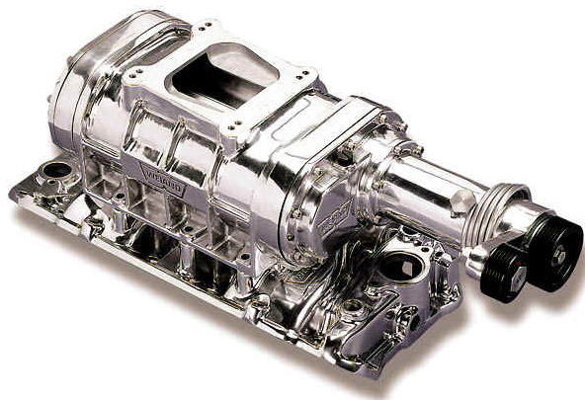
Regex Engine Modifiers
Change how the pattern works:
  /i ignore case
  /g return all matches
  /s period (.) now matches newline (\n)
  /m “multi-line”: ^ and $ match near
  any \n, not just start/end of string
  /x “expanded” regex: space and newlines
  are ignored, and # comments allowed:
  Example:
  /\w+ # first name
  \s+ # space
  \d+ # age
  /x

Slide 11

Matching and Capturing
Basic Matching:
  $var =~ m/something here/;
Capturing:
  $var =~ m/(pattern)/;
$1 contains “pattern”
  $catch = $1;
or
  ($catch) = $var =~ m/(pattern)/;
  ($x,$y) = $var =~ m/(first) (second)/;
Backreferences: refer to previous match
  $var = “The red red book.”;
  $var =~ m/(red) \1/;

Slide 12
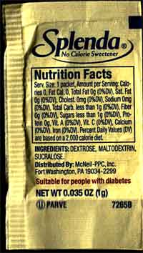
Substitutions
Basic Substitutions:
  $var =~ s/pattern/replacement/;
“this” is any m/pattern/
“that” is a double-quoted string
For example
  $var =~ s/(first) (last)/$2 $1/;
Backreferences belong in pattern only!
Inline captures don’t work with s///:
  ($x) = $var =~ s/(this)/that/; # wrong
Use $1 instead:
  $x = $1;

Slide 13
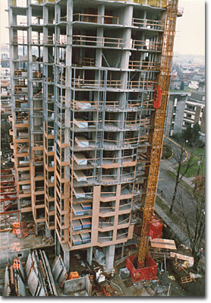
Putting It All Together
Wacky Test Names
  while (<>)
  { # FREQ BYP4 TRY
  if ( m/mpll_(\d+)_(byp|by4)_(\w)/i )
  { $data{$die}{FREQ} = $1;
  $data{$die}{BYP4} = $2;
  $data{$die}{TRY} = $3;
  next;
  }
  }

Slide 14

Next Time?
FTP?
  Using Net::FTP
  Navigating Remotely
  Moving Files
Subroutines?
  Passing parameters
  Catching parameters
  Returning data
Filehandles?
  Open
  Close
  EOF

