Slide 1
Perl Brown Bag
Data Mining
Shaun Griffith
March 20, 2006

Slide 2

Agenda
Program Structure
Slinging Strings

Slide 3
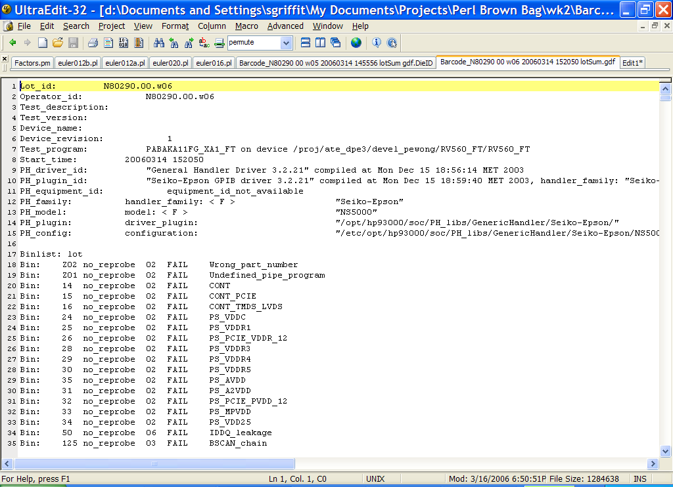
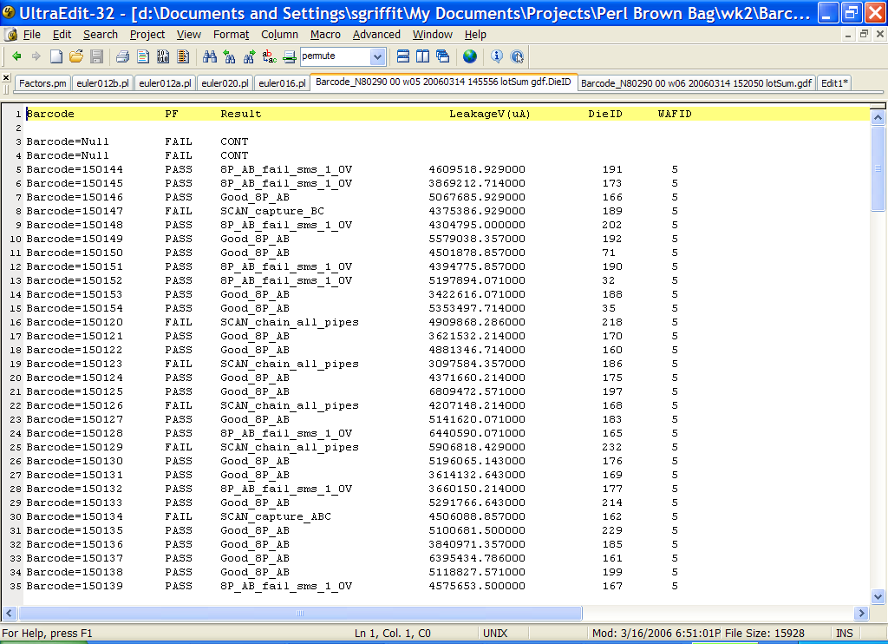
First Program
Read a GDF and grab some data

Slide 4

Program Structure
Shebang
  #!/path/to/perl
Unix shell runs this program on the script
Other choices
  DOS:
  #!/this/doesn’t/do/much
  Unix – find Perl in your path
      eval '(exit $?0)' && eval 'exec perl -w -S $0 ${1+"$@"}‘
      && eval 'exec perl -w -S $0 $argv:q'
      if 0;
      # The above invocation finds Perl in the path,
      # wherever it may be

Slide 5
Program So Far
#!/your/perl/here

Slide 6
Scriptures
Also known as “strictures”
use strict;
use warnings;
Strict
Declare all variables before use (“vars”)
No symbolic references (“refs”)
Declare all subroutines before use (“subs”)

Slide 7

Scriptures…
Warnings
  isn’t numeric
  undefined value
Warnings print to STDERR by default
Warnings usually mean program errors or bad data!

Slide 8
Program So Far
#!/your/perl/here
use strict;
use warnings;

Slide 9

Variables
Scalars
Hold a single value
  String
  Number
  Reference (like a pointer)
Start with $
  $name = “Fred”;
  $age = 17;
  $current_name = \$name;

Slide 10

Variables…
Arrays
Hold more than one value (scalar)
Order is important
Start with @ or $
  @list = (1,2,3,4,5);
  $list[3] = “Markam”;
  @list[11,28] = (“Red”,”Green”);
Size: $size = @list;
Last index: $last = $#list;

Slide 11

Variables…
Hashes
Pairs of data: key and value
No order – No duplicate keys
Start with % or @ or $
%cost = ( “apples” => 0.45,
“bananas” => 0.55 );
@cost{@fruit} = ( 0.45, 0.55 );
$cost{apples} = 0.45;
List of keys: @keys = keys %cost;
Size: $fruit = scalar keys %cost;

Slide 12
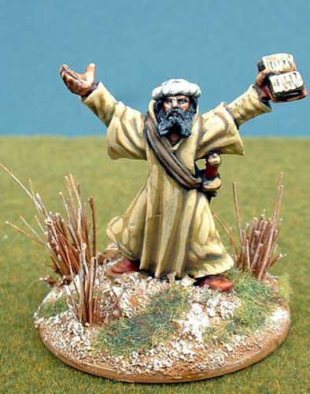
Reading Files
Perl DWIM (Do What I Mean)
To read files listed on the command line:
while (<>) { do_something_here; }
  “<>” is the “diamond” operator
  If empty, reads from STDIN (a file “handle”)…
  …which defaults to @ARGV
  “<>” automatically opens and closes files

Slide 13
Program So Far
#!/your/perl/here
use strict;
use warnings;
while (<>)
{
}

Slide 14
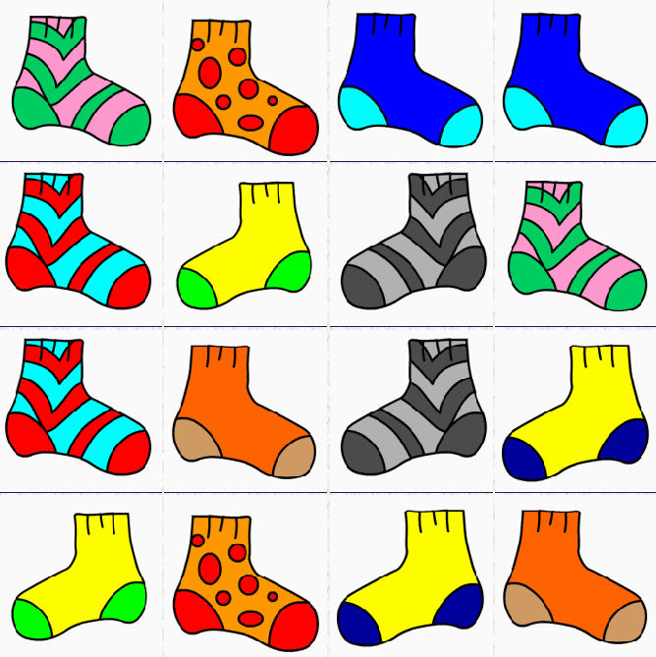
Matching
To match barcodes:
  m/barcode=(\d+)/i;
  m// is the match operator
  barcode= is literal text to match
  \d+ matches one or more digits (0-9)
  () captures matches into $1, $2, etc.
  /i ignores case
To print it out:
  print “$1\n”; # \n is end of line
Putting them together:
  if ( m/barcode=(\d+)/i )
  { print “$1\n”; }

Slide 15
Program So Far
#!/your/perl/here
use strict;
use warnings;
while (<>)
{
  if ( m/barcode=(\d+)/i )
  { print “$1\n”; }
}

Slide 16

More Stuff
Pass/Fail is on the same line:
  m/(PASS|FAIL)/i;
    Vertical bar is “or”
Print this out too:
  if ( m/(PASS|FAIL)/i )
  { print “$1\n”; }
But let’s print all of that on one line:
  if ( m/barcode=(\d+)/i )
  { print “$1\t”;
  if ( m/(pass|fail)/i )
  { print "$1”; }
  print "\n";
  }

Slide 17
Program So Far
#!/your/perl/here
use strict;
use warnings;
while (<>)
{
  if ( m/barcode=(\d+)/i )
  { print “$1\t”;
    if ( m/(pass|fail)/i )
    { print "$1”; }
    print "\n";
  }
}

Slide 18
Printing Headers
You could do this:
  print “Barcode\tPF\n”; # \t is tab
…but if spacing is important:
  printf “%10s\t%4s\n”, “Barcode”, “ PF ”;
This is the same printf as C.
  %10s
    % starts a field
    10 gives the width
    s is for strings
    d is for integers
    e/f/g are for real (floats)
Do the same for the other prints if you want…

Slide 19

Ta-Da!!!
#!/your/perl/here
use strict;
use warnings;
# header
printf “%10s\t%4s\n”, “Barcode”, “ PF ”;
while (<>)
{
  if ( m/barcode=(\d+)/i )
  { printf “%10s\t”, $1;
    if ( m/(pass|fail)/i )
    { printf “%4s”, $1; }
    print "\n";
  }
}
exit; # redundant, but good for debugger

Slide 20
Questions?
Questions on this material?
  Reading files
  Variables
  Matching
  Printing
Questions on anything else?
  Reading from more than 1 file?
  Substitutions?
  Loops?
  Subroutines?

Slide 21
Next Time
Running Perl
Perl Debugger

