Slide 1
Perl Brown Bag
Datalog Parsing
Shaun Griffith
March 27, 2006

Slide 2
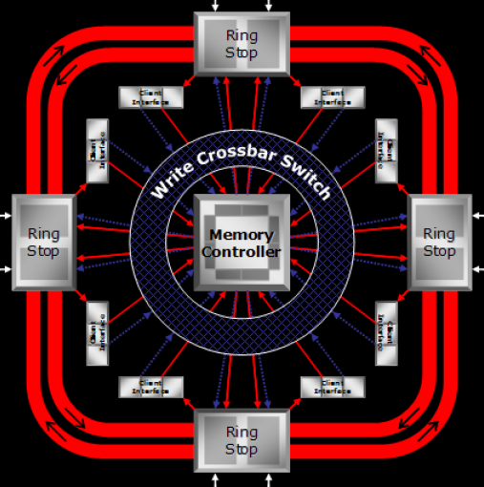
Agenda
Setting a goal
Step by step

Slide 3
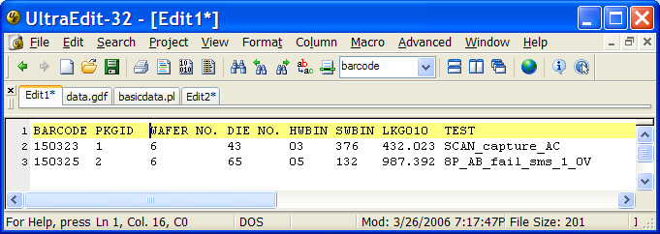
Setting a Goal
What should the output look like?
Barcode, Package ID, Wafer, Die ID
Hard Bin, Soft Bin, LKG010, Failing Test

Slide 4

…And Another Goal
Retests?
  Print all?
  Keep first?
  Average or aggregate?
  Keep last!

Slide 5

…And Even More
More than 1 input file
Wildcards in DOS
Error checking

Slide 6
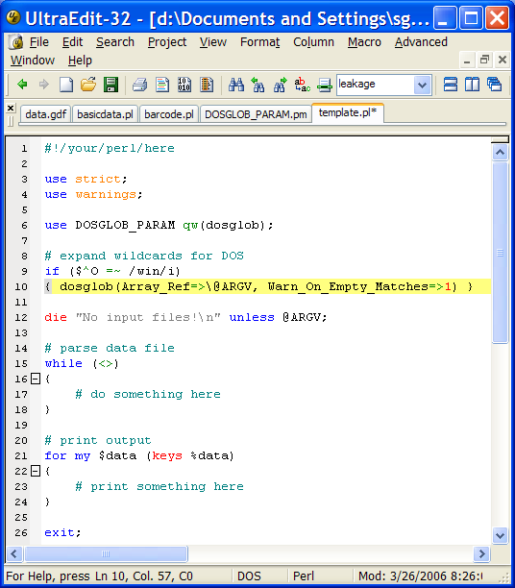
Step by Step
Program Template
  header
  DOS wildcards
  error checking
  main loop
  print loop

Slide 7

Template Breakdown
Header
  Perl 5:
    use strict;
    use warnings
  Perl 4: -w
Wildcards for DOS
  Which operating system: $^O
  Match to Windows: =~ /win/i
  Command line: @ARGV
  Expand wildcards: glob
Error checking
  Count of items: @ARGV in scalar context

Slide 8

Finding Data
Split Arguments:
  Delimiter (match)
    ‘ ‘ (blank) is special (and default)
    like /\s+/, but no leading null field
  Target, default is $_
  Always catch in array
    @fields = split;

Slide 9

Handling Data
Is it a barcode line?
  if ( /^barcode=/i )
  { do_something_here }
Fields
  ($barcode) = $fields[0] =~ /=(\d+)/;
  $pkgid = $fields[1];
  $softbin = $fields[2];
  $hardbin = $fields[3];
  $test_fail = $fields[-1];
  # clear other variables (if needed)

Slide 10

Regular Expressions
Regex Metacharacters
Anchors
  ^ start of string if /^.../
  $ end of string if /...$/
Quantifiers
  ? zero or one of preceding
  + one or more of preceding
  * any number of preceding
  {x,y} at least x, no more than y of preceding
    {x} exactly x
    {x,} at least x
    {,y} no more than y

Slide 11

Regexes…
Regex Metacharacters…
Character Class
  [abc1-7] match one of “a”, “b”, “c”, or a digit 1 to 7
Alternation
  | “or” – either the left or right pattern
  abc|def either “abc” or “def”
Grouping & Captures
  (abc) capture “abc”
  (abc)+ capture “abc”, at least one must occur
  (?:abc)+ “abc” at least once, but don’t capture
  (?i) case insensitive flag [ (?-i) to change back ]

Slide 12

Regexes…
Regex Metacharacters…
Character Class Shortcuts
  \s whitespace (blank, tab, newline, carriage return)
  \w “word” characters, same as [A-Za-z_]
  \d digits [0-9]
Special Character Shortcuts
  \t tab
  \n newline
  \xAB hex “AB”
  \X escape any special character X

Slide 13

Handling Data…
Is it a wafer line?
  if ( /wafer_id\s+=\s+(\d+)/i )
  { $wafer = $1; }
Is it a die id line?
  if ( /die_id\s+=\s+(\d+)/I )
  { $die_id = $1; }
Is it a leakage line?
  if ( /leakage_all0=(-?\d+(\.\d+))/ )
  { $lkg_all0 = $1; }

Slide 14

Saving Data
What starts a new device?
  Barcode!
  if (/^barcode=/i)
  { if ( defined($barcode) )
    { $data{$barcode} = “$barcode $pkgid $wafer $die_id $hardbin $softbin $lkg_all0 $test_fail”; }
    ($barcode) = $fields[0] =~ /=(\d+)/;
Use the Barcode as the key
  Retests will just overwrite the old data
  (This is the easiest case to handle)

Slide 15
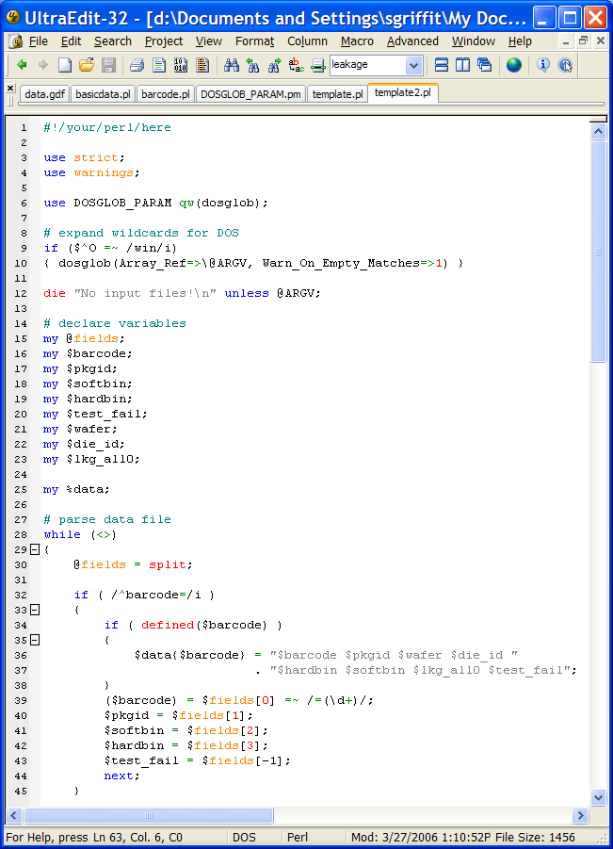
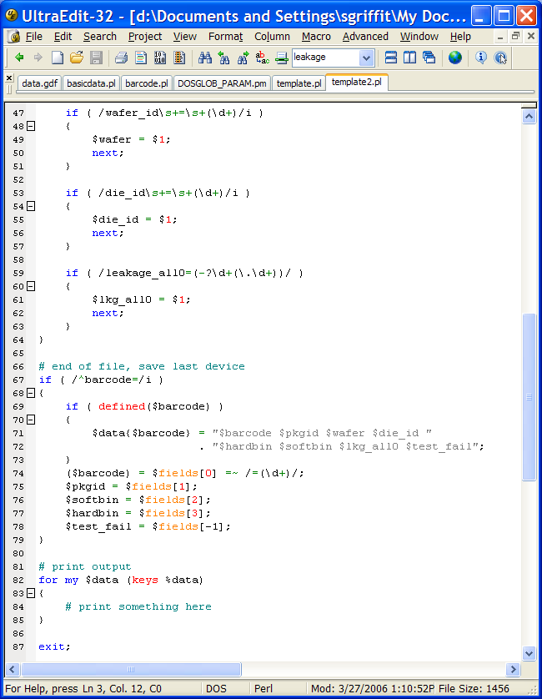
Program so far…

Slide 16
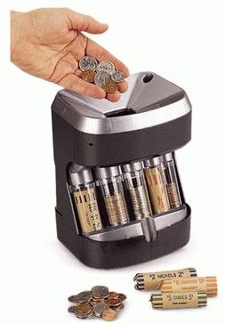
Print It Out!
Print header line
  print “BARCODE PKGID WAFER NO. “
    . ”DIE NO. HWBIN SWBIN LKG010 TEST\n”;
    Note the dot for string concatenation
For loop, Perl style
  for my $line (values %data)
  { print “$line\n”; }
values gets all data out of data, in random order
To sort by barcode, use sort and keys:
  for my $barcode ( sort {$a <=> $b} keys %data)
  { print “$data{$barcode}\n”; }

Slide 17

Questions?
Questions on this material?
  Template
  Command line arguments
  Split
  Matching
  Hashes and unique keys
Questions on anything else?

Slide 18
Working Session
Running Perl
Perl Debugger

Slide 19

Command Line
Common Options
  -c “compile check” – check syntax, but don’t run the program
  -w turn on basic warnings (-W for *all* warnings)
  -d load the debugger (with program or -e)
  -e ‘code’ run this code
  -n wraps this around the –e code:
  while (<>) { code goes here }
  -p same as –n, but prints $_ after each iteration:
  while (<>) {code} continue {print $_}
  -a “autosplit”, used with –p or –n, puts this in the while (<>) loop:
  @F = split; # whitespace, same as split ‘ ‘
  -F/pattern/ used with –a to split on a different pattern
  -h help summary

Slide 20

Debugger
Common Options
  l x-y list lines x to y
  n single step (over function calls)
  s single step (into functions)
  <enter> repeat last n or s
  c x continue (execute) to line x
  b x break on line x
  b x condition break on line x when condition is true
  e.g., /barcode/ (same as $_ =~ /barcode/)
  B x delete breakpoint on line x (or * to delete all breakpoints)
  p expression print expression, with newline
  x expression eXamine expression, including nested structure
  x $scalar or x @array or x \%hash
  h help
  R Restart program, rewinding all inputs (doesn’t work on DOS)

