Slide 1
Perl Brown Bag
Command Line and Debugger
Shaun Griffith
April 3, 2006

Slide 2

Agenda
Command Line
Debugger

Slide 3

Command Line
Common Options
  -c “compile check” – check syntax, but don’t run the program
  -w turn on basic warnings (-W for *all* warnings)
  -d load the debugger (with program or -e)
  -e ‘code’ run this code
  -n wraps this around the –e code:
  while (<>) { code goes here }
  -p same as –n, but prints $_ after each iteration:
  while (<>) {code} continue {print $_}
  -a “autosplit”, used with –p or –n, puts this in the while (<>) loop:
  @F = split; # whitespace, same as split ‘ ‘
  -F/pattern/ used with –a to split on a different pattern
  -h help summary

Slide 4

Command Line: Examples
Version:
  C:\>perl -v
  This is perl, v5.8.7 built for MSWin32-x86-multi-thread
  (with 14 registered patches, see perl -V for more detail)
Compiler Check:
  C:\>perl –c dupes.pl
  syntax error at dupes.pl line 17, near "))
  “
  syntax error at dupes.pl line 23, near "}“
  dupes.pl had compilation errors.
Removing a stray right paren:
  C:\>perl –c dupes.pl
  dupes.pl syntax OK

Slide 5

Command Line: Examples
One-liners: -p and –n
  -n: loop on input, but don’t print unless requested:
    perl –ne “your program here”
  is equivalent to
    while (<>) { your program here }
  -p: loop on input, run “program”, print every line:
    perl –pe “your program here”
  is equivalent to
    while (<>) { your program here; print }
  “Golf”ed line counter
    perl –pe “}{$_=$.}”
  Homework – what does this do?
perl –MO=Deparse –pe “}{$_=$.}”

Slide 6

Command Line: Examples
One-liners: -e
  Change all “FAIL”s to “PASS”es:
    perl –pe “s/FAIL/PASS/g” my_input_file
  Print lines with wafer coordinates:
  perl –ne “/\d+,\d+/ and print” my_input_file
  Sum the 7th column if the last column matches “Buy”
    perl –ane “$sum+= $F[6] if ($F[-1]=~/buy/i);
    print qq(sum=$sum\n) if eof” my_input_file
  For DOS, use double-quotes, and qq() to double-quote in programs.
  For Unix, use single quotes, and q() to single-quote in programs.

Slide 7

Debugger
Common Options
  l x-y list lines x to y
  n single step (over function calls)
  s single step (into functions)
  <enter> repeat last n or s
  c x continue (execute) to line x
  b x break on line x
  b x condition break on line x when condition is true
  e.g., /barcode/ (same as $_ =~ /barcode/)
  B x delete breakpoint on line x (or * to delete all breakpoints)
  p expression print expression, with newline
  x expression eXamine expression, including nested structure
  x $scalar or x @array or x \%hash
  h help
  R Restart program, rewinding all inputs (doesn’t work on DOS)

Slide 8

Debugger: Examples
Perl Scratch Pad
  C:\>perl -demo
  Loading DB routines from perl5db.pl version 1.28
  Editor support available.
  Enter h or `h h' for help, or `perldoc perldebug' for more help.
  main::(-e:1): mo
  DB<1>
Print shortcut:
  DB<1> p 17+42
  59
Examine a variable
  DB<5> x \%hash
  0 HASH(0x1d4cd18)
  'Fred' => HASH(0x1d00a4c)
  'Office' => '1F17'
  'Phone' => 'x1234'
  'George' => HASH(0x1cef8e0)
  'Office' => '2F35'
  'Phone' => 'x9876'

Slide 9
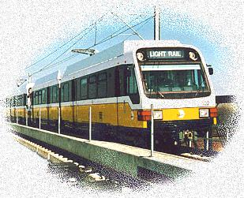
Debugger: Examples
Load a program:
perl –d histo.pl histo.pl
l (“ell”): list program
DB<1> l 1-11
1 #!/your/perl/here
2: use strict;
3: use warnings;
4
5==> my %seen;
6
7: while (<>)
8 {
9: my @fields = split;
10: $seen{$fields[0]}++;
11 }
Break (with condition), and continue
DB<2> b 10 $. > 5
DB<3> c
Use of uninitialized value in hash element at histo.pl line 10, <> line 4.
at histo.pl line 10
main::(histo.pl:10): $seen{$fields[0]}++;

Slide 10
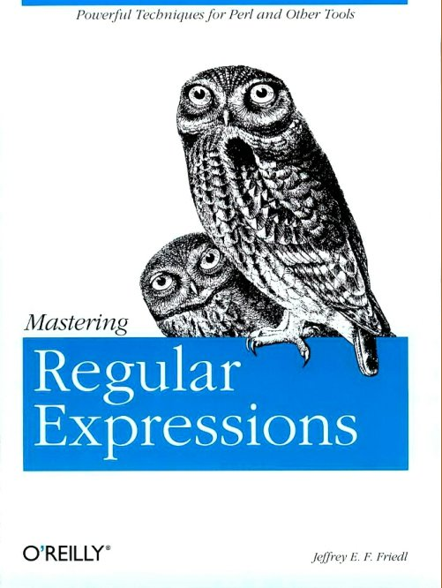
Next Time?
Regular Expressions?
  Matches
  Substitutions
  Wildcards
  Captures
Subroutines?
  Passing parameters
  Catching parameters
  Returning data
Filehandles?
  Open
  Close
  EOF

