Slide 1
Perl Brown Bag
FTP
File Transfer Protocol
Shaun Griffith
April 17, 2006

Slide 2
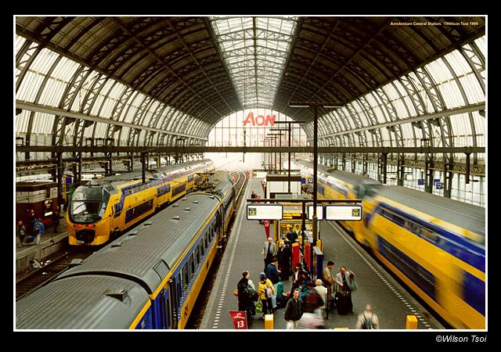
Agenda
Net::FTP
  Boring Stuff You Should Know
  Classes, Objects, Methods
  Useful Example
  Reaching Further

Slide 3

Net::FTP
Boring Details You Should Know
Net::FTP is a Perl module that handles FTP commands within a Perl program.
Net::FTP is part of the “core distribution”, and always comes with Perl.
In Perl, the double colon “::” indicates a subdirectory in the library.
use dir1::dir2::this looks for dir1\dir2\this.pm in the library paths.
If your main Perl library is c:\Perl\lib, then Net::FTP should be in c:\Perl\lib\net\ftp.pm.
Modules are always “.pm” files (Perl Module).

Slide 4

Net::FTP
Synopsis:
use Net::FTP;
my $host = ‘some.host.name’;
my $ftp = Net::FTP->new($host)
or die "Cannot connect to $host: $@";
$ftp->login(‘user’,‘password’)
or die "Cannot login ", $ftp->message;
$ftp->cwd("/pub")
or die "Cannot change working directory ",
$ftp->message;
$ftp->get("that.file")
or die "get failed ", $ftp->message;
$ftp->quit;

Slide 5

Classes, Objects, Methods
  use Net::FTP;
This tells Perl to compile and run the file Net\FTP.pm in the installed library.
  my $host = ‘some.host.name’;
  my $ftp = Net::FTP->new($host)
  or die "Cannot connect to $host: $@";
Net::FTP is a Class module. It creates and manipulates Net::FTP Objects.
Objects can only be manipulated by Methods (special subroutines).
new is a Method in the Net::FTP class. It takes a hostname, and returns a Net::FTP object reference.
$ftp holds the Net::FTP object reference.
If new fails, the error message will be in $@.

Slide 6

More Methods…
  $ftp->login(‘user’,‘password’)
  or die "Cannot login ", $ftp->message;
login takes a username and password, and logs into the remote host.
  $ftp->cwd(‘/pub’)
  or die "Cannot change working directory ",
  $ftp->message;
cwd changes the directory.
  $ftp->get("that.file")
  or die "get failed ", $ftp->message;
get transfers “that.file” to the local machine.
  $ftp->quit;
quit ends the FTP session with the remote host.

Slide 7
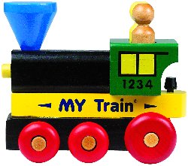
Simple Example
Simple Example:
  use Net::FTP;
  my $host = ‘210.68.241.2’;
  my $user = ‘ati’;
  my $pw = (shift or ‘’);
Don’t put password in scripts!
  my $ftp = Net::FTP->new($host) or die;
  $ftp->login($user,$pw) or die;
  $ftp->cwd(‘RV530/0414’) or die;
  $ftp->binary() or die;; # for gzip, etc.
  $ftp->get(‘/RV530A26_B_FT_X1.tar.gz’)
  or die;
  $ftp->quit() or die;

Slide 8

Reaching Further
What about automation?
What about scanning directories?
  my @dirs = $ftp->dir();
  for my $dir ( @dirs )
  {
  if ( $dir =~ /$match_directory/ )
  { use_as_directory }
  else
  { use_as_file }
  }

Slide 9

Walking the Dir Tree
To really walk the directory tree, you need either:
  stack
  recursion
Recursion is easier to program:
  sub ftp_tree_walk
  { my @dirs = $ftp->dir();
  ($is_dir,$can_read,$name)
  = $dir =~ m/some_long_regex/;
  if ( $is_dir =~ /$dir_match/ )
  { $ftp->cwd($dir);
  ftp_tree_walk();
  $ftp->cdup();
  }
  else
  { $ftp->get($dir) }
  }

Slide 10

Next Time?
Subroutines?
  Passing parameters
  Catching parameters
  Returning data
  Recursion
Filehandles?
  Open
  Close
  EOF
  Pipes

