Slide 1
Perl Brown Bag
Subroutines
Closures
Shaun Griffith
April 24, 2006

Slide 2

Agenda
Subs
  Basics
  Arguments
  Return values
Closures
  Static variables
  Anonymous subs

Slide 3

Subs
Basics
  sub my_sub
  { code goes here } # no semi-colon
Calling
  my_sub( arg1, arg2, …);
  $catch = my_sub();
  @stuff = my_sub(@args);
Ambiguous
  my_sub @args; # must be defined earlier
  &my_sub; # current @_ available inside

Slide 4

Arguments
Passing Args
  my_sub( “one”, $two, \@three, %four );
Catching Args
  sub my_sub
  { my $x1 = shift @_;
  my $x2 = shift; # @_ is default
  my $x3 = shift; # reference
  my %x4 = @_; # all the rest
  … }
With a long list, that’s a lot of work!

Slide 5
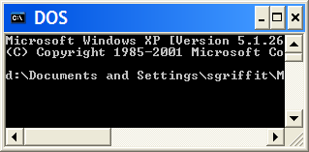
Try It And See™
Do this on your own machine:
  Save the file sub1.pl on you PC
  go to Start, Run, cmd (to get to DOS)
  cd to the directory with sub1.pl
  perl –d sub1.pl
  > s
Now use <enter> to step through the program, and x $var to examine variables at key places.

Slide 6



Try It And See™…
Now answer these questions:
  Did you get “Odd number of elements…”? What does that mean? How did it happen?
  What’s odd about %four in the second call to simple?
  Why doesn’t print %four do what you expect?
  Why isn’t smart all that good?
  Is smarter better?
  What happens if smarter gets a parameter it doesn’t know? What is it missing?

Slide 7

Recursion
Factorial
  sub fac
  {
  my $x = shift;
  # exit conditions
  return if ( $x < 0 ); # bad input
  return 1 if ( ($x == 0) or ($x == 1));
  my $y = $x * fac($x-1);
  return $y;
  }
return $y could be written as just $y, since the last expression evaluated will be returned in the absence of an explicit return.

Slide 8

Return
How many values should the sub return?
  0: return;
  1: return $x;
  list: return( $x, $y); # parens are better
  ref: return \@array;
Here’s a gotcha:
  Sometimes you want to signal an error or an empty result, so you might try returning undef:
    return undef;
  However, in list context, undef is a one-element list:
    if ( scalar( @x = ( undef ) ) )…
  This is always true!!!

Slide 9
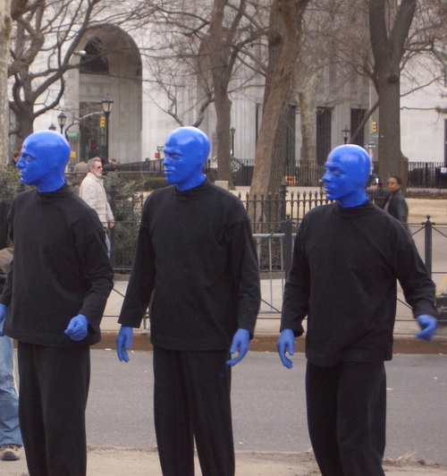
Return with Context
wantarray (should have been named “wantlist”):
  sub check_context
  { if (not defined wantarray)
  { print “void” }
  elsif ( wantarray )
  { print “list” }
  else
  { print “scalar” }
  print “ context\n”;
  }
(For a more complete mechanism, see the Want module.)

Slide 10

Closures
Closures “enclose” lexical (my) variables.
Recall sub fac – once fac(317)is computed, there’s no reason to compute it again, is there? One use of closures is for simple cache variables:
  { # closure for fac
    my %cache; # only visible to fac, but “static”
    sub fac
    {
      my $x = shift;
      return if ( $x < 0 ); # bad input
      return 1 if ( ($x == 0) or ($x == 1));
      if ( not exists( $cache{$x} ) )
      { $cache{$x} = $x * fac($x-1); }
      return $cache{$x};
    } # end sub fac
  } # end closure for fac
Closures must be defined above the first call!

Slide 11

Anonymous Subs
Create a sub with no name (but save it as a coderef):
  my $two = 2;
  my $times_2 = sub { $two * shift };
  $z = $times_2->(17);
Note that $two is “captured” in the anonymous sub – as long as $times_2 exists, so will $two.
The uglier syntax for this is:
  $z = &$times_2(17); # less clear
& is the sub sigil, like $ is for scalars.

Slide 12
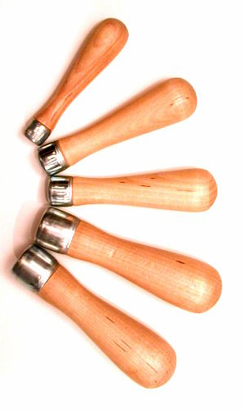
Next Time?
Filehandles?
  Open
  Close
  EOF
  Pipes
Command Line Arguments?
  Catching
  Checking
  Using

