Slide 1
Perl Brown Bag
File Handles
Shaun Griffith
May 1, 2006

Slide 2
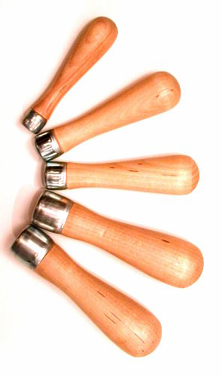
Agenda
Filehandles
  What are they?
  Predefined
  Open
  Close
  EOF
  Pipes
FTP Scripting
  Non-Perl FTP hacking

Slide 3

File Handles
What are File Handles?
  File handles act like a reference to a specific entity in the file system.
  Ordinarily associated with a file or a stream.
    A “stream” is data piped through a process (e.g., cat or gzip).

Slide 4
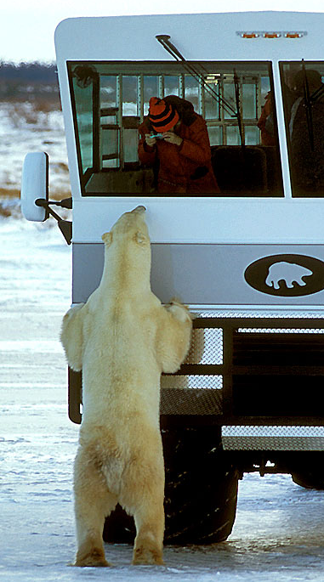
How do You Call Them?
How do you reference them?
  File handles do not have a sigil (i.e., no $/@/%)
  Just a bare identifier, by convention, all uppercase:
    MY_FILE_HANDLE
    XYZ
    ABC

Slide 5

Predefined File Handles
Perl has several predefined file handles:
Like “C”:
  STDIN
  STDOUT (default for print)
  STDERR (default for warn/die)
Unique to Perl:
  ARGV (default for <>)
    Perl “magic”
  DATA
    inline after __DATA__
      (note the double underlines)
ARGV!

Slide 6

Open and Close
Opening a file:
open(STDIN,‘<‘, “myfile.txt”)
or die “Error opening myfile.txt for reading, $! “;
  $! holds the error message.
  Use parens for open to avoid problems with expressions as parameters.
Closing a file:
close STDIN;
  or die only needed in rare cases for close
2 Argument open
Older Perls
Less safe
  open(STDIN, “< $somefile”) or die…
  $somefile could be “x;rm –r /*”

Slide 7

EOF
Why check for EOF?
while (<>) does this for you…
But with multiple input files, $. (input line number) is not reset.
To reset the line number for each new file:
  while (<>)
  { do something here }
  continue
  { close( ARGV ) if eof }
Note: no parens!!!
  eof is the same as eof( ARGV ), the current file read with <>
  eof() is the final file in @ARGV
Other uses – output filename derived from input filename:
  if ( eof )
  { close( ARGV );
  open(STDOUT,‘>’,$ARGV[0].”out”; }

Slide 8

Pipes
What are pipes?
Chain processes together to work on a data stream
Example:
  noblanks *.txt | fix_names | mail joe@x.com
In Perl?
open(STDIN,‘<‘,‘gzip -d myfile.gz |’) or die…
  This unzips the file directly into Perl.
  No other special handling required.
    while (<STDIN>) { do something here }
open(STDOUT,’>’,’| gzip –c >myfile.gz’) or die…
  This zips the file directly from Perl.
  No other special handling required.
    print “You’re data here\n”;
Some useful Unix commands:
  mail
  gzip
  tee

Slide 9

FTP Hacking
FTP also takes input from a control file
  ftp –n –i < control_file
    -n: don’t automate login (easier to script)
    -i: don’t prompt for mget
What does the control file look like?
  open ftp.urcompany.com
  user myuser mypassword
  cd somedir/otherdir
  bin
  get somefile.lotgdf
  mget lots-o-files*.lotgdf
  quit
Notes:
  Must already know directory tree & files
  bin for binary (sometimes type i or image)
  get, put, mget, mput
  Don’t forget to quit

Slide 10
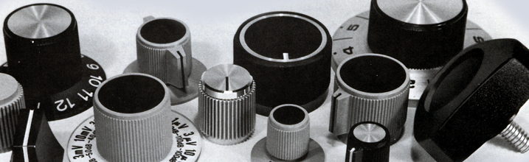
Next Time?
Command Line Arguments?
  Catching them
  Checking them
  Using them
  My pet module

