Slide 1
Canadian Bioinformatics Workshops
www.bioinformatics.ca

Slide 2

Module #: Title of Module

Slide 3

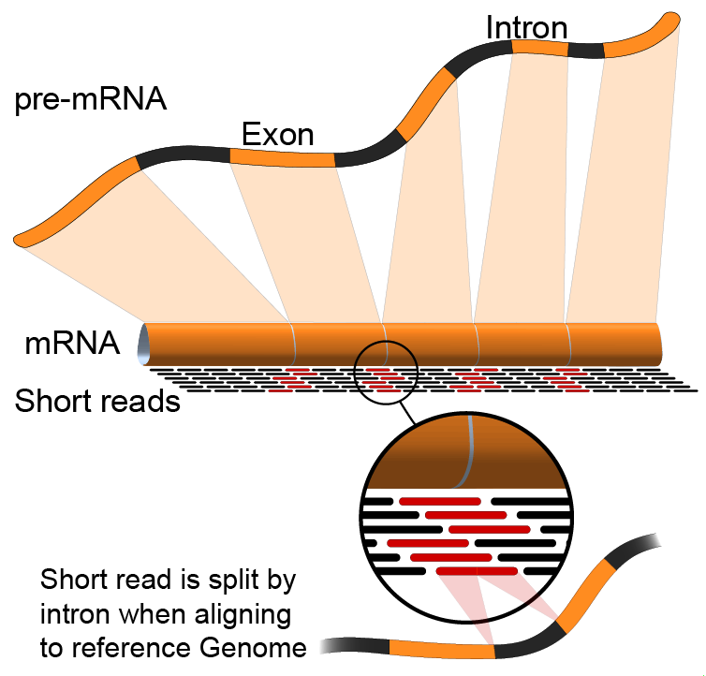

Module 1
Introduction to RNA sequencing (lecture)
www.malachigriffith.org
mgriffit@genome.wustl.edu
www.obigriffith.org
ogriffit@genome.wustl.edu

Slide 4
Learning objectives of the course
Module 1: Introduction to RNA sequencing
Module 2: RNA-seq alignment and visualization
Module 3: Expression and Differential Expression
Module 4: Isoform discovery and alternative expression
Module 5: Gene fusion discovery
Tutorials
  Provide a working example of an RNA-seq analysis pipeline
  Run in a ‘reasonable’ amount of time with modest computer resources
  Self contained, self explanatory, portable

Slide 5
Learning objectives of module 1
Introduction to the theory and practice of RNA sequencing (RNA-seq) analysis
  Rationale for sequencing RNA
  Challenges specific to RNA-seq
  General goals and themes of RNA-seq analysis work flows
  Common technical questions related to RNA-seq analysis
  Getting help outside of this course
  Introduction to the RNA-seq hands on tutorial

Slide 6
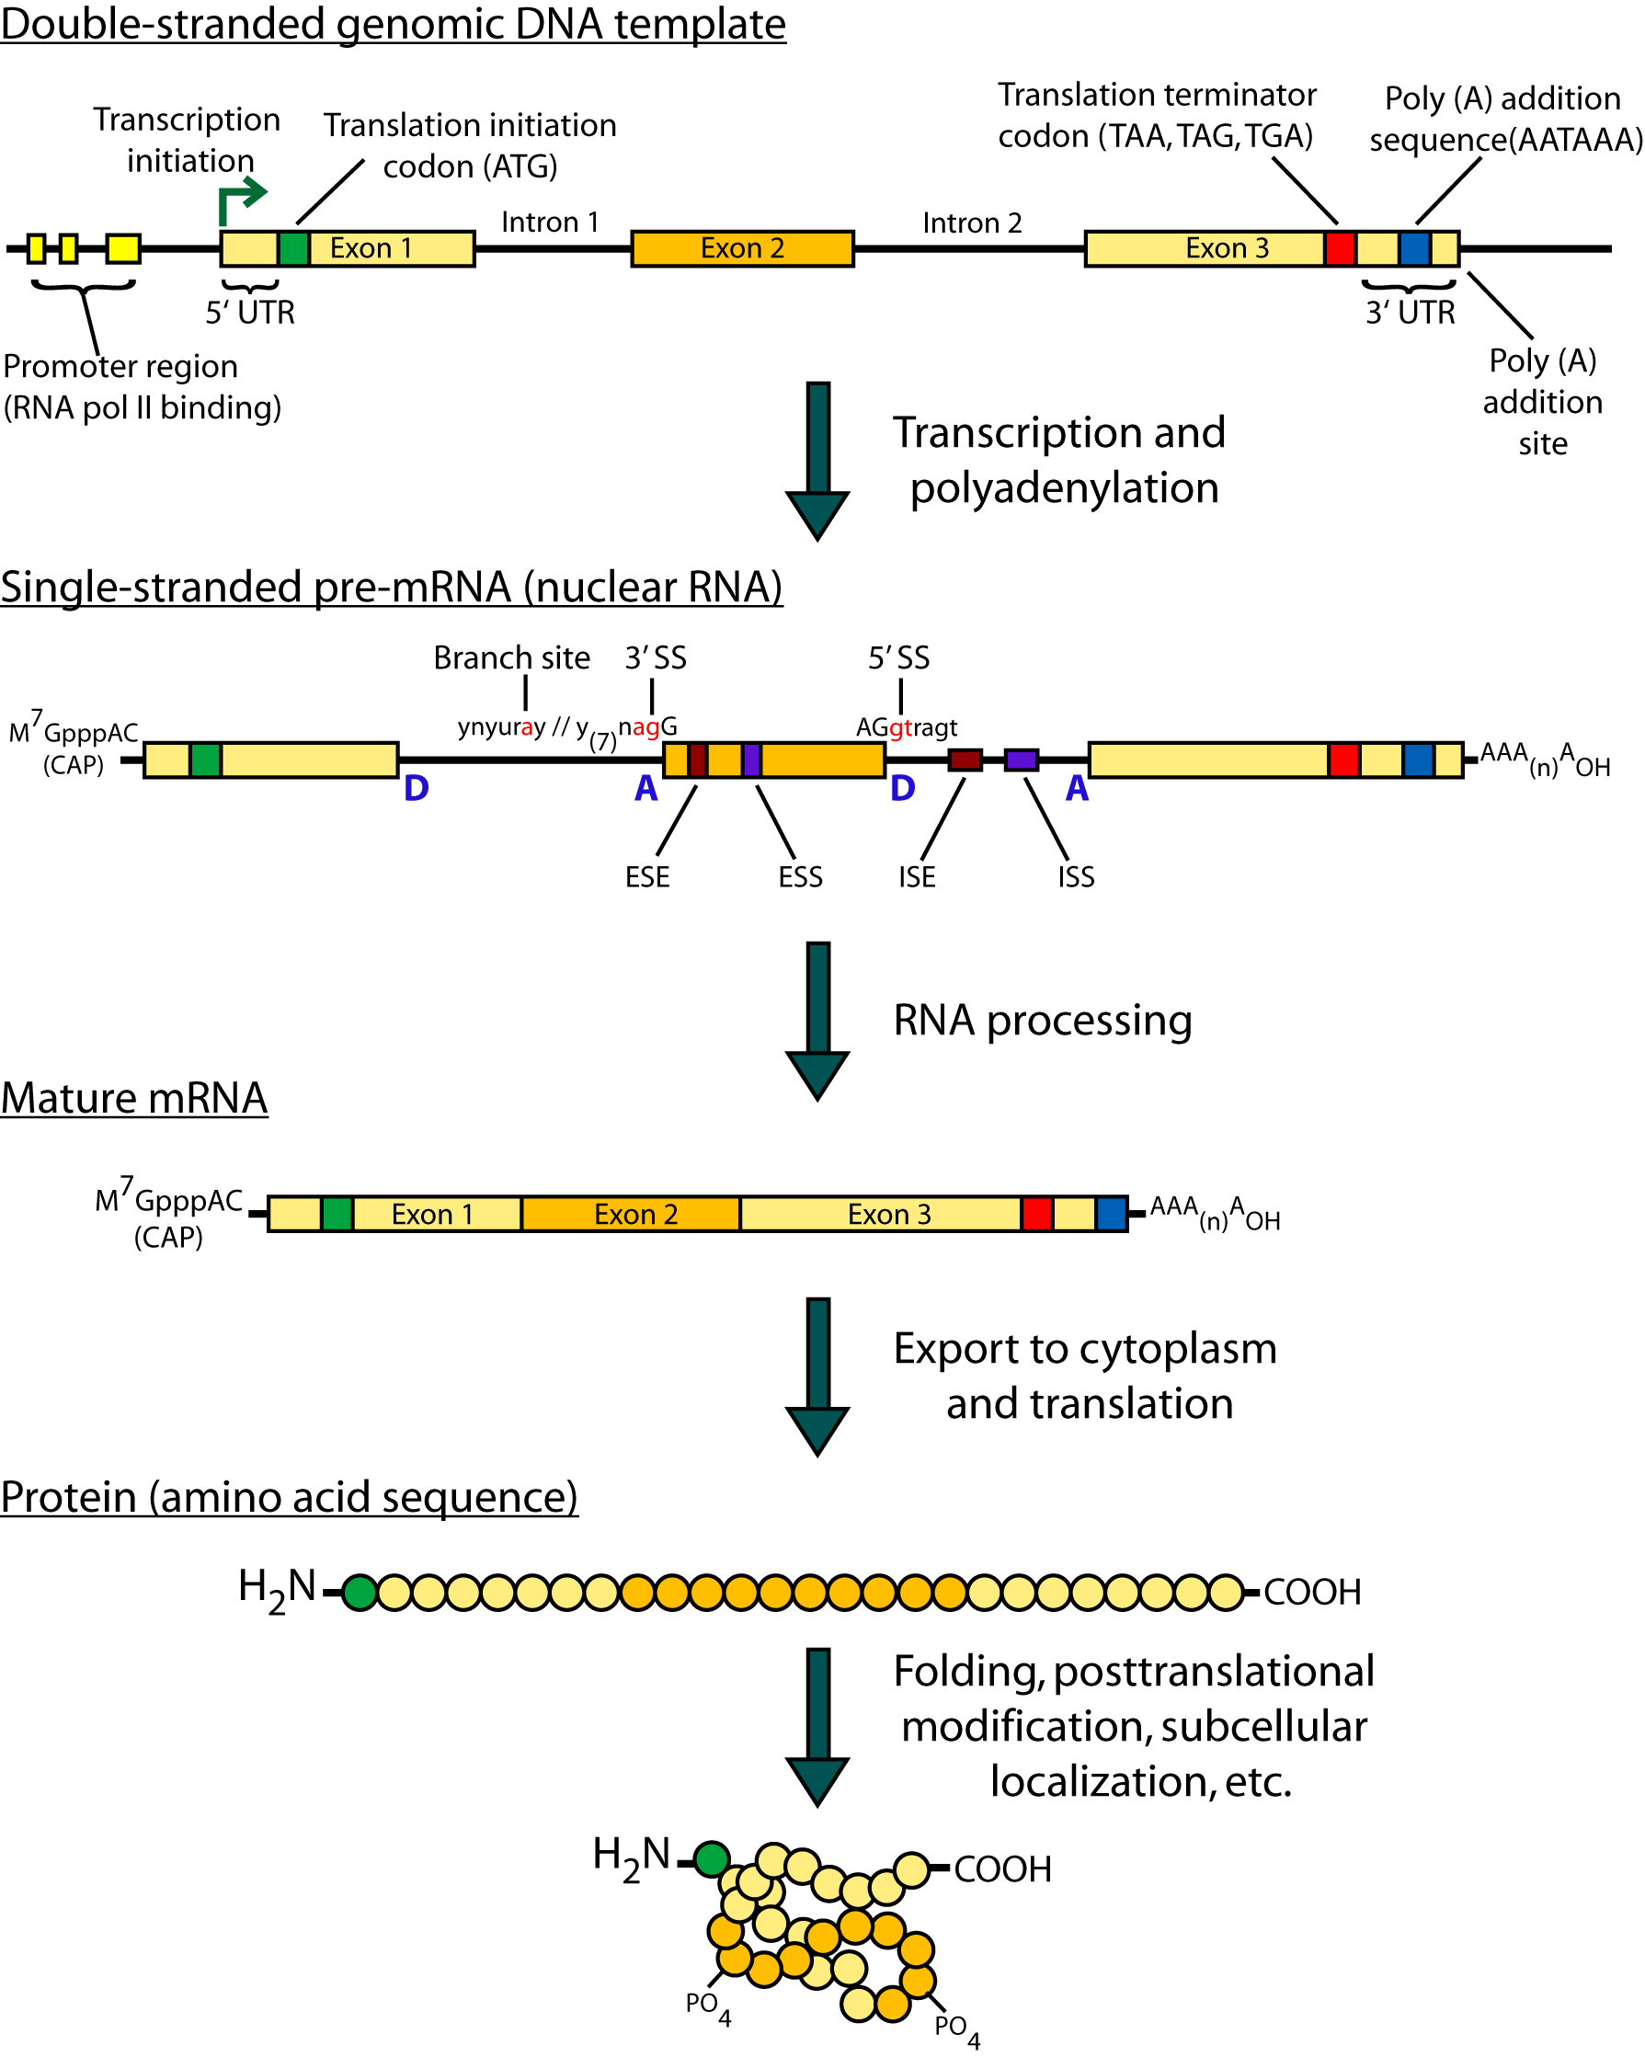
Gene expression

Slide 7
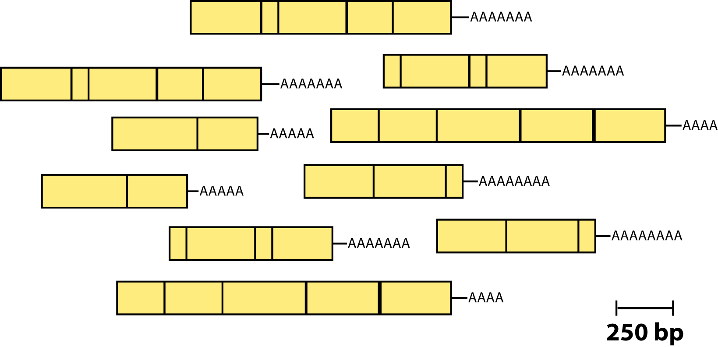
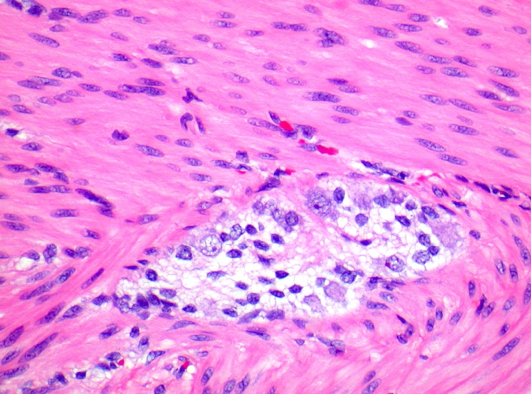
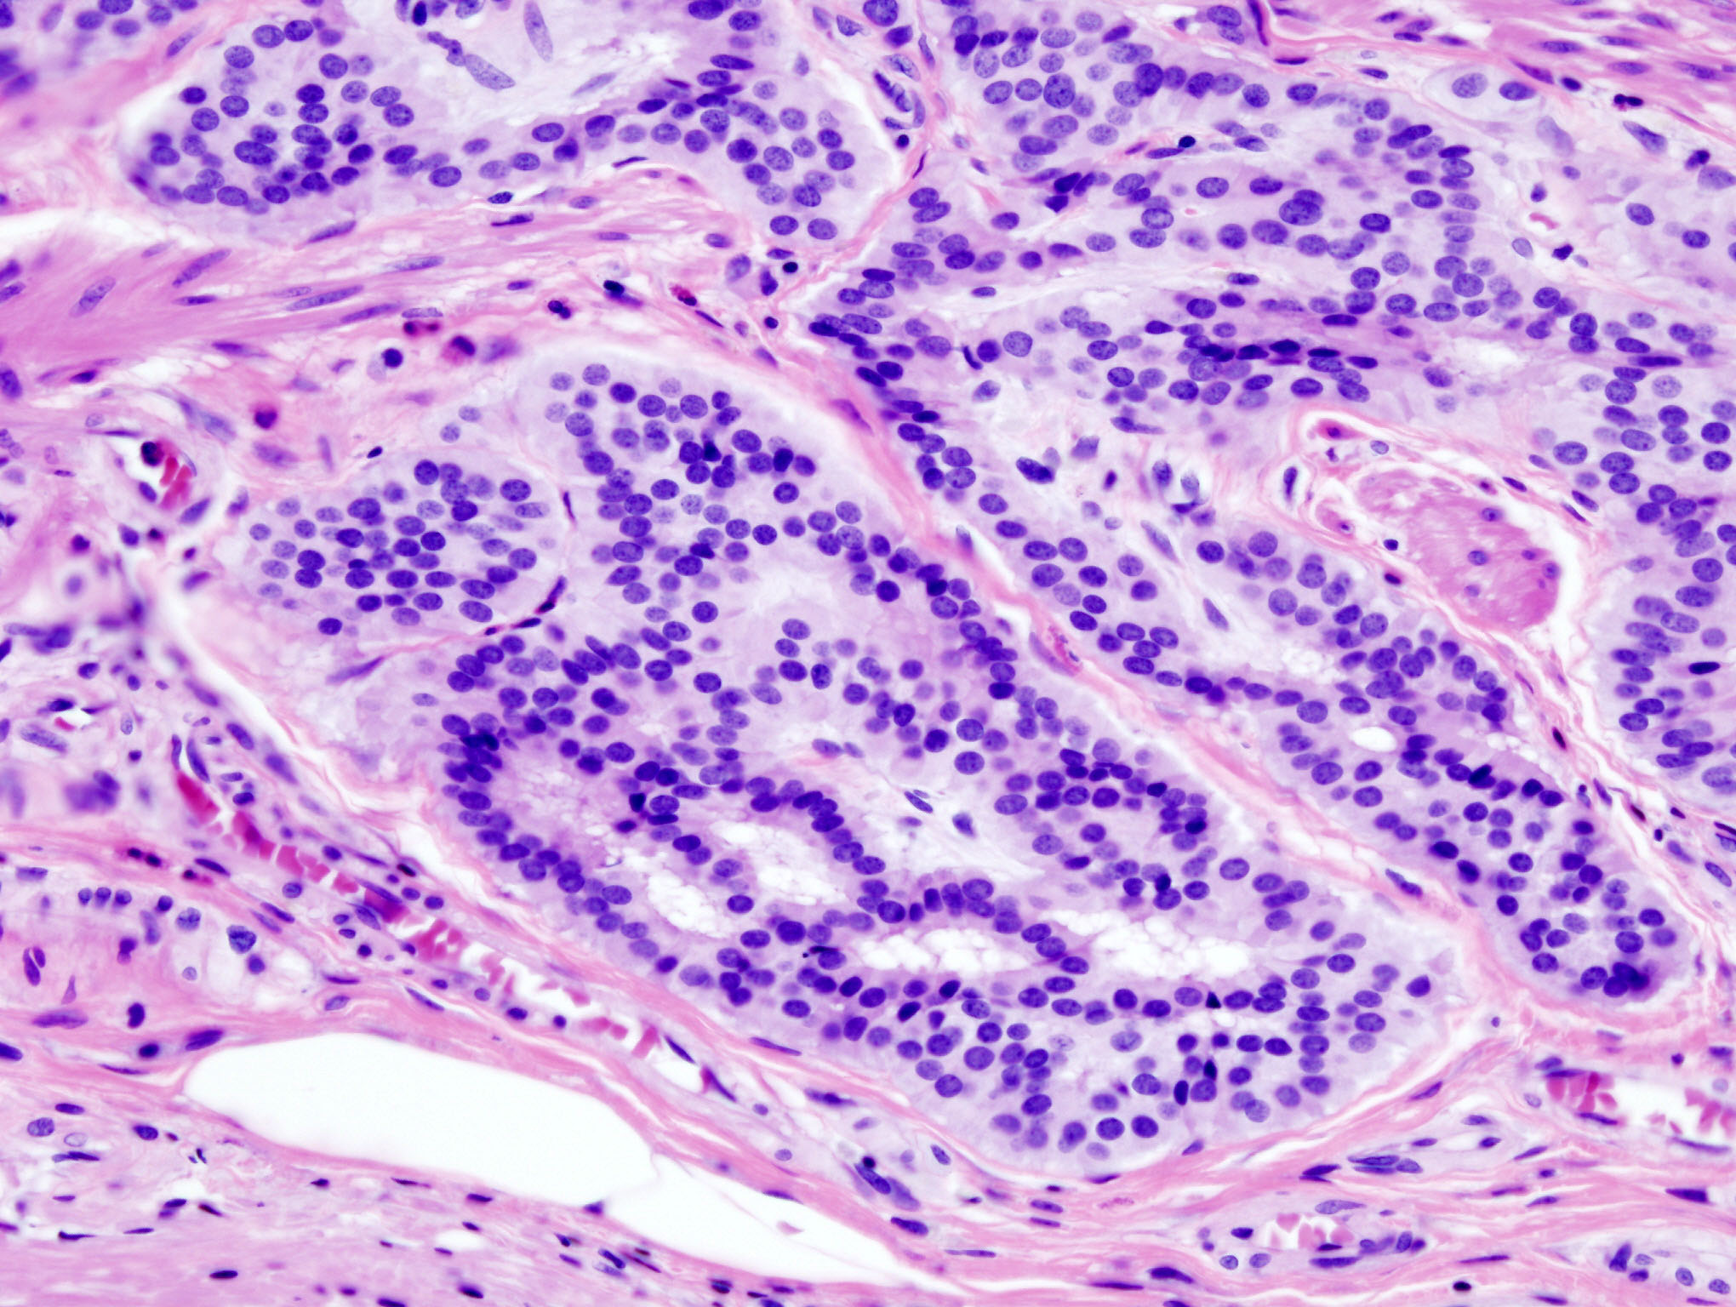
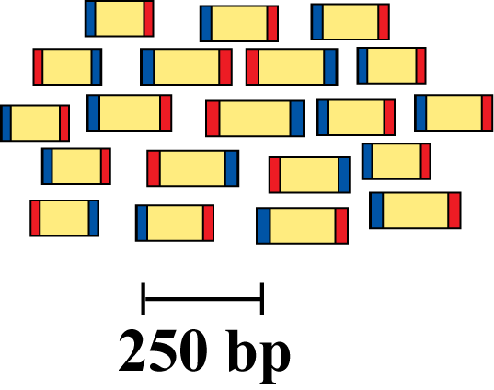
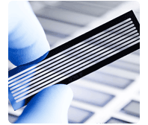
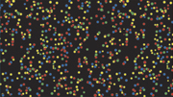
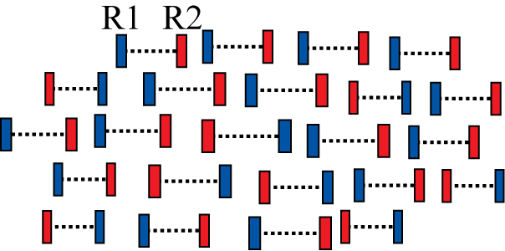
RNA sequencing
Isolate RNAs
Generate cDNA, fragment, size select, add linkers
Samples of interest
Condition 1
(normal colon)
Condition 2
(colon tumor)
Sequence ends
Map to genome, transcriptome, and predicted exon junctions
100s of millions of paired reads
10s of billions bases of sequence
Downstream analysis

Slide 8
Why sequence RNA (versus DNA)?
Functional studies
  Genome may be constant but an experimental condition has a pronounced effect on gene expression
    e.g. Drug treated vs. untreated cell line
    e.g. Wild type versus knock out mice
Some molecular features can only be observed at the RNA level
  Alternative isoforms, fusion transcripts, RNA editing
Predicting transcript sequence from genome sequence is difficult
  Alternative splicing, RNA editing, etc.

Slide 9
Why sequence RNA (versus DNA)?
Interpreting mutations that do not have an obvious effect on protein sequence
  ‘Regulatory’ mutations that affect what mRNA isoform is expressed and how much
    e.g. splice sites, promoters, exonic/intronic splicing motifs, etc.
Prioritizing protein coding somatic mutations (often heterozygous)
  If the gene is not expressed, a mutation in that gene would be less interesting
  If the gene is expressed but only from the wild type allele, this might suggest loss-of-function (haploinsufficiency)
  If the mutant allele itself is expressed, this might suggest a candidate drug target

Slide 10
Challenges
Sample
  Purity?, quantity?, quality?
RNAs consist of small exons that may be separated by large introns
  Mapping reads to genome is challenging
The relative abundance of RNAs vary wildly
  10⁵ – 10⁷ orders of magnitude
  Since RNA sequencing works by random sampling, a small fraction of highly expressed genes may consume the majority of reads
  Ribosomal and mitochondrial genes
RNAs come in a wide range of sizes
  Small RNAs must be captured separately
  PolyA selection of large RNAs may result in 3’ end bias
RNA is fragile compared to DNA (easily degraded)

Slide 11
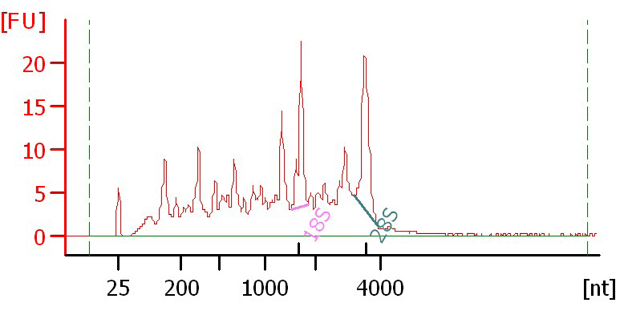
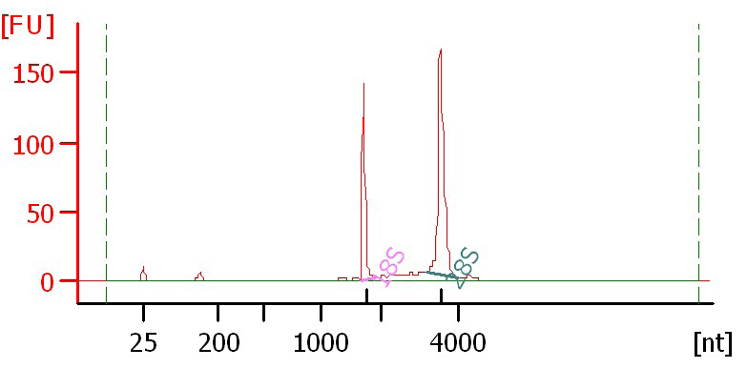
Agilent example / interpretation
http://www.alexaplatform.org/courses/2013/cbw/Agilent_Trace_Examples.pdf
‘RIN’ = RNA integrity number
  0 (bad) to 10 (good)
RIN = 6.0
RIN = 10

Slide 12
Design considerations
Standards, Guidelines and Best Practices for RNA-seq
  The ENCODE Consortium
  Download from the Course Wiki
  Meta data to supply, replicates, sequencing depth, control experiments, reporting standards, etc.
http://www.alexaplatform.org/courses/2013/cbw/ENCODE_RNAseq_standards_v1.0.pdf

Slide 13
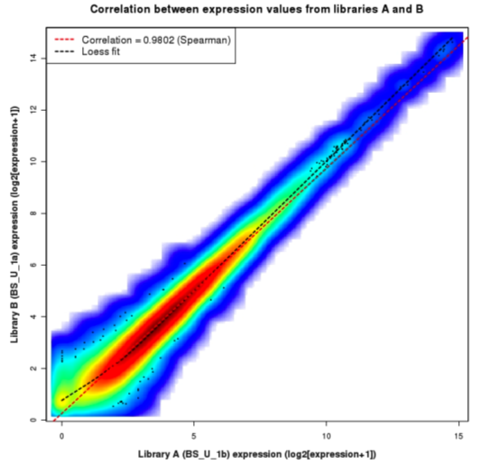
Replicates
Technical Replicate
  Multiple instances of sequence generation
    Flow Cells, Lanes, Indexes
Biological Replicate
  Multiple isolations of cells showing the same phenotype, stage or other experimental condition
  Some example concerns/challenges:
    Environmental Factors, Growth Conditions, Time
  Correlation Coefficient 0.92-0.98

Slide 14
Common analysis goals of RNA-Seq analysis (what can you ask of the data?)
Gene expression and differential expression
Alternative expression analysis
Transcript discovery and annotation
Allele specific expression
  Relating to SNPs or mutations
Mutation discovery
Fusion detection
RNA editing

Slide 15
General themes of RNA-seq workflows
Each type of RNA-seq analysis has distinct requirements and challenges but also a common theme:
Obtain raw data (convert format)
Align/assemble reads
Process alignment with a tool specific to the goal
  e.g. ‘cufflinks’ for expression analysis, ‘defuse’ for fusion detection, etc.
Post process
  Import into downstream software (R, Matlab, Cytoscape, Ingenuity, etc.)
Summarize and visualize
  Create gene lists, prioritize candidates for validation, etc.

Slide 16
Tool recommendations
Alignment
  BWA (PMID: 20080505)
    Align to genome + junction database
  Tophat (PMID: 19289445), STAR (PMID: 23104886), MapSplice (PMID: 20802226), hmmSplicer (PMID: 21079731)
    Spliced alignment to genome
Expression, differential expression alternative expression
  Cufflinks/Cuffdiff (PMID: 20436464), ALEXA-seq (PMID: 20835245), RUM (PMID: 21775302)
Fusion detection
  Tophat-fusion (PMID: 21835007), ChimeraScan (PMID: 21840877), Defuse (PMID: 21625565), Comrad (PMID: 21478487)
Transcript assembly
  Trinity (PMID: 21572440), Oases (PMID: 22368243), Trans-ABySS (PMID: 20935650)
Visit the ‘SeqAnswers’ or ‘BioStar’ forums for more recommendations and discussion
  http://seqanswers.com/
  http://www.biostars.org/
Notes:
To find the papers above using their PMID, go to PubMed and enter the ID in the search box
http://www.ncbi.nlm.nih.gov/pubmed

Slide 17
SeqAnswers exercise
Go to:
  http://seqanswers.com/
Click the ‘Wiki’ link
  http://seqanswers.com/wiki/SEQanswers
Visit the ‘Software Hub’
  http://seqanswers.com/wiki/Software
Browse the software that has been added
  http://seqanswers.com/wiki/Special:BrowseData
Use the tag cloud to identify tools related to your area of interest. e.g. RNA-seq alignment

Slide 18
Common questions: Should I remove duplicates for RNA-seq?
Maybe… more complicated question than for DNA
Concern.
  Duplicates may correspond to biased PCR amplification of particular fragments
  For highly expressed, short genes, duplicates are expected even if there is no amplification bias
  Removing them may reduce the dynamic range of expression estimates
Assess library complexity and decide…
If you do remove them, assess duplicates at the level of paired-end reads (fragments) not single end reads

Slide 19
Common questions: How much library depth is needed for RNA-seq?
Depends on a number of factors:
  Question being asked of the data. Gene expression? Alternative expression? Mutation calling?
  Tissue type, RNA preparation, quality of input RNA, library construction method, etc.
  Sequencing type: read length, paired vs. unpaired, etc.
  Computational approach and resources
Identify publications with similar goals
Pilot experiment
Good news: 1-2 lanes of recent Illumina HiSeq data should be enough for most purposes

Slide 20
Common questions: What mapping strategy should I use for RNA-seq?
Depends on read length
< 50 bp reads
  Use aligner like BWA and a genome + junction database
  Junction database needs to be tailored to read length
    Or you can use a standard junction database for all read lengths and an aligner that allows substring alignments for the junctions only (e.g. BLAST … slow).
  Assembly strategy may also work (e.g. Trans-ABySS)
> 50 bp reads
  Spliced aligner such as Bowtie/TopHat

Slide 21
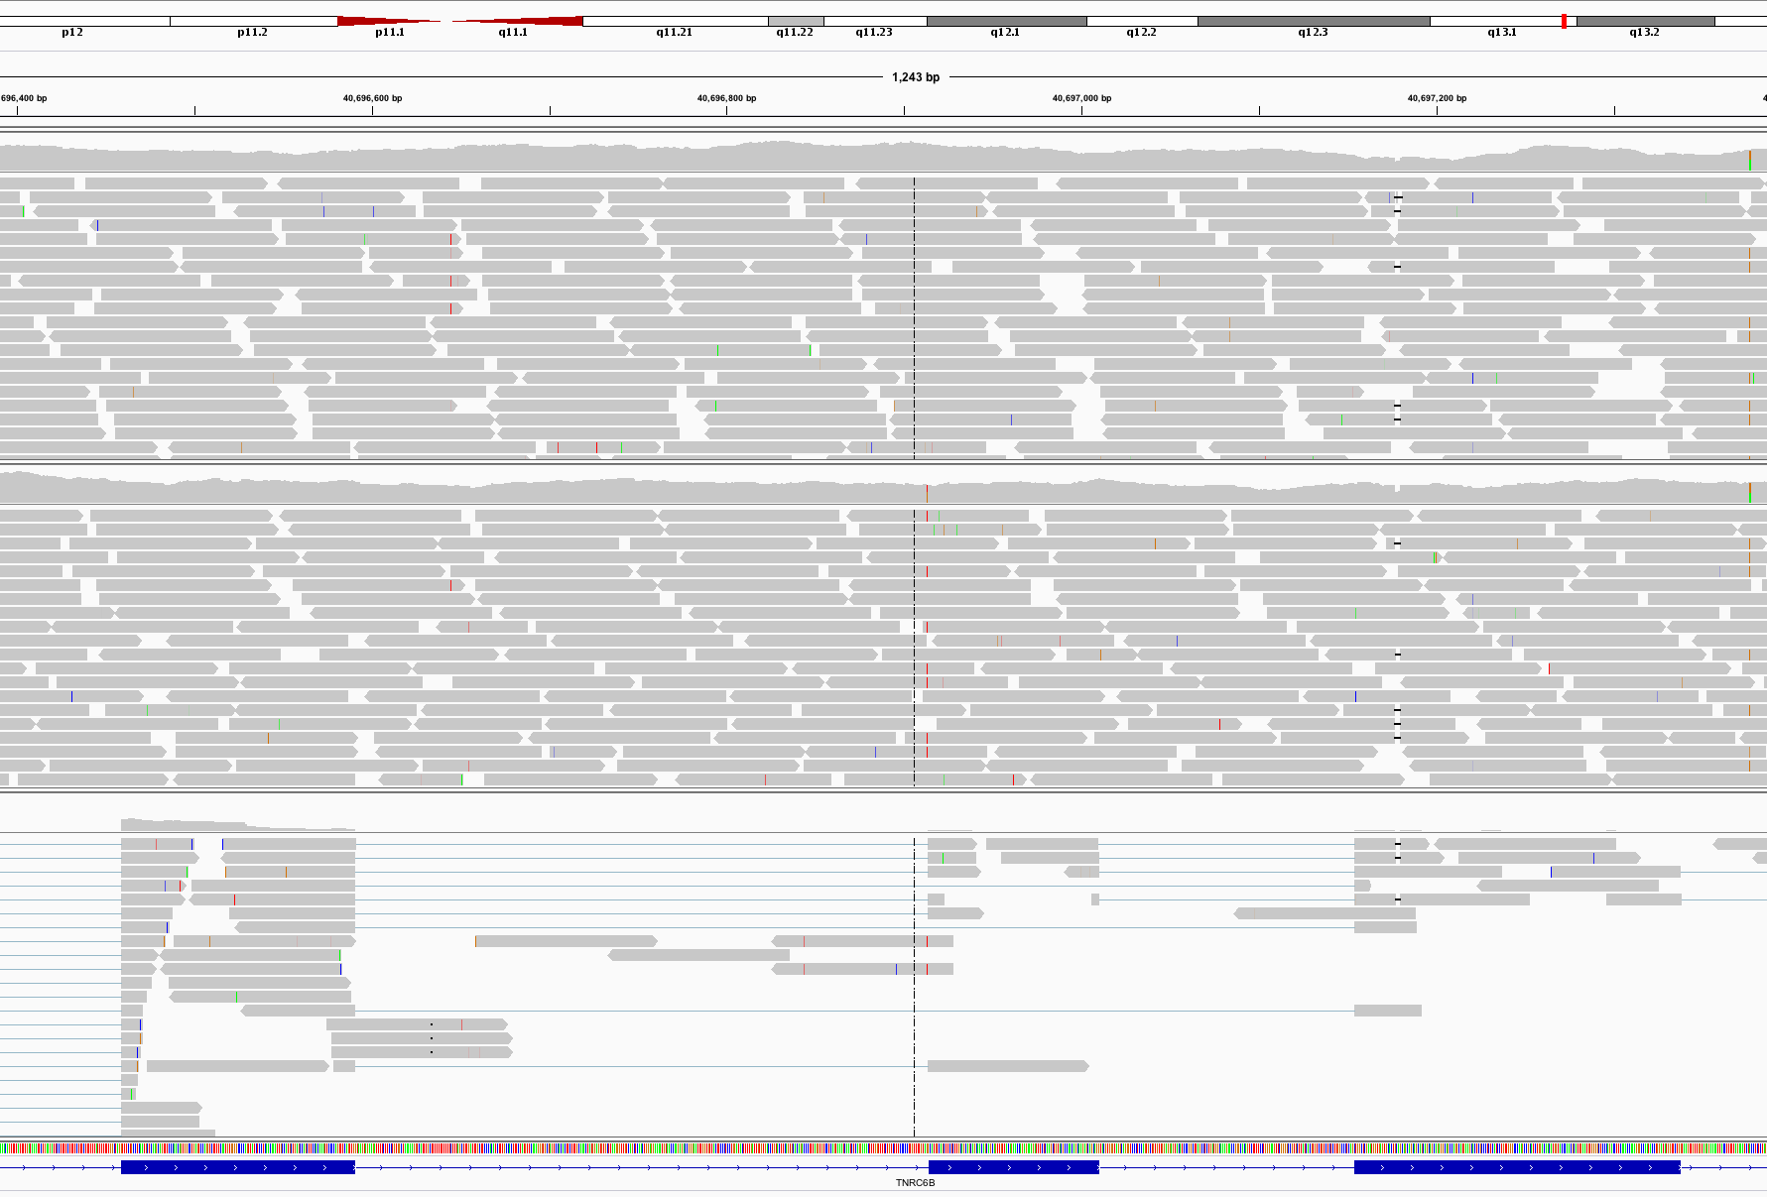
Visualization of spliced alignment of RNA-seq data
Normal WGS
Acceptor site mutation
Tumor WGS
IGV screenshot
Tumor RNA-seq

Slide 22
Common questions: how reliable are expression predictions from RNA-seq?
Are novel exon-exon junctions real?
  What proportion validate by RT-PCR and Sanger sequencing?
Are differential/alternative expression changes observed between tissues accurate?
  How well do DE values correlate with qPCR?
384 validations
  qPCR, RT-PCR, Sanger sequencing
See ALEXA-Seq publication for details:
  Also includes comparison to microarrays
  Griffith et al. Alternative expression analysis by RNA sequencing. Nature Methods. 2010 Oct;7(10):843-847.

Slide 23
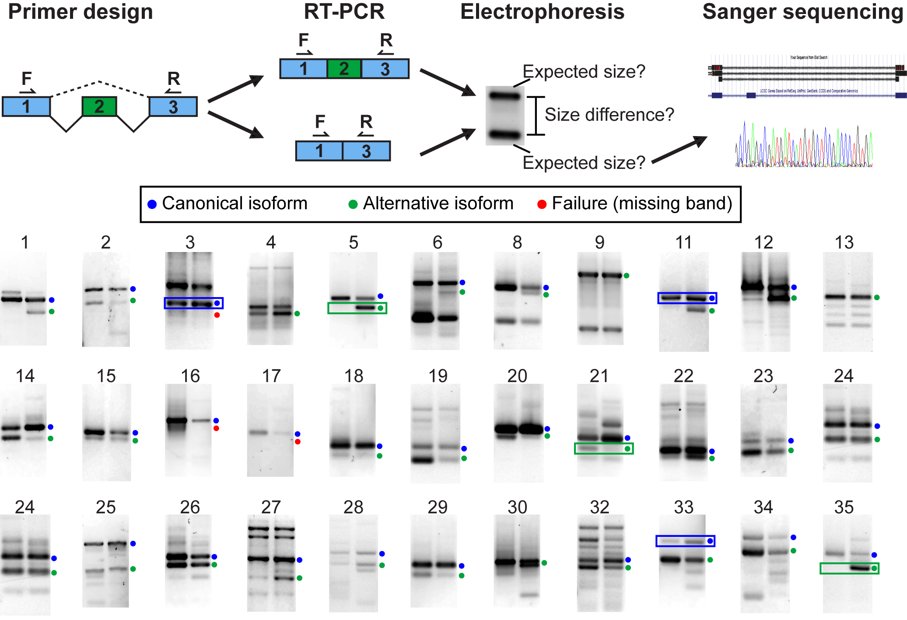
Validation (qualitative)
33 of 192 assays shown. Overall validation rate = 85%

Slide 24
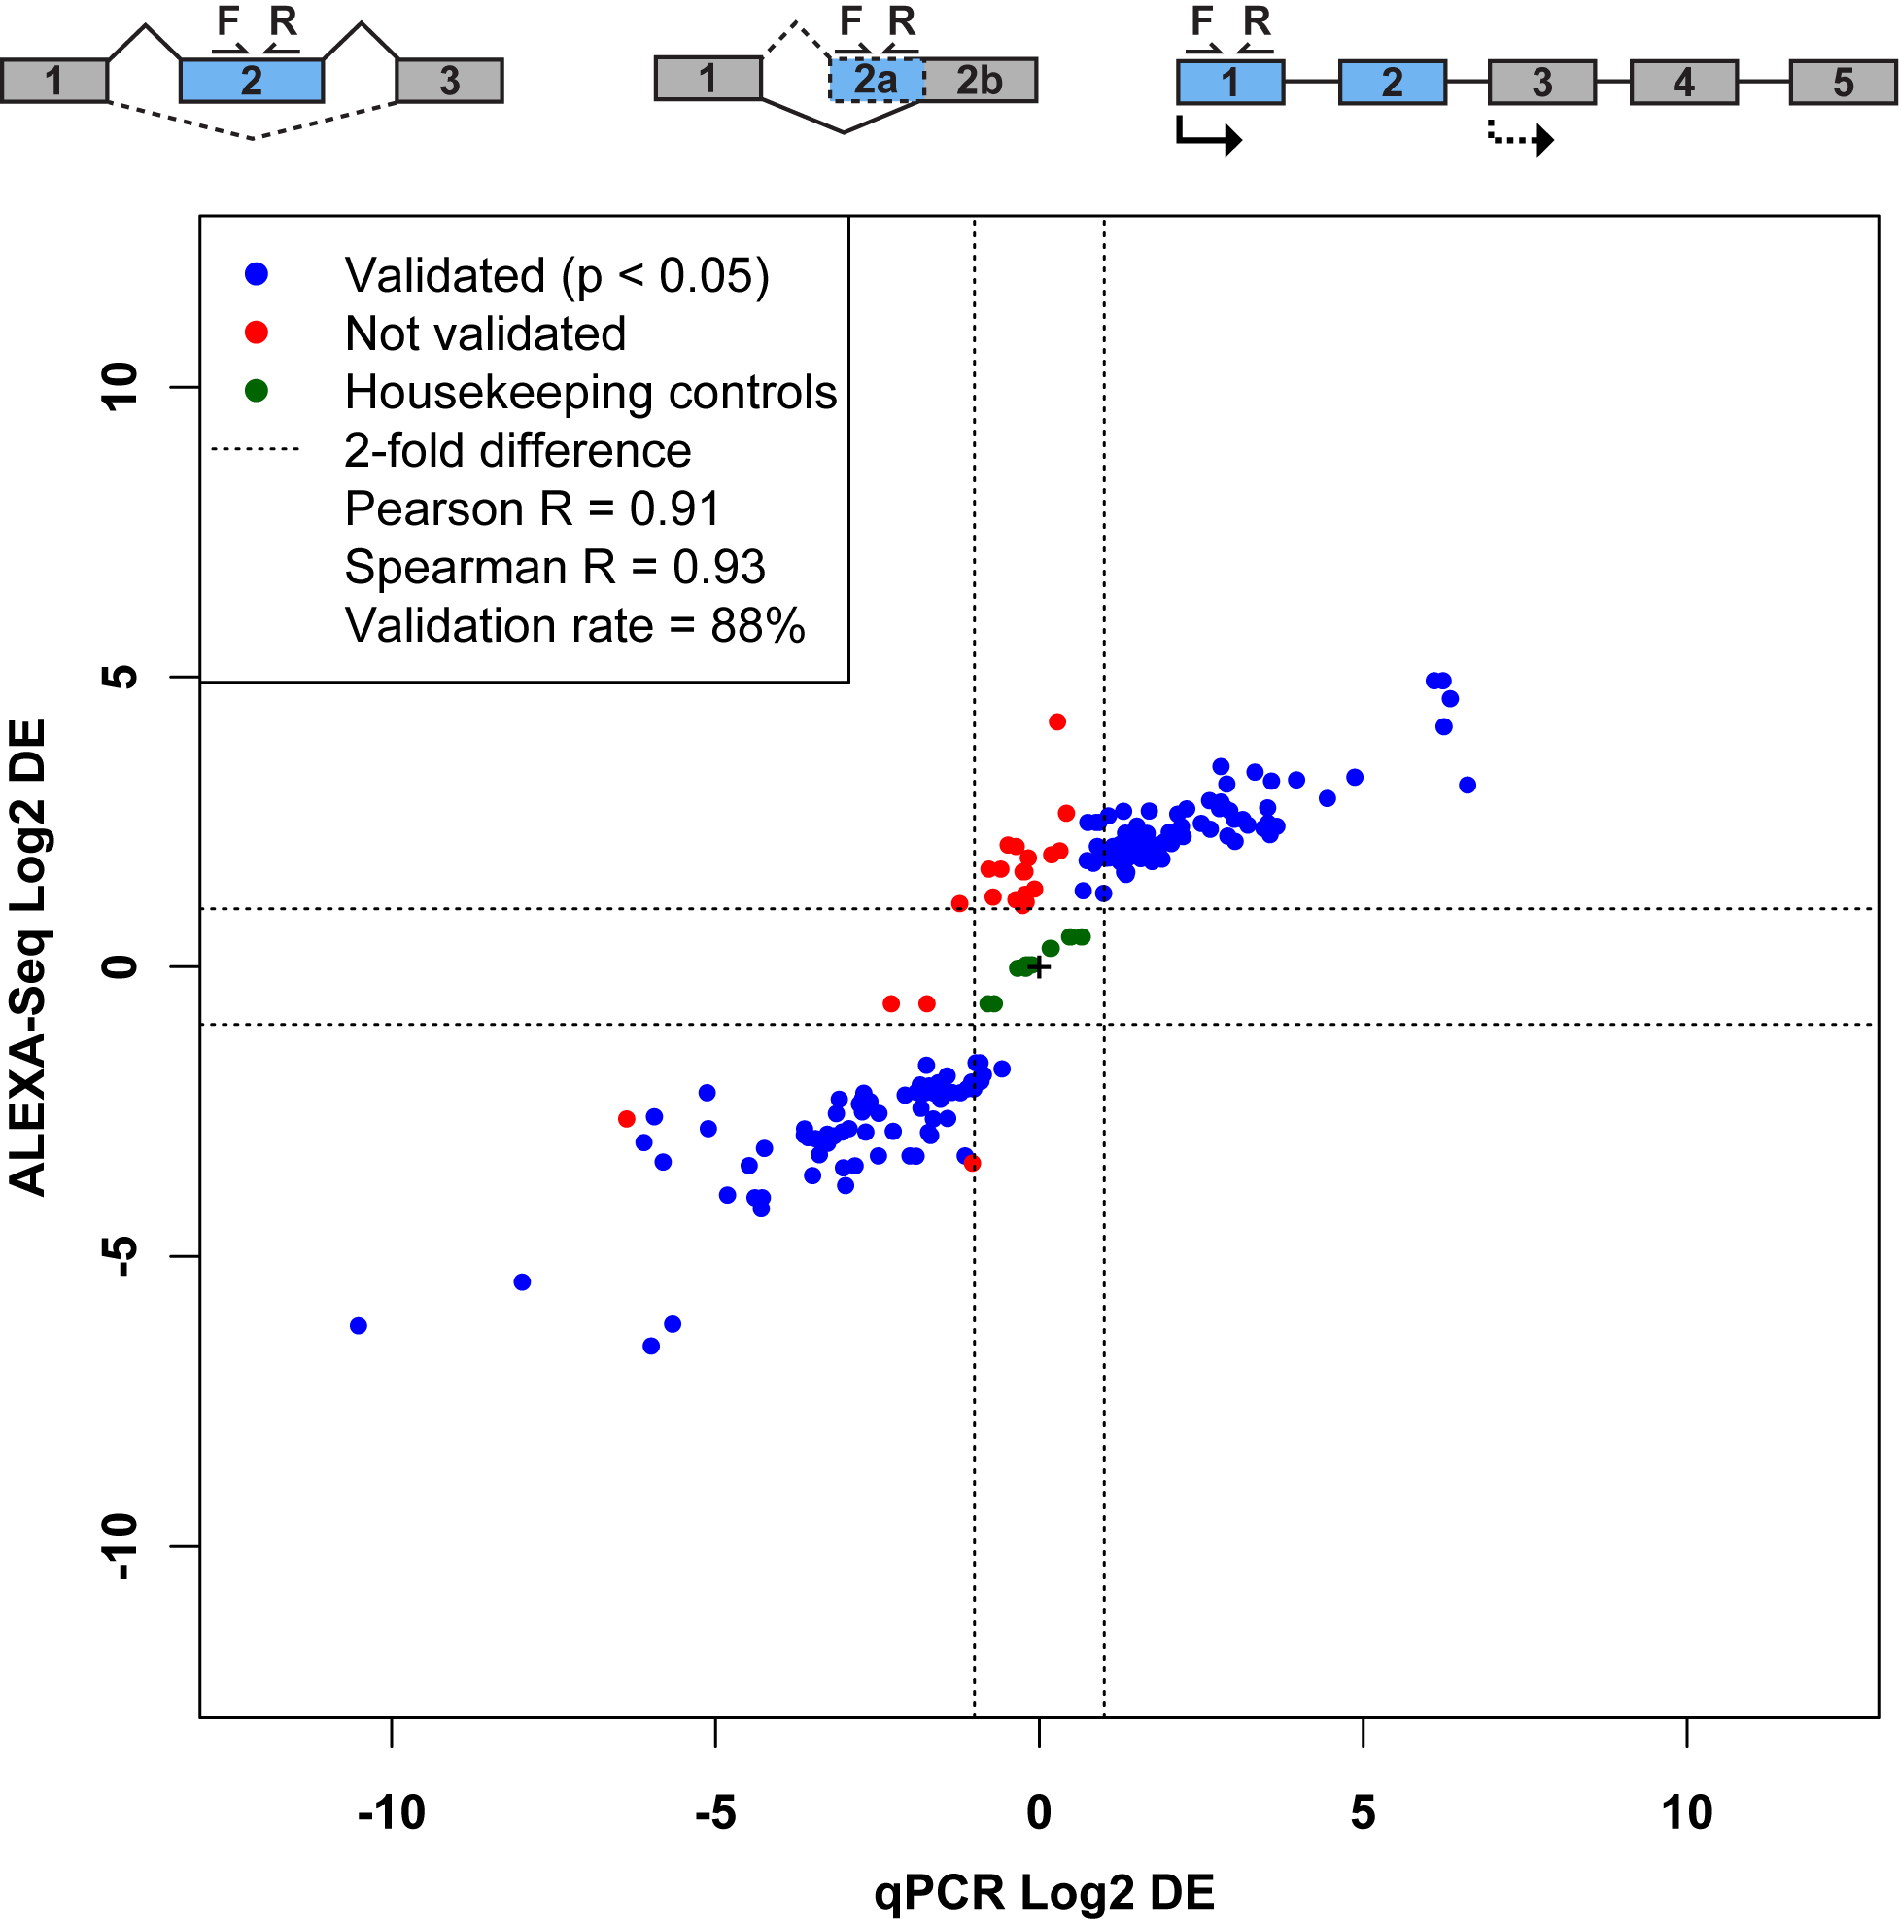
Validation (quantitative)
qPCR of 192 exons identified as alternatively expressed by ALEXA-Seq
Validation rate = 88%

Slide 25
BioStar exercise
Go to the BioStar website:
  http://www.biostars.org/
  If you do not already have an OpenID (e.g. Google, Yahoo, etc.)
  Login -> ‘get one’
Login and set up your user profile
Tasks:
  Find a question that seems useful and ‘vote it up’
  Answer a question [optional]
  Search for a topic area of interest and ask a question that has not already been asked [optional]

Slide 26
Introduction to tutorial
(Module 1)

Slide 27
Bowtie/Tophat/Cufflinks/Cuffdiff
RNA-seq Pipeline
Sequencing
Read alignment
Transcript compilation
Gene identification
Differential expression
RNA-seq reads (2 x 100 bp)
Bowtie/TopHat alignment (genome)
Cufflinks
Cufflinks (cuffmerge)
Cuffdiff
(A:B comparison)
Raw sequence data
(.fastq files)
Reference genome
(.fa file)
Gene annotation
(.gtf file)
CummRbund
Inputs
Visualization

Slide 28
Bowtie/Tophat/Cufflinks/Cuffdiff
RNA-seq Pipeline
Sequencing
Read alignment
Transcript compilation
Gene identification
Differential expression
RNA-seq reads (2 x 100 bp)
Bowtie/TopHat alignment (genome)
Cufflinks
Cufflinks (cuffmerge)
Cuffdiff
(A:B comparison)
Raw sequence data
(.fastq files)
Reference genome
(.fa file)
Gene annotation
(.gtf file)
CummRbund
Inputs
Visualization
Module 1

Slide 29
We are on a coffee break & networking session

