Slide 1
NGS data analysis in R
Biostrings and Shortread
Stacy Xu
BD

Slide 2
NGS analysis
Sequencing analysis
  Functionally
    String manipulations
    NGS formats (sequences, intervals)
    Statistical model testing
    Graphical data representation
  Knowledgably
    Large amount of raw data sets
    Large amount of annotations
    Database connections

Slide 3
NGS related bioconductor packages
String and interval packages
  Biostrings (Herve Pages)
    Biological string objects & Matching algorithms
  GenomicRanges (P. Aboyoun)
    Genomic intervals representation
  Rsamtools (Martin Morgan)
    Wrap of samtools, bcftools, tabix
  ShortRead (Martin Morgan)
    HT short-read sequences
  girafe (J. Toedling)
    Genomic intervals and read alignments
Annotations
  GenomicFeatures (M. Carlson)
    Transcript centric annotations from UCSC & BioMart
  BSgenomes (Herve Pages)
    Biostrings-based genome annotations
  rtracklayer (Michael Lawrence)
    Genome browsers and their annotation tracks

Slide 4
NGS work flow
Biological sample/library preparation
Sequencing process
Sequence alignment
Data interpretation
  Input sequencing data
    Fasta (sequence) & fastq (sequence + qual) files
    BAM & SAM files (reads with header, alignments and references)
  Analysis
    QA, alignment, coverage, identification, etc
Data representation
  Plotting coverage, quality, etc

Slide 5
BioStrings
--Genomic data retrieval
  Load from BSgenome
    library(BSgenome)
    available.genomes()
  Download related files from NCBI
    .fna files (whole genomic sequence)
    .rnt files (rna positions)
    .faa files (protein sequences in fasta format)
    .ffn files (protein coding portions)
    .frn files (rna coding portions)
    .gbk files (genome, genbank file format )
    .gff files (genome features)

Slide 6
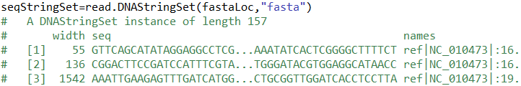

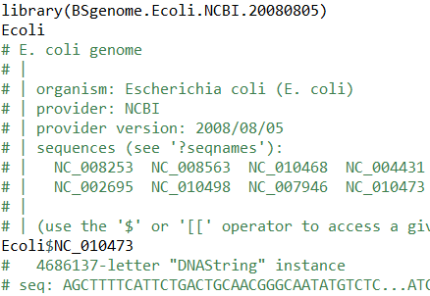
Biostrings
--Create objects
Containers
  XString – DNA, RNA, AA
  XStringSet – multiple sequences
  XStringViews
Create from
fasta file
Create from
scratch
Load from
packages

Slide 7
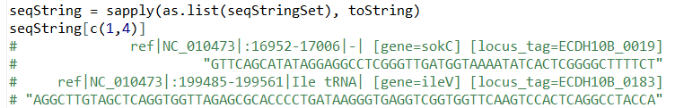
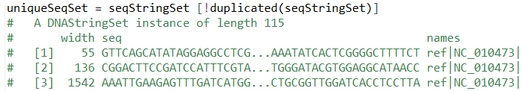
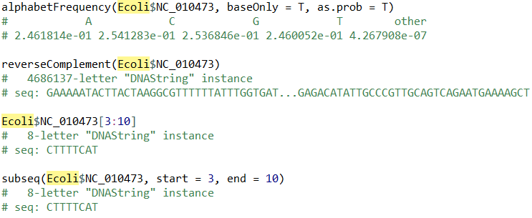
Biostrings
--Basic functions
String manipulations
Base manipulations

Slide 8
BioStrings
--Pattern matching methods
(v)matchPDict
  Match one or more patterns with one or more strings – not with indels, allow mismatches
(v)matchPattern
  Match one pattern with one or more strings – with indels, allow mismatches
pairwiseAlignment
  Align two sequences – with indels
matchPWM
  Position specific matrix matching for motif matching
matchProbePair
  Primer pair matching – not allow mismatches

Slide 9
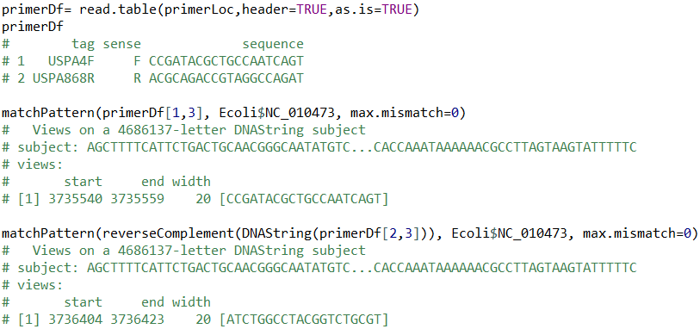
BioStrings
-- Pattern matching examples

Slide 10
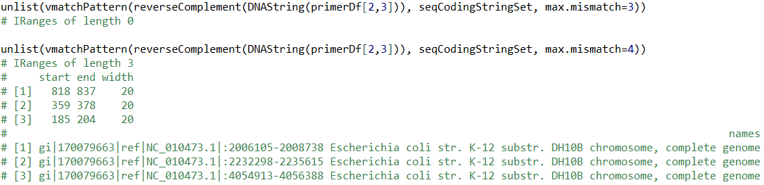
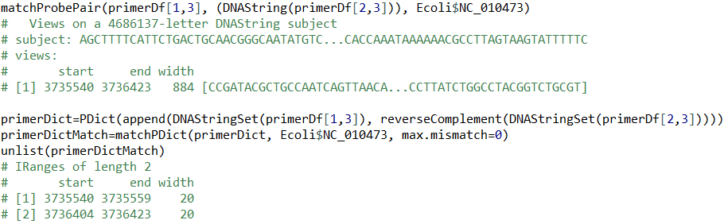
BioStrings
-- Pattern matching examples

Slide 11
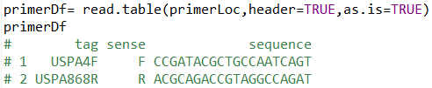
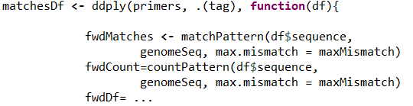

BioStrings
--Pattern matching examples
Primer pair matching

Slide 12
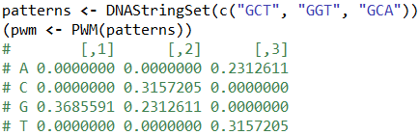
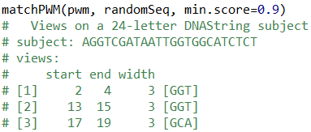
BioStrings
--Pattern matching examples
Motif matching

Slide 13



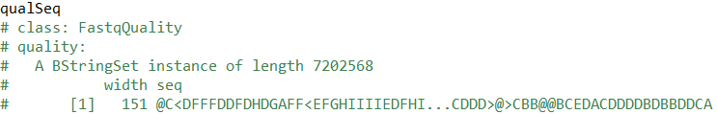
ShortRead
--Load sequencing data
library(ShortRead)
fastq = readFastq(fastqFile)
seqID = id(fastq)
seqs = sread(fastq)
qualSeq = quality(fastq)
totalReads = length(fastq)
# [1] 7202568

Slide 14
ShortRead
--Bam header
bam = scanBam(bamLoc)[[1]]
names(bam)
# [1] "qname" "flag" "rname" "strand" "pos" "qwidth" "mapq" "cigar"
# [9] "mrnm" "mpos" "isize" "seq" "qual”
scanBamHeader(bamLoc)
# $`C:\MiSeq_Ecoli_DH10B_110721_PF.bam`
# $`C:\MiSeq_Ecoli_DH10B_110721_PF.bam`$targets
# EcoliDH10B.fa
# 4686137
#
# $`C:\MiSeq_Ecoli_DH10B_110721_PF.bam`$text
# $`C:\MiSeq_Ecoli_DH10B_110721_PF.bam`$text$`@HD`
# [1] "VN:1.3" "SO:coordinate“
#
# $`C:\MiSeq_Ecoli_DH10B_110721_PF.bam`$text$`@PG`
# [1] "ID:Illumina.SecondaryAnalysis.SortedToBamConverter“
#
# $`C:\MiSeq_Ecoli_DH10B_110721_PF.bam`$text$`@SQ`
# [1] "SN:EcoliDH10B.fa" "LN:4686137“
# [3] "M5:28d8562f2f99c047d792346835b20031“
#
# $`C:\MiSeq_Ecoli_DH10B_110721_PF.bam`$text$`@RG`
# [1] "ID:_5_1" "PL:ILLUMINA" "SM:DH10B_Sample1"

Slide 15
ShortRead
--Retrieve information from bam files
cseq = as.character(bam$seq)
cig = bam$cigar
head(cig, 2)
# [1] "150M" "150M"
qual = bam$qual
head(qual, 2)
# A PhredQuality instance of length 6
# width seq
# [1] 150 @@CDFFFFHHHHHJJJJIJJJJJJJJJJIJIJFI...DDD>CDCCDCDDEDDDDDCDCD@CCDCDCCCDD
# [2] 150 A?34(@:C>:4CCC@CA9&)&0((34:4(4(33+...BFA3C,IHHFFA<GIF@GAEFBFHDDDADD??@
qname = bam$qname
head(qname, 2)
# [1] "_5:1:1:23848:21362" "_5:1:9:8728:9854"
rname = as.character(bam$rname)
head(rname, 2)
# [1] EcoliDH10B.fa EcoliDH10B.fa

Slide 16
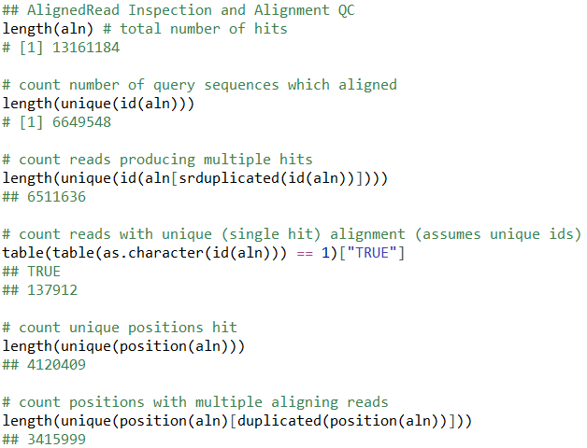

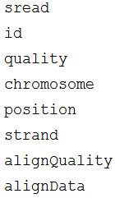
ShortRead
--BAM QC
aln = readAligned(bamLoc, type="BAM")

Slide 17
ShortRead
--Filter fastq reads
filter1 <- nFilter(threshold=3) # keep only reads with fewer than 3 Ns
filter2 <- polynFilter(threshold=20, nuc=c("A", "C", "T", "G")) # remove reads with 20 or more of the same letter
filter <- compose(filter1, filter2) # Combine filters into one
filteredReads <- fastq[filter(seqs)] # apply filter to sequences, and use this to remove "bad" reads
writeFastq(filteredReads, outputFile)

Slide 18
Summary
R contains the basic facilities that is needed for NGS analysis
Fast string manipulation functions are enabled in R
For large NGS experiments, other software with faster speed would be preferred
R is great tool for statistical summaries

Slide 19
References
Patrick Aboyoun, Sequence Alignment of Short Read Data using Biostrings, Nov 2009
Martin, Morgan etc, High-throughput sequence analysis with R and Bioconductor, Aug, 2011
Bioconductor at http://bioconductor.org
Part of the R code was derived from Perry Haaland and Frances Tong’s work at BD, Technologies
The part of PWM matching and bam QC comes from http://manuals.bioinformatics.ucr.edu/home/ht-seq#TOC-Biostrings

