Slide 1
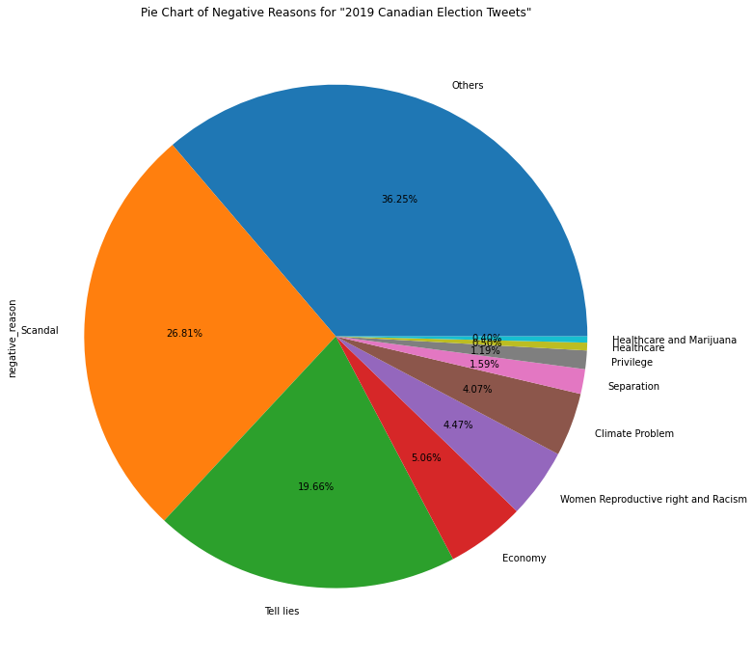
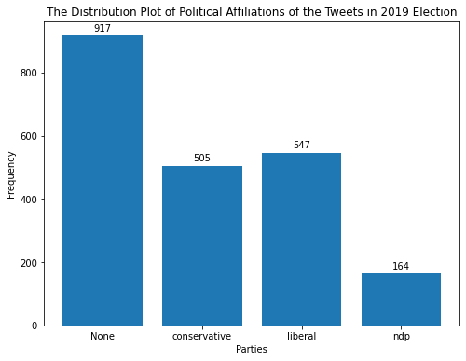
Findings from Exploratory analysis – Data set Structure
There are 917 (42.99%) tweets not related to the three major parties . Among the three major parties, "Liberal Party" is mentioned in 547 (25.64%) tweets while "Conservative Party" is slightly less popular than "Liberal Party" with 505 (23.68%) tweets. NDP is mentioned less than others, with 164 tweets (7.69%).
As shown in the pie chart, despite 36.25% reason from "others", the major reason for tweets been negative in 2019 Canadian election is "Scandal" which occupies 26.81% and "Tell Lies" which occupies 19.66%.

Slide 2
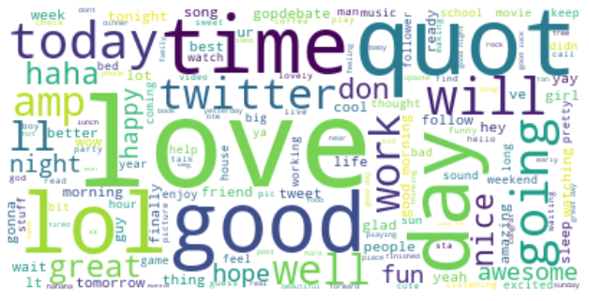
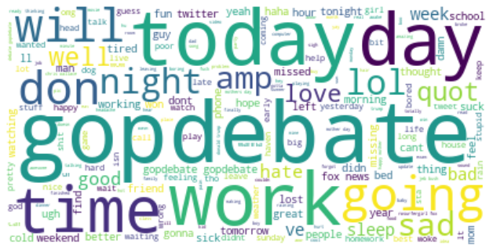
Positive Word Cloud
Keywords
Love
Good
LOL
haha
Nice
Negative Word Cloud
Keywords
gopdebate
work
sad
sick
hate

Slide 3
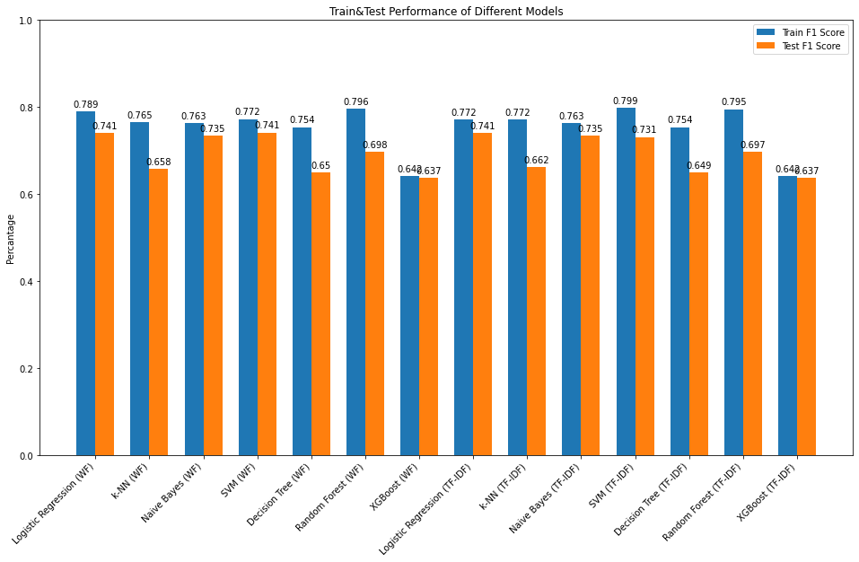
Compare the Performance between Different Models
Perform Best:
Logistic Regression
SVM
Naïve Bayes

Slide 4
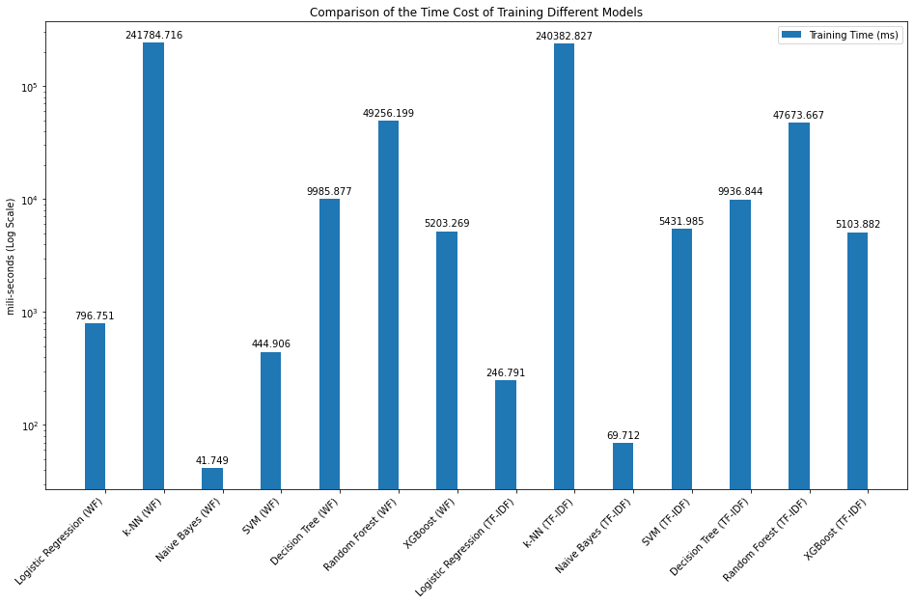
Compare the Time Cost of Training Different Models
Perform Best:
Naïve Bayes
Logistic Regression
SVM

Slide 5
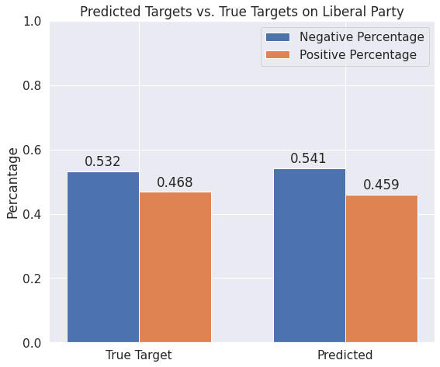
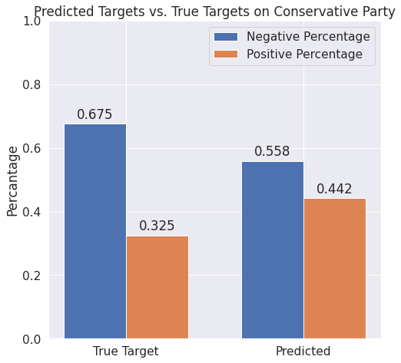
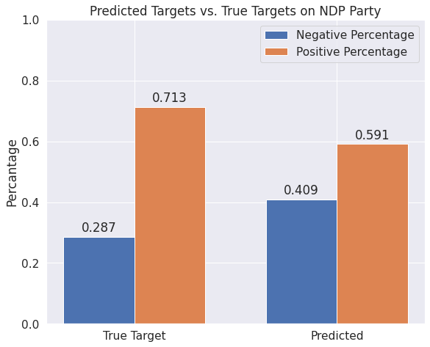
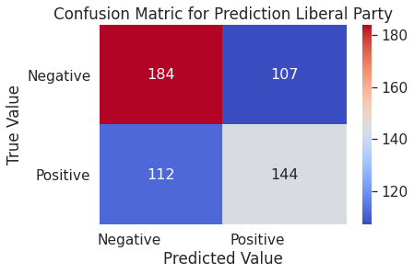
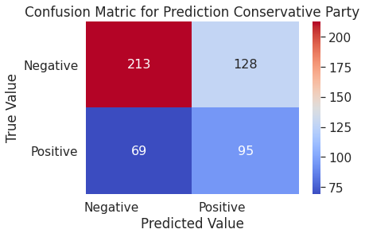
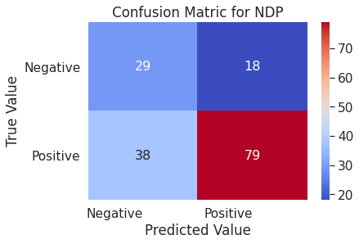
Liberal vs. Conservative vs. NDP

