Slide 1

Credit Card Fraud Detection
STAT101 Loser

Slide 2
Data Exploaration
Very imbalanced dataset – need some re-sampling
Undersampling
Oversampling
Two types of features
Numerical features—used in model
Non-numerical features
City
User Agent
Card credit for fraud transactions
FLAG Analysis
Transaction Fraud Rate, Fraud Amount Comparison, # of Fraud Transactions

Slide 3
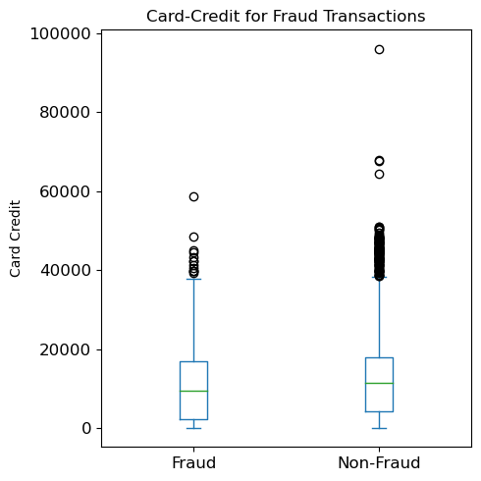
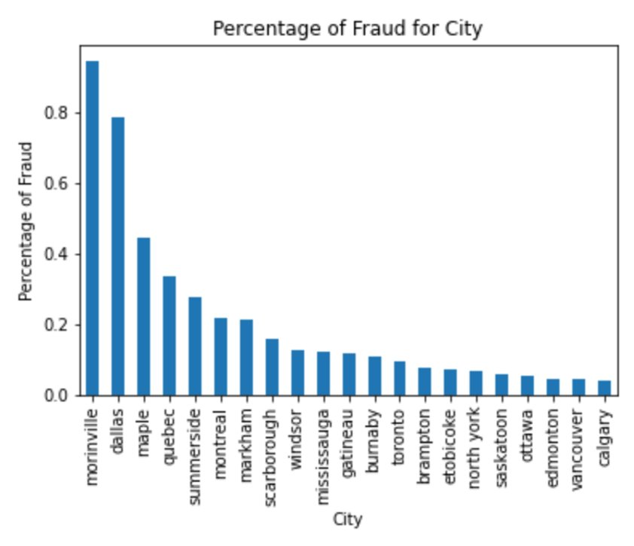
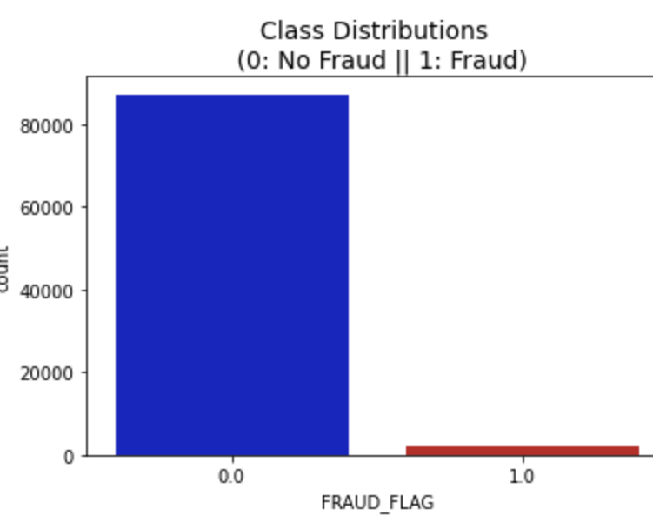

Slide 4
Transaction Fraud Rate
FRAUD_FLAG | Non-Fraud | Fraud
FLAG_INTERNATIONAL | 84.45% | 15.55%
FLAG_CASH | 87.22% | 12.78%
FLAG_ATM | 87.30% | 12.70%
FLAG_RISKY | 88.05% | 11.95%
FLAG_INTERNET | 88.89% | 11.11%
FLAG_ELCTRNCS | 95.23% | 4.77%
FLAG_HIGH_AMT | 95.40% | 4.60%
FLAG_JEWELRY | 95.89% | 4.11%
FLAG_AUTO | 96.32% | 3.68%
FLAG_DISCOUNT | 96.89% | 3.11%
FLAG_REG_AMT | 97.57% | 2.43%
FLAG_MANUAL_ENTRY | 97.91% | 2.09%
FLAG_PHONE_ORDER | 98.00% | 2.00%
FLAG_WEEKEND | 98.30% | 1.70%
FLAG_GAS | 98.39% | 1.61%
FLAG_PURCHASE_EXCLUDING_GAS | 98.41% | 1.59%
FLAG_SWIPE | 98.48% | 1.52%
FLAG_LS | 98.64% | 1.36%
FLAG_LOW_AMT | 98.81% | 1.19%
FLAG_FASTFOOD | 98.92% | 1.08%
FLAG_RECREA | 98.92% | 1.08%
FLAG_PLANNED | 98.92% | 1.08%
FLAG_HIGH_RECREA | 99.01% | 0.99%
FLAG_LX | 99.22% | 0.78%
FLAG_TRAVEL_AND_ENTERTAINMENT | 99.44% | 0.56%
FLAG_TRAVEL_ONLY | 99.46% | 0.54%
Insight
5 Categories with in-group fraud rate higher than 10%
Transaction Fraud Rate
Recommendations
Allocate more resources to investigate why these groups are more prone to fraud transactions

Slide 5
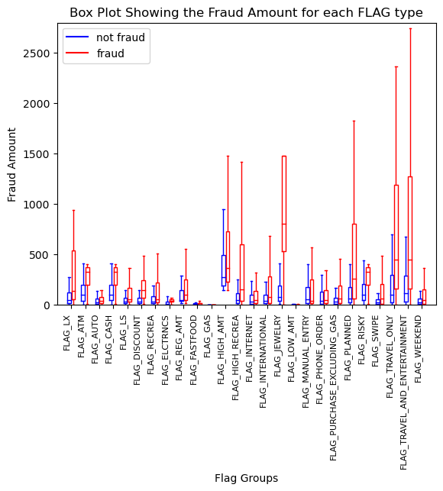
Fraud Amount Comparison
Insight
Fraud transaction: Higher amount
Certain Categories are associated with higher fraud amount
Recommendations
Use utilize the distribution difference in this comparative plot to predict the probability that a transaction with certain amount is/isn't fraud.

Slide 6
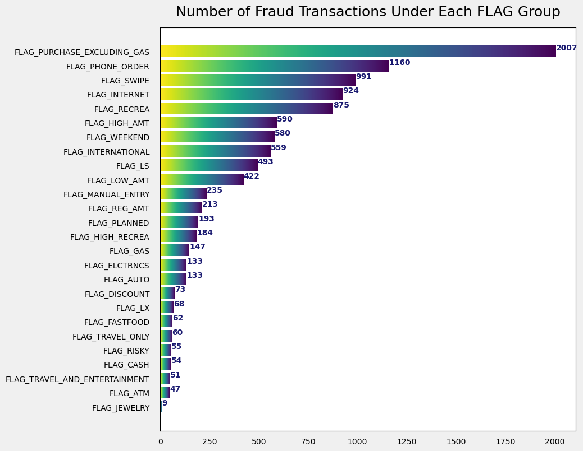
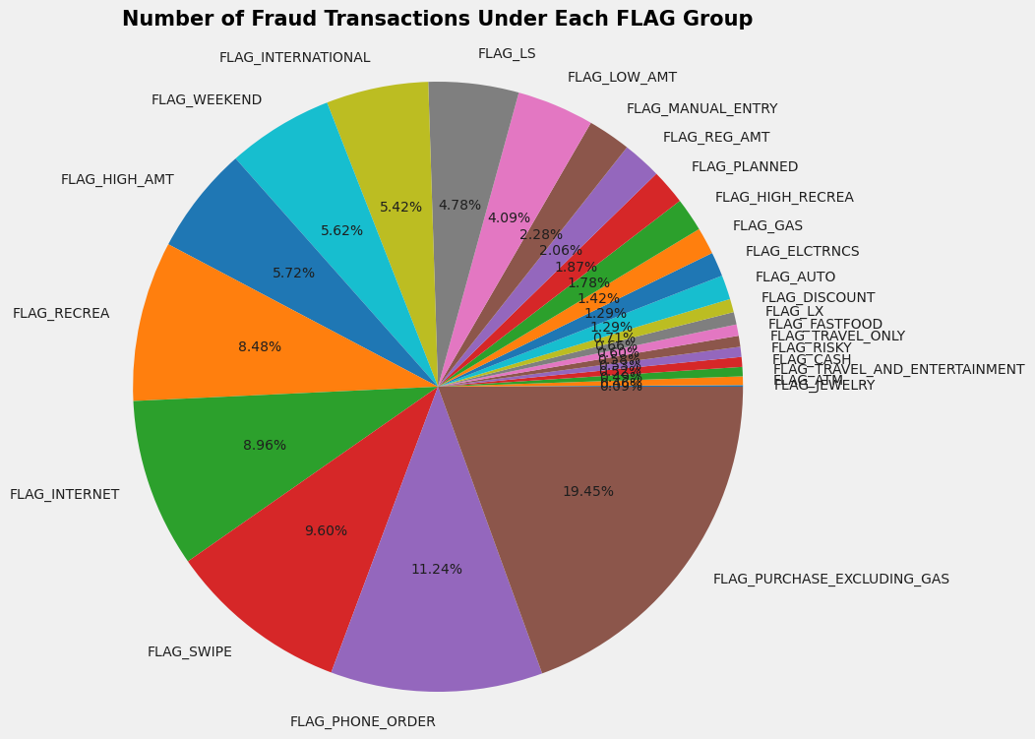
Number of Fraud Transaction
Insight
Highest: PURCHASE_EXCLUDING_GAS
Other areas for high fraud transaction: PHONE_ORDER, SWIPE, INTERNET, RECREA.
INTERNET: large number of fraud transactions and high fraud rate (see here)
Internet transaction a common fraud method
Recommendations
Look into why these high fraud transaction areas are under frequent attack of fraud transaction; enhance the security protection against fraud in these areas.
Companies should design better Internet fraud protection strategy
Advise users to beware of Internet transactions.

Slide 7
Transaction Amount
First 15% Sample Data
Insight
This is the cumulative percent count in terms of number of frauds.
Positive Skewed: First 50% percentile:$0 - 50, second 50% percentile: $50 - 9750.
Most fraud are over small quantity.
There is no fraud above $10000.
Recommendation
Strategy for handling fraud talors the fraud loss – customer experience tradeoff: more tolerance to small transaction value; freeze the card immediately for large transaction value.
Cutoff determined using this percentile chart, false-positive prediction rate and expected loss
Transaction Amount | Cumulative Fraud Percentage | Individual Fraud Percentage
0.97 | 4.92% | 4.92%
1.02 | 10.17% | 5.25%
1.95 | 10.82% | 0.65%
2.05 | 11.33% | 0.51%
2.92 | 11.79% | 0.46%
3.08 | 12.07% | 0.28%
3.9 | 12.72% | 0.65%
4.1 | 13.05% | 0.32%
4.88 | 13.83% | 0.79%
5.12 | 14.62% | 0.79%
5.85 | 15.00% | 0.37%

Slide 8
Data Cleansing
Large gap for covariates
Standardized numerical covariates
Over and under sample
Imbalanced Data
Large dataset
Feature Selection
Challenges encountered
Solving method
Convert event time to float data
Apply StandardAero
Results:
Increased the efficiency of the algorithms significantly.
Methods tried: repeating sample, SMOTE and random under sample
Results:
A combination of SOMTE and under sample performances the best for F1 Score and AUC criteria.
Performed feature selection methods: SelectKBest, REF, PVC and feature importance
SelectKBest method is not stable.
REF selects feature based on logistic regression which may easily cause overfitting.
PVC components reduce the precision significantly.
Feature importance is not statically reliable.
Results: eliminate features that have too much NA values.

Slide 9
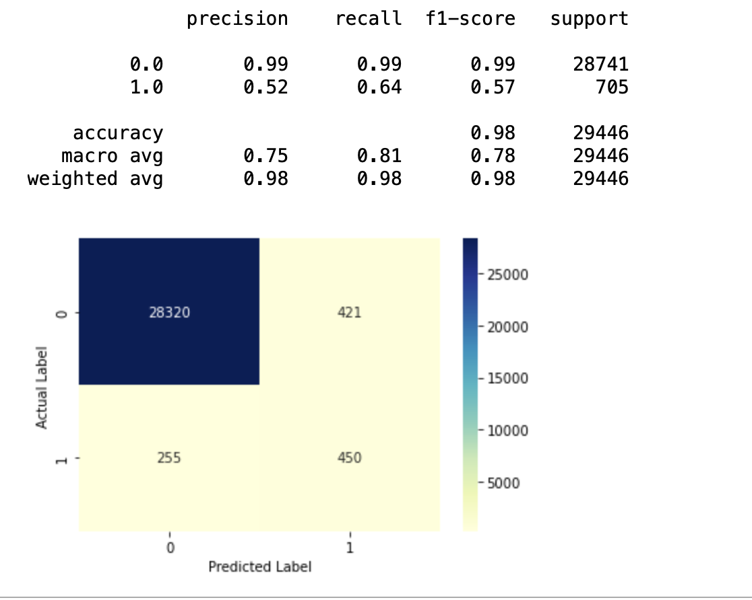
Model Selection & Performance
We use Xgbooster classifier to fit the data
Higher f1 score
Efficient to handle large dataset
Model | Shortcoming
Logistic regression | Overfitting, low F1 score
Random Forest/AdaBoost | Perform not as well as Xgbooster
Neural Network | Low Efficiency

Slide 10
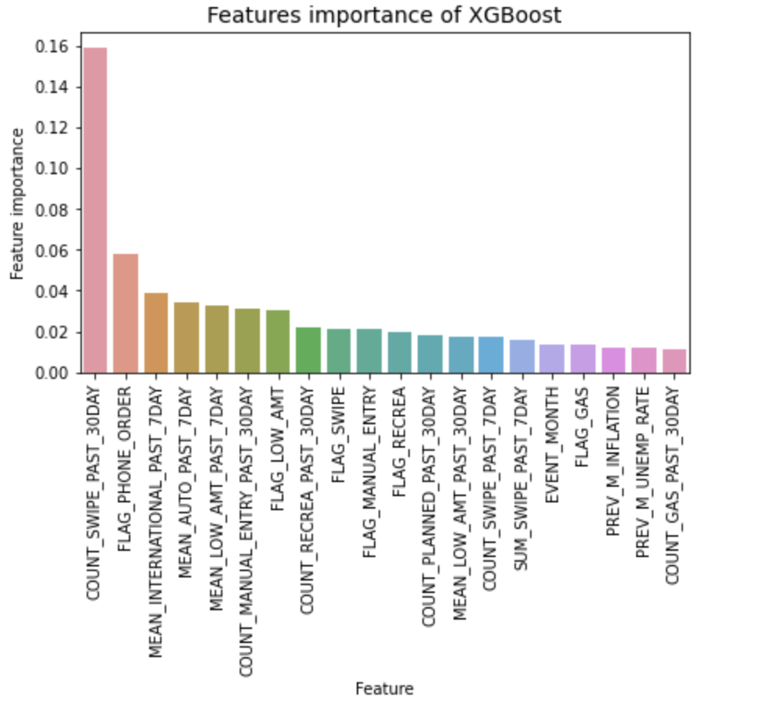
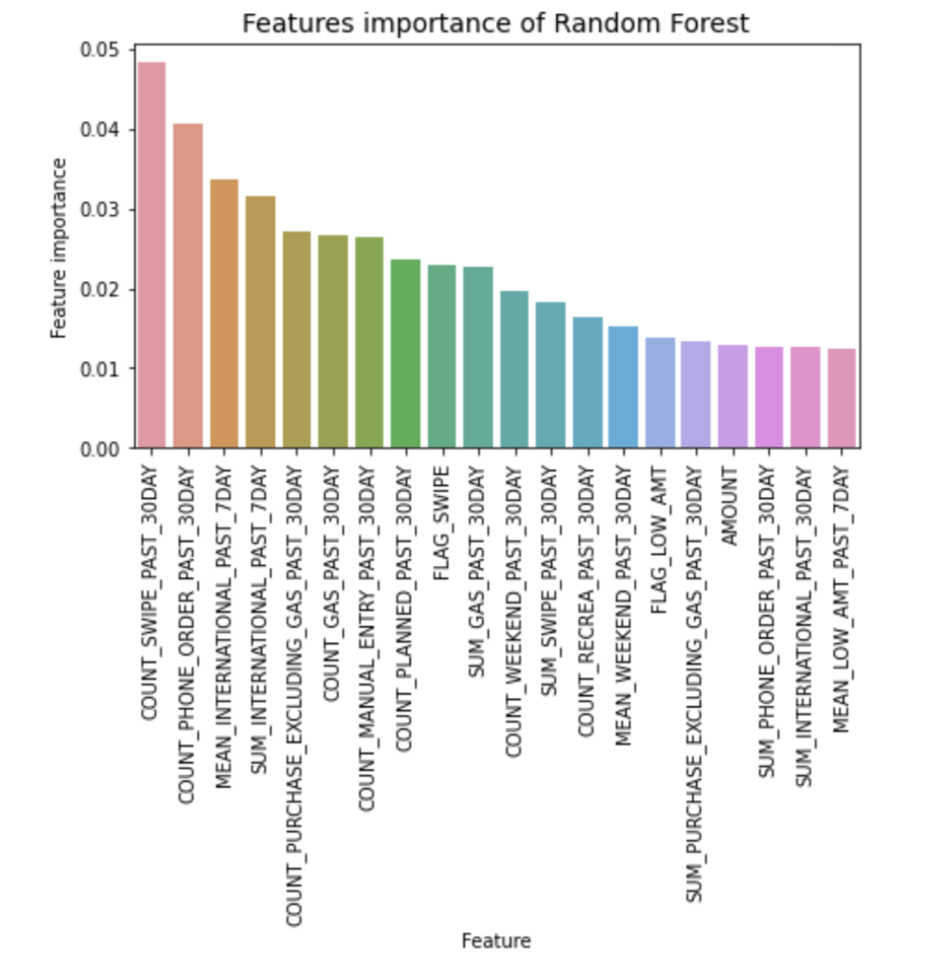
Importance Features
Count_swipe_past_30day
Mean_international_past_7day
High importance

