Slide 1
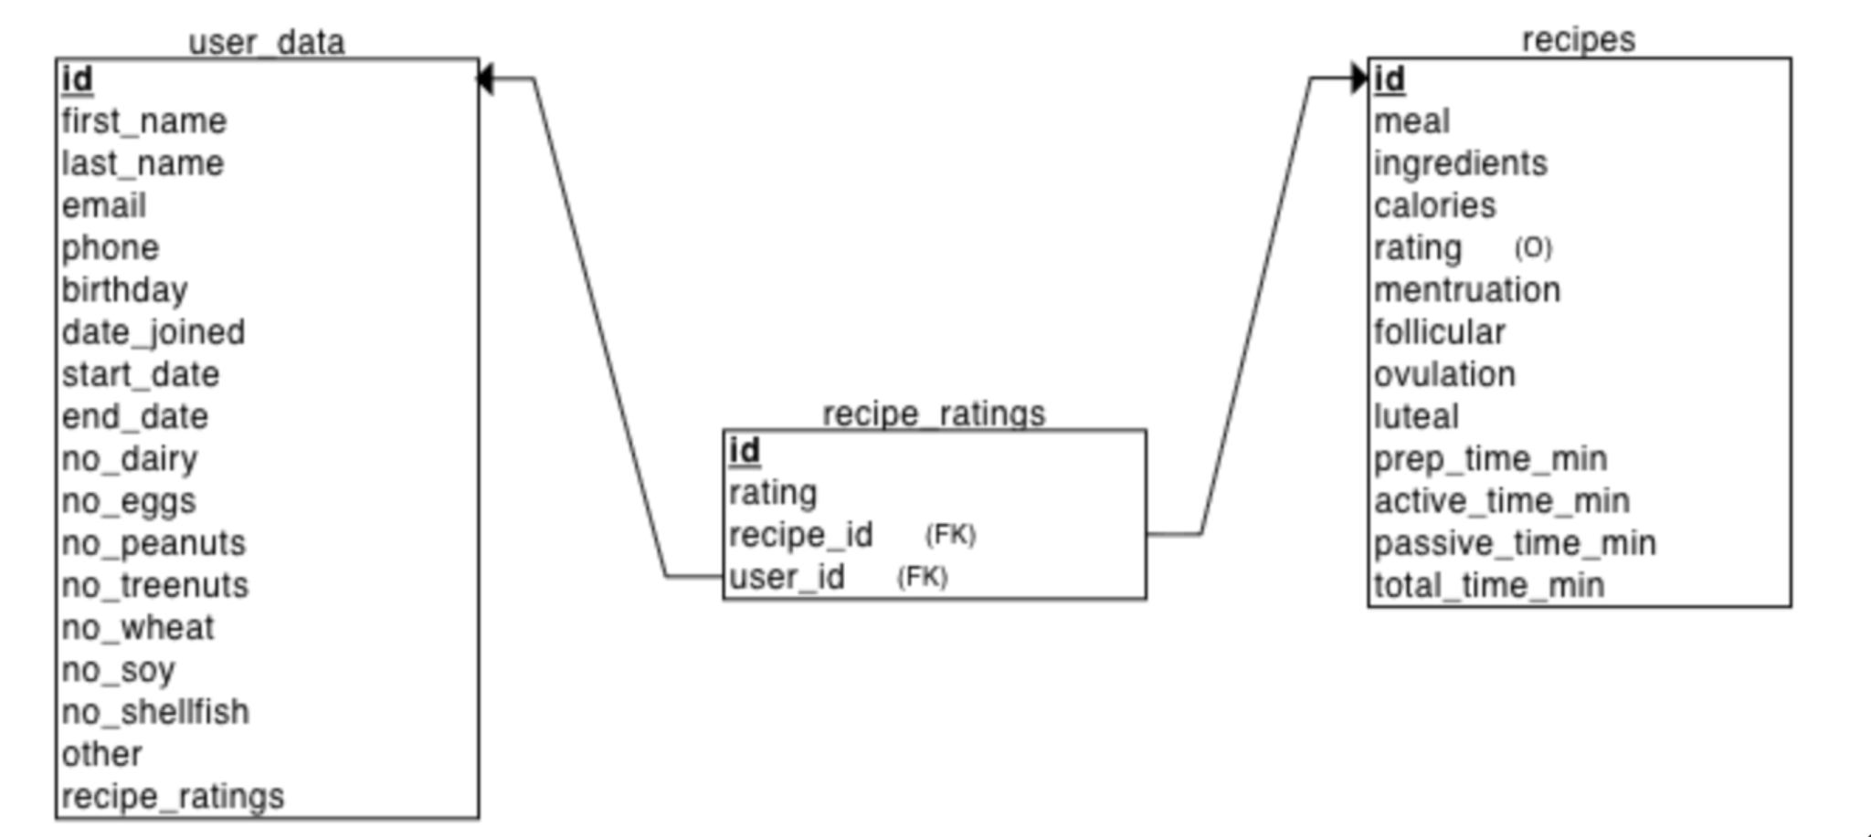
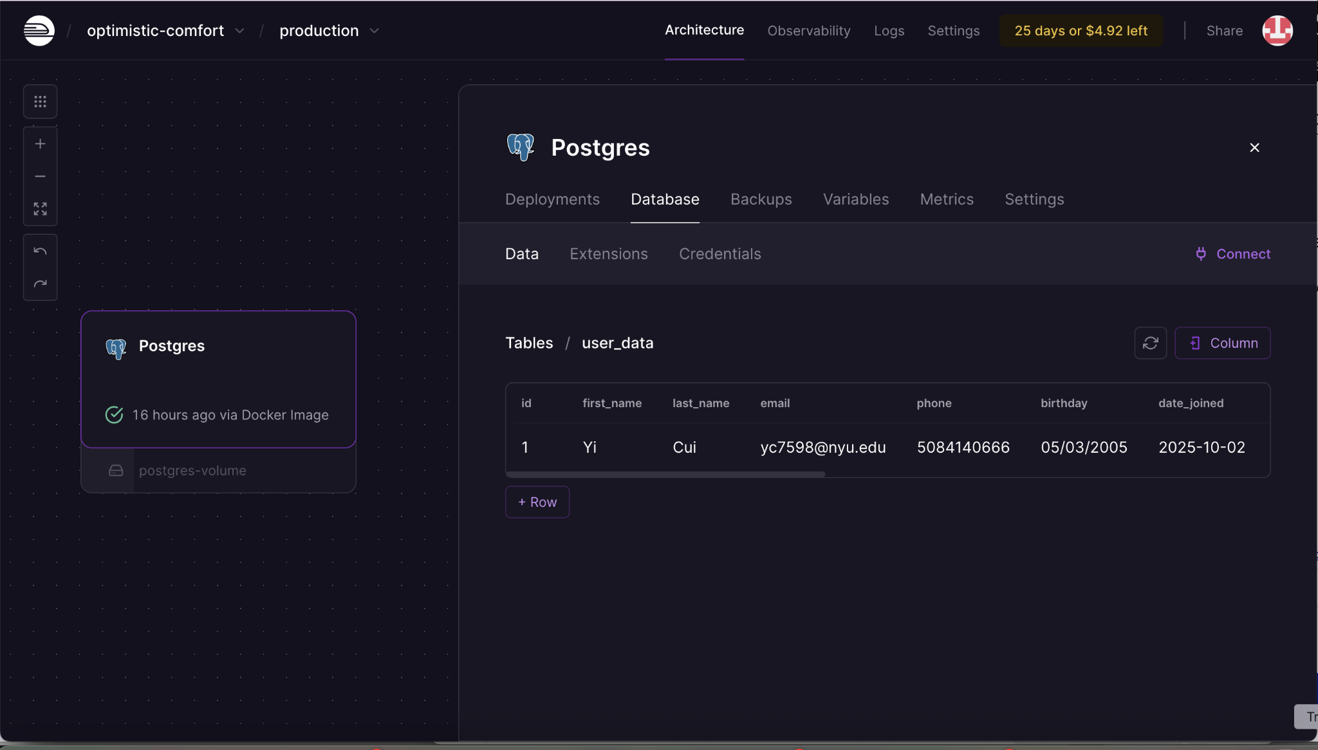
DATABASE Setup
Schema Map
Database
String
Integer
String
String
String
String
Integer
Integer
Float
Date
String
Date
String
Date
String
Date
String
Integer
Boolean
Float
Integer
Boolean
Integer
Integer
Boolean
Integer
Integer
Boolean
Boolean
Boolean
Boolean
JSON
JSON
Notes:
Schema map (tables, fields, and relationships)
Evidence of functioning database (e.g., screenshot of schema in Railway, example of initial data loaded)
.env file with connection parameters such that grader can connect to your database
Presentation: None
Notes: Focus is on technical execution and demonstrating a working, well-structured database rather than abstract design diagrams.

