Slide 1
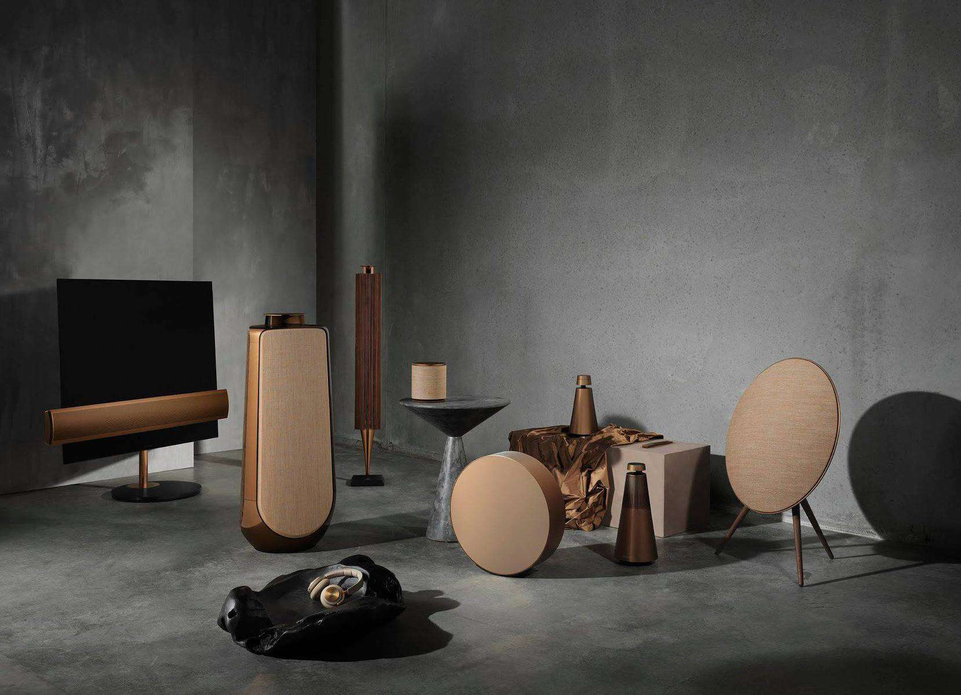
Best Speaker Brands
Presented by Yiyang XU

Slide 2
Top 5 Speaker Brands in the World
JBL
Objectives

Slide 3

Top 5 Speaker Brands
Sony
Sennheiser
Definitive Technology
Marshall
Bose
Notes:
Wirtschaftswunder
The term Wirtschaftswunder ("economic miracle"), also known as the Miracle on the Rhine, describes the rapid reconstruction and development of the economies of West Germany and Austria after World War II. The expression referring to this phenomenon was first used by The Times in 1950.[1]
In short, Germany was a ruined state facing an incredibly bleak future. But by 1989, when the Berlin Wall fell and Germany was once again reunited, it was the envy of most of the world.

Slide 4

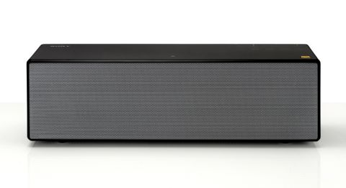
Sony
Founded in 1946 in Japan
Home Audio business started in 1950
Famous Product: SRS-X88
Spacious and detailed sound, ClearAudio+, Hi-Res Audio Support.
$399 on Amazon.
Sony SRS-X88
Notes:
1.
2. It is also called coordinated market economy. The state introduce welfare measures to cancel out the inequality caused by capitalism. For example, Equalization of Burdens Law (1950): transferred wealth from the well off to provide for those who had lost everything during the war.
3. The welfare state is a form of government in which the state protects and promotes the economic and social well-being of its citizens, based upon the principles of equal opportunity, equal distribution of wealth, and public responsibility for citizens who found themselves struggling.
魏玛共和国时期的影响
4 & 5. Ludwig Erhard: was a German politician affiliated with the CDU, and chancellor of West Germany from 1963 until 1966. He is known for leading the West German postwar economic reforms and economic recovery in his role as Minister of Economic Affairs under Chancellor Konrad Adenauer from 1949 to 1963. During that period he promoted the concept of the social market economy on which Germany's economic policy in the 21st century continues to be based.

Slide 5
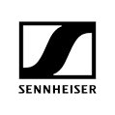
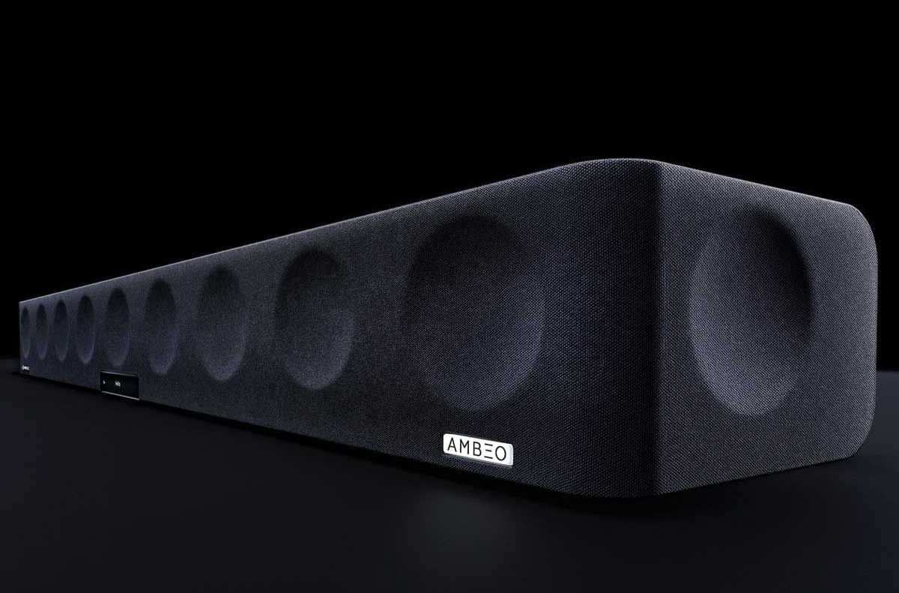
Sennheiser
Founded in 1945 in German
They make everything from microphones to headphones, headsets and speakers.
Famous Product: AMBEO
Rich, natural sound, Dolby Atmos bar.
13 large speaker drivers
$2499 on Amazon.
AMBEO Soundbar
Notes:
1.
2. It is also called coordinated market economy. The state introduce welfare measures to cancel out the inequality caused by capitalism. For example, Equalization of Burdens Law (1950): transferred wealth from the well off to provide for those who had lost everything during the war.
3. The welfare state is a form of government in which the state protects and promotes the economic and social well-being of its citizens, based upon the principles of equal opportunity, equal distribution of wealth, and public responsibility for citizens who found themselves struggling.
魏玛共和国时期的影响
4 & 5. Ludwig Erhard: was a German politician affiliated with the CDU, and chancellor of West Germany from 1963 until 1966. He is known for leading the West German postwar economic reforms and economic recovery in his role as Minister of Economic Affairs under Chancellor Konrad Adenauer from 1949 to 1963. During that period he promoted the concept of the social market economy on which Germany's economic policy in the 21st century continues to be based.

Slide 6

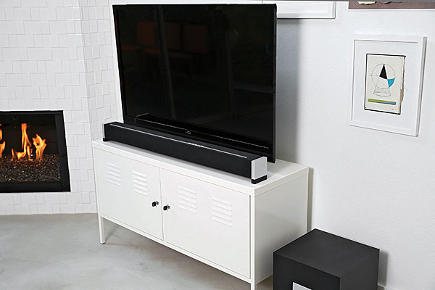
Definitive Technology
Founded in 1990 in USA
One of the top American audio equipment companies.
Fully customizable products
Virtual 5.1-Channel Soundbar
9 discrete transducers and amplifiers
$1499 on Amazon.
Studio Advance Soundbar
Notes:
1.
2. It is also called coordinated market economy. The state introduce welfare measures to cancel out the inequality caused by capitalism. For example, Equalization of Burdens Law (1950): transferred wealth from the well off to provide for those who had lost everything during the war.
3. The welfare state is a form of government in which the state protects and promotes the economic and social well-being of its citizens, based upon the principles of equal opportunity, equal distribution of wealth, and public responsibility for citizens who found themselves struggling.
魏玛共和国时期的影响
4 & 5. Ludwig Erhard: was a German politician affiliated with the CDU, and chancellor of West Germany from 1963 until 1966. He is known for leading the West German postwar economic reforms and economic recovery in his role as Minister of Economic Affairs under Chancellor Konrad Adenauer from 1949 to 1963. During that period he promoted the concept of the social market economy on which Germany's economic policy in the 21st century continues to be based.

Slide 7

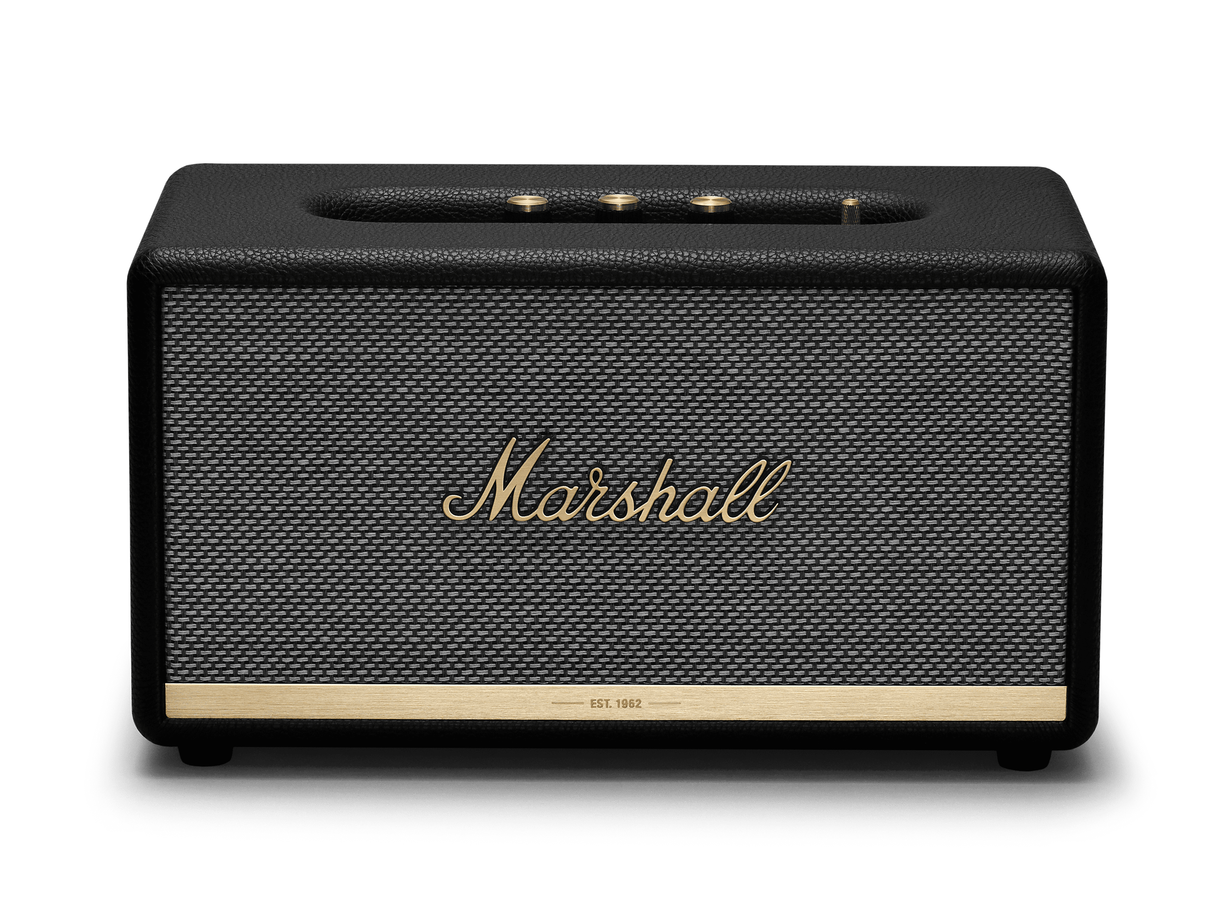
Marshall
Founded in 1962 in Britain by a drum shop owner and drummer
Classic high-end speakers and guitar amplifiers manufacture
Stanmore II Speaker
Bluetooth 5.0 and aptX technology
Iconic Marshall Design
$349 on Amazon.
Stanmore II Speaker
Notes:
1.
2. It is also called coordinated market economy. The state introduce welfare measures to cancel out the inequality caused by capitalism. For example, Equalization of Burdens Law (1950): transferred wealth from the well off to provide for those who had lost everything during the war.
3. The welfare state is a form of government in which the state protects and promotes the economic and social well-being of its citizens, based upon the principles of equal opportunity, equal distribution of wealth, and public responsibility for citizens who found themselves struggling.
魏玛共和国时期的影响
4 & 5. Ludwig Erhard: was a German politician affiliated with the CDU, and chancellor of West Germany from 1963 until 1966. He is known for leading the West German postwar economic reforms and economic recovery in his role as Minister of Economic Affairs under Chancellor Konrad Adenauer from 1949 to 1963. During that period he promoted the concept of the social market economy on which Germany's economic policy in the 21st century continues to be based.

Slide 8

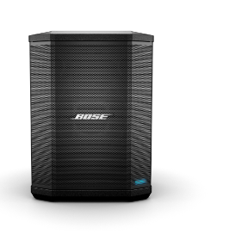
Bose
Founded in 1964 in the USA
Provides a wide range of speaker from portable ones to heavy party-oriented ones.
S1 Pro Portable Speaker
Built-in ToneMatch processing.
Built-in sensors and multiple aiming positions
$549 on Amazon.
S1 Pro Portable Speaker
Notes:
1.
2. It is also called coordinated market economy. The state introduce welfare measures to cancel out the inequality caused by capitalism. For example, Equalization of Burdens Law (1950): transferred wealth from the well off to provide for those who had lost everything during the war.
3. The welfare state is a form of government in which the state protects and promotes the economic and social well-being of its citizens, based upon the principles of equal opportunity, equal distribution of wealth, and public responsibility for citizens who found themselves struggling.
魏玛共和国时期的影响
4 & 5. Ludwig Erhard: was a German politician affiliated with the CDU, and chancellor of West Germany from 1963 until 1966. He is known for leading the West German postwar economic reforms and economic recovery in his role as Minister of Economic Affairs under Chancellor Konrad Adenauer from 1949 to 1963. During that period he promoted the concept of the social market economy on which Germany's economic policy in the 21st century continues to be based.

Slide 9


TITLE
HERE
JBL
Founded in 1946.
The company has two divisions:
JBL Consumer
JBL Professional
Each division has its own speakers that are beloved.
JBL's speaker variety spans across all major speaker “types,” including portable Bluetooth, home, car, public address, cinema, live sound, and recording.
Notes:
The country is by far the world’s largest exporter of automobiles (just below 19% of total exported cars worldwide), but it also exports parts of motor vehicles, machinery, medicaments and planes. The manufacturing output alone counted around 20% of the GDP.
Depend too much on manufacturing, when crisis like COVID 19 comes, will get greatly influenced. Because of its dependency on capital good exports, the economy had a significant setback post-2008 financial crisis. The German economy is currently in the middle of its fourth industrial revolution due to the Internet and the digital age. Industry 4.0 is the term used for this transformation, which embraces solutions, processes, and technologies and describes the use of IT and a high degree of system networking in factories.

Slide 10
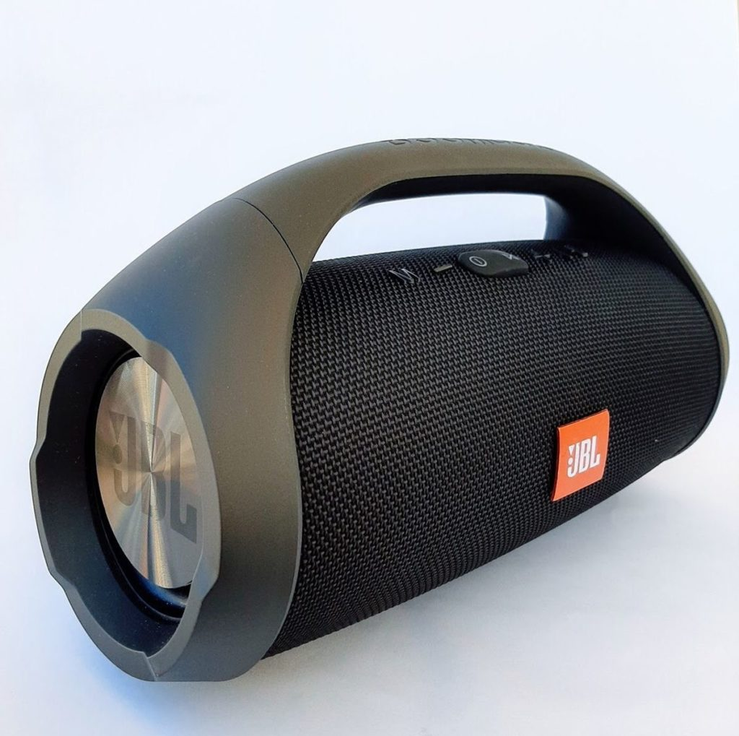

TITLE
HERE
JBL Boombox
JBL Flip 5
Indoor and Outdoor modes
Powerful bass depth and high volumes
Waterproof capabilities
$450 on Amazon
12 different designs and can be customized
Waterproof capabilities
$120 on Amazon
Notes:
The country is by far the world’s largest exporter of automobiles (just below 19% of total exported cars worldwide), but it also exports parts of motor vehicles, machinery, medicaments and planes. The manufacturing output alone counted around 20% of the GDP.
Depend too much on manufacturing, when crisis like COVID 19 comes, will get greatly influenced. Because of its dependency on capital good exports, the economy had a significant setback post-2008 financial crisis. The German economy is currently in the middle of its fourth industrial revolution due to the Internet and the digital age. Industry 4.0 is the term used for this transformation, which embraces solutions, processes, and technologies and describes the use of IT and a high degree of system networking in factories.

Slide 11
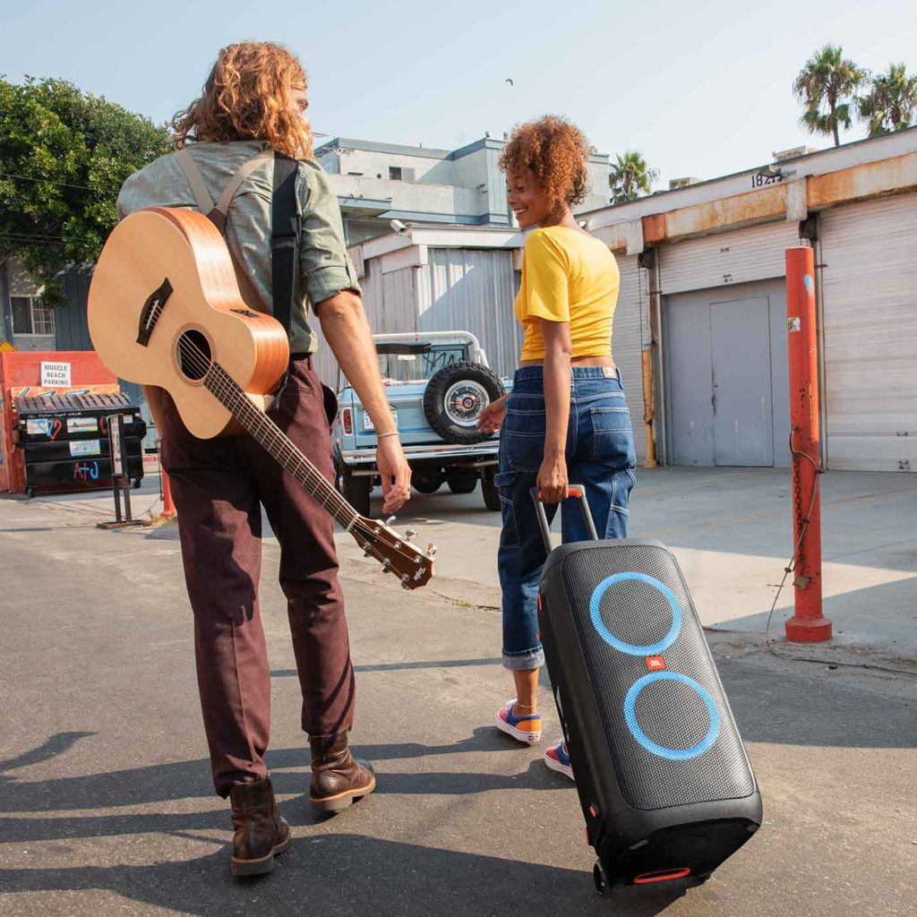
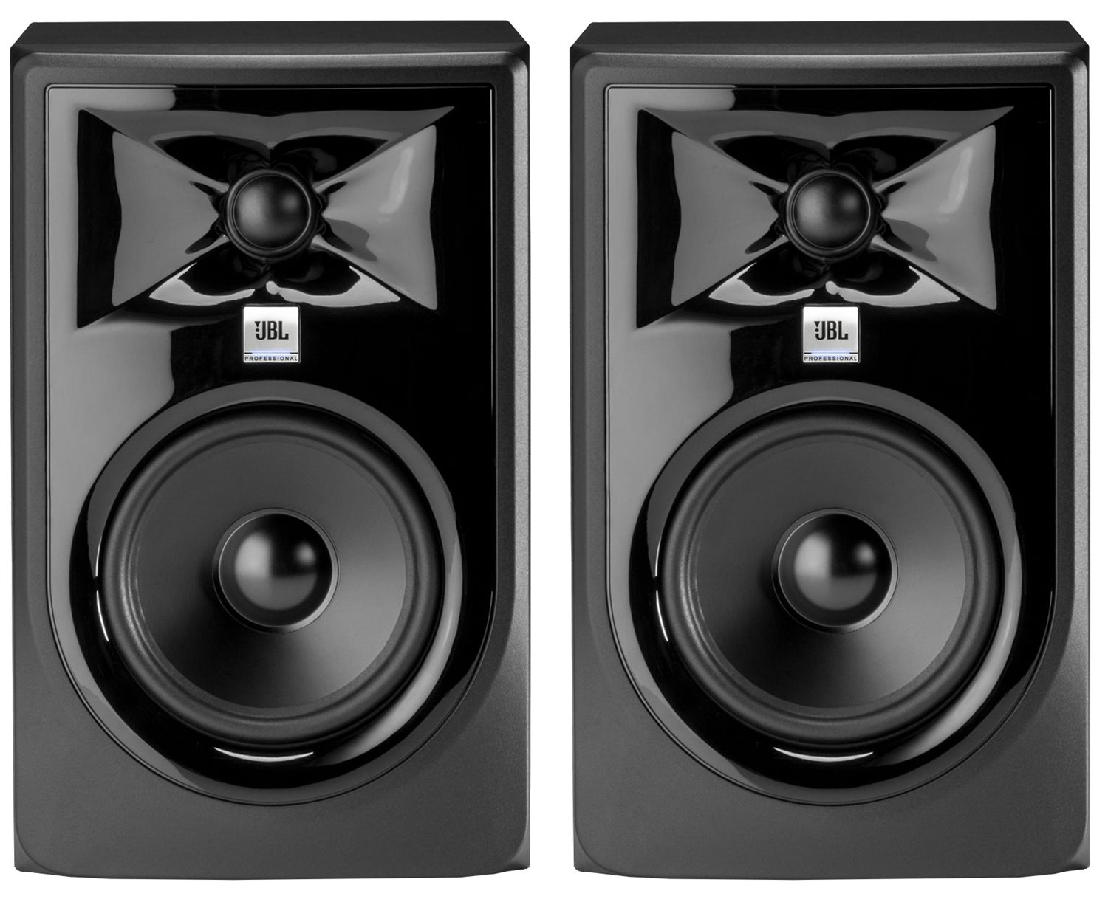
TITLE
HERE
JBL Professional 308P MkII
JBL PartyBox 300
15 hours on battery
Pre-set light patterns to give party more flash
$350 on Amazon
Studio monitor line introduced in 2014
Smooth integration between lows and highs
$249 each on Amazon
Notes:
The country is by far the world’s largest exporter of automobiles (just below 19% of total exported cars worldwide), but it also exports parts of motor vehicles, machinery, medicaments and planes. The manufacturing output alone counted around 20% of the GDP.
Depend too much on manufacturing, when crisis like COVID 19 comes, will get greatly influenced. Because of its dependency on capital good exports, the economy had a significant setback post-2008 financial crisis. The German economy is currently in the middle of its fourth industrial revolution due to the Internet and the digital age. Industry 4.0 is the term used for this transformation, which embraces solutions, processes, and technologies and describes the use of IT and a high degree of system networking in factories.

