Slide 1
2018 fall gra work
Week 4

Slide 2
tasks
Extract subratings from Glassdoor
Extract audio files from Earningscast.com

Slide 3
progress
Extract subratings from Glassdoor
import urllib
from urllib.request import urlopen, Request
from bs4 import BeautifulSoup
file = open("Test.txt", "r")
f = open("Result.txt","w")
theEnd = False
while not theEnd:
line = file.readline()
if line != "":
…. 40 more lines

Slide 4
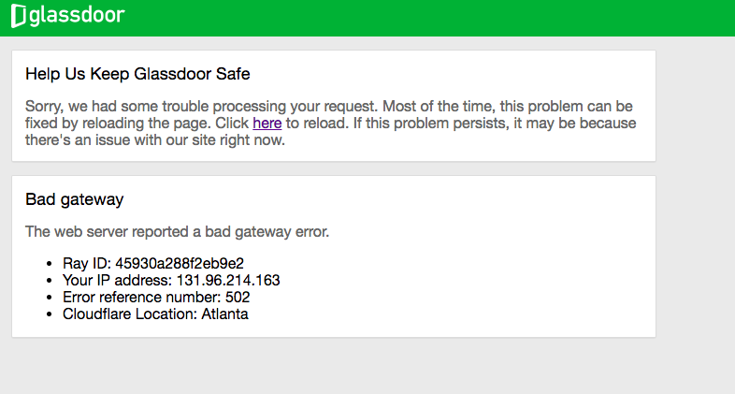
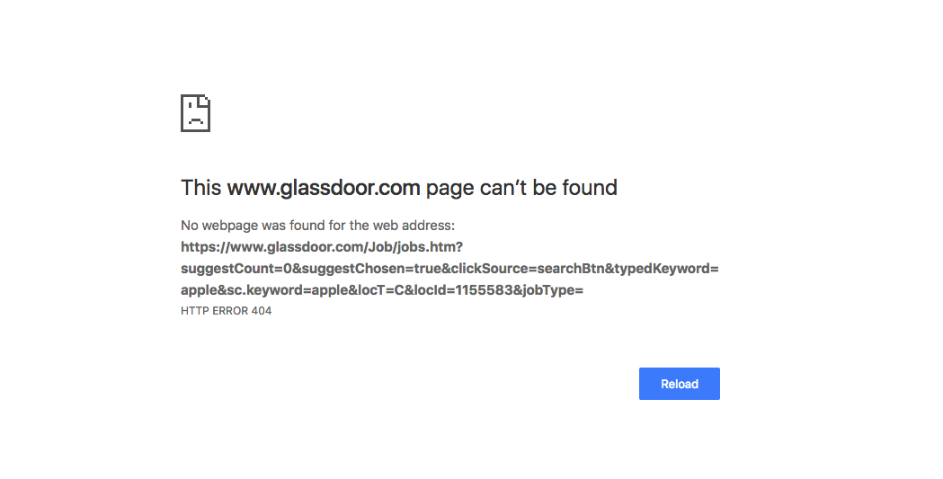
challenges
Extract subratings from Glassdoor
My ip address was blocked by Glassdoor after the subrating scraping practice.
Even using GSU VPN, I was not able to go to these subratings web pages.
Even manually request, I was not able to go to Apple company in Glassdoor.

Slide 5
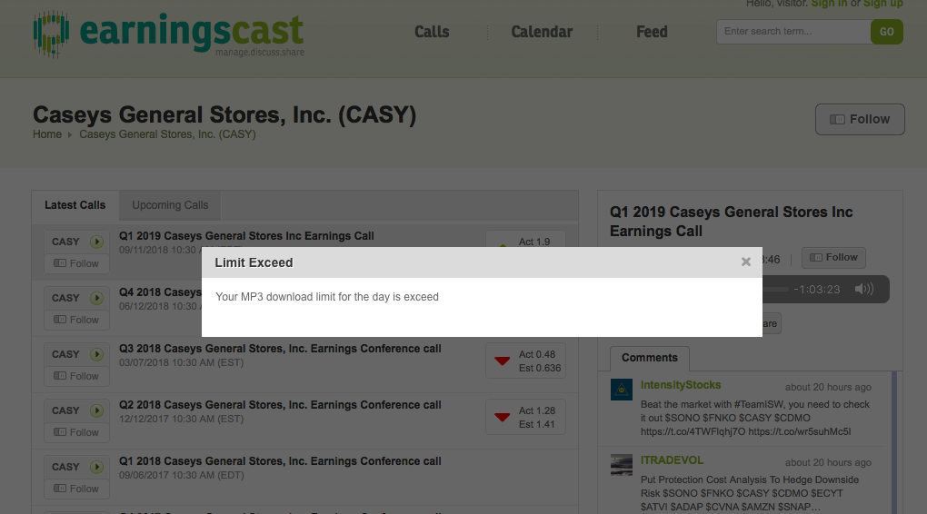
challenges
Extract audio files from Earningscast.com
The earningscast.com website does not allow me to download the audio files as a visitor/anonymous person, which sets challenges for web scraping, as web scraping usually mocks visitor requests.

Slide 6
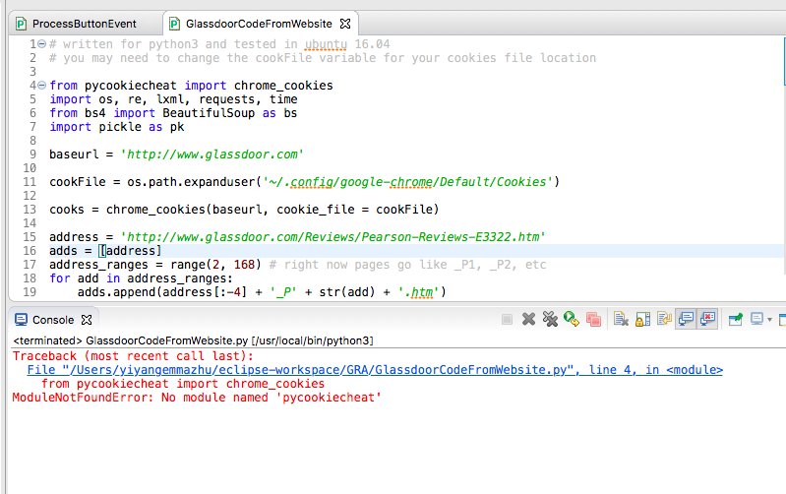
Other tries
Extract subratings from Glassdoor
Use codes from http://ngeorge.us/glassdoor-analysis/
May be helpful ”do the analysis of the words.”

Slide 7
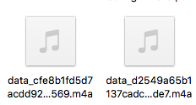
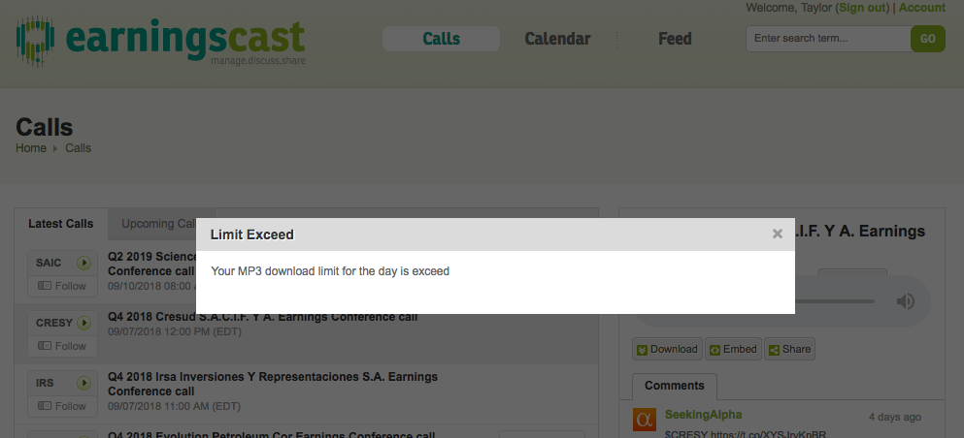
Other tries
Extract audio files from Earningscast.com
After signing in, was able to download 2 audio files.
After downloading 2 audio files, more attempt to download
audio files was denied.

Slide 8
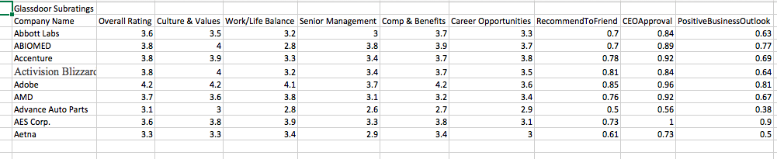
Other tries
Extract subratings from Glassdoor
After manually requesting subratings from Glassdoor 9 times (except for Apple company), my ip address was not blocked. Results are as follows:

Slide 9
discussion
Other GRAs encountered same situations: ip address was blocked.
The above situations happened may due to those companies

