Slide 1
Interactive Smart Assistant for the Visual Impaired
The Hong Kong Polytechnic University

Slide 2
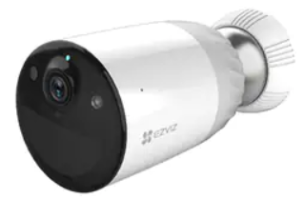
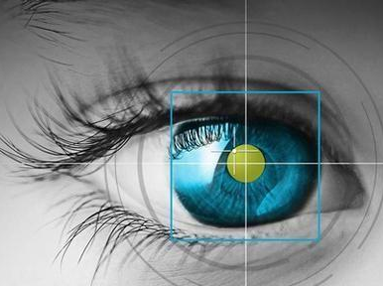


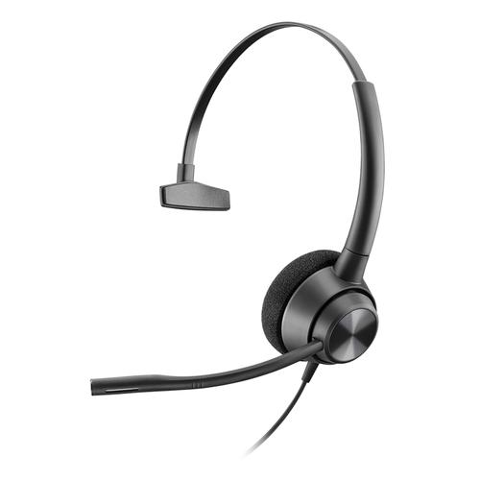

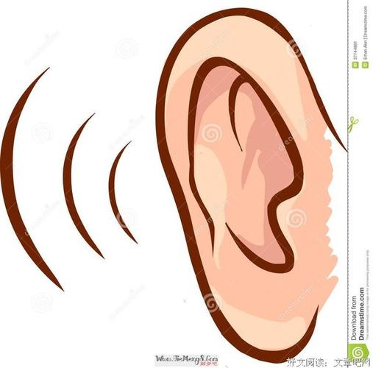

Concept Diagram
CV
Look
Video
Stream
Object metadata
Network
Camera
Network
Cable
Wireless
Update
Prior knowledge
NLP
Think
Prior
Knowledge
Speech
Listen
Speak
Command
text
Verbal
Command
Task
Status
Ear set
Guidance
Voice
Generate
Guidance text
Physical
Network
Perception
AI & command center

Slide 3
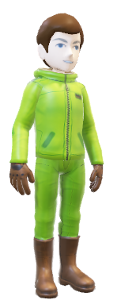




User case diagram
Indoor object detection
VI user
Receipt
Checking 从现在开始收集！
QRCode
Scanning
System
Speech
CV
ASR
TTS
Decode
NLP
Preprocessing (CSC, Prompt loc.)
NLU
(command recognize)
NLG
(assisting voice)
Object
Detection & Classification
Tasks Status Update
Summarization
QRCode
OCR
Location/Distance/Orientation
Action
Decision
Image
Understanding
Frame Metadata
Update
Tracking

Slide 4

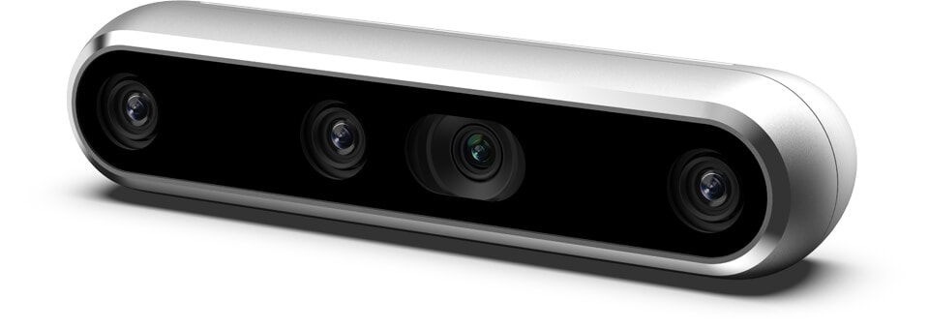

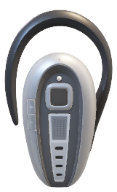
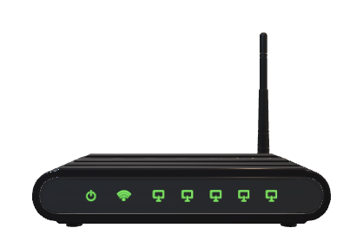

Hardware Deployment
Edge / Mobile / Outdoor
High Performance Computing
Realsense
Realsense
Headset
Headset
Laptop
High
Performance
Laptop
Server
Optional
Wifi Router
AP

Slide 5
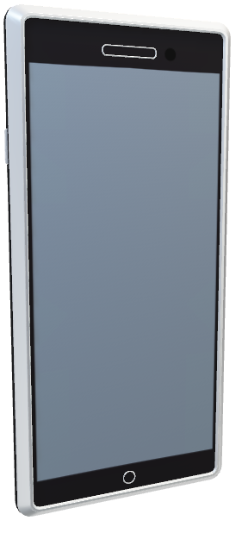
Hardware Deployment
Edge / Mobile / Outdoor
High Performance Computing
Realsense
Realsense
Headset
Headset
Laptop
High
Performance
Laptop
Server
Wifi Router

Slide 6
Pipeline of CV
Task-oriented prior knowledge
(Shared with NLP)
Narrow down the range of object labels
Decoding
Image Processing
Object Detection
Image Processing
Composition(OPTIONAL)
Display
Image Processing
Object Classification/ OCR
Network
Camera
Object Tracking
Object
metadata
Object Tracking
(OPTIONAL)
Typically FHD/HD
H.264
Sometimes raw video
Image scaling/normalization
Color space convention
Yolo/SSD
Image segmentation if necessary
Crop ROI coordinates
Image scaling
ResNet / DenseNet / GoogleNet
Optional
Draw/Highlight bounding box/text
Optional
Kalman filters
Object name
Object Coordinates
Optical Text

Slide 7
Pipeline of NLP
AI Center
Identify user’s intention
Speech to text
Task-oriented prior knowledge
(Shared with CV)
Prior
Knowledge
For structured text analysis, identify word and structural information
For object detection, extract task related information
Update task status
Natural language understanding
ASR
Verbal
Command
Task
Status
Character
Structured text analysis
Object
metadata
Object &
Coordination
Semantic
understanding
Store key information
Assistant
Decision
Natural language generation
TTS
Guidance
Voice
Summarize a report about key objects ahead
Summarization
Current object coordination
Key object information
Make a decision for the next assistant movement
Generate guidance text
Text to speech

Slide 8
Status diagram (CV – Frame metadata)
Start
Stand by / Video receiving
Decode
Object & hand location
Prepare for Hand Tracking
Image decoded
User’s hand
approaches
object
Object
Detection &
Classification
Object
Detection &
Classification
Object
Detection &
Classification
Object Detected
Receipt
Detected
QRCode
Detected
Information
Recognized
Information
Recognized
Information
Recognized
Information
Recognized
Frame
Metadata
Update

Slide 9
Status diagram (NLP – Task status)
Start
Stand by
Verbal
Command
Verbal
Command
User’s hand
approaches
object
Verbal
Command
Verbal
Command
Prepare for receipt checking
Verbal
Command
Object & hand location
Prepare for object location
Prepare for QRCode
Scanning
Verbal
Command
OCR &
Receipt
recognition
User’s hand
Reaches
object
QRCode
Decode
Action decision & summary
Action decision & summary
Action decision & summary
TTS
TTS
TTS

Slide 10
Workflow diagram --- Dataset
2D Image Collection
Developer
System (CV)
Data Server
Setup / Calibrate
realsense
Shot with realsense (video)
Frame extraction
Frame record
Depth record
Data storage

Slide 11
Workflow diagram --- Dataset
3D Image Collection
Developer
System (CV)
Data Server
Setup / Calibrate
realsense
Shot with realsense (video)
Frame extraction
3D reconstruction
Data storage

Slide 12
Workflow diagram --- Dataset
3D Data augmentation
Developer
Data Server
System (CV)
3D Rendering
Setup / Calibrate
realsense
3D data
3D reconstruction
Object detection/replacement
3D synthesis
Data storage

Slide 13
Workflow diagram --- CV
Object detection
User
System (CV)
System (CV)
Use realsense for front viewing
Image
Preprocessing
Object detection
Object classification
Hand tracking
Object coordination depth analysis
Frame metadata update

Slide 14
Workflow diagram --- CV
OCR for receipt analysis
User
System (CV)
Use realsense for front viewing
Image
Preprocessing
Image cropping for ROI
OCR
Character analysis
Frame metadata update

Slide 15
Workflow diagram --- CV
QRCode Analysis
User
System (CV)
Use realsense for front viewing
Image
Preprocessing
Image cropping for ROI
QRCode translation
Fetch URL
Frame metadata update

Slide 16
Workflow diagram --- Speech
Voice wake-up
User
System (Speech)
Speak to mic
ASR
Keyword detection
Speech module status update

Slide 17
Workflow diagram --- Speech
Voice command
User
System (Speech)
System (NLP)
Speak to mic
ASR
Keyword detection
Intention classification
Task status update

Slide 18
Workflow diagram --- Speech
Voice assistant
User
System (Speech)
System (NLP)
Instruction
Generation
Text segmentation
TTS
Listen to the instruction

Slide 19
Workflow diagram --- NLP
AI-Care assistant (Action decision)
User
System (Speech)
System (NLP)
System (CV)
Speak to mic
ASR
Command recognition
Fetch frame metadata
Task status update
Assistant command generation
TTS
Listen to earphone

Slide 20
Class diagram
TBD

Slide 21
Interface Design
TBD

Slide 22
Questions
I-frame需要特殊处理么?
看编码得IBP的配置，可以提前获得I-frame。1/4 I-frame
多线程/多进程
流水线并行，10GPU分别load不同的模块，有没有更高效的做法， density （路数）目前不考虑，单节点服务多人，多并发。。。
端-端延迟，vmap!!! pmap!!! 单卡上load尽量多的模型，避免GPU之间的数据传输延迟
3D CV部分是否有必要？
只用来做数据生成
移动中使用realsense有没有什么风险?
平滑
YoloV8能否完成整个项目的需求？在training的时候需要注意什么？
超曝光问题需要处理不？
物理：滤镜，偏光镜
算法：
直接把Edge换成手机端！！！考虑可行性

