Slide 1
A Survey and Assessment of Large Models for Visually Impaired Assisting

Slide 2
Abstract
One important motivation in computer vision (CV) is assisting visually impaired persons (VIPs).
Recently, the advent of Large Models (LMs) has significantly propelled the domains of Natural Language Processing (NLP) and CV, setting unprecedented benchmarks across a spectrum of tasks.
However, despite these developments, a significant research gap in LM-based assistance for VIPs exists.
This paper aims to address this gap and, to the best of our knowledge, is the first to explore how LMs can aid the visually impaired.
An extensive survey of Large Language Models (LLMs), Vision Language Models (VLMs), and Embodied Agents is presented, assessing their prospective roles in facilitating VI assistance.
Furthermore, this paper provides an in-depth evaluation of the current state-of-the-art end-to-end VLMs, such as GPT-4, and offers critical insights into their capabilities and limitations in assisting VIPs. The approach undertaken models this task as a visual question answering problem, with outputs being specifically tailored to be grounded tactile guidance to meet the unique needs of VIPs.
In summary, the conducted survey and assessment suggest future directions for enhancing VI assistance through Large Models.

Slide 3
Introduction—每一段
One of the primary motivations for developing computer vision (CV) technologies was to aid visually impaired individuals.—VizWiz等
The advancements in LMs are multifaceted.—LLM
VLMs advancements
Embodied Agents
3点embodied agents 与盲人辅助的区别
General Framework—输入输出
Contributions of this article
Remaining structures

Slide 4
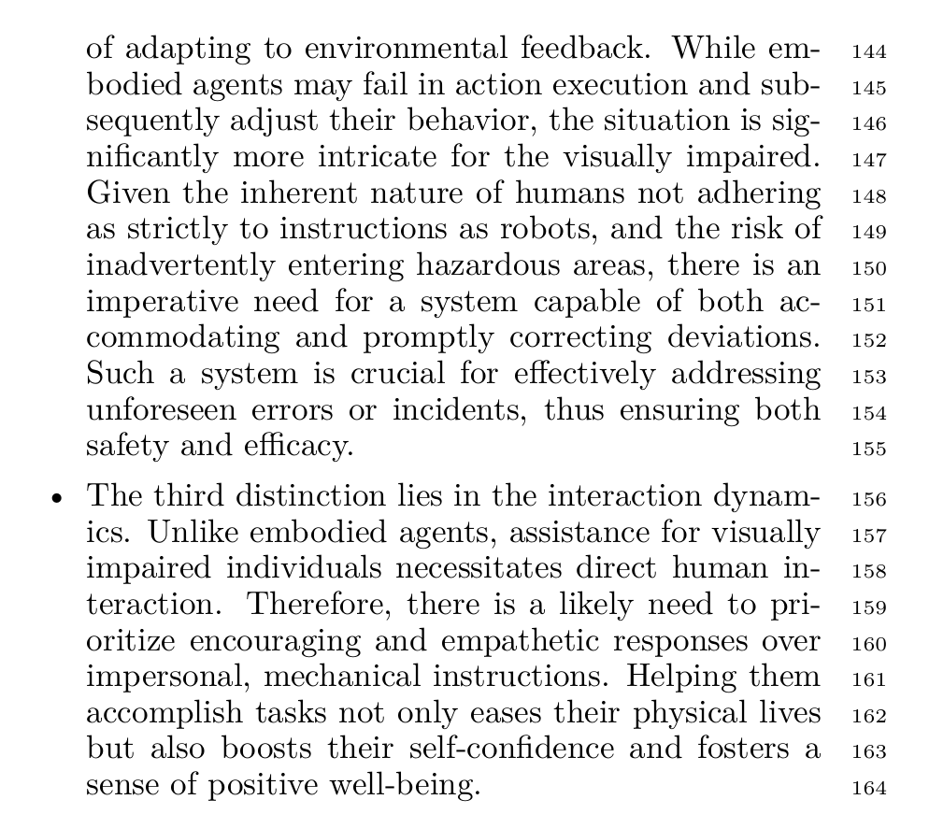
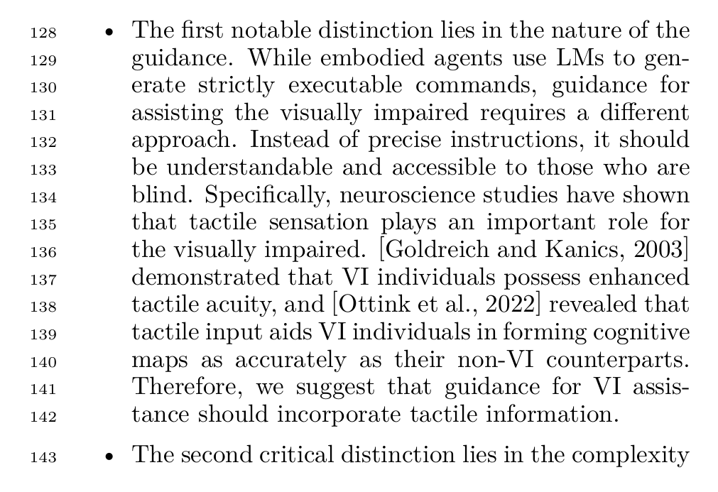
Introduction
3点embodied agents 与盲人辅助的区别

Slide 5
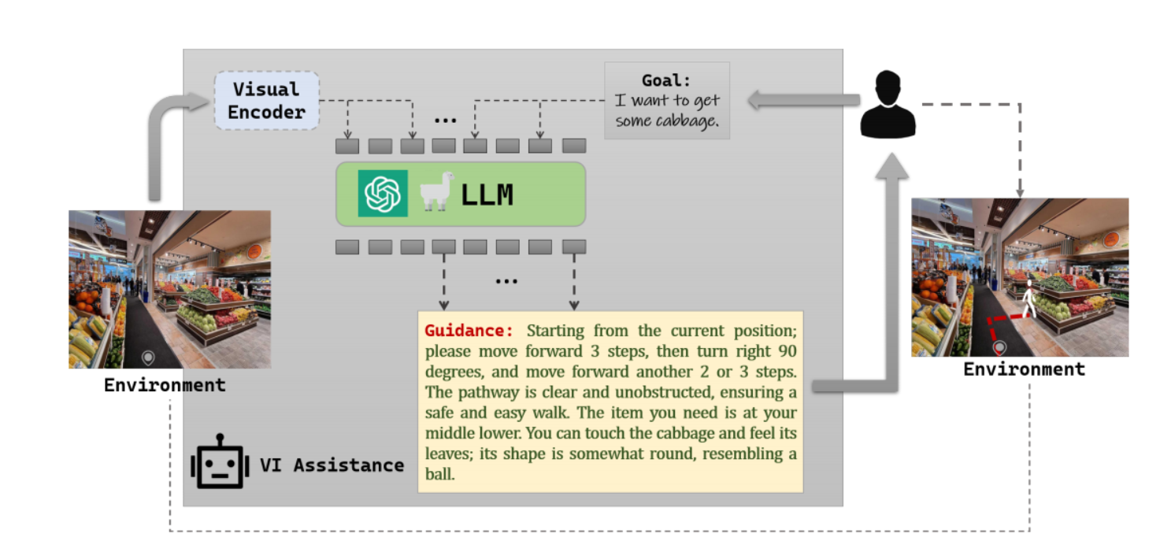
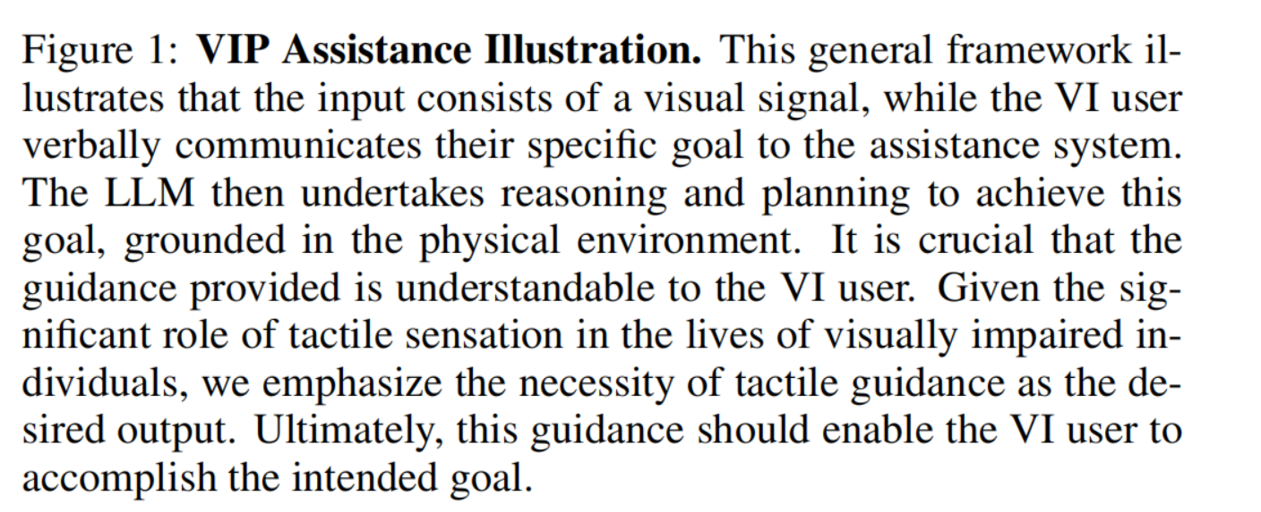
Introduction
General Framework—输入输出

Slide 6
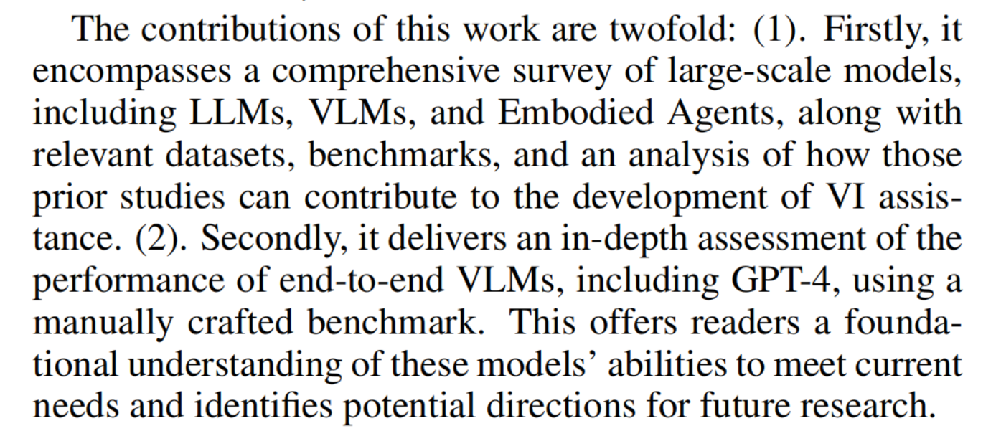
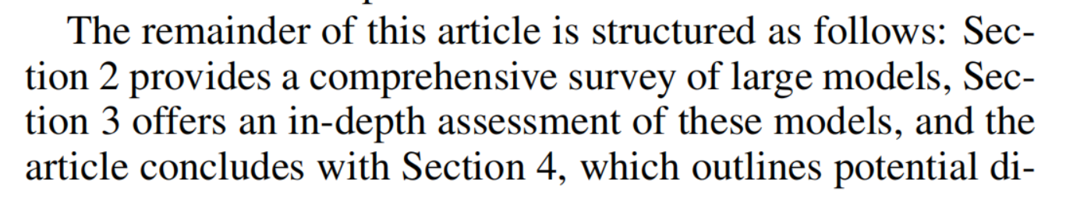
Introduction
Contributions of this article
Remaining structures

Slide 7
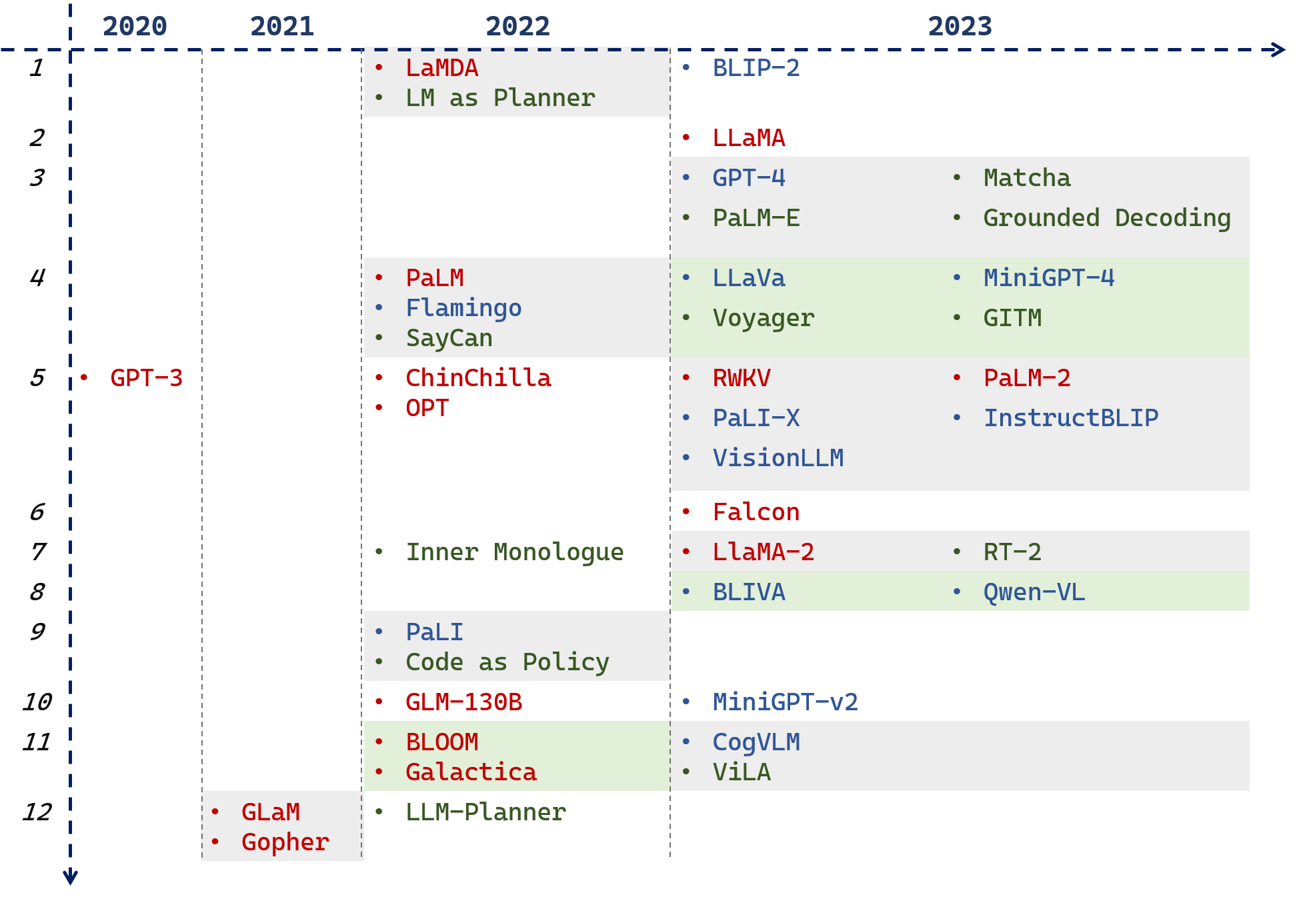
Section 2--LMs

Slide 8
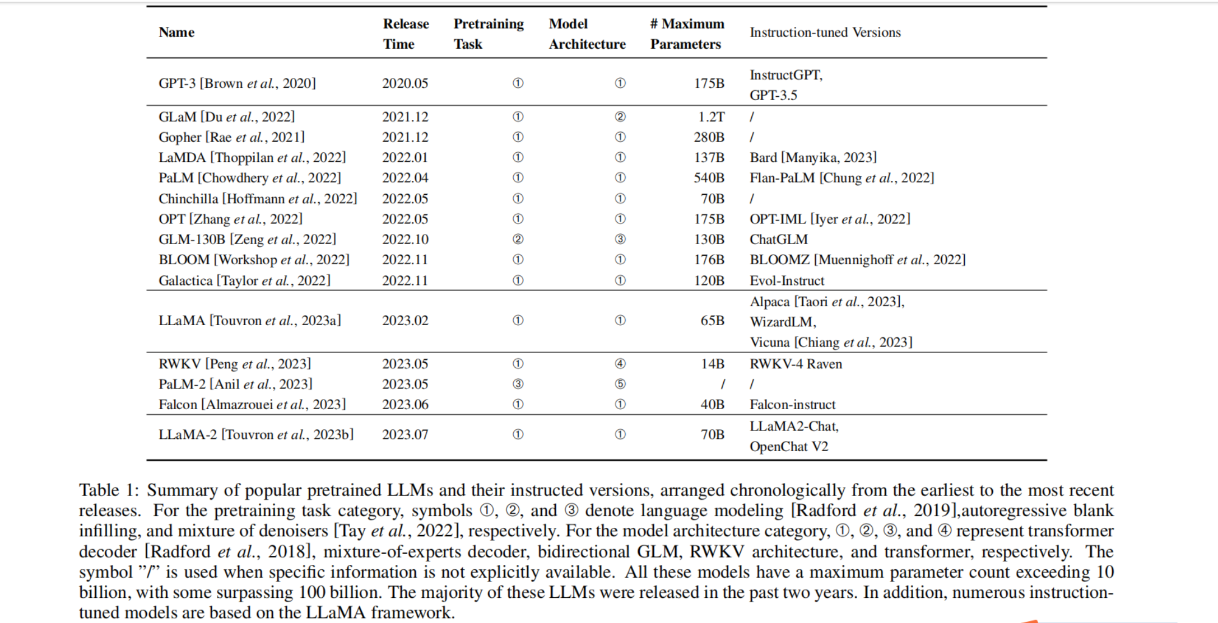
Section 2—LMs---LLMs

Slide 9
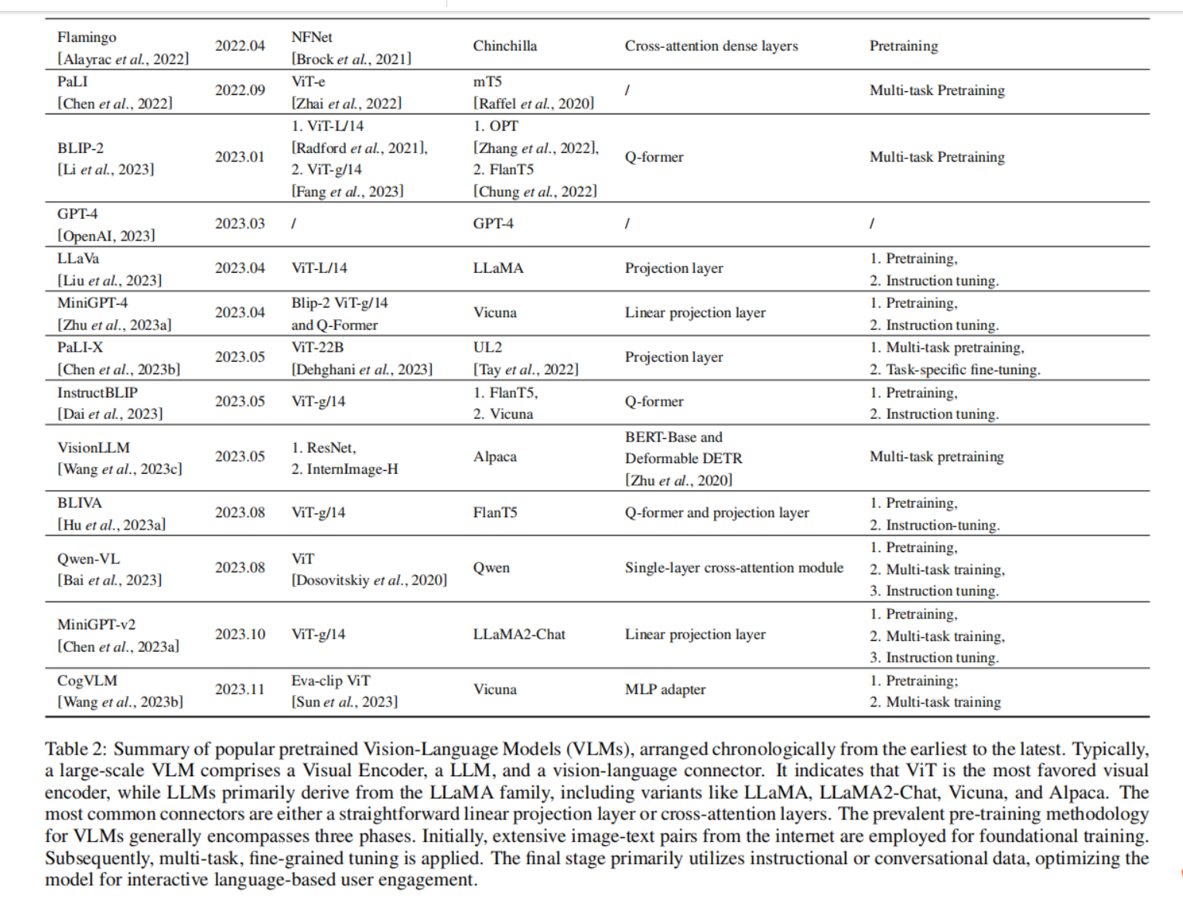
Section 2—LMs---VLMs

Slide 10
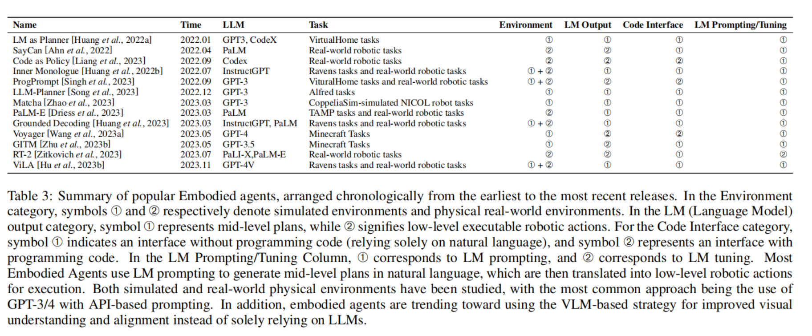
Section 2—LMs---Embodied Agents

