Slide 1




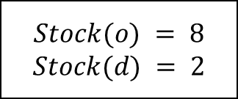
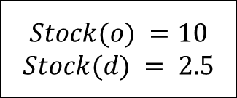


$$K_{1}$$
$$K_{2}$$
$$Stock(o) = 8$$
$$Stock(d) = 2$$
$$K_{1}$$
$$Stock(o) =10$$
$$Stock(d) = 2.5$$
$$x units$$
o
d
$$y units$$
$$K_{2}$$
Notes:
DataCase1

Slide 2






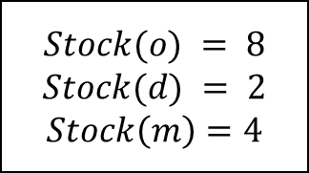
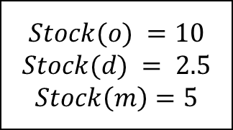


$$K_{1}:x$$
$$K_{1}$$
$$Stock(o) = 8$$
$$Stock(d) = 2$$
$$Stock\left(m\right)=4$$
$$K_{1}:z$$
$$K_{2}$$
o
m
d
$$K_{2}$$
$$Stock(o) =10$$
$$Stock(d) = 2.5$$
$$Stock\left(m\right)=5$$
$$K_{2}:w$$
$$K_{1}$$
$$K_{2}:y$$
Notes:
DataCase2

Slide 3
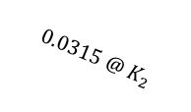

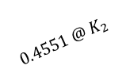
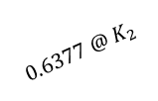
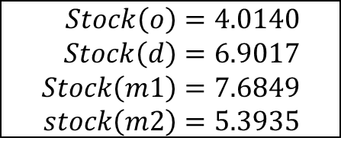



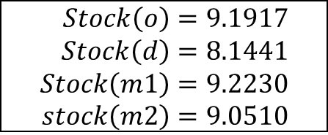

$$K_{1}$$
m1
$$Stock\left(o\right)=9.1917 \\ Stock\left(d\right)=8.1441 \\ Stock\left(m1\right)=9.2230 \\ stock\left(m2\right)=9.0510$$
$$0.4551 @ K_{2}$$
$$0.0950 @ K_{2}$$
$$0.6497 @ K_{1}$$
o
d
$$0.5134 @ K_{2}$$
$$K_{2}$$
$$Stock\left(o\right)=4.0140 \\ Stock\left(d\right)=6.9017 \\ Stock\left(m1\right)=7.6849 \\ stock\left(m2\right)=5.3935$$
m2
$$0.0315 @ K_{2}$$
$$0.6377 @ K_{2}$$
Notes:
DataCase3 With Loop Elimination

Slide 4


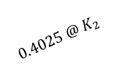
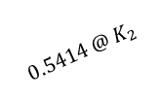

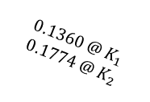

$$K_{1}$$
m1
$$Stock\left(o\right)=9.1917 \\ Stock\left(d\right)=8.1441 \\ Stock\left(m1\right)=9.2230 \\ stock\left(m2\right)=9.0510$$
$$0.4025 @ K_{2}$$
$$0.1360 @ K_{1} \\ 0.1774 @ K_{2}$$
$$0.9263 @ K_{1}$$
o
d
$$0.5042 @ K_{2}$$
$$K_{2}$$
$$0.4071 @ K_{2}$$
$$Stock\left(o\right)=4.0140 \\ Stock\left(d\right)=6.9017 \\ Stock\left(m1\right)=7.6849 \\ stock\left(m2\right)=5.3935$$
m2
$$0.0933 @ K_{2}$$
$$0.5414 @ K_{2}$$
Notes:
DataCase3 Without Loop Elimination

Slide 6
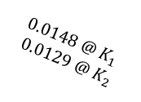
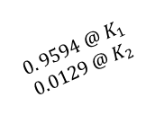


$$K_{1}$$
m1
$$Stock\left(o\right)=9.1917 \\ Stock\left(d\right)=8.1441 \\ Stock\left(m1\right)=9.2230 \\ stock\left(m2\right)=9.0510$$
$$0. 9594 @ K_{1}$$
$$0.0129 @ K_{2}$$
$$0.0033 @ K_{1}$$
$$1.9401 @ K_{2}$$
o
d
$$K_{2}$$
$$1.0730 @ K_{1}$$
$$0.0492 @ K_{2}$$
$$Stock\left(o\right)=4.0140 \\ Stock\left(d\right)=6.9017 \\ Stock\left(m1\right)=7.6849 \\ stock\left(m2\right)=5.3935$$
m2
$$0.0148 @ K_{1}$$
$$0.0129 @ K_{2}$$
Notes:
DataCase3 Without Loop Elimination

Slide 7
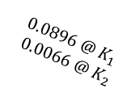
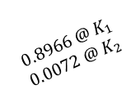


$$K_{1}$$
m1
$$Stock\left(o\right)=9.1917 \\ Stock\left(d\right)=8.1441 \\ Stock\left(m1\right)=9.2230 \\ stock\left(m2\right)=9.0510$$
$$0.8966 @ K_{1}$$
$$0.0072 @ K_{2}$$
$$0.0464 @ K_{1}$$
$$1.8709 @ K_{2}$$
o
d
$$K_{2}$$
$$1.1876 @ K_{1}$$
$$0.0099 @ K_{2}$$
$$Stock\left(o\right)=4.0140 \\ Stock\left(d\right)=6.9017 \\ Stock\left(m1\right)=7.6849 \\ stock\left(m2\right)=5.3935$$
m2
$$0.0896 @ K_{1}$$
$$0.0066 @ K_{2}$$
Notes:
DataCase3 Without Loop Elimination

Slide 8
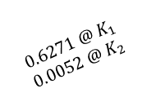

$$K_{1}$$
m1
$$Stock\left(o\right)=9.1917 \\ Stock\left(d\right)=8.1441 \\ Stock\left(m1\right)=9.2230 \\ stock\left(m2\right)=9.0510$$
$$0.8966 @ K_{1}$$
$$0.0072 @ K_{2}$$
$$0.0202 @ K_{1}$$
$$0.8133 @ K_{2}$$
o
d
$$K_{2}$$
$$Stock\left(o\right)=4.0140 \\ Stock\left(d\right)=6.9017 \\ Stock\left(m1\right)=7.6849 \\ stock\left(m2\right)=5.3935$$
m2
$$0.0896 @ K_{1}$$
$$0.0066 @ K_{2}$$
$$0.6271 @ K_{1} \\ 0.0052 @ K_{2}$$
Notes:
DataCase3 Without Loop Elimination

Slide 9
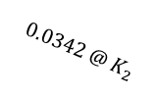
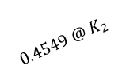
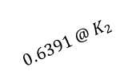

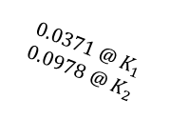

$$K_{1}$$
m1
$$Stock\left(o\right)=9.1917 \\ Stock\left(d\right)=8.1441 \\ Stock\left(m1\right)=9.2230 \\ stock\left(m2\right)=9.0510$$
$$0.4549 @ K_{2}$$
$$0.0371 @ K_{1} \\ 0.0978 @ K_{2}$$
$$0.6473 @ K_{1}$$
o
d
$$0.5109 @ K_{2}$$
$$K_{2}$$
$$Stock\left(o\right)=4.0140 \\ Stock\left(d\right)=6.9017 \\ Stock\left(m1\right)=7.6849 \\ stock\left(m2\right)=5.3935$$
m2
$$0.0342 @ K_{2}$$
$$0.6391 @ K_{2}$$
Notes:
DataCase3 Without Loop Elimination

