Slide 1
Homework 3
Satellite/Aerial Image Retrieval
Member: Yizhi Hong A20386348
Sanchuan Jiang A20401358
Yifan Xu A20385903

Slide 2
OUTLINE
Introduction
Algorithm
Map tiles and Level of Detail
Image processing
Crop image
Other
Result
Drawbacks and discussion

Slide 3
INTRODUCTION
Automatically download aerial imagery (maximum resolution available) given a lat/lon bounding box. Note that we should take the highest resolution of the image.
-Input: lat1, lon1, lat2, lon2
-Output: an aerial imagery within the bounding box defined above

Slide 4
2. ALGORITHM
(1)For lat1, lon1, lat2, lon2: Pairing into 4 points and finding the Max level of detail recursively.
Start at common min level and diagonal points(Ps,Pe) with latitude and longitude.
(2)For this level, Ps, Pe convert to Tile system as area(startTileX, endTileX, startTileY, startTileY)
For startTileX to endTileX:
For startTileY to endTileY:
Check the aerial image is exist. If any missing image, level = level - 1 and break back to (2)
If this level all image exist, Concatenate the images in this area(startTileX, endTileX, startTileY, startTileY)
(3) Crop the image by their pixel coordinate.

Slide 5
3. Map tiles and Level of Detail
To make the map seamless and to ensure that aerial images from different sources line up properly.
We chose to use the Mercator projection from bing maps Tile System.
APIurl = 'https://dev.virtualearth.net/REST/V1/Imagery/Metadata/Aerial/' (API)
From this Restful Api, we recursively find the max level of details. The way to evaluate the retrieval json is that the status code (200 -> success, 400 -> fail) and the ‘vintagestart’ attribute (if not None the image exist)
The translation between the Tiles, pixels and lat,long will provided below and the bing maps Tile System.

Slide 6
3. Map tiles and Level of Detail
Two important properties of Mercator projection:
It’s a conformal projection, which means that it preserves the shape of relatively small objects. This is especially important when showing aerial imagery, because we want to avoid distorting the shape of buildings. Square buildings should appear square, not rectangular.
It’s a cylindrical projection, which means that north and south are always straight up and down, and west and east are always straight left and right.

Slide 7
3. Map tiles and Level of Detail
The ground resolution or map scale must be specified in order to render a map.
In general, the width and height of the map (in pixels) can be calculated as:
map width = map height = 256 * 2^level pixels.
The ground resolution (in meters per pixel) can be calculated as:
round resolution = cos(latitude * pi/180) * earth circumference / map width
= (cos(latitude * pi/180) * 2 * pi * 6378137 meters) / (256 * 2^level pixels)

Slide 8
3. Map tiles and Level of Detail
The map scale indicates the ratio between map distance and ground distance, when measured in the same units.
It can be calculated from the ground resolution as follows, given the screen resolution in dots per inch, typically 96 dpi:
map scale = 1 : ground resolution * screen dpi / 0.0254 meters/inch
= 1 : (cos(latitude * pi/180) * 2 * pi * 6378137 * screen dpi) / (256 * 2^level * 0.0254)

Slide 9
3. Map tiles and Level of Detail
We can convert geographic coordinates into pixel coordinates.
Given latitude and longitude in degrees, and the level of detail, the pixel XY coordinates can be calculated as follows:
sinLatitude = sin(latitude * pi/180)
pixelX = ((longitude + 180) / 360) * 256 * 2^level
pixelY = (0.5 – log((1 + sinLatitude) / (1 – sinLatitude)) / (4 * pi)) * 256 * 2^level
Given a pair of pixel XY coordinates, determine the tile XY coordinates of the tile containing that pixel:
tileX = floor(pixelX / 256)
tileY = floor(pixelY / 256)

Slide 10
4. Image Processing
In order to concatenate the valid images. We find the common lowest level to make sure all 4 points can be included. From this level, we iteratively find the level that provides all valid images through the tile area by decreasing their level.
Once found the level, we translate the lat,long to the tile system in this level. Traversal the tile and concatenate the images in the figure below.

Slide 11
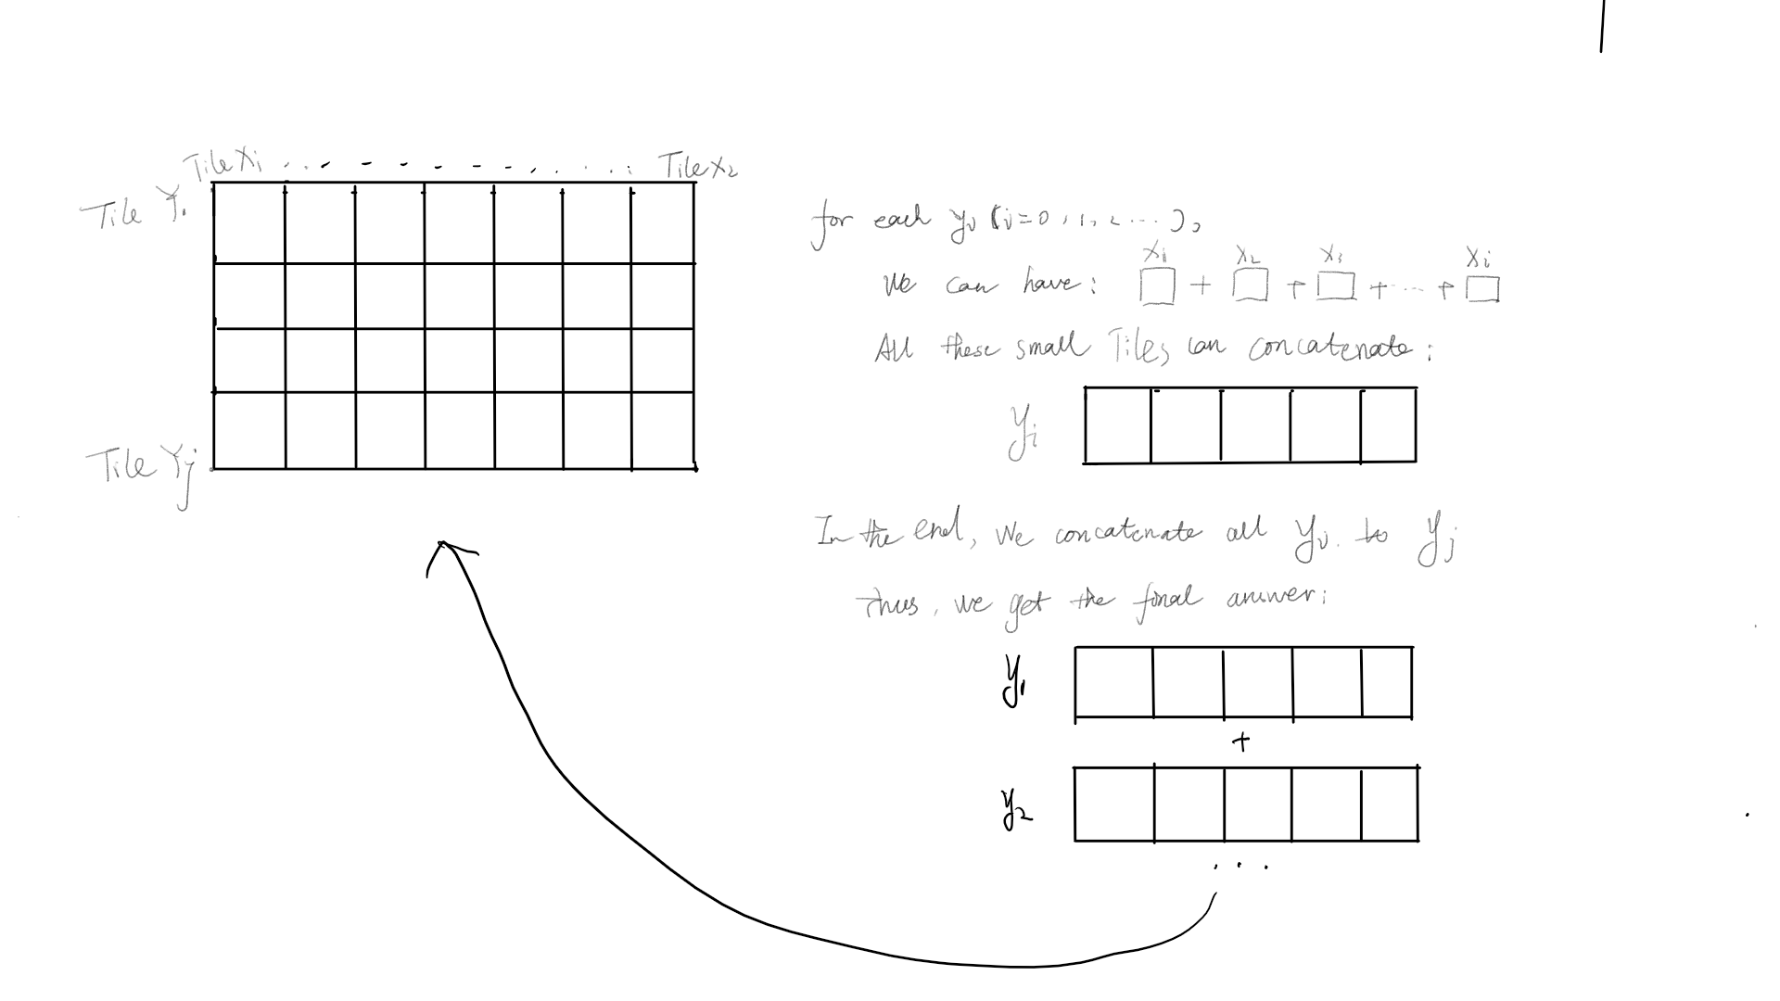
4. Image Processing

Slide 12
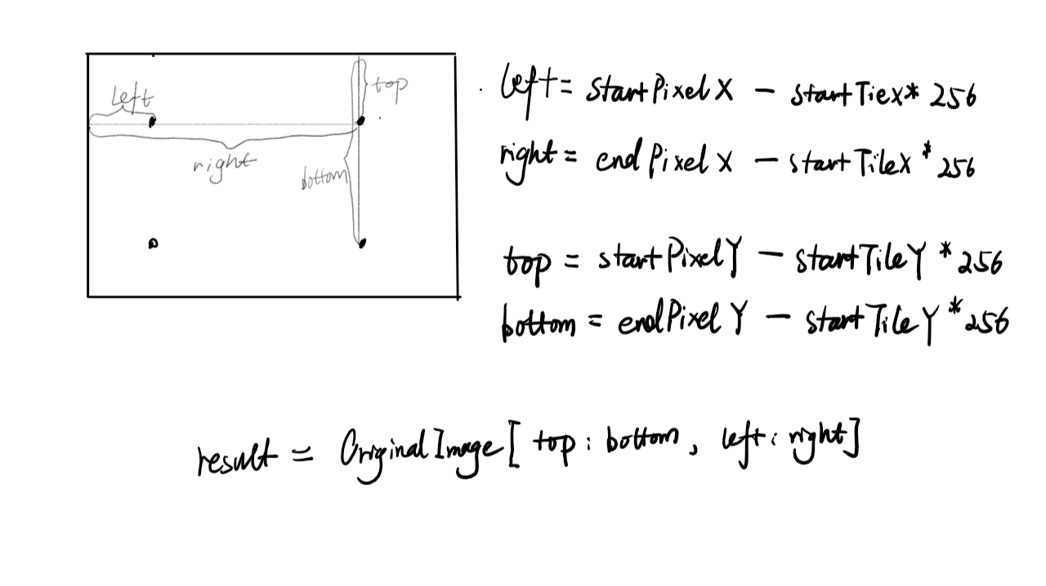
5. Crop Image

Slide 13
6. Other
We set up a train set error.jpeg to verify the image we get. It helps improve the performance. Since we don’t have to use Restful API to get the json data. We can simply replace the quadKey of the url and get the image directly.

Slide 14
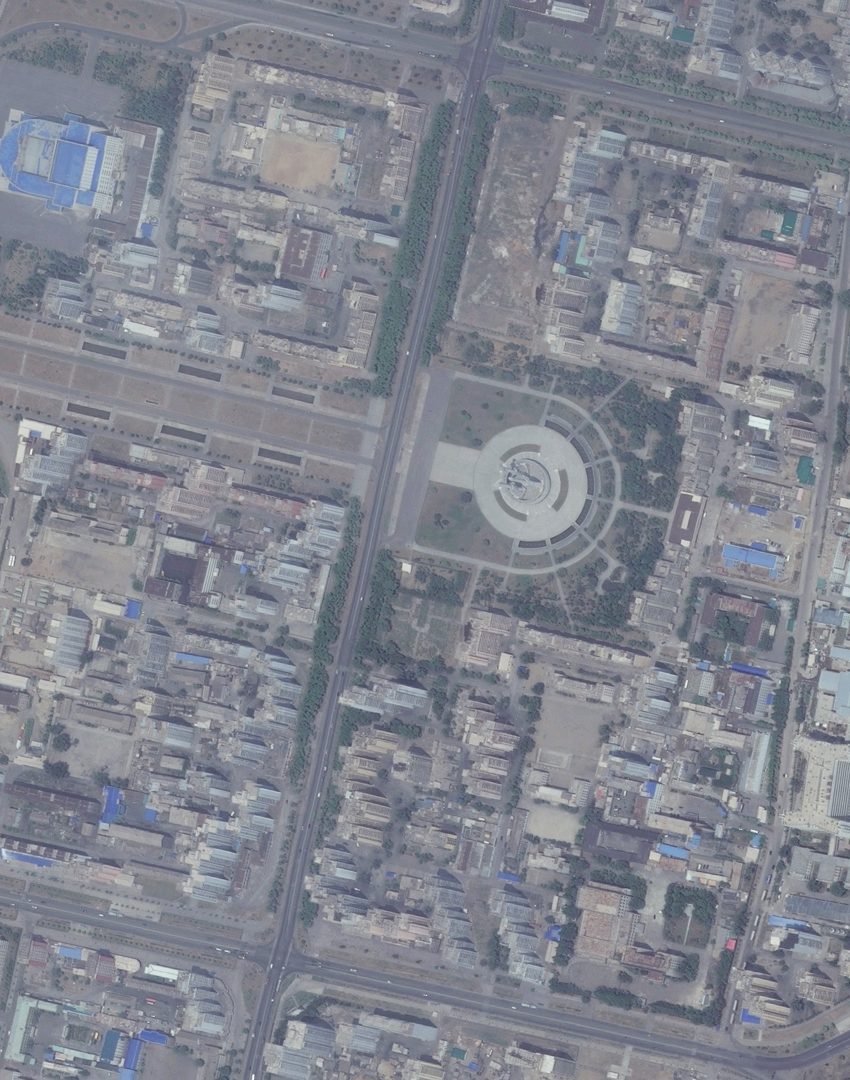
7.RESULT
Lat1,Lon1: 39.032759,125.769613
Lat2,Lon2: 39.021827,125.780696

Slide 15
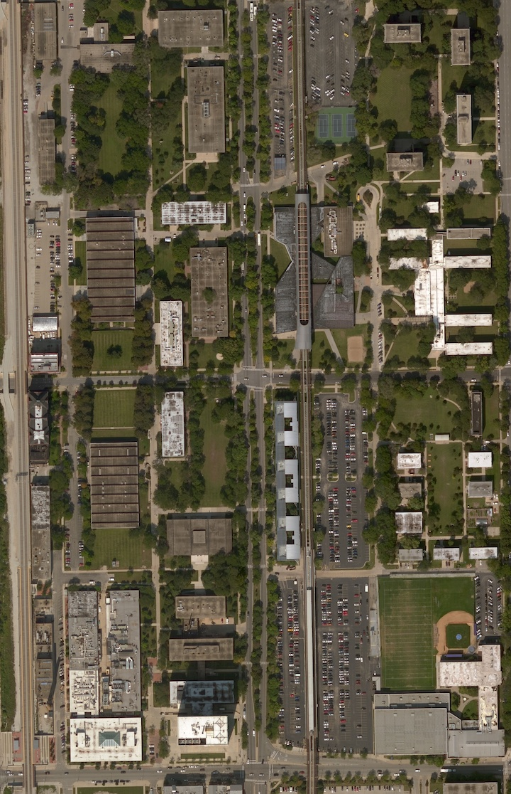
7.RESULT
IIT campus By
Lat1,Lon1: 41.838194,-87.629760
Lat2,Lon2: 41.830807,-87.623366

Slide 16
DRAWBACKS AND DISCUSSION
Performance: we recursively checking the image from internet. It means we make lots of requests, which will influences our performance. Furthermore, the depth of levels are unpredictable.
The time complexity might consider as ((Hl+Ll)/2)*n*m, where n is the number of the tileX, m is the number of the tileY. Where Hl is start level, Ll is the level that we found all images. But as we know as level decrease, the n and m will decrease quadratically. So our analysing might not accurate.

Slide 17
REFERENCE
Imagery Metadata API (https://msdn.microsoft.com/en-us/library/ff701712.aspx)
Bing Maps Tile System（https://msdn.microsoft.com/en-us/library/bb259689.aspx）

Slide 18
THANK YOU

