Slide 1
Data Analytics Systems: Metrics and Architecture
张晓达
2017年12月4日
Heavily based on Mike Freedman’s slides

Slide 2









Big data analytics
Notes:
大量的开源软件组成了数据分析系统软件栈，资源管理层：Hadoop YARN, Mesos;计算框架层：MapReduce, Spark,Tez;应用层：Hive，HBASE

Slide 3


Computation frameworks
MPI(Message Passing Interface)
Tasks execute concurrently and communicate during their execution.
Killing or removing a single process requires restart of all the other processes in the set.
Hadoop MapRedeuce
Tasks are independent of each other, thus killing one task will not impact another.
Computation benefits from a fine-grain (dynamic) resource sharing model.
Notes:
MPI：科学计算，专用设备，需要任务的同步和通信，同时，低容错性。
Hadoop: 通用设备，任务相对独立。

Slide 4

Computation frameworks
Dryad (Microsoft)
App combines computational vertices with communication channels to form a dataflow graph (DAG).
Dryad runs the app by executing the vertices on a set of available computers, communicating as appropriate method.
Spark
Resilient Distributed Datasets (RDDs) is a distributed memory abstraction that lets programmers perform in-memory computations.
Execute apps by building their lineage graphs (DAGs) and split them into stages.
Notes:
Dryad: 比mapreduce更一般化地抽象一个应用为DAG
Spark: 与Dryad相比，把尽可能多的task pipeline起来，而不是每个节点都是用一个任务去做，如何划分这些任务？

Slide 5
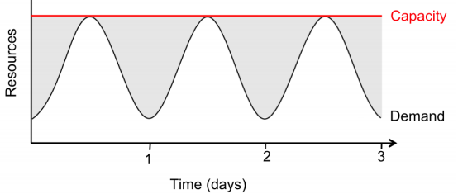
Towards fuller utilization
Source of variable demand?
Search, social networks, e-commerce, usage have diurnal patterns
Apocryphal story: AWS exists because Amazon needed to provision for holiday shopping season, wanted to monetize spare capacity
But…if provision for peak, what around remaining time?
Fill-in with non-time-sensitive usage, e.g., various data crunching
E.g., Netflix using AWS at night for video transcoding
Notes:
在集群资源管理层，我们总是希望机器能够物尽其用，保持比较高的利用率。但是常常事与愿违，因为各种应用包括搜索应用，社交应用，电商等都展现了这种波动式的利用率曲线。我们知道基础设施的配置肯定是为了高峰时端的压力来配置的。那么在平时不是就有空闲了吗？空闲的怎么办？亚马逊一开始搞云计算的初衷就是为了把它不用的空闲机器租出去赚钱。
今天我们主要关注的就是集群资源管理这一层。

Slide 6
Outline
Metrics / goals for scheduling resources
Max-min fairness
Dominate resource fairness
System architecture for big-data scheduling
Centralized architecture: Google’s Borg, YARN
Offer-based architecture: Mesos
Notes:
首先讲讲资源管理层的目标是什么？或者说调度的准则是什么？然后讲讲现有的一些资源管理和调度的框架有什么？

Slide 7
Scheduling: An old problem
CPU allocation
Multiple processors want to execute, OS selects one to run for some amount of time
Bandwidth allocation
Packets from multiple incoming queue want to be transmitted out some link, switch chooses one
Notes:
调度是一个古老的问题了。在操作系统中，在每一时刻都需要决定运行哪一个可执行的进程；在交换机上，会有多个入口的队列等着传输数据报，选择哪一个队列的包传出去是流调度问题。

Slide 8
What do we want from a scheduler?
Isolation
Have some sort of guarantee that misbehaved processes cannot affect me “too much”
Efficient resource usage
Resource is not idle while there is process whose demand is not fully satisfied
“Work conservation” -- not achieved by hard allocations
Flexibility
Can express some sort of priorities, e.g., strict or time based
Notes:
我们总是希望调度器能够满足我们提出的一些需求：比如隔离性：别的进程不管他怎么操作不会影响我的进程的执行；另一个常见的目标是资源充分利用：也就是当有进程资源需求还没被满足，而且当前有空闲的资源时，我必须得把资源给他，这也就是work conservation；第三个目标是灵活性，也就是我的调度算法能够表达多种优先级。

Slide 9
Single Resource: Fair Sharing
CPU
100%
n users want to share a resource (e.g. CPU)
Solution: give each 1/n of the shared resource
Generalized by max-min fairness
Handles if a user wants less than its fair share
E.g. user 1 wants no more than 20%
Generalized by weighted max-min fairness
Give weights to users according to importance
User 1 gets weight 1, user 2 weight 2
33%
50%
33%
33%
0%
100%
20%
40%
50%
40%
0%
100%
33%
50%
66%
0%
Notes:
比如我们想调度CPU这个单一的资源，我们想要的公平的把资源分配出去。N个用户，每个人拿到1/N就是公平的。
当有用户的需求少于1/N，我们首先满足他的需求，将剩余的平均分给其他人，这就叫max-min fairness.
当用户有权重时，分配时按照权重比例进行分配，这就是weighted max-min fairness

Slide 10
Max-Min Fairness is Powerful
Weighted Fair Sharing / Proportional Shares
User u1 gets weight 2, u2 weight 1
Priorities: Give u1 weight 1000, u2 weight 1
Reservations
Ensure u1 gets 10%: Give u1 weight 10, sum weights ≤ 100
Deadline-based scheduling
Given a job’s demand and deadline, compute user’s reservation / weight
Isolation: Users cannot affect others beyond their share
Notes:
可以用max-min fairness来实现按比例分配；可以实现优先级，将优先级高的权重设比优先级低的高非常多；可以实现资源预留，将一个用户的权重设为10，给用户的总权重不超过100，那么我就保证了这个用户保证能拿到10%的资源量；能够实现基于deadline的调度，将权重设为deadline;

Slide 11
Max-min Fairness via Fair Queuing
Fair queuing explained in a fluid flow system: reduces to bit-by-bit round robin among flows
Each flow receives min( r_{i}, f ), where
r_{i} – flow arrival rate
f – link fair rate (see next slide)
Weighted Fair Queuing (WFQ)
Associate a weight with each flow
Notes:
如何实现这个max-min fairness, 有个很好的比喻，就是涨水的模型

Slide 12
Fair Rate Computation
If link congested, compute f such that
f = 4:
min(8, 4) = 4
min(6, 4) = 4
min(2, 4) = 2
8
10
4
6
4
2
2

Slide 13
Fair Rate Computation
Associate a weight w_{i} with each flow i
If link congested, compute f such that
f = 2:
min(8, 2*3) = 6
min(6, 2*1) = 2
min(2, 2*1) = 2
(w₁ = 3)
8
10
6
(w₂ = 1)
6
2
(w₃ = 1)
2
2
Notes:
能够很容易扩展为带权的max-min fairness

Slide 14
Theoretical Properties of Max-Min Fairness
Share guarantee
Each user gets at least 1/n of the resource
But will get less if her demand is less
Strategy-proof
Users are not better off by asking for more than they need
Users have no reason to lie
Notes:
可以通过博弈论的方法证明这个max-min fainess能够使得每个用户都有share guarantee, 同时又是strategy-proof：也就是用户不能通过撒谎来获得更多的资源

Slide 15

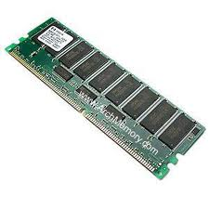
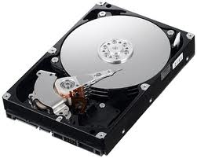
Why is Max-Min Fairness Not Enough?
Job scheduling is not only about a single resource
Tasks consume CPU, memory, network and disk I/O
What are task demands today?
Notes:
但是这个max-min fairness能够解决我们在集群资源调度中的问题吗？计算机系统的资源显然不是一种

Slide 16
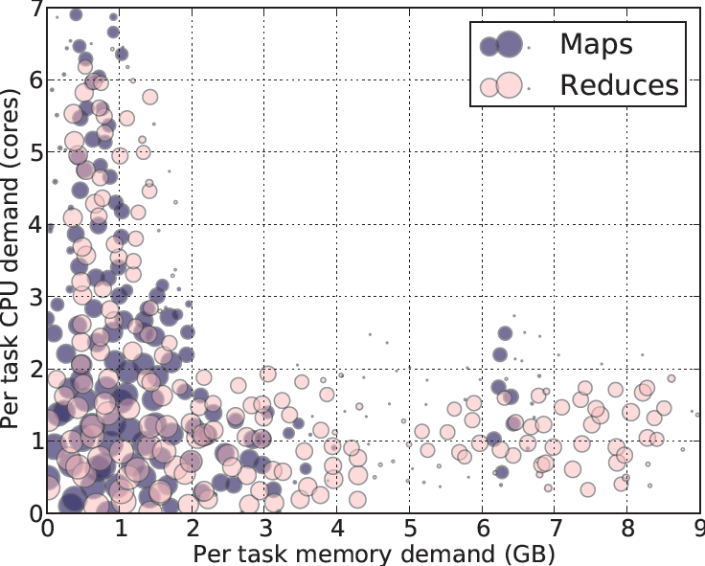
Heterogeneous Resource Demands
Some tasks are CPU-intensive
Most task need ~
<2 CPU, 2 GB RAM>
Some tasks are memory-intensive
2000-node Hadoop Cluster at Facebook (Oct 2010)

Slide 17
How to allocate?
2 resources: CPUs & memory
User 1 wants <1 CPU, 4 GB> per task
User 2 wants <3 CPU, 1 GB> per task
What’s a fair allocation?
100%
? ?
50%
0%
CPU
mem
Notes:
有两种资源需求，如何分配才算是公平的呢？

Slide 18
A Natural Policy
Asset Fairness: Equalize each user’s sum of resource shares
Cluster with 28 CPUs, 56 GB RAM
U₁ needs <1 CPU, 2 GB RAM> per task, or <3.6% CPUs, 3.6% RAM> per task
U₂ needs <1 CPU, 4 GB RAM> per task, or <3.6% CPUs, 7.2% RAM> per task
Asset fairness yields
U₁: 12 tasks: <43% CPUs, 43% RAM> (∑=86%)
U₂: 8 tasks: <28% CPUs, 57% RAM> (∑=86%)
100%
43%
43%
50%
57%
Problem: violates share guarantee
User 1 has < 50% of both CPUs and RAM
Better off in separate cluster with half the resources
28%
0%
CPU
RAM
User 1
User 2
Notes:
一个自然的想法就是asset fairness, 把每个task的CPU占比和mem占比加起来，使得用户1的task的这个和与用户2的这个和相等。
但是这样就违反了share guarantee这个特性了！直接把这个集群一刀均分成两半得到的结果会比现在更好。

Slide 19
Cheating the Scheduler
Users willing to game the system to get more resources
Real-life examples
A cloud provider had quotas on map and reduce slots Some users found out that the map-quota was low. Users implemented maps in the reduce slots!
A search company provided dedicated machines to users that could ensure certain level of utilization (e.g. 80%). Users used busy-loops to inflate utilization.
How achieve share guarantee + strategy proofness for sharing?
Generalize max-min fairness to multiple resources
Notes:
用户可能会骗service provider来获取更多的资源

Slide 20
Dominant Resource Fairness (DRF)
A user’s dominant resource is resource user has biggest share of
Example:
Total resources:
User 1’s allocation:
Dominant resource of User 1 is CPU (as 25% > 20%)
A user’s dominant share: fraction of dominant resource allocated
User 1’s dominant share is 25%
8 CPU
2 CPU
5 GB
1 GB
25% CPUs
20% RAM
Ali Ghodsi, et al. Dominant resource fairness: fair allocation of multiple resource types. NSDI '11.

Slide 21
Dominant Resource Fairness (DRF)
Apply max-min fairness to dominant shares
Equalize the dominant share of the users. Example:
Total resources: <9 CPU, 18 GB>
User 1 demand: <1 CPU, 4 GB>; dom res: mem (1/9 < 4/18)
User 2 demand: <3 CPU, 1 GB>; dom res: CPU (3/9 > 1/18)
Analysis: DRF satisfies appropriate properties
Strategy-proofness
Sharing incentive
100%
User 1
3 CPUs
12 GB
66%
User 2
50%
66%
6 CPUs
2 GB
0%
CPU
(9 total)
mem
(18 total)

Slide 22
Online DRF Scheduler
Whenever available resources and tasks to run:
Schedule task to user with smallest dominant share

Slide 23
Many Competing Frameworks
Many different “Big Data” frameworks
Hadoop | Spark
Storm | Spark Streaming | Flink
GraphLab
MPI
Heterogeneity will rule
No single framework optimal for all applications
So…each framework runs on dedicated cluster?
Notes:
各种类型的计算框架，每种都单独占用一部分集群

Slide 24
One Framework Per Cluster Challenges
Inefficient resource usage
E.g., Hadoop cannot use underutilized resources from Spark
Not work conserving
Hard to share data
Copy or access remotely, expensive
Hard to cooperate
E.g., Not easy for Spark to use graphs generated by Hadoop
Notes:
为每个应用都配置一个单独的集群？

Slide 25

Common resource sharing layer ?
Abstracts (“virtualizes”) resources to frameworks
Enable diverse frameworks to share cluster
Make it easier to develop and deploy new frameworks
Hadoop
Spark
Hadoop
Spark
Resource Management System
Uniprograming
Multiprograming
Notes:
是不是得有一个专门负责资源管理的平台？为上层的计算框架提供抽象的资源，不同的框架可以共享这个集群的资源

Slide 26
Approach #1: Global scheduler
Global scheduler takes input, outputs task schedule
Organization policies
Resource Availability
Estimates: Task durations, input sizes, xfer sizes, …
Job requirements: Latency, throughput, availability…
Job execution plan: Task DAG, inputs/outups
Advantages: “Optimal”
Disadvantages
More complex, harder to scale (yet Google: 10,000s servers/scheduler)
Anticipate future requirements, refactor existing

Slide 27
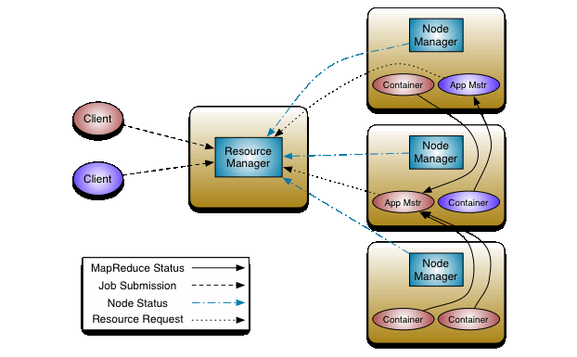
Apache Hadoop YARN
Split up the functionalities of resource management and job scheduling into separate daemons
ResourceManager(RM), NodeManager(NM), ApplicationMaster(AM)
AM and NM report their states through heartbeats
Resource allocations happen at
NMs’ heartbeats, and will wait for AMs
to pull them (pull-based).
Vinod K. Vavilapalli et al. Apache Hadoop YARN: Yet Another Resource Negotiator. SoCC '13.

Slide 28
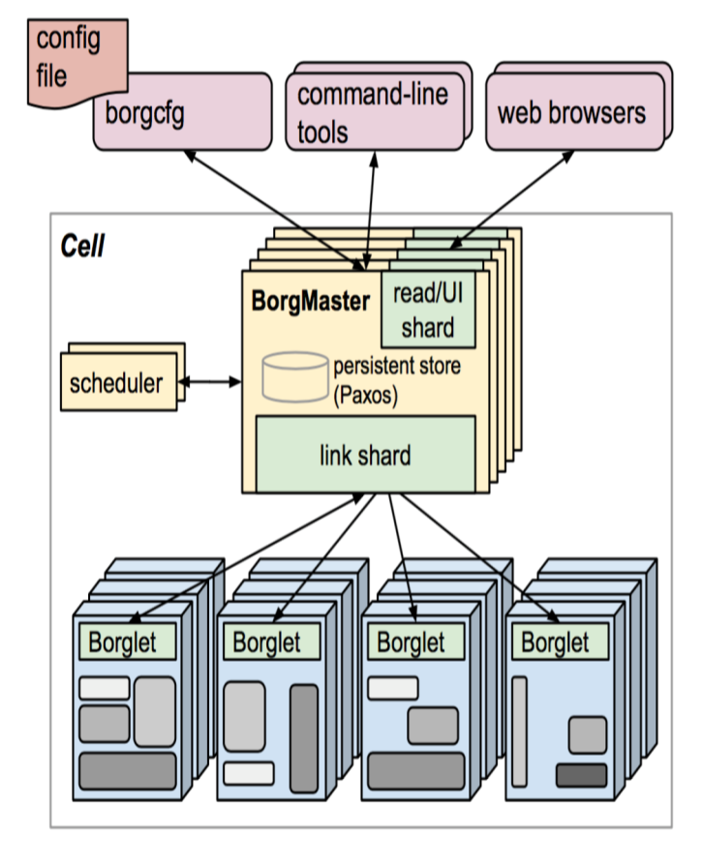
Google’s Borg
Centralized Borgmaster + Localized Borglet (manage/monitor tasks)
Goal: Find machines for a given job
job hello = {
runtime = { cell = “ic” }
binary = ‘../hello_webserver’
args = { port = ‘%port%’ }
requirements = {
RAM = 100M
disk = 100M
CPU = 0.1
}
replicas = 10000
}
Large-scale cluster management at Google with Borg
A. Verma, L. Pedrosa, M. Korupolu, D. Oppenheimer, E. Tune, J. Wilkes, EuroSys ‘15

Slide 29
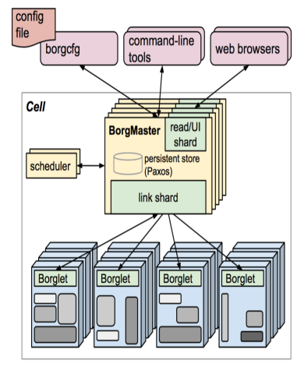
Google’s Borg
Centralized Borgmaster + Localized Borglet (manage/monitor tasks)
Goal: Find machines for a given job
Used across all Google services
Services: Gmail, web search, GFS
Analytics: MapReduce, streaming
Framework controller sends master allocation request to Borg for full job

Slide 30
Google’s Borg
Centralized Borgmaster + Localized Borglet (manage/monitor tasks)
Goal: Find machines for a given job
Allocation
Minimize # / priority preempted tasks
Pick machines already having copy of the task’s packages
Spread over power/failure domains
Mix high/low priority tasks
Notes:
在分配作业时，有这样的几个优化点：选择已经有task包的那些机器来执行；为实现容错，将job分散在不同的domain中；为提高资源利用率，将高优先级和低优先级的task混合执行

Slide 31
Approach #2: Offers, not schedule
Unit of allocation: resource offer
Vector of available resources on a node
E.g., node1: <1CPU, 1GB>, node2: <4CPU, 16GB>
Master sends resource offers to frameworks
Frameworks:
Select which offers to accept
Perform task scheduling
Unlike global scheduler, requires another level of support
Mesos: A Platform for Fine-Grained Resource Sharing in the Data Center
Benjamin Hindman, Andy Konwinski, Matei Zaharia, Ali Ghodsi, Anthony D. Joseph, Randy Katz, Scott Shenker, Ion Stoica, NSDI’11
Notes:
只负责资源管理，task的调度扔给上层的计算框架来做

Slide 32
Mesos Architecture: Example
Slaves continuously send status updates about resources
Framework executors launch tasks and may persist across tasks
Framework scheduler selects resources and provides tasks
Slave S1
Hadoop Executor
task 1
Hadoop
JobTracker
MPI executor
task 1
S1:<8CPU,8GB>
(task1:[S1:<2CPU,4GB>];
task2:[S2:<4CPU,4GB>])
8CPU, 8GB
Mesos Master
task1:<4CPU,2GB>
S1
S1
S1
<6CPU,4GB>
<8CPU,8GB>
Slave S2
<2CPU,2GB>
task 1:<2CPU,4GB>
S2
S2
<8CPU,16GB>
Hadoop Executor
<4CPU,12GB>
(S1:<8CPU, 8GB>,
S2:<8CPU, 16GB>)
task 2
(S1:<6CPU,4GB>, S3:<16CPU,16GB>)
S3
<16CPU,16GB>
S2:<8CPU,16GB>
task 2:<4CPU,4GB>
Allocation Module
8CPU, 16GB
Slave S3
Spark
JobTracker
S3:<16CPU,16GB>
Pluggable scheduler to
pick framework to
send an offer to
([task1:S1:<4CPU,2GB])
16CPU, 16GB
Notes:
插件式的分配模块

Slide 33
Why does it Work?
A framework can wait for offer that matches its constraints or preferences, reject otherwise
Example: Hadoop’s job input is blue file
S1
Hadoop
(Job tracker)
(task1:[S2:<…>];
task2:[S3:<..>])
(S2:<…>,S3:<…>)
S1:<…>
Mesos
master
S2
task1:<…>
Accept: both S2 and S3 store the blue file
task2:<…>
Reject: S1 doesn’t store blue file
S3

Slide 34
Two Key Questions
How long does a framework need to wait?
Depends on distribution of task duration
“Pickiness” of framework given hard/soft constraints
How allocate resources of different types?
Use DRF!
Notes:
不同的framework等待多长时间？取决于他运行什么类型的作业

Slide 35
Thanks Q&A

