Slide 1
Molecular Dynamics:
From Learning the Fundamentals to a Complete Water Simulation
Youssef Ahmed
Westlake University
Youssef@westlake.edu.cn
Under the supervision
of
Prof. Yiqin Gao and Dr. Manas Mondal
1

Slide 2
PART A — THE LEARNING PHASE
My Journey
Book
Molecule
Computer / Box
Graph
Learning
Implementation
Simulation
Analysis
Understanding how molecular dynamics works physically and computationally
Building a complete liquid-water molecular system
Preparing, equilibrating and running the system with SPONGE
Thermodynamics, molecular geometry and radial distribution functions
Learn → Build → Simulate → Analyze
2

Slide 3
PART A — THE LEARNING PHASE
What I First Needed to Learn
Before running simulations, I first studied four main areas:
Molecular
Physics
Numerical
Algorithms
• Molecular interactions and force calculation
• Numerical algorithms for atomic motion
• Periodic systems, electrostatics and thermodynamic ensembles
• Practical MD tools and the connection between MD and AI
These were exactly the four broad learning areas developed from the
mentor-provided materials.
Statistical
Mechanics
Simulation
Tools
3

Slide 4
PART A — THE LEARNING PHASE
What Is Molecular Dynamics?
Atomic
positions
Molecular Dynamics (MD) simulates how atoms move through time by repeatedly applying Newton's laws.
Calculate
potential energy
Fᵢ = −∇ᵢU
aᵢ = Fᵢ / mᵢ
Calculate
forces
↺ repeat
Then a numerical integration algorithm updates the positions and velocities.
Update velocities
& positions
New
configuration
4

Slide 5
PART A — THE LEARNING PHASE
How a Molecular System Is Represented
A simulation needs more than atomic coordinates.
O → charge, mass,
LJ parameters
O
For each atom or molecule we need information such as:
• position
• velocity
• mass
• charge
• atom type
• molecular connectivity
• interaction parameters
H
H
O–H → bonded /
constraint information
H → charge, mass
Molecular structure → numerical data used by the MD engine
5

Slide 6
PART A — THE LEARNING PHASE
Force Fields: Turning Chemistry Into Equations
A classical force field approximates the potential energy:
Bonded
Non-bonded
U = U_bonded + U_nonbonded
O
O
O
Conceptually:
H
H
H
H
H
H
Bonded interactions
Non-bonded interactions
• bonds
• angles
• dihedrals
• van der Waals / Lennard-Jones
• electrostatics
bond / angle
LJ + electrostatics
The force is obtained from the gradient of this potential.
6

Slide 7
PART A — THE LEARNING PHASE
From Forces to Motion
The computer cannot solve molecular motion continuously.
Instead:
t, t + Δt, t + 2Δt, …
O
O
O
O
H
H
H
H
H
H
H
H
At every small timestep:
1. update motion;
2. calculate new forces;
3. update motion again;
4. repeat.
Frame 1
Frame 2
Frame 3
Frame 4
Frame 1 → Frame 2 → Frame 3 → Frame 4
Accuracy ↔ computational cost
Smaller timestep → more stable/accurate
Larger timestep → faster but potentially unstable
7

Slide 8
PART A — THE LEARNING PHASE
Numerical Integration and Velocity Verlet
One important algorithm I studied was Velocity Verlet.
1/2 velocity
Conceptually:
Half velocity update
↓
Position update
position
↓
New force calculation
↓
Second half velocity update
↓
1/2 velocity
repeat
new force
The earlier learning work specifically covered Verlet, Velocity Verlet and Leapfrog, together with timestep stability and numerical error.
Velocity Verlet loop
8

Slide 9
PART A — THE LEARNING PHASE
Preparing a System Before MD
A simulation cannot normally start directly from arbitrary coordinates.
Preparation includes:
Bad
structure
Minimized
structure
Velocities
added
MD
ready
Initial positions
→ avoid overlaps and unrealistic geometries
Energy minimization
→ move toward a physically reasonable low-energy structure
Initial velocities
→ assign a temperature-dependent velocity distribution
Constraints
→ keep selected molecular geometry fixed
Energy minimization is preparation — it is not physical simulation time.
The learning phase covered initial position preparation, velocity assignment, minimization and constraints including SHAKE, RATTLE, LINCS and SETTLE.
9

Slide 10
PART A — THE LEARNING PHASE
Periodic Boundary Conditions
A small simulation box has artificial surfaces.
O
O
O
H
H
H
H
H
H
crosses boundary
To approximate bulk material, the box is repeated periodically.
When a molecule leaves one side:
O
O
O
H
H
H
H
H
H
it enters through the opposite side.
O
O
O
H
H
H
H
H
H
3 × 3 periodic copies
10

Slide 11
PART A — THE LEARNING PHASE
Minimum Image + Non-Bonded Cutoff
For short-range interactions:
use the nearest periodic copy of another atom.
cutoff radius
A cutoff reduces computational cost by ignoring sufficiently distant short-range interactions.
But electrostatics cannot simply be truncated in the same way because Coulomb interactions are long-ranged.
nearest periodic copy
Central box
11

Slide 12
PART A — THE LEARNING PHASE
Long-Range Electrostatics: PME
Particle Mesh Ewald
Particles
Particles
PME separates electrostatic calculations into:
Short-range
Charge mesh
→ direct calculation in real space
Real-space
interactions
Long-range
→ charges mapped to a mesh
→ FFT
→ reciprocal-space contribution
FFT
Then both contributions are combined.
Reciprocal-space
interactions
combine
12

Slide 13
PART A — THE LEARNING PHASE
NVE, NVT and NPT Ensembles
Ensemble
Fixed/controlled
Main use
NVE
N, V, E
Numerical/stability studies
NVT
N, V, T
Temperature equilibration
NPT
N, P, T
Density/volume equilibration and pressure-controlled simulation
NVE
NVT
NPT
Thermostat controls temperature.
fixed box
heat bath
heat bath +
shrinking/expanding box
Barostat controls pressure/volume.
heat
heat
13

Slide 14
PART A — THE LEARNING PHASE
Thermostats and Barostats
I studied several thermostat approaches:
• velocity rescaling
• Andersen
• Berendsen
• Langevin
• Nosé–Hoover
Thermostat
Barostat
MD box ↔ heat bath
small box ↔ large box
They differ in:
heat
bath
• how temperature is controlled;
• how fluctuations are reproduced;
• how much dynamics is disturbed.
For pressure:
barostat → changes box dimensions / volume
14

Slide 15
PART A — THERMOSTAT APPROACHES
1. Velocity Rescaling
Core idea
Before rescaling
After rescaling
Multiply every particle velocity by the same factor so the instantaneous temperature moves to the target.
λ
λ = √(Ttarget / Tinst) and vi ← λ vi
If T is too high → shorten all velocity arrows
If T is too low → lengthen all velocity arrows
Strengths
Limitations
Very simple
Rapidly reaches target T
Basic form does not reproduce canonical temperature fluctuations
Abrupt scaling can disturb dynamics
Best for initialization or simple temperature correction — not the best choice for rigorous production sampling.

Slide 16
PART A — THERMOSTAT APPROACHES
2. Andersen Thermostat
Core idea
Random collision with heat bath
Particles experience random “collisions” with an imaginary heat bath. When a collision occurs, the selected particle receives a new velocity drawn from the target-temperature distribution.
bath
randomize one velocity
Collision frequency ν controls coupling strength
More collisions → faster thermalization
Fewer collisions → dynamics are less disturbed
Strengths
Limitations
Samples the canonical ensemble
Easy to understand and tune
Random collisions disturb real-time dynamics
Can distort diffusion and transport properties
Good for canonical sampling, but the random collisions can strongly alter physical dynamics.

Slide 17
PART A — THERMOSTAT APPROACHES
3. Berendsen Thermostat
Core idea
Smooth relaxation toward target temperature
Weakly couple the simulated system to a heat bath. Velocities are rescaled smoothly so temperature relaxes toward the target instead of jumping there instantly.
T target
dT/dt = (T₀ − T) / τT
τT = coupling time
small τT → strong/faster coupling
Strengths
Limitations
Very stable
Excellent for early equilibration
Suppresses natural temperature fluctuations
Does not generate the correct canonical ensemble
Excellent equilibration tool; avoid treating it as rigorous canonical production sampling.

Slide 18
PART A — THERMOSTAT APPROACHES
4. Langevin Thermostat
Core idea
Friction + random kicks
Add two heat-bath effects to Newtonian motion: a friction term that removes kinetic energy and a random force that adds thermal energy back.
velocity
m
friction
random thermal kicks
m dv/dt = F − γmv + R(t)
γ = friction strength
R(t) = random thermal force
Strengths
Limitations
Correct canonical sampling when configured properly
Stable and robust for small systems
Friction can damp real dynamics
Too-large γ can overdamp motion
This is the family used in our project: Middle Langevin controlled temperature during the accepted simulations.

Slide 19
PART A — THERMOSTAT APPROACHES
5. Nosé–Hoover Thermostat
Core idea
Deterministic feedback loop
Add an extra dynamical variable that acts like a deterministic friction coefficient. The thermostat variable responds continuously to whether the system is too hot or too cold.
MD system
T(t)
ξ
feedback
ṗᵢ = Fᵢ − ξ pᵢ
ξ grows if T is too high; decreases if T is too low
Strengths
Limitations
Nosé–Hoover chains add multiple thermostat variables to improve ergodicity.
Deterministic; often preserves dynamics better than random collisions
Can sample canonical ensemble when ergodic
Can be non-ergodic for small/simple systems
More parameters and dynamics to tune
A powerful deterministic thermostat, especially with chains, but more subtle than Langevin or Berendsen.

Slide 20
PART B — BAROSTAT APPROACHES
1. Berendsen Barostat
Core idea
Smooth box-volume relaxation
Weakly couple the simulation box to a pressure bath. The box volume is smoothly rescaled so the pressure relaxes toward the target.
If pressure is too high → expand the box
If pressure is too low → compress the box
high P
lower P
τP controls how quickly the volume responds
Strengths
Limitations
Very stable and simple
Useful for density/volume equilibration
Suppresses correct NPT volume fluctuations
Not appropriate for rigorous production ensemble sampling
We used Berendsen only as an initial practical pressure-relaxation tool, not as our final production barostat.

Slide 21
PART B — BAROSTAT APPROACHES
2. Parrinello–Rahman Barostat
Core idea
Volume and shape can respond
Treat the simulation cell itself as a dynamical object. The box vectors can change in length and, when allowed, in shape in response to the pressure/stress tensor.
Useful when anisotropic shape changes matter — especially solids, crystals, interfaces, or phase transformations.
cell shape changes
Strengths
Limitations
Cell matrix h becomes a dynamical variable
Allows physically meaningful box fluctuations and anisotropy
Widely used for NPT production
Can oscillate if coupling is poorly chosen
More complex; not always ideal for tiny systems
Unlike Berendsen, Parrinello–Rahman is designed to let the box fluctuate dynamically rather than simply relax it.

Slide 22
PART B — BAROSTAT APPROACHES
3. Bussi / Stochastic Cell-Rescaling Barostat
Core idea
Fluctuating around the target volume
Rescale the box volume using a controlled relaxation toward the target pressure plus a stochastic term that restores the correct NPT volume fluctuations.
volume change = pressure-relaxation term + random fluctuation term
small fluctuation
target region
small fluctuation
Strengths
Limitations
The stochastic part is not “noise for no reason” — it is what helps reproduce the correct ensemble fluctuations.
Designed for correct NPT fluctuations
Stable and practical for production
Still requires sensible coupling parameters
Stochastic box dynamics are not intended to reproduce a literal physical piston
This was our final barostat: Bussi pressure coupling for the accepted NPT equilibration and production stages.

Slide 23
PART B — BAROSTAT APPROACHES
4. Monte Carlo Barostat
Core idea
Discrete trial move
Instead of continuously moving the box, periodically propose a trial volume change. Recalculate the energetic/statistical cost, then accept or reject the new box according to the NPT probability.
ACCEPT
REJECT
propose V′ → evaluate → accept / reject
Accepted move → continue from V′
Rejected move → keep the old box
Strengths
Limitations
Samples NPT ensemble without fictitious box dynamics
Conceptually clean acceptance rule
Each volume proposal can require expensive energy work
Not a continuous physical pressure trajectory
Useful when correct equilibrium sampling matters more than having continuous barostat dynamics.

Slide 24
THERMOSTATS AND BAROSTATS — SUMMARY
Which Methods Did We Use in Our Water Project?
Temperature control
Pressure / volume control
Middle Langevin
Berendsen — early relaxation
Bussi — final NPT
Stable canonical temperature control
Handles small-system temperature fluctuations well
Used throughout the accepted heating / equilibration / production stages
Berendsen: gently move density/volume toward a reasonable region
Bussi: retain appropriate NPT fluctuations for final equilibration and production
Why? Robust temperature control without the fluctuation-suppression problem of Berendsen.
Protocol logic: relax first → sample properly later.
Thermostats and barostats are not interchangeable: they control different physical variables and can generate different ensembles.

Slide 25
PART A — THE LEARNING PHASE
Practical MD Tools
The learning phase also moved from theory to real simulation tools.
Xponge
system preparation / processing
SPONGE
System
prep
MD
engine
Output
files
Analysis
runs molecular dynamics
Trajectory + simulation outputs
Xponge → SPONGE → VMD / MDAnalysis
Visualization / Python analysis
VMD → visualization
MDAnalysis / Python → trajectory analysis
The practical-learning section connected Xponge → SPONGE → visualization/analysis tools.
25

Slide 26
PART A — THE LEARNING PHASE
Where AI Fits Into Molecular Dynamics
Traditional loop
Traditional MD:
Coordinates
Analytical
force field
Forces
Integrator
coordinates → analytical force field → forces → integrator
AI-based MD:
AI-assisted loop
coordinates → learned potential → forces → integrator
Coordinates
Learned
potential
Forces
Integrator
AI may replace the energy/force model — not the whole MD engine.
Periodic boundaries, integration, ensembles, thermostats, stability and analysis are still required.
This distinction was a key conclusion of the learning phase.
26

Slide 27
PART B — FROM LEARNING TO THE ACTUAL EXPERIMENT
Moving From Theory to My First MD Experiment
After learning the MD workflow, the next objective was to implement it end-to-end.
Project objective
Build a periodic liquid-water system and complete:
system
preparation
minimization
temperature
conditioning
heating
equilibration
production
analysis
27

Slide 28
PART B — FROM LEARNING TO THE ACTUAL EXPERIMENT
Why Start With Water?
Water was a useful first complete molecular simulation because:
O
O
O
H
O
H
H
O
H
• it is physically important;
• molecular geometry is well defined;
• established classical water models exist;
• liquid structure can be analyzed using RDFs;
• it contains the main ingredients of realistic MD: electrostatics, van der Waals interactions, constraints, PBC and pressure control.
O
H
H
H
H
H
H
O
O
O
H
O
H
H
O
H
H
H
H
H
H
H
O
O
H
H
O
O
O
H
H
H
H
H
H
H
H
H
H
O
O
O
H
H
H
H
one water
molecule
H
H
many water Molecules
liquid box
28

Slide 29
PART B — FROM LEARNING TO THE ACTUAL EXPERIMENT
Choosing the TIP3P Water Model
We selected TIP3P, a three-site rigid water model.
δ−
One molecule contains:
O
• 1 oxygen
• 2 hydrogen atoms
Final system:
H
H
862 water molecules
δ+
δ+
862 × 3 = 2586 atoms
O–H distance
H–O–H angle
The final input files preserve the O–H–H atom ordering for all 862 molecules.
29

Slide 30
PART B — FROM LEARNING TO THE ACTUAL EXPERIMENT
Building the Simulation Box
Initial periodic system:
• 862 TIP3P water molecules
• 2586 atoms
• approximately 30 × 30 × 30 Å³
• initial density ≈ 0.9551 g/cm³
PLACEHOLDER
Insert actual VMD-style screenshot
of the 30 Å water box here
Process
Generate molecules
→ place them inside box
→ check atom ordering/topology
→ check overlaps
→ create periodic system
~30 Å
30

Slide 31
PART B — FROM LEARNING TO THE ACTUAL EXPERIMENT
From the Water Box to SPONGE Input Files
Geometry
The molecular system was converted into SPONGE input files describing:
Topology
• coordinates
• atom names/types
• masses
• charges
• Lennard-Jones parameters
• bonds / constraints
• exclusions
• residue information
water_30A_
randomized_*
Charges
LJ
Masses
Exclusions
In backup, we can show the complete input-file table.
31

Slide 32
PART B — FROM LEARNING TO THE ACTUAL EXPERIMENT
Final Simulation Parameters
This should be one of the cleanest technical slides.
Parameter
Final choice
Parameter
Final choice
Water model
TIP3P
Non-bonded cutoff
8 Å
Molecules
862
Long-range electrostatics
Particle Mesh Ewald
Atoms
2586
Water constraints
SETTLE
Initial box
~30 × 30 × 30 Å³
Thermostat
Middle Langevin
Target temperature
300 K
Initial pressure relaxation
Berendsen
Target pressure
1 bar
Final NPT equilibration / production
Bussi pressure coupling
Main timestep
1 fs
SPONGE was requested with a SHAKE constraint flag, but the runtime initialized all 862 rigid waters through SETTLE, so SETTLE is the correct constraint method to report.
32

Slide 33
PART B — FROM LEARNING TO THE ACTUAL EXPERIMENT
Simulation Environment
Platform
Windows + PowerShell
Environment
sponge-cpu
MD engine
SPONGE
Supporting package
Xponge
Input files
↓
SPONGE
O
H
H
↓
system box
restart files + trajectory
+ mdout + box data
O
O
H
H
↓
H
H
Python analysis
Do not show a big terminal screenshot unless you have a clean one.
Simple architecture of the practical SPONGE workflow
33

Slide 34
PART C — THE FULL EXPERIMENTAL WORKFLOW
The Complete Accepted Simulation Workflow
Main production chain
Side branch from the 5 ps practical NPT state
Build water box
50 → 300 K heating
7 ps
↓
↓
Practical NPT relaxation
5 ps
Energy minimization
7600 steps
300 K NVT
10 ps
↓
↓
↓
50 K seed velocity
Practical NPT relaxation
5 ps
2 ps NVE diagnostic
↓
↓
10 K quench
0.02 ps
Bussi-NPT equilibration
80 ps
Diagnostic only — not production input
↓
↓
25 K low-temperature relaxation
0.10 ps
Production Segment 1
6 ps
↓
↓
50 K conditioning
0.30 ps
Production Segment 2
4 ps
↓
↓
1 fs preflight at 50 K
0.20 ps
Final analysis
34

Slide 35
PART C — THE FULL EXPERIMENTAL WORKFLOW
Stage 1: Energy Minimization
Why?
The constructed box may contain unfavorable local geometry or excessive forces.
What we did
Accepted minimization: 7600 cumulative steps
Goal
reduce problematic forces and moves atoms toward a safer, lower-energy configuration..
Initial structure at high point
minimization
lower-energy structure
Potential energy landscape
Before minimization → After minimization
35

Slide 36
PART C — THE FULL EXPERIMENTAL WORKFLOW
Stage 2: Initial Velocities and Low-Temperature Conditioning
Generate valid rigid-water
50 K velocities
→
10 K quench
→
25 K relaxation
→
50 K NVT conditioning
→
50 K, 1 fs preflight
50 K
200 steps
0.02 ps
400 steps
0.10 ps
600 steps
0.30 ps
0.20 ps
Temperature staircase: 50 K seed → 10 K → 25 K → 50 K → 50 K preflight
The 25 K state is not claimed to be a fully equilibrated 25 K system.
It was accepted as a safe low-temperature state for continuing to 50 K.
36

Slide 37
PART C — THE FULL EXPERIMENTAL WORKFLOW
Stage 3: Controlled Heating to 300 K
Heating too rapidly can destabilize a newly prepared system by excessive velocities, unstable forces, and structural problems.
So temperature was increased gradually.
Temperature staircase graph
300 K
300 K
Actual heating protocol
50 K starting state
→ 100 K — 1 ps
→ 150 K — 1 ps
→ 200 K — 1 ps
→ 250 K — 1 ps
→ 300 K — 1 ps
→ 300 K hold — 2 ps
Total
7 ps
250 K
200 K
150 K
100 K
50 K
50 → 100 → 150 → 200 → 250 → 300 → hold
37

Slide 38
PART C — THE FULL EXPERIMENTAL WORKFLOW
Stage 4: 300 K NVT Stabilization
After heating, the system was held at:
300 K
under the NVT ensemble
for:
10 ps
Heating
→
10 ps NVT @ 300 K
→
NPT
Purpose
• allow temperature to stabilize;
• relax the heated configuration;
• prepare a stable input for pressure relaxation.
300 K target
schematic temperature fluctuations around 300 K
38

Slide 39
PART C — THE FULL EXPERIMENTAL WORKFLOW
Stage 5: Practical NPT Density Relaxation
The next goal was to allow the box volume and density to respond to pressure.
Conditions
NPT
300 K
1 bar target
5 ps practical relaxation
Method
Middle Langevin thermostat
• initial Berendsen pressure relaxation
→
initial size
slightly adjusted size
density moving toward a stable region
Berendsen was used as a practical relaxation tool, not as evidence of rigorous production-ensemble sampling.
39

Slide 40
PART C — THE FULL EXPERIMENTAL WORKFLOW
Stage 6: NVE Numerical-Stability Diagnostic
From the relaxed NPT state, we also ran a separate:
2 ps NVE diagnostic
Why?
To check for obvious short-time numerical or structural instability without active temperature/pressure control.
Practical NPT
relaxed state
Bussi-NPT
production path
2 ps NVE
diagnostic
NVE was diagnostic only.
It was not used as the input to production.
side branch only
40

Slide 41
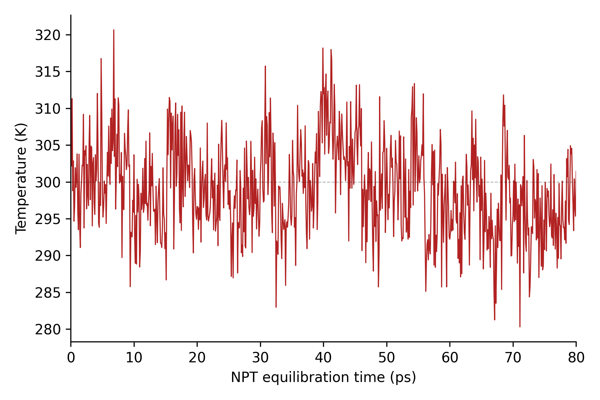
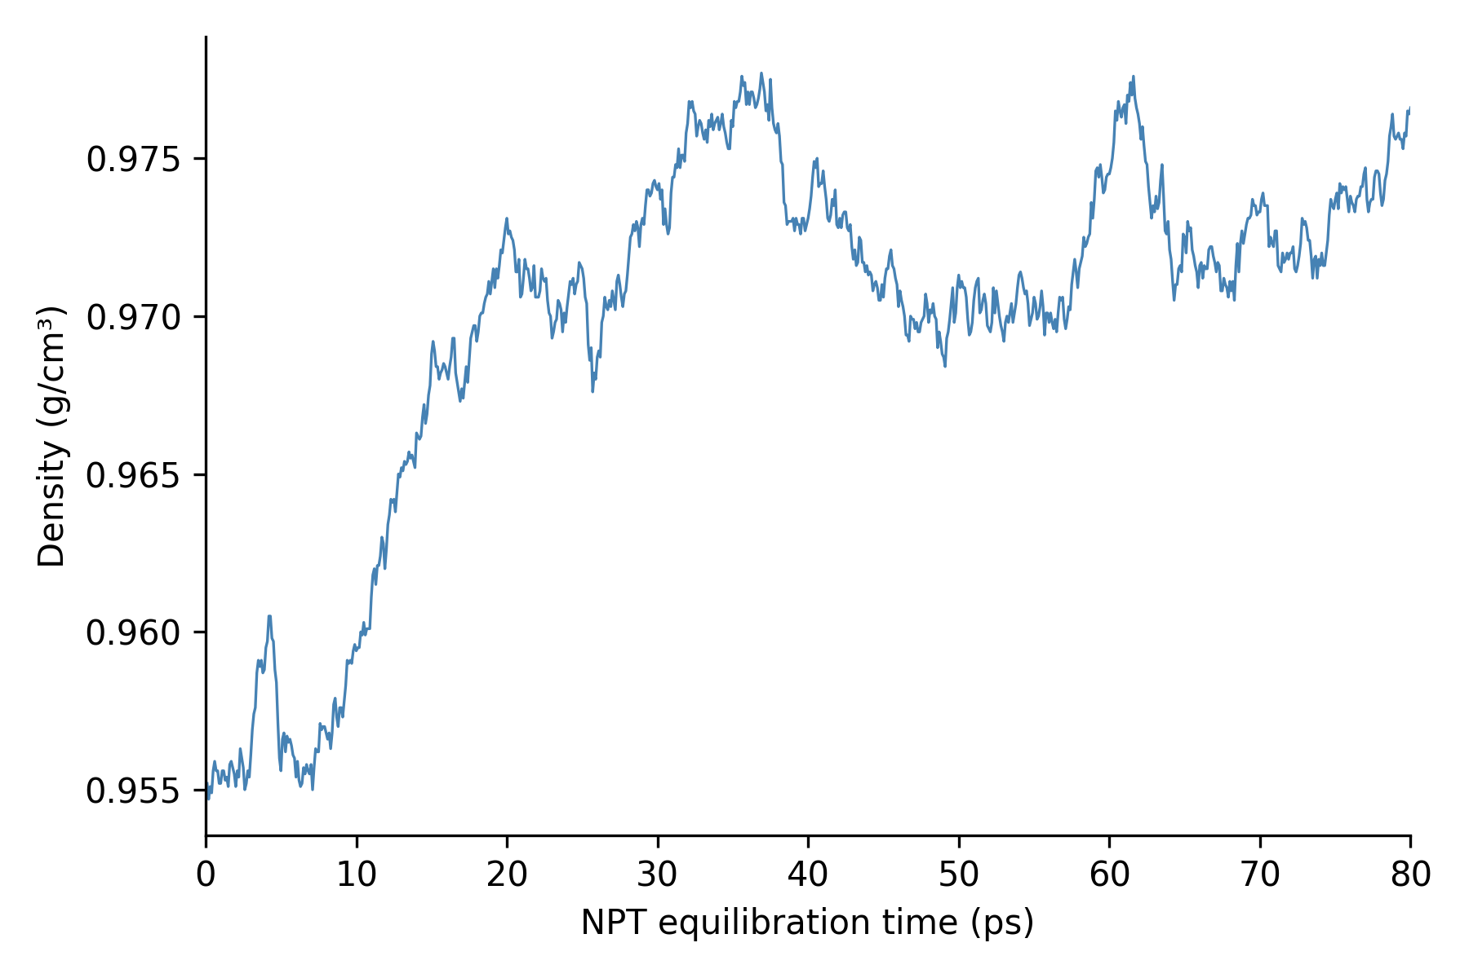
PART C — THE FULL EXPERIMENTAL WORKFLOW
Stage 7: 80 ps Bussi-NPT Equilibration
For the final pre-production equilibration:
Ensemble: NPT
Temperature: 300 K
Pressure target: 1 bar
Duration: 80 ps accepted
npt_equilibration_80ps_temperature
Why this stage mattered
It was much longer than the earlier relaxation (5ps) and allowed the volume/density behavior to be assessed before production.
npt_equilibration_80ps_density
41

Slide 42
PART C — THE FULL EXPERIMENTAL WORKFLOW
Stage 8: Final Production Simulation
Production had to be completed in two validated segments.
Segment 1
6 ps accepted
The later unsynchronized tail was excluded after an unexpected laptop/system restart.
Segment 2
Restarted from the synchronized Segment-1 endpoint
4 ps
Segment 1
0 → 6 ps
restart
Segment 2
6 → 10 ps
→
→
→ final production trajectory
6 ps + 4 ps = 10 ps
We combine them for analysis
42

Slide 43
PART C — THE FULL EXPERIMENTAL WORKFLOW
Challenges and How the Protocol Evolved
This is valuable because an internship is also about solving problems. Do not make it a diary of every failed pass.
Runtime limits
Low-temperature initialization
Original longer trajectories were computationally impractical on the available CPU.
The early state required additional conditioning.
Decision: use shorter scientifically controlled stages.
Decision: validated 50 K seed + staged conditioning.
Interrupted production
RDF normalization
Laptop/system restart interrupted Segment 1.
Initial RDF calculation was not conventionally normalized.
Decision: identify synchronized restart → continue with Segment 2.
Decision: audit analysis → recompute proper dimensionless intermolecular g(r).
The final RDF calculation deliberately excludes same-molecule O–H and H–H pairs and correctly approaches g(r) ≈ 1 at large separation.
43

Slide 44
PART D — RESULTS
Final Production Analysis Window
Final production: 10 ps
Primary thermodynamic window:
107.72−112.62 ps
approximately the final 4.9 ps
Thermodynamic records: 50
Accepted structural trajectory frames: 14
0 ps
~5 ps
10 ps
early production
primary analysis window
Highlight the last ~5 ps.
Results are suitable for a short-timescale practical MD study, not for strong long-timescale statistical conclusions.
44

Slide 45
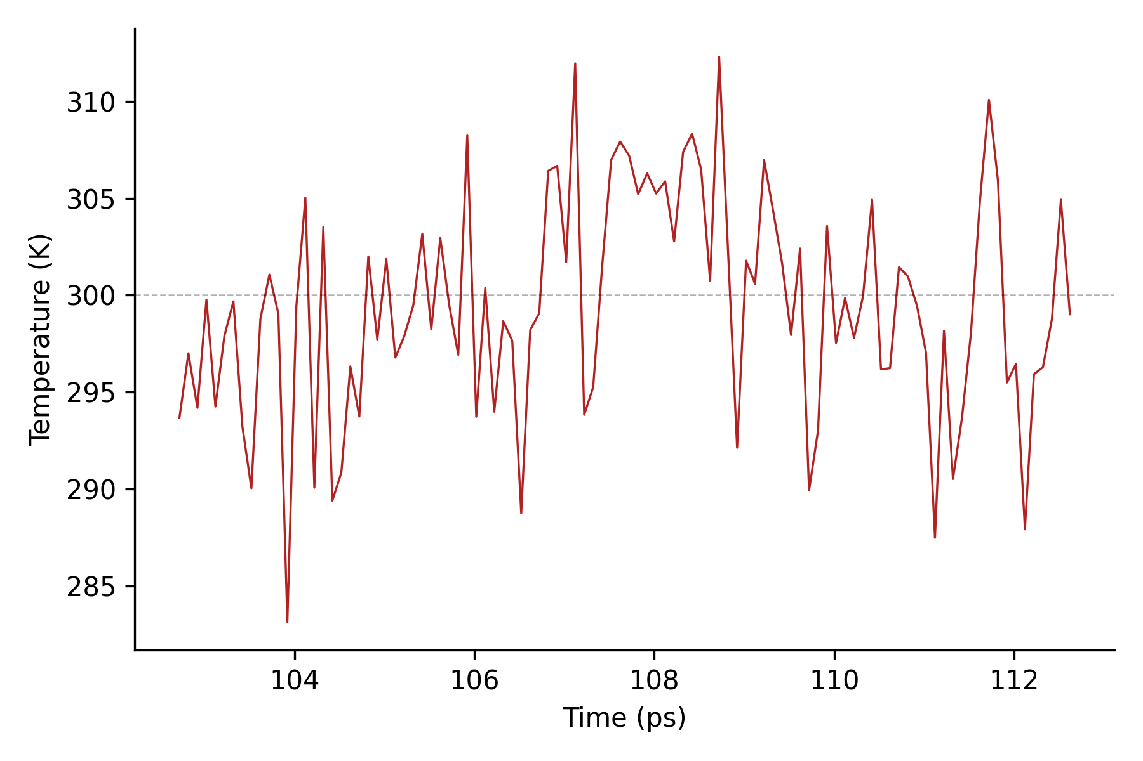
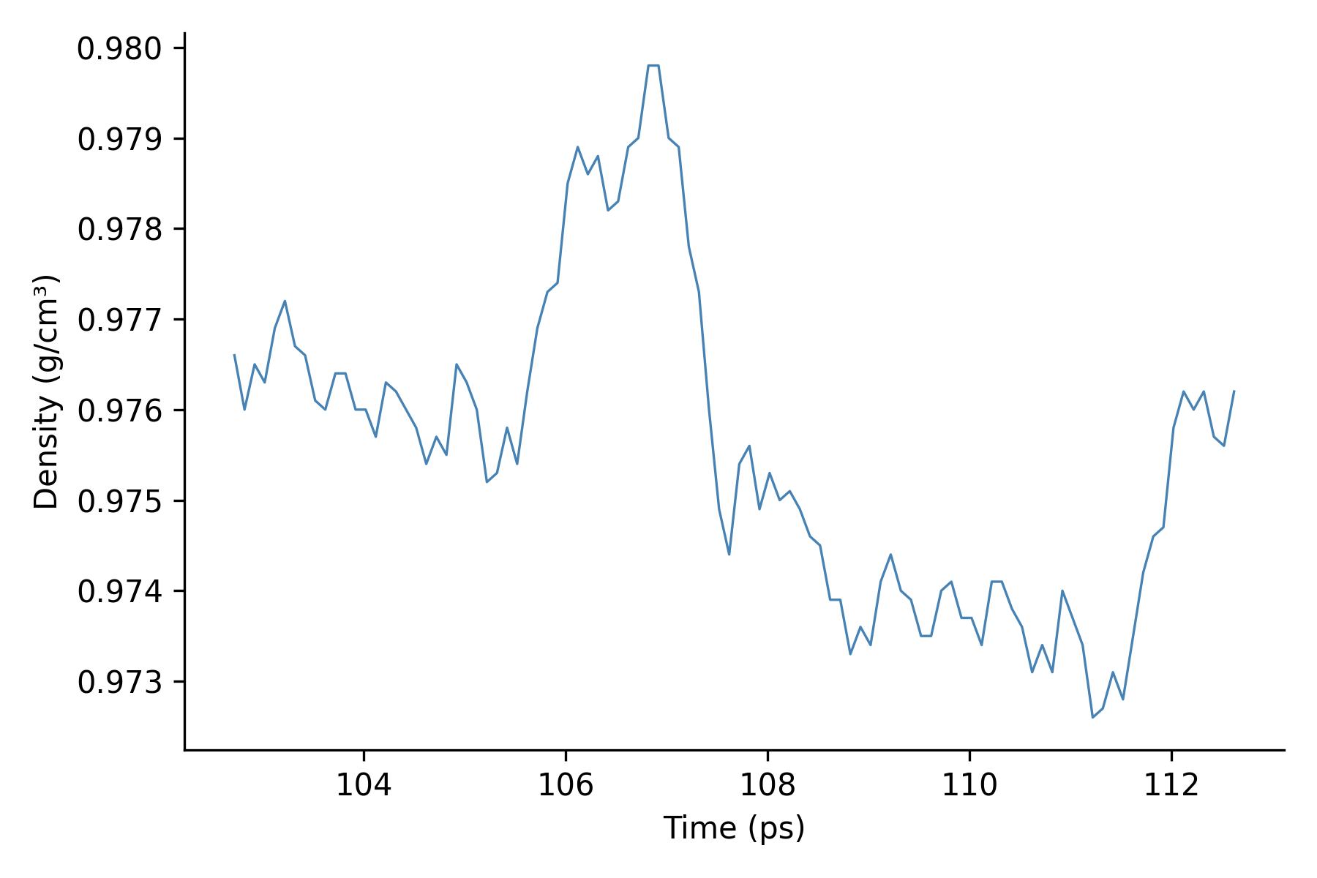
PART D — RESULTS
Final Thermodynamic Results
Quantity
Mean ± SD
Temperature
300.386 ± 5.682 K
Pressure
9.37 ± 483.60 bar
Density
0.974238 ± 0.000979 g/cm³
Potential energy
−8203.52 ± 34.10 kcal/mol
temperature
density
Box volume
26468.73 ± 32.50 Å³
These values are the frozen final production-level results.
Main interpretation
Temperature remained near the 300 K target.
Density was stable around 0.974 g/cm³ during the short primary window.
45

Slide 46
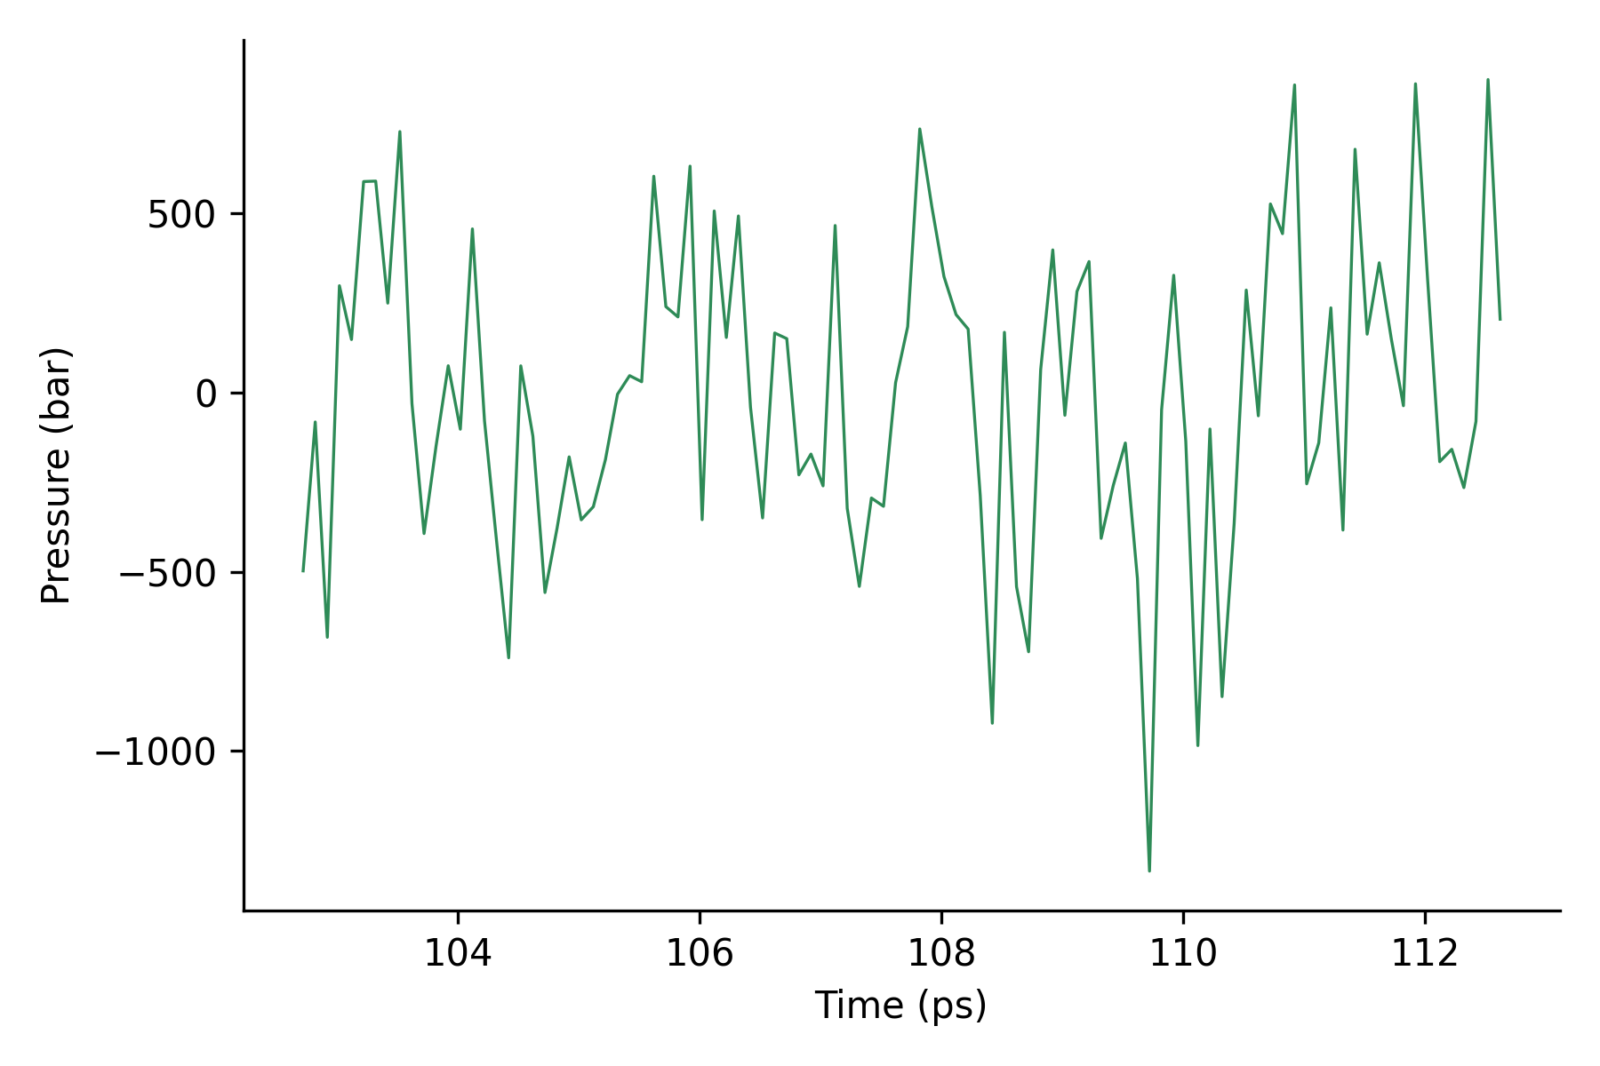
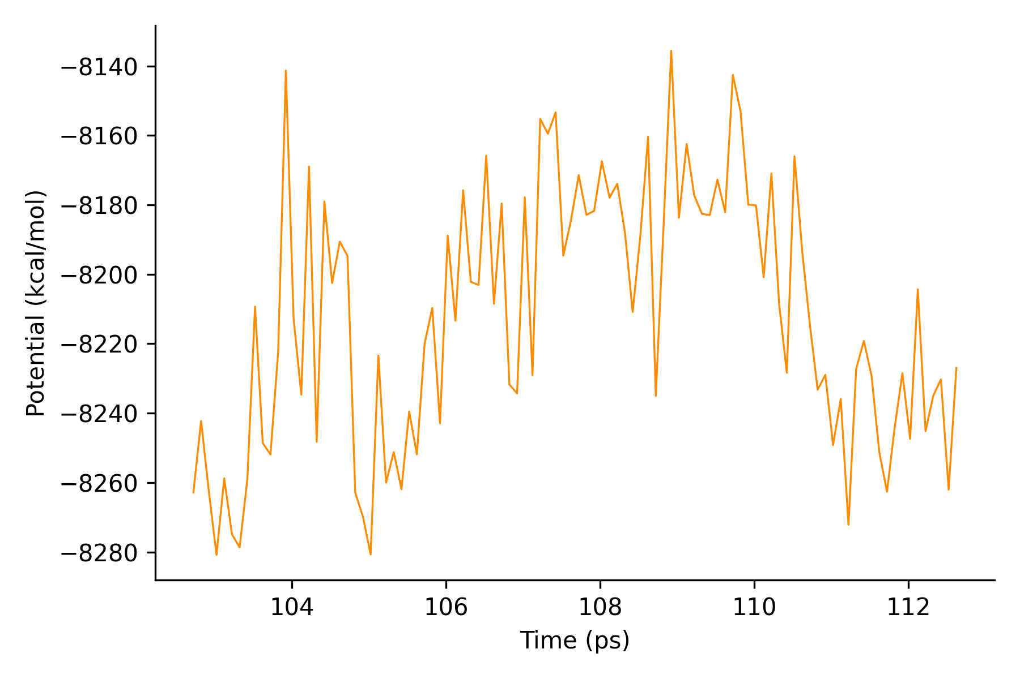
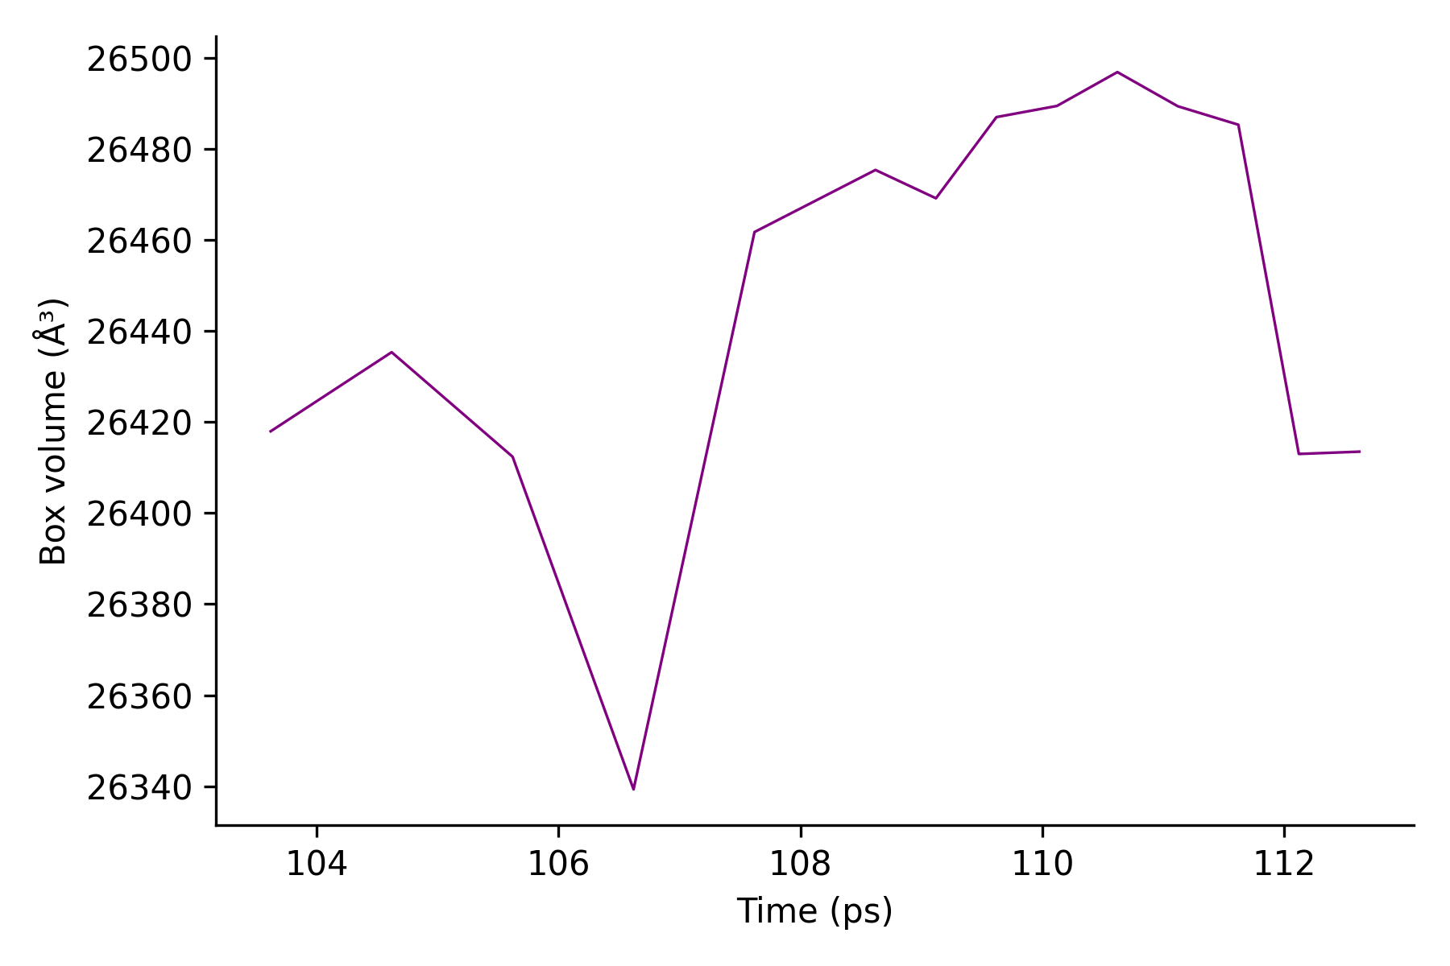
PART D — RESULTS
Pressure, Potential Energy and Volume
Pressure
9.37±483.60 bar
Pressure fluctuated strongly.
Therefore:
the mean pressure should not be interpreted as proof of complete pressure equilibration.
Other behavior
Potential energy remained finite and stable over the short analysis window.
Volume showed relatively small fluctuations.
pressure
potential
box_volume
46

Slide 47
PART D — RESULTS
Did the TIP3P Molecular Geometry Stay Correct?
Property
Mean
O–H distance
0.957197 Å
0.9572 Å
0.9572 Å
H–H distance
1.513595 Å
O
H–O–H angle
104.4906°
H
H
The measured deviations were extremely small.
Interpretation
The rigid-water geometry remained essentially fixed.
This is consistent with SETTLE correctly maintaining TIP3P geometry.
H–H 1.5136 Å
104.49°
47

Slide 48
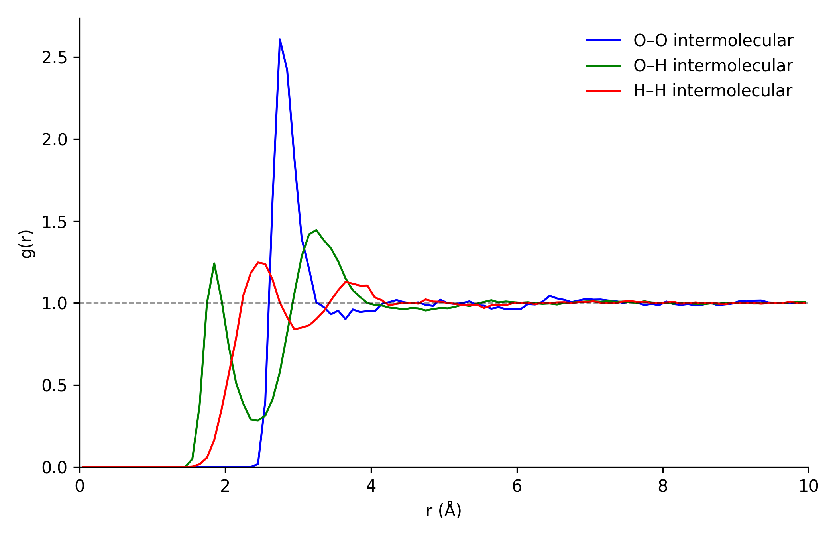
PART D — RESULTS
Liquid Structure: Radial Distribution Functions
Pair
First local peak
g(r)
O–O
2.75 Å
2.607
O–H intermolecular
1.85 Å
1.242
H–H intermolecular
2.45 Å
1.247
At large r:
g(r) → 1
The O–O peak near 2.75 Å shows a preferred nearest-neighbor oxygen separation and local liquid-water organization.
rdf_intermolecular_normalized
14 frames only → qualitative/illustrative structural interpretation.
48

Slide 49
PART E — INTERPRETATION AND INTERNSHIP TAKEAWAYS
What the Results Tell Us
1. Temperature
2. Molecular structure
3. Liquid organization
O
H
H
The system stayed centered near the 300 K target.
TIP3P geometry remained stable and physically reasonable.
The RDF shows short-range structural organization, especially the O–O first shell around 2.75 Å.
The complete workflow produced a physically reasonable short-timescale liquid-water simulation.
49

Slide 50
Experiment 2: How Temperature Changes
Liquid-Water Structure
300 K target
273 K target
Matched TIP3P Molecular Dynamics at 300 K and 273 K
O
O
O
O
H
H
H
H
H
H
H
H
O
O
O
O
The first experiment established a complete, validated TIP3P liquid-water MD workflow at 300 K.
After reviewing the results, the next objective was to go beyond basic thermodynamics and RDFs and ask how lowering temperature changes the liquid-water interaction network and local structure.
H
H
H
H
H
H
H
H
O
O
H
H
H
H
same molecules • same box style • only temperature differs
50

Slide 51
PART A — FROM THE FIRST EXPERIMENT TO A NEW QUESTION
The Main Question
How does lowering the target temperature from 300 K to 273 K change the thermodynamic behavior, hydrogen-bond network and local molecular structure of liquid TIP3P water?
Thermodynamics
Hydrogen-bond network
Local structure
Temperature
Density
Potential energy
Volume
Population
Distance
Angle
OO / OH / HH RDF
Tetrahedral order
Coordination
51

Slide 52
PART A — FROM THE FIRST EXPERIMENT TO A NEW QUESTION
What Changed — and What Stayed the Same?
Kept identical
Changed
TIP3P water
Target temperature
862 waters / 2586 atoms
300 K → 273 K
300 K
branch
273 K
branch
Same force field
Thermostat seed
NPT / 1 bar
Required restart provenance
1 fs timestep
same system +
same methodology
PME
8 Å cutoff
Only the experimental temperature branch and unavoidable provenance details changed.
SETTLE rigid water
Middle Langevin
Bussi barostat
5 ps production
0.05 ps structural sampling
The goal was a matched comparison, so temperature was changed while the physical and numerical setup remained as similar as possible.
52

Slide 53
PART B — BUILDING THE MATCHED TEMPERATURE DATASETS
The Complete Experiment 2 Workflow
Experiment-1 accepted final state
↻
Checkpoint 2 — 2 ps
112.620 ps
interrupted + resumed
New dense 300 K reference
Additional 1 ps equilibration
5 ps / 100 frames
Cooling
↻
273 K production
290 K → 280 K → 273 K
0.5 + 0.5 + 1 ps
5 ps
interrupted at 3 ps + resumed 2 ps
273 K equilibration
Matched deep analysis
Checkpoint 1 — 2 ps
300 K vs 273 K
Final comparison: 100 structural frames at 300 K + 100 structural frames at 273 K
53

Slide 54
PART B — BUILDING THE TWO DATASETS
Stage 1: Building a Matched 300 K Reference
The original Experiment-1 structural analysis contained only 14 accepted structural frames.
That was sufficient for an illustrative RDF, but not ideal for a direct dense comparison with a new 273 K trajectory.
So we generated a new matched reference:
Original Experiment 1
14 structural frames
Parameter
Value
Target temperature
300 K
Ensemble
NPT
Duration
5 ps
Steps
5000
Matched Experiment 2 reference
Timestep
1 fs
100 frames
Sampling interval
0.05 ps
Trajectory frames
100
Box records
100
Thermo records
100
54

Slide 55
PART B — BUILDING THE TWO DATASETS
Stage 2: Controlled Cooling
300 K state
Stage
Observed mean T
290 K target
293.54 K
290 K — 0.5 ps
280 K target
289.38 K
280 K — 0.5 ps
273 K target
284.51 K
273 K — 1.0 ps
Cooling protocol
300 K → 290 K → 280 K → 273 K
Cooling was completed successfully, but the final state was not yet thermally equilibrated around 273 K.
55

Slide 56
PART B — BUILDING THE TWO DATASETS
Stage 3: 273 K Equilibration — Checkpoint 1
NPT · 273 K target · 1 bar · 2 ps · same physical settings
Window
Temperature
280.6 K
282.2 K
283.6 K
Full 2 ps
280.61 ± 4.58 K
Last 1 ps
282.21 K
full
last 1 ps
last 0.5 ps
Last 0.5 ps
283.57 K
Computationally valid — thermally not accepted
The temperature remained well above the target, so production was not started.
56

Slide 57
PART B — BUILDING THE TWO DATASETS
Checkpoint 2: Continue Equilibration — Then Another Interruption
Planned: 2 ps additional equilibration at 273 K
↻ restart
0 ps
1.5 ps
2.0 ps
synchronized restart available
at 123.120 ps
Recovery
After recovery
Instead of repeating all 2 ps, we resumed only the missing 0.5 ps.
Last 1 ps: 278.93 ± 2.93 K
Last 0.5 ps: 278.45 ± 2.91 K
Temperature had become stable, but around 278–279 K, still above the 273 K target.
57

Slide 58
PART B — BUILDING THE TWO DATASETS
Before Running More MD, We Audited the Thermal Behavior
✓
Target temperature
✓
Thermo parsing
Density was nearly flat, while potential energy was still evolving, suggesting that the system had not fully finished relaxing.
All accepted segments used 273 K
Correct temperature column
✓
Degrees of freedom
✓
Thermostat configuration
We did not change the thermostat or force the temperature downward artificially.
Correct rigid-water DOF treatment
No configuration error found
NO CONFIGURATION PROBLEM
→ extend equilibration by only 1 ps
The audit separated a genuine relaxation problem from a configuration or parsing failure.
58

Slide 59
PART B — BUILDING THE TWO DATASETS
The Final 1 ps Extension Reached the Operational Target
Quantity
Result
Full 1 ps temperature
272.44 ± 5.11 K
Last 0.5 ps
270.52 ± 5.84 K
Density
essentially flat
Potential-energy drift
leveled off
T3_273K_EQUILIBRATION_OPERATIONALLY_ACCEPTED
Accepted for beginning matched production. Not claimed as rigorous long-timescale equilibrium.
59

Slide 60
PART B — BUILDING THE TWO DATASETS
Stage 4: Matched 273 K Production
Parameter
Final choice
Parameter
Final choice
Target T
273 K
PME cutoff
8 Å
Target P
1 bar
Constraint
SETTLE
Ensemble
NPT
Thermostat
Middle Langevin
Duration
5 ps
Barostat
Bussi
Steps
5000
Structural interval
0.05 ps
Timestep
1 fs
Intended frames
100
This matched the new 300 K reference except for temperature, seed and required restart provenance.
60

Slide 61
PART B — BUILDING THE TWO DATASETS
The 5 ps Production Was Also Interrupted
Segment 1
60 frames
restart
Segment 2
40 frames
0 ps
3 ps
5 ps
At the interruption:
• synchronized restart existed at 127.620 ps
• structural frame 60 was already safely written
• box record 60 was safely written
• the step-3000 thermo record was still buffered and was lost
Recovery
Resume from the synchronized step-3000 restart for only the remaining 2 ps.
61

Slide 62
PART B — BUILDING THE TWO DATASETS
Final Production Dataset
Trajectory
Box
Thermodynamics
60 + 40 = 100 frames
100 records
59 + 40 = 99 records
One genuine record at 127.620 ps is absent.
T4_273K_PRODUCTION_SEGMENTED_VALIDATED
Final simulation time: 129.620 ps
62

Slide 63
PART D — DEEP STRUCTURAL AND NETWORK ANALYSIS
The Analysis
RDF
Hydrogen bonds
Local order
Thermodynamics
OO
OH
HH
secondary features
count vs time
distance
angle
tetrahedral q
coordination
temperature
density
potential
volume
Both temperatures were recalculated with the same analysis settings and the same 100-frame structural sampling.
63

Slide 64
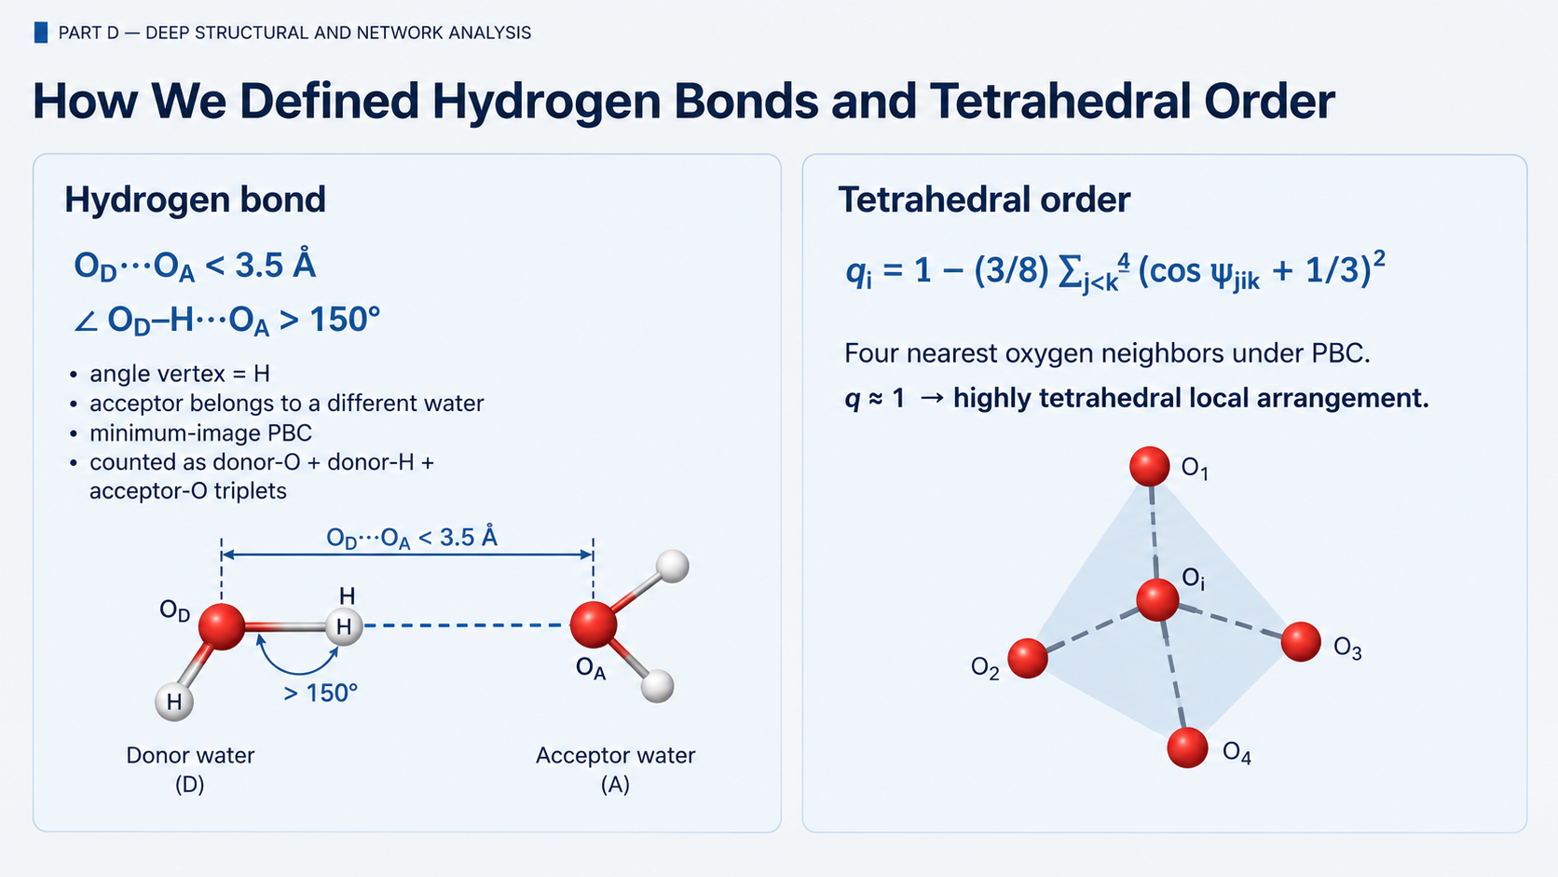
PART D — DEEP STRUCTURAL AND NETWORK ANALYSIS
How We Defined Hydrogen Bonds and Tetrahedral Order
Hydrogen bond
Tetrahedral order
Oᴅ···Oₐ < 3.5 Å
qᵢ = 1 − (3/8) Σⱼ<ₖ⁴ (cos ψⱼᵢₖ + 1/3)²
O···O < 3.5 Å
Oₐ
∠ Oᴅ–H···Oₐ > 150°
Oᴅ
Four nearest oxygen neighbors under PBC.
O
• angle vertex = H
• acceptor belongs to a different water
• minimum-image PBC
• counted as donor-O + donor-H + acceptor-O triplets
q ≈ 1 → highly tetrahedral local arrangement.
O
H
θ > 150°
O
O
H
O
O
O
four nearest O neighbors
64
64
Notes:
In a perfect tetrahedral arrangement, these four neighbors have very specific angles around the central oxygen
basically a mathematical score for:
“How close is this local arrangement to an ideal tetrahedron?”

Slide 65
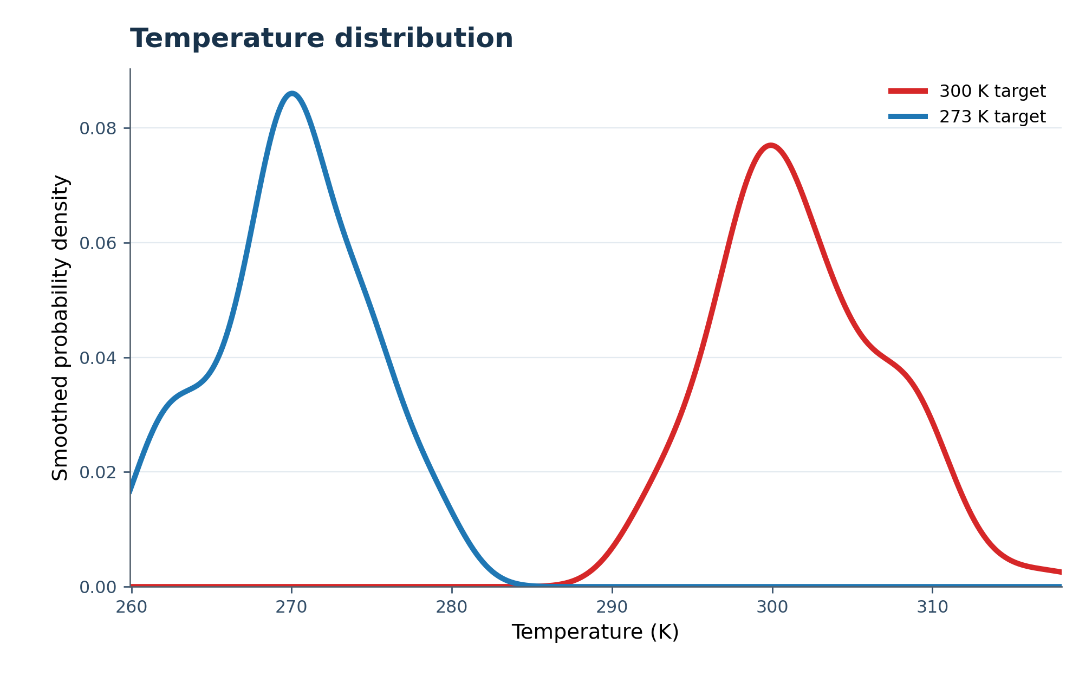
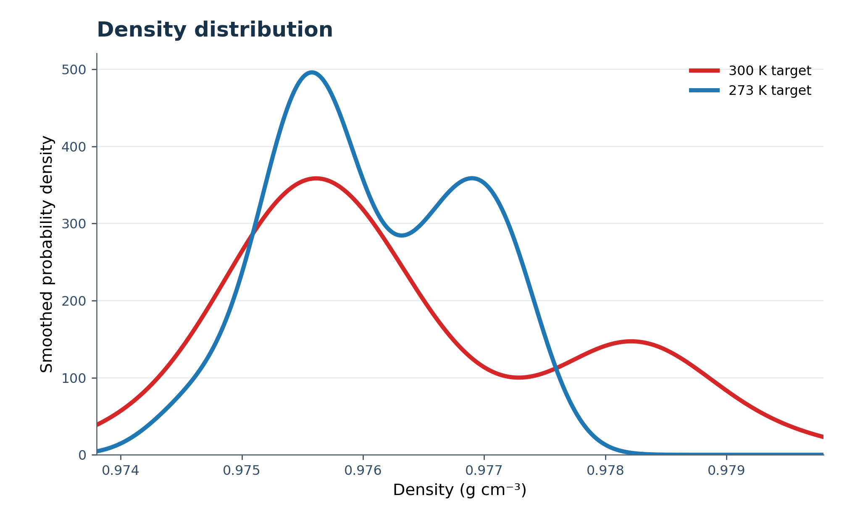
PART D — RESULTS
Thermodynamic Comparison: Temperature and Density
300 K target
273 K target
The two branches clearly sampled different thermal regimes.
Mean density remained very similar over these short trajectories.
Sampled T
301.79 ± 5.30 K
269.96 ± 4.76 K
Density
0.976319 ± 0.001366
0.976066 ± 0.000786 g/cm³
65
Notes:
Cooling affected the microscopic organization of the water much more clearly than its average density over these short trajectories.

Slide 66
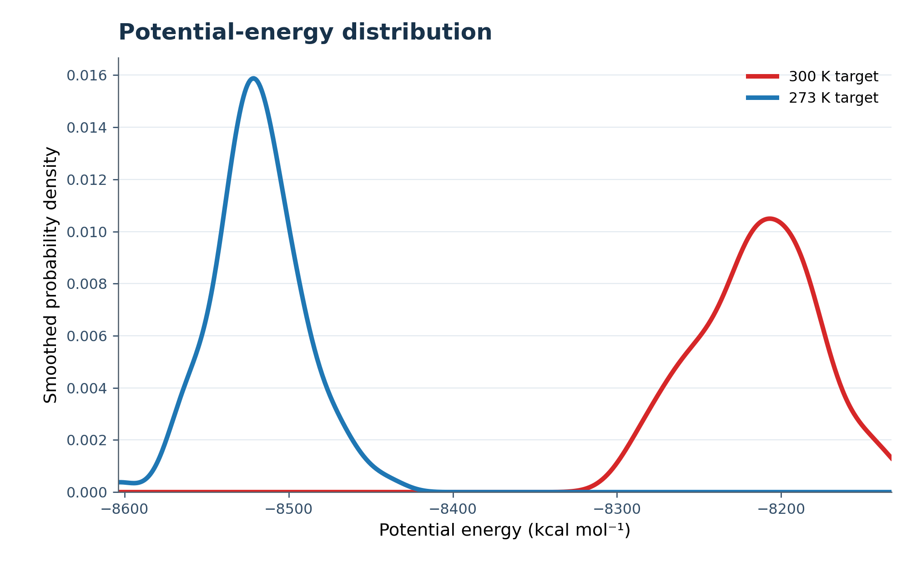
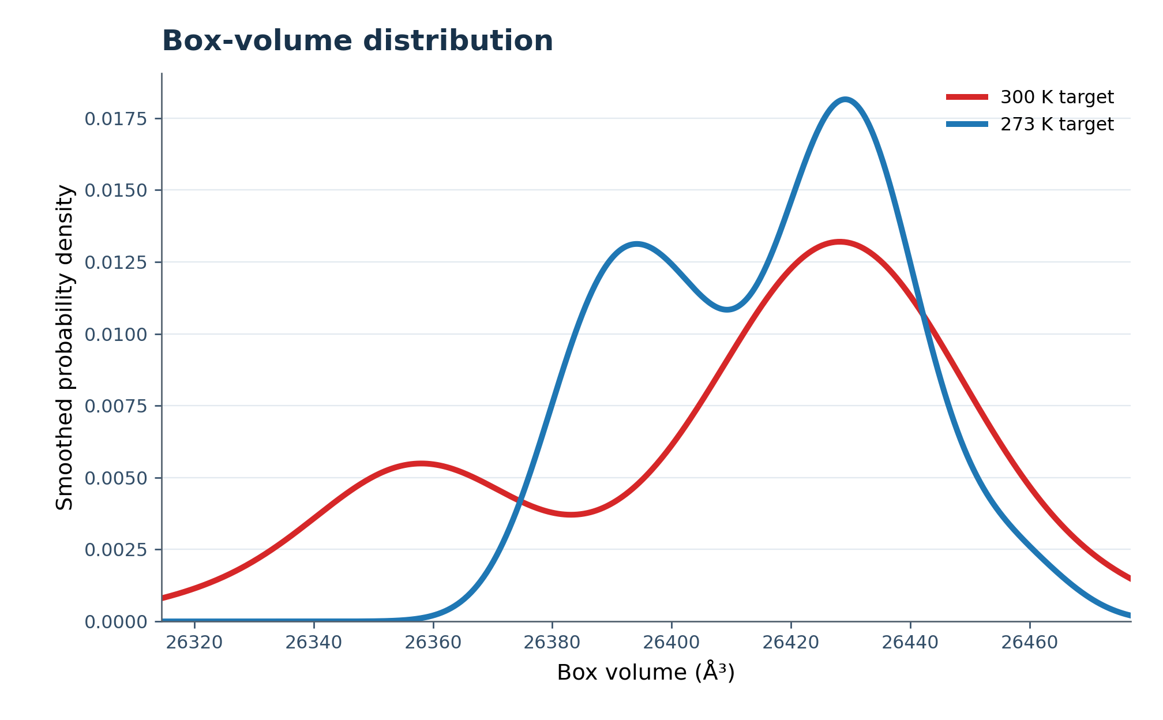
PART D — RESULTS
Energy and Box Behavior
Quantity
300 K target
273 K target
The cooler branch had a substantially lower potential energy.
Mean volume remained very similar.
Potential energy
−8214.39 ± 36.21
−8518.88 ± 27.19 kcal/mol
Box volume
26409.27 ± 36.92
26415.94 ± 21.32 Å³
Pressure
−75.25 ± 395.94
−592.70 ± 357.78 bar
We have exactly the same 862 water molecules in both systems, so if volume hardly changes, density also hardly changes.
66
Notes:
potential energy
It describes the interaction energy associated with how all the atoms/molecules are arranged and interacting.
More negative means the system occupies a lower potential-energy state.
This is consistent with what we later find:
more hydrogen bonds, more tetrahedral organization,
stronger structural ordering.

Slide 67
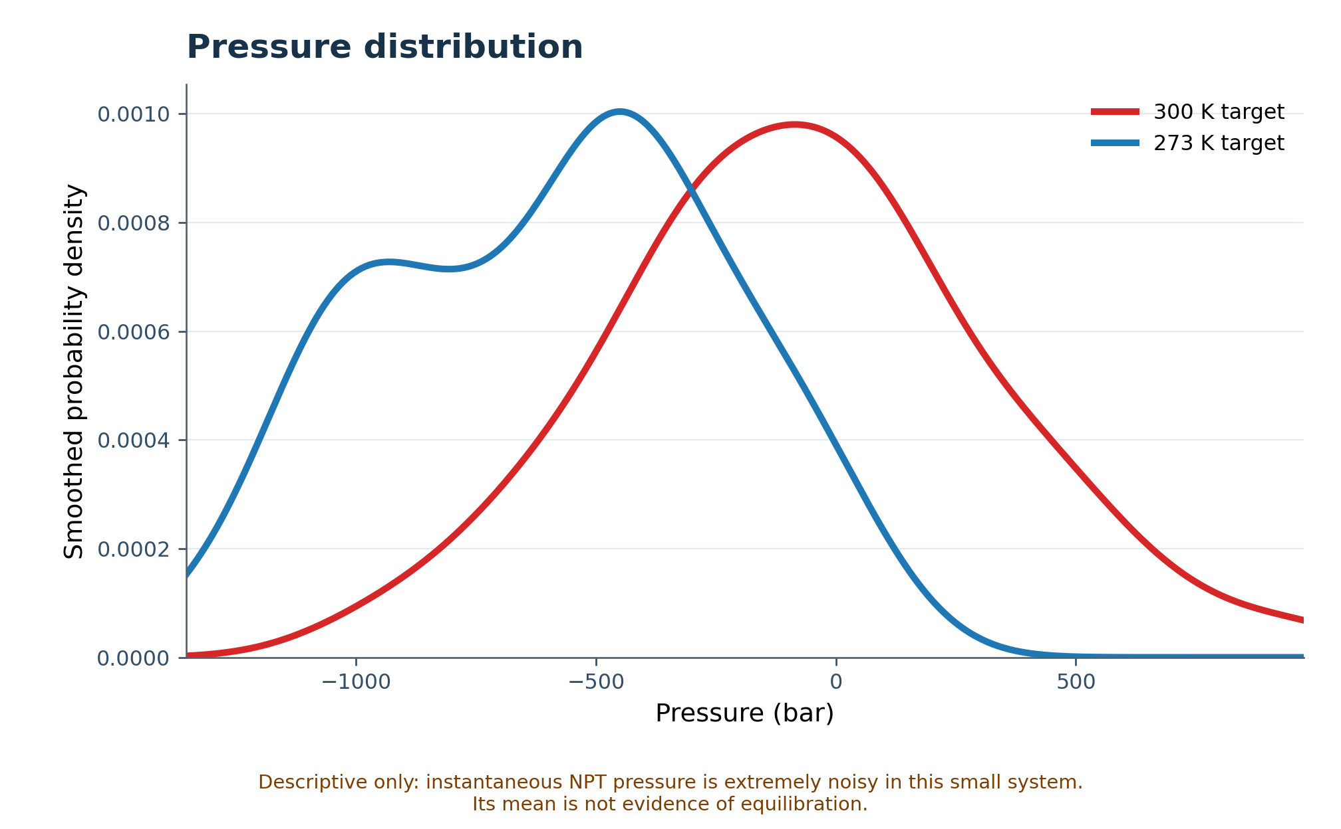
PART D — RESULTS
Pressure Distribution
Quantity
300 K target
273 K target
Pressure
−75.25 ± 395.94 bar
−592.70 ± 357.78 bar
Interpretation
large fluctuations
large fluctuations
Instantaneous NPT pressure
is extremely noisy in small-
system MD. Its mean is not
strong evidence of
equilibration.
Pressure is shown descriptively only;
it was not used as the main
acceptance criterion.
The broad pressure distributions reflect strong small-system fluctuations, so pressure is reported only descriptively.
67
Notes:
potential energy
It describes the interaction energy associated with how all the atoms/molecules are arranged and interacting.
More negative means the system occupies a lower potential-energy state.
This is consistent with what we later find:
more hydrogen bonds,
more tetrahedral organization,
stronger structural ordering.

Slide 68
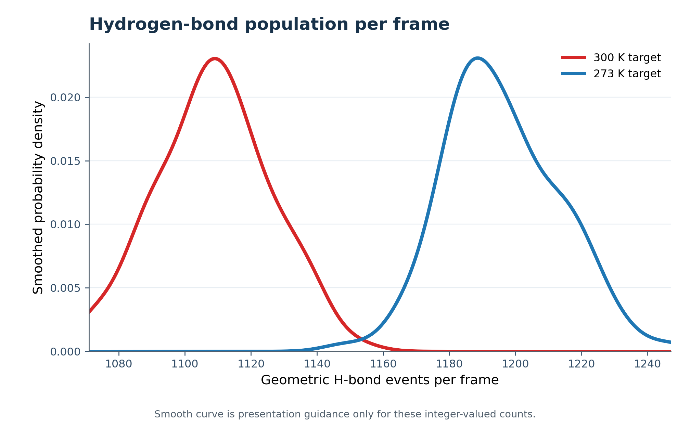
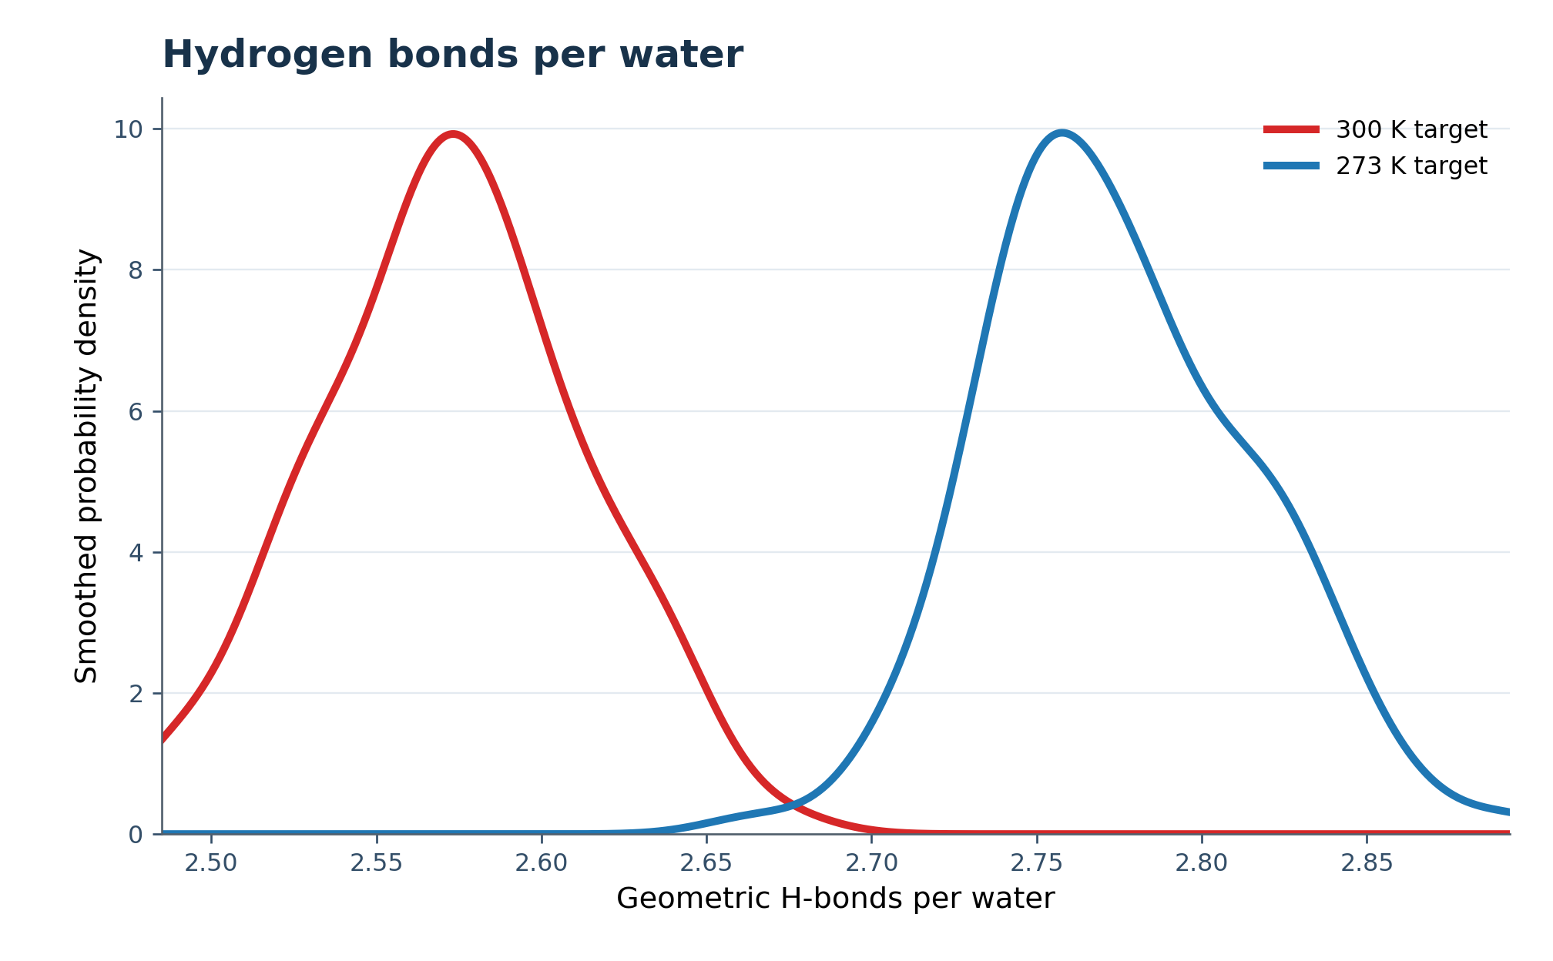
PART D — RESULTS
Cooling Produced More Geometric Hydrogen Bonds
300 K target
273 K target
Approximately 7.9% more geometric H-bond events in the cooler-target trajectory.
H-bond events/frame
1108.70 ± 17.00
1195.86 ± 17.19
H-bonds/water
2.5724 ± 0.0394
2.7746 ± 0.0399
68

Slide 69
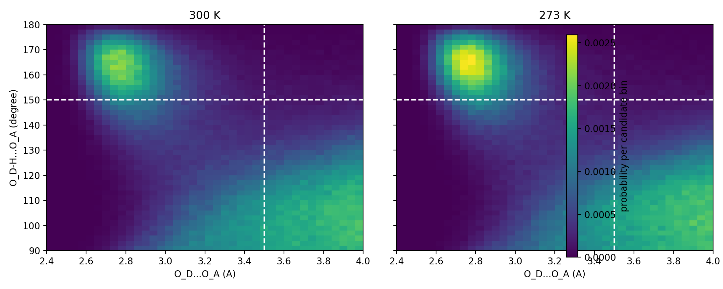
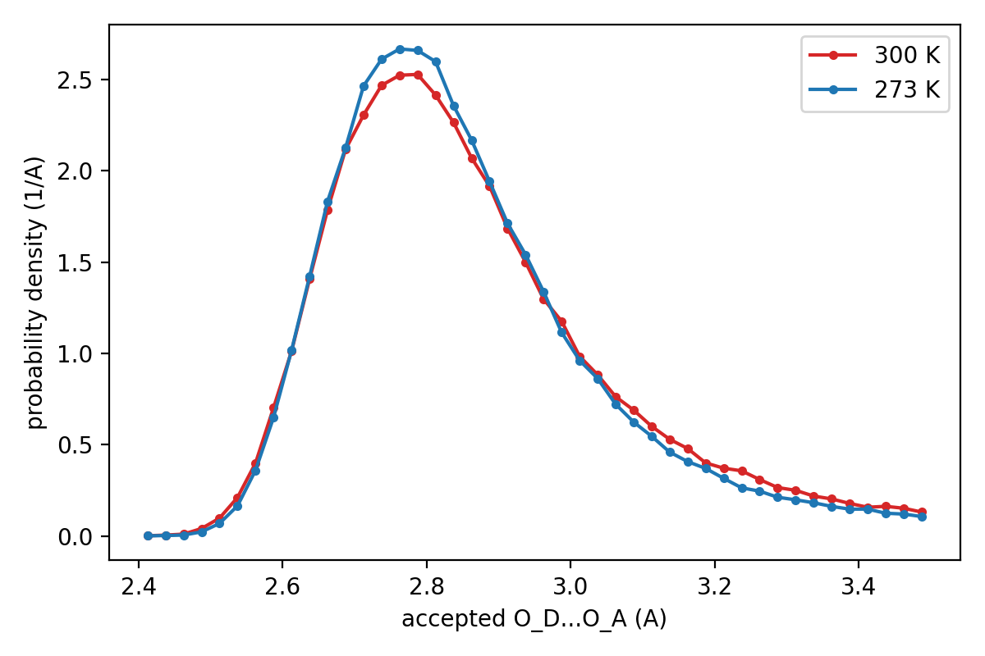
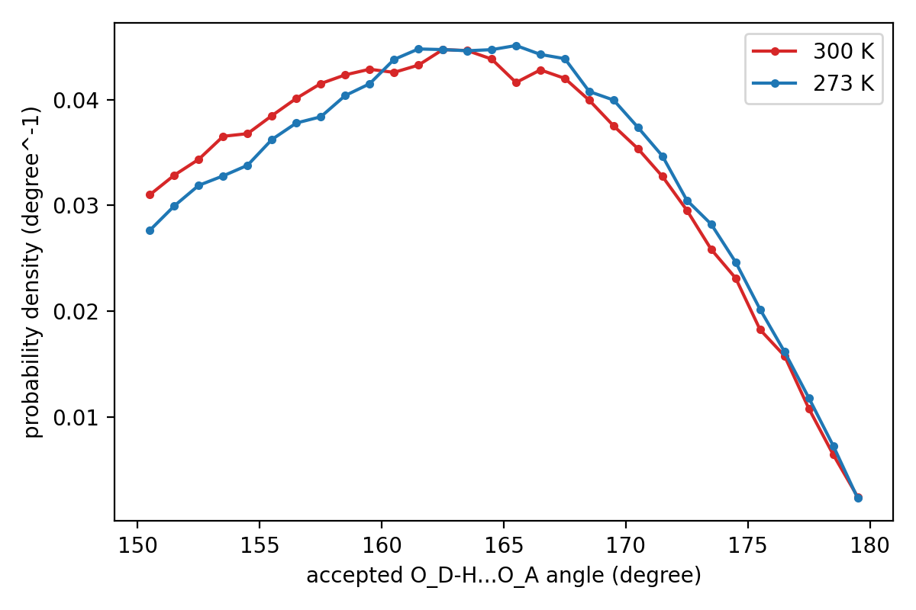
PART D — RESULTS
The Cooler Network Was Slightly Shorter and Straighter
300 K
273 K
Accepted H-bond geometries shifted slightly toward shorter O···O distances and more linear angles.
Accepted O···O
2.8614 ± 0.1910 Å
2.8523 ± 0.1809 Å
O–H···O angle
162.99 ± 7.31°
163.39 ± 7.28°
This is consistent with a somewhat more ordered geometric network, not a direct measurement of H-bond energy.
69
Notes:
Where do most hydrogen bonds live in the combined distance–angle space?

Slide 70
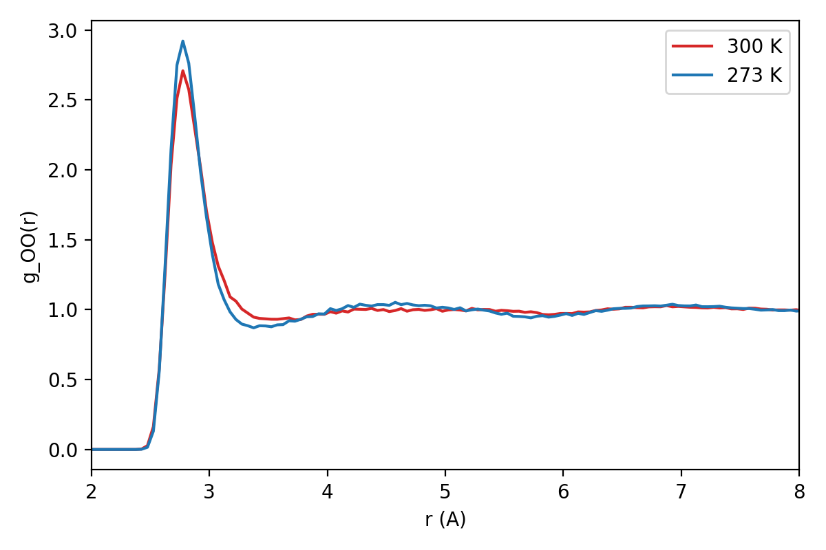
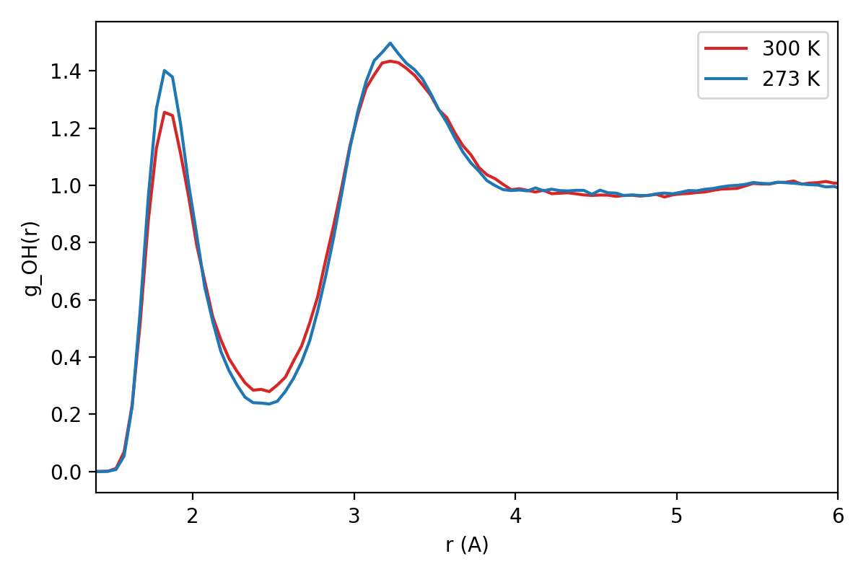
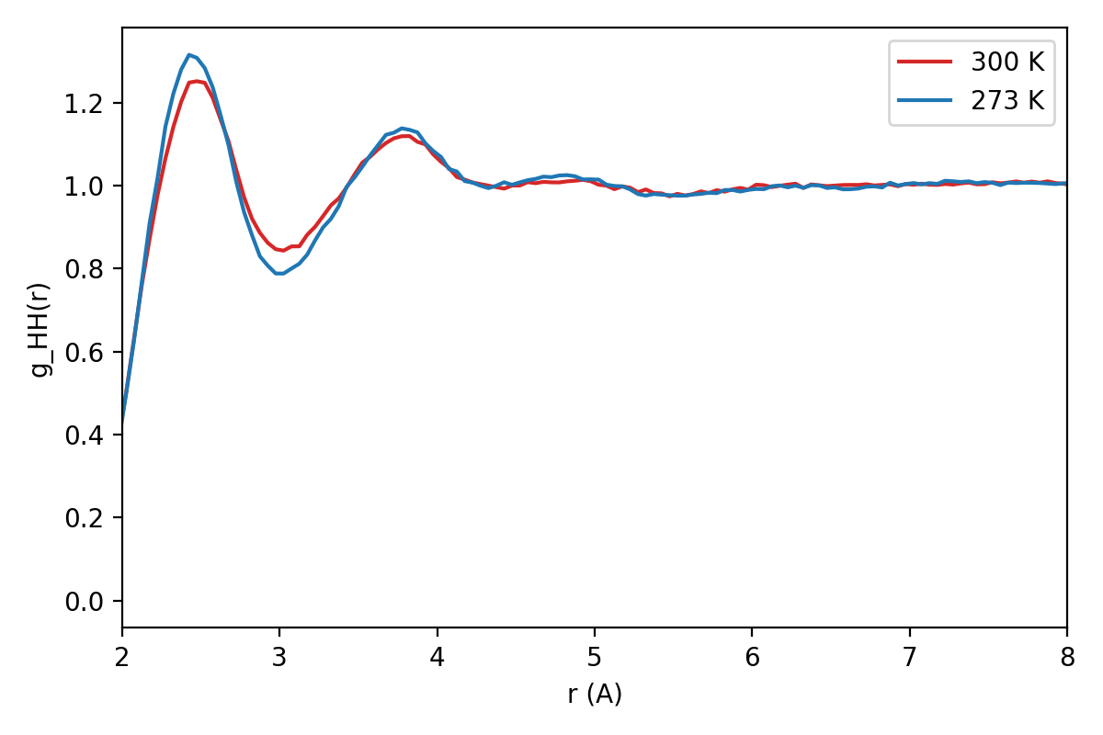
PART D — RESULTS
How Local Liquid Structure Changed
O–O
O–H
H–H
First peak
300 K: 2.775 Å, g=2.708
273 K: 2.775 Å, g=2.921
First feature: 1.825 Å
g: 1.256 → 1.401
Later robust feature: 3.225 Å
First feature: 2.475 Å → 2.425 Å
Later robust feature: 3.775 Å in both
Same peak position, but a higher/sharper first shell at the cooler target.
Short O–H feature: close intermolecular/H-bond-related contacts; later feature: further orientational/shell structure.
The cooler branch shows stronger local H–H structural organization.
70
Notes:
how likely we are to find one type of atom at a distance r from another atom, compared with a completely uniform distribution.
First peak: most preferred nearest-neighbor distance. First minimum: approximate boundary of the first coordination shell.

Slide 71
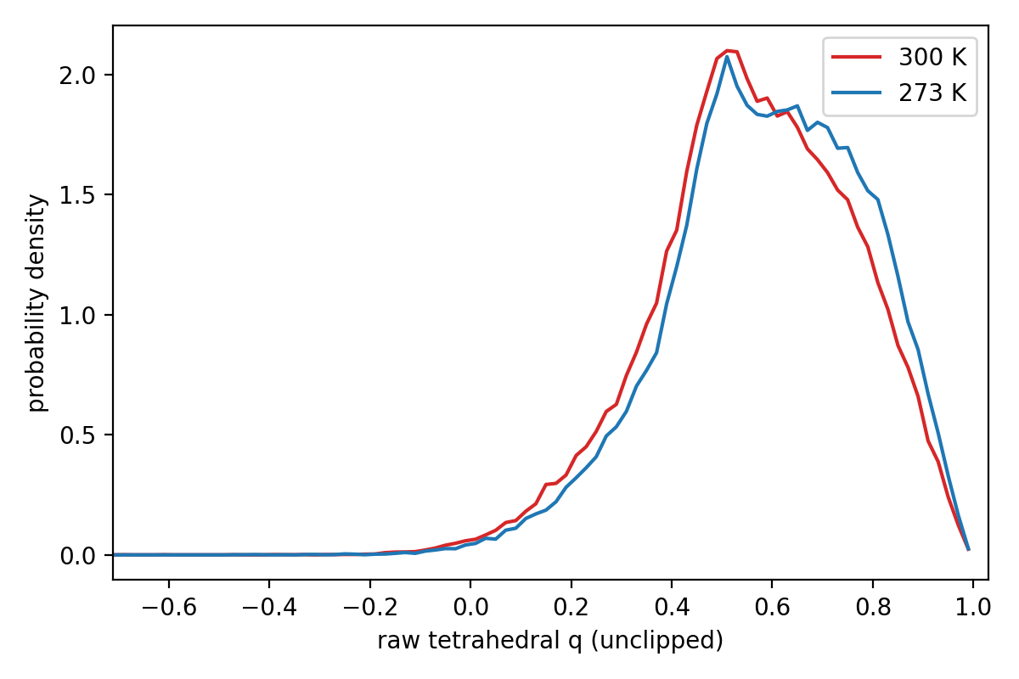
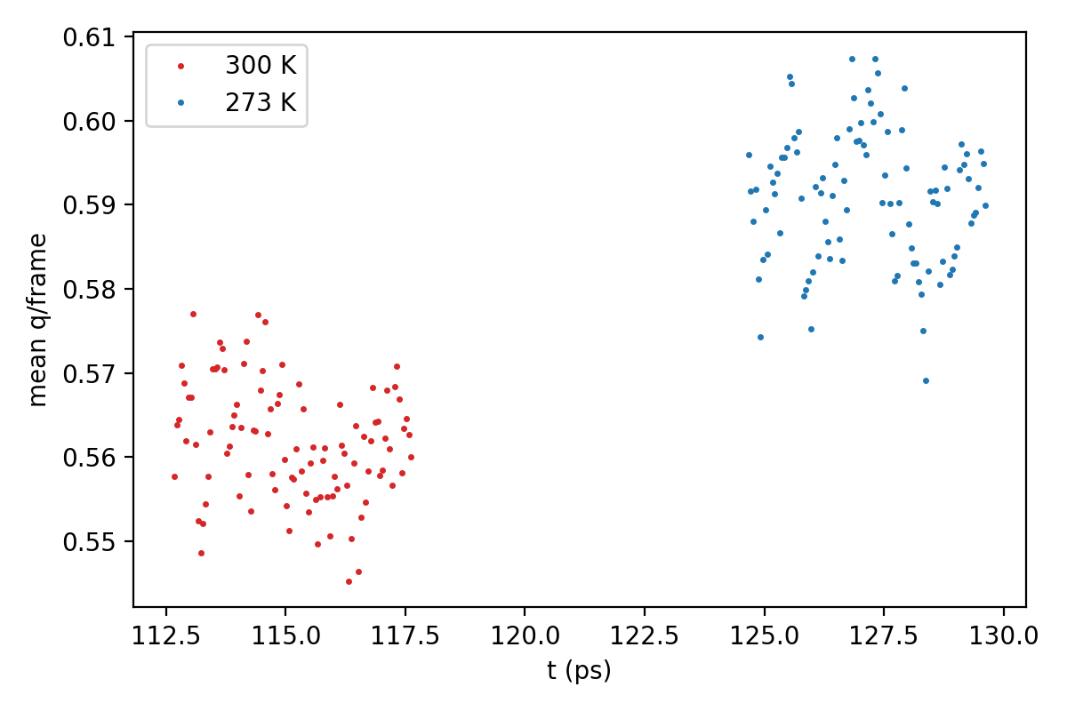
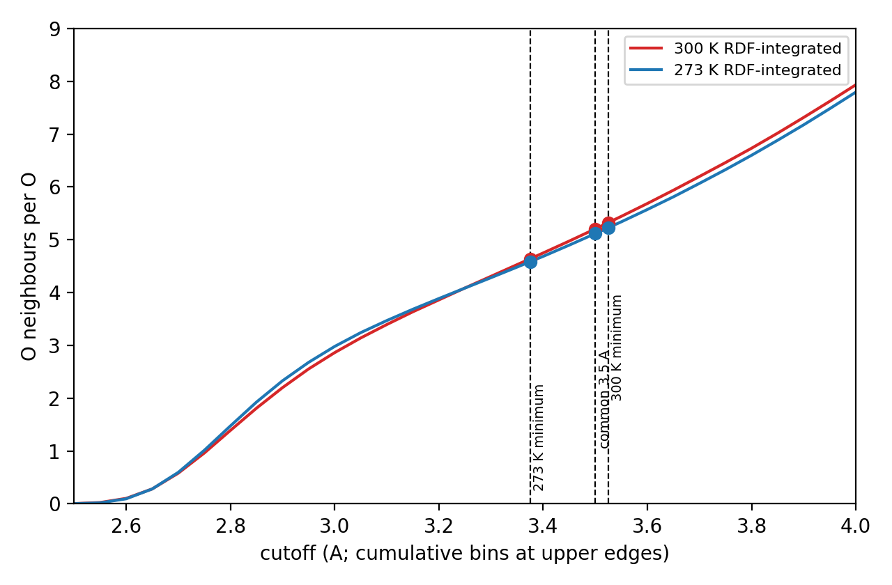
PART D — RESULTS
The Cooler Liquid Became More Tetrahedrally Ordered
q: 0.5617 → 0.5908
Same 3.5 Å cutoff
Coordination changed only slightly at a matched radius.
Higher q = stronger tetrahedral local ordering
300 K: 5.2066 | 273 K: 5.1170 neighbors/O
We do not claim that cooling removed ~1 whole neighbor; that earlier large difference came from different cutoff radii.
71

Slide 72
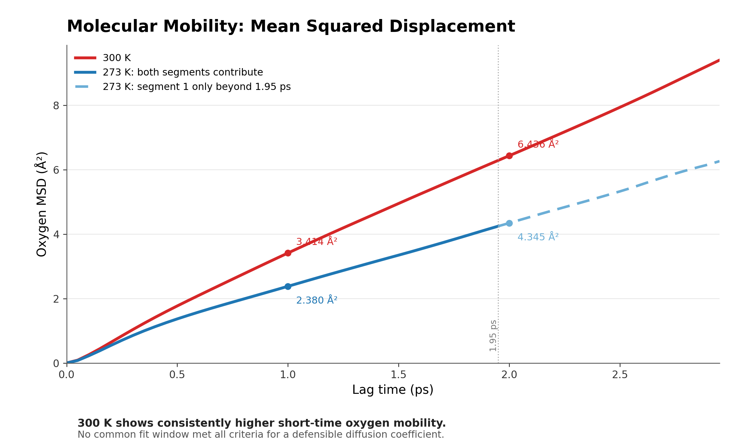
PART D — RESULTS
Molecular Mobility: Mean Squared Displacement
The 300 K curve stays above the 273 K curve, so the warmer liquid has higher short-time oxygen mobility.
At 1.0 ps
At 2.0 ps
3.414 Å² (300 K) vs 2.380 Å² (273 K)
6.436 Å² (300 K) vs 4.345 Å² (273 K)
Diffusion from MSD
For 3D diffusion: D = (1/6) · d(MSD)/dt
So the diffusion coefficient is obtained from the slope of the approximately linear MSD region divided by 6.
Apparent short-time estimates:
• 300 K: D ≈ 5.17 × 10⁻⁵ cm²/s
• 273 K: D ≈ 3.29 × 10⁻⁵ cm²/s
Interpretation: the larger D at 300 K means the warmer liquid has higher molecular mobility.
Note: these are apparent short-time estimates, not converged bulk diffusion coefficients, because the trajectories are only ~5 ps.
72
Notes:
MSD measures how far molecules move as lag time increases. No common fit window satisfied all criteria for a reliable diffusion coefficient, so no converged bulk D is claimed.

Slide 73
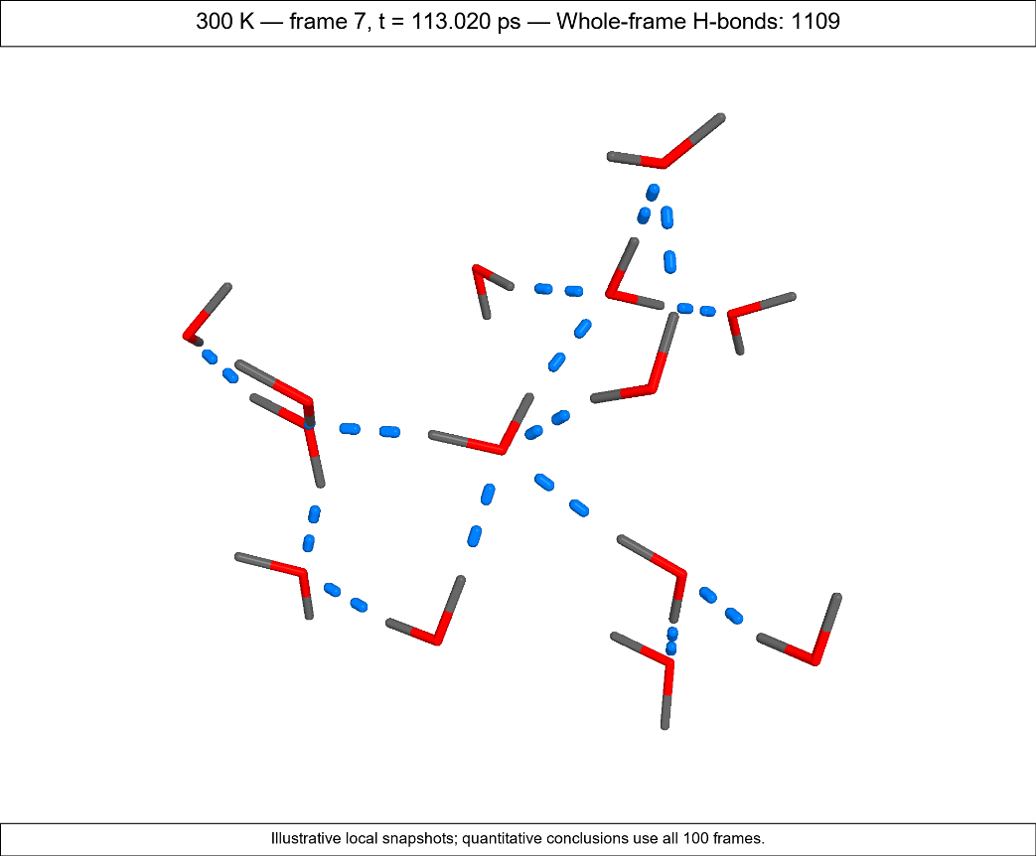
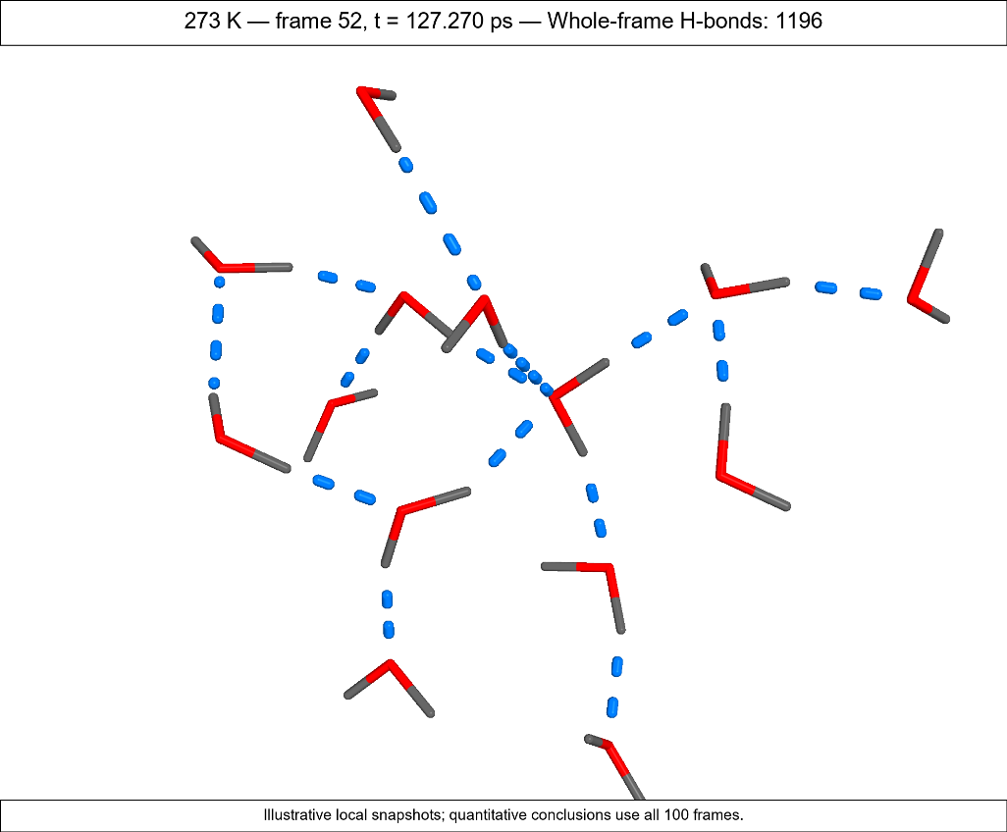
PART D — RESULTS
Hydrogen-Bond Network: Representative Local Snapshots
300 K representative frame
273 K representative frame
Quantitative result: the cooler trajectory has more geometric H-bonds overall
(2.775 vs 2.572 H-bonds/water).
frame 7 • 113.020 ps • 1109 whole-frame H-bonds
frame 52 • 127.270 ps • 1196 whole-frame H-bonds
300 K local network
273 K local network
Red/gray sticks = water molecules • Blue dashed = H···O hydrogen bonds
Same H-bond criterion: O···O < 3.5 Å and ∠O–H···O > 150°
Illustrative local snapshots only; quantitative conclusions come from the full 100-frame analysis.
69

Slide 74
PART E — INTERPRETATION
Putting All the Evidence Together
Thermodynamics
Hydrogen-bond network
• lower sampled temperature
• lower potential energy
• very similar density/volume
• more H-bond events
• slightly shorter O···O
• slightly straighter angles
Local structure
Coordination
• sharper OO/OH features
• increased tetrahedral q
• only a small matched-radius change
Lowering the target temperature produced a more populated and more tetrahedrally ordered geometric hydrogen-bond network in this short liquid-water trajectory.
This is a structural/geometric conclusion—not direct proof of stronger H-bond energy.
73

Slide 75
Thank you
Questions?
O
H
H
Youssef Ahmed
Molecular Dynamics
Westlake University
Youssef@westlake.edu.cn
74

