Slide 1

DUPIS Alexis, VIDAL Ugo, TERRIEN Marie, LEFOL Yohan

Slide 2
Goals
Create a user friendly tool
Results are clear and publishable in scientific publication
Identification of non-canonical genes
Interpretation of results
Host the tool on the client’s website (Cellomet) → Download and data retrieval

Slide 3




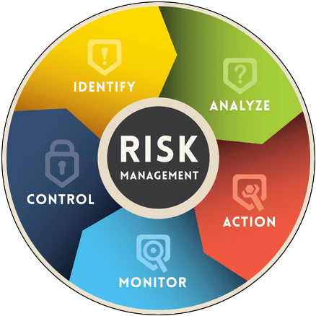


T
Risk of high demand (server)
Portability to Mac
Lack of control on database
O
No competition
High utility
Easy to use
S
Diverse skill set
W
Short deadlines
T
Risk of high demand (server)
O
No competition
Access to expert advise
High utility
Open source packages (no budget needed)
Portability to Mac
Lack of control on database
Emerging scientific field
Client infrequently available
Easy to use
Notes:
Quickly mention each element of the SWOT, however we will then focus on the Threats than opportunities
Threats:
1: Risk of high demand (server)
To resolve this issue, we decided to make the application downloadable file which then connects to a database on the server
This ensures that the processing power for the analyses is dependant on a users computer and not the server
It is noteworthy to mention that our server is hosted on NUXIT at the lowest price, it would not be able to handle high end processing.
3: Lack of control on the database:
This was one of the biggest unknowns of the project as our control on the database must goes through NUXIT. The unknown was if we could have enough security in our database with the current server ‘plan’ that our client had. To solve this, we checked the various plans offered by NUXIT and stayed in close contact to figure out which plan would be necessary to accomplish our needs. We then obtained confirmation from our client to upgrade his plan. This resulted in a 3 euros per months increase from his current plan, which was 6 euros per months.
2: Portability to MAC
It was unknown to us if we could create a ‘executable’ app for MAC. We were certain it was possible for Windows
In order to alleviate this risk we came up with a back-up solution. This was to simplify the launch of the application using R scripts and get users to download R in order to launch the simplified script with a double click. This single script would call all other scripts to launch the application.
This was an important preparation as we did end up having to resort to this back-up solution.

Slide 4
Understand DESeq2
Nov 11 - Nov 22
Yohan Lefol
Write functionnal scripts
Nov 11 – Dec 20
Alexis Dupis
Link all scripts
Dec 9 - Dec 20
Marie Terrien
Create the web interface
Dec 9 - Jan 24
Ugo Vidal
Create local non canonical database
Jan 13 - Jan 24
Format server
Nov 11 - Jan 24
Add the Database on client’s server and implement web design
Jan 13 - Feb 14
Find and explain non-canonical pathways
Nov 11 - Jan 24
Develop exe for Windows and Mac
Dec 9 - Feb 14
Meet with client/End of Project
Feb 18
Nov
Dec
2020
Feb
2020
Today
Notes:
Mention that this was our GANTT for the main points of this project, for the details we used a KanBan method which will be detailed later in the presentation.
This Gantt helps us see the planned time for each main aspects of the project as well as see who worked on which aspects. (show the ‘lined’ examples)

Slide 5


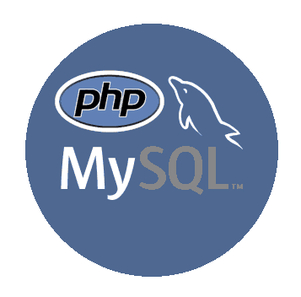




Tools
GitKraken
R statistical programming
Nuxit environment
Web design
Notes:
Mention each tool tool, no need to dive into the specifics. Mention that R was for the creation of the application, NUXIT was for everything server related, and HTML, CSS etc… was for web design. Git Kraken was used for project management

Slide 6
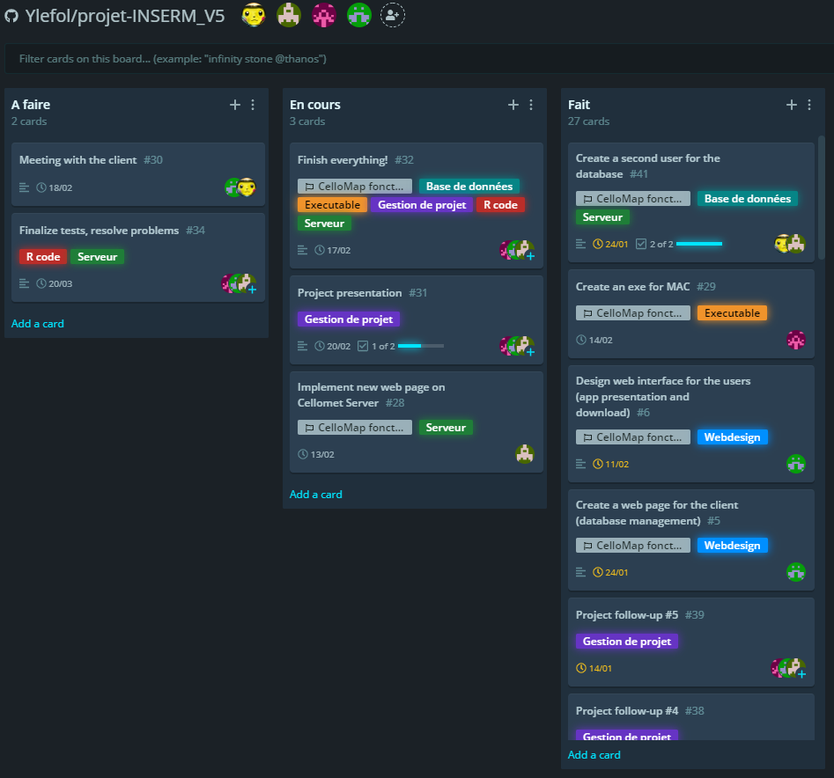
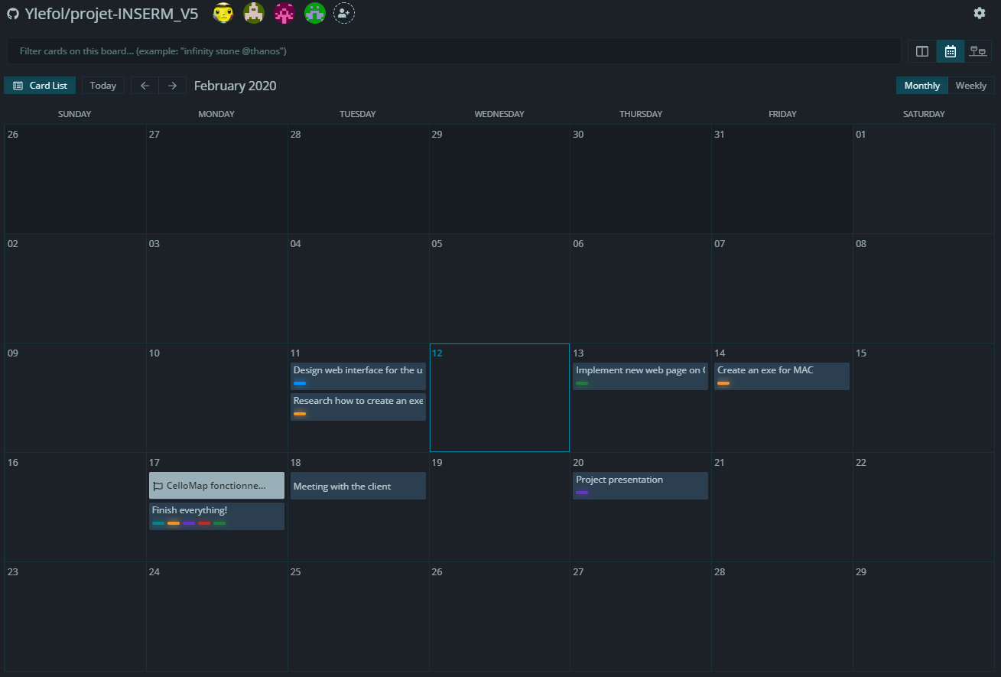
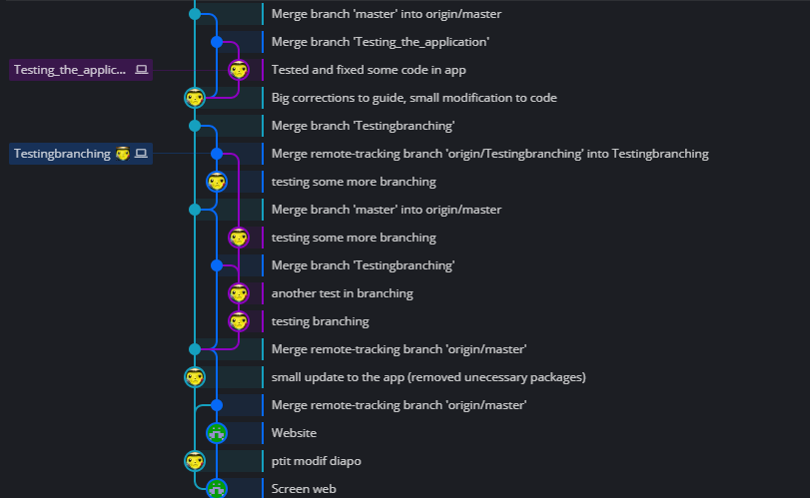
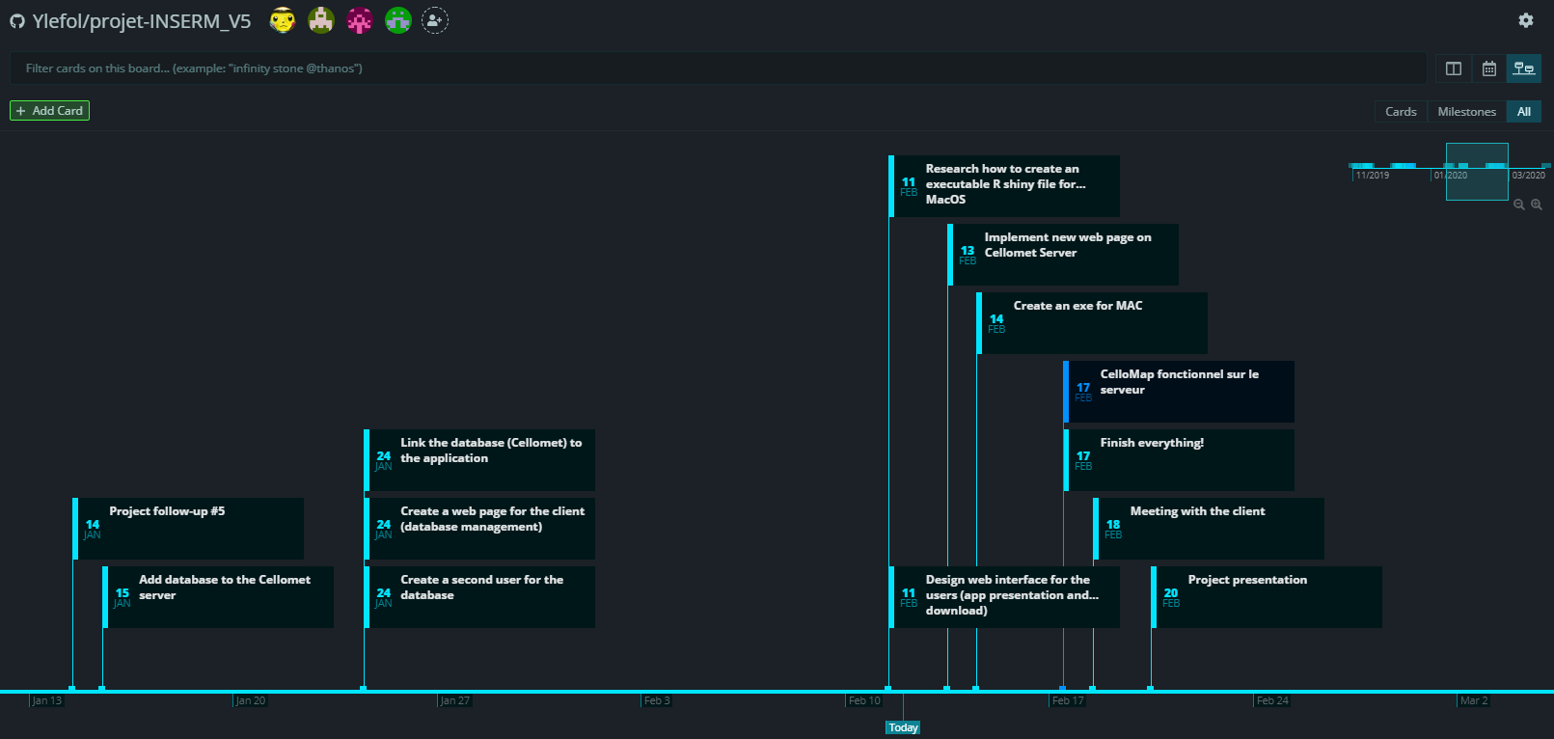
GitKraken
KanBan
Traditional
Calendar
Timeline
Github GUI
Merge conflict finder
Notes:
First we show the Kanban in it’s traditional form, followed by it’s calendar form, noting that the cards are on the days on which the tasks are due. The timeline view is also an option and is very useful to visualize the progress of the project.
Also, GitKraken offers a git GUI (graphical user interface) which shows the various pushes as well the correction of merge conflicts

Slide 7

What are non-canonical pathways?
Glucose
Glucose production
Binds to and inhibits
Fructose 6P
HIT
PPP
FBP1
FBP2
Glycogen metabolism
Fructose -1,6BP
Clear Cell Renal Cell Carcinoma
~85% of all kidney cancers
Pyruvate
Notes:
Start by showing the glyconeogenesis pathway (from pyruvate to glucose) focusing on a specific step, the one handled by FBP1 and FBP2..
We then show a separate pathway, one cause by CCRC, which increases hypoxia-inducible factors (HIT) which increases production in various pathways, thus increasing the proliferation of cancerous cells.
A non-canonical effect of FBP1 is it’s binding to HITs, inhibiting it’s effect and preventing the proliferation of CCRC cells.
This would be a non-canonical pathway.

Slide 8

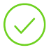

Where are we ?
GitKraken was set up and is functional
4 R scripts functional and tested
Started designing web interface
Convert 4 R scripts in one script and test it
Local database
Complete the Rshiny interface
Strategic reorientation
Add the Database on client’s server
Executable file for windows
Application to database (server)
Finished web interfece
Created executable Mac file
Upload everything to the server

Slide 9
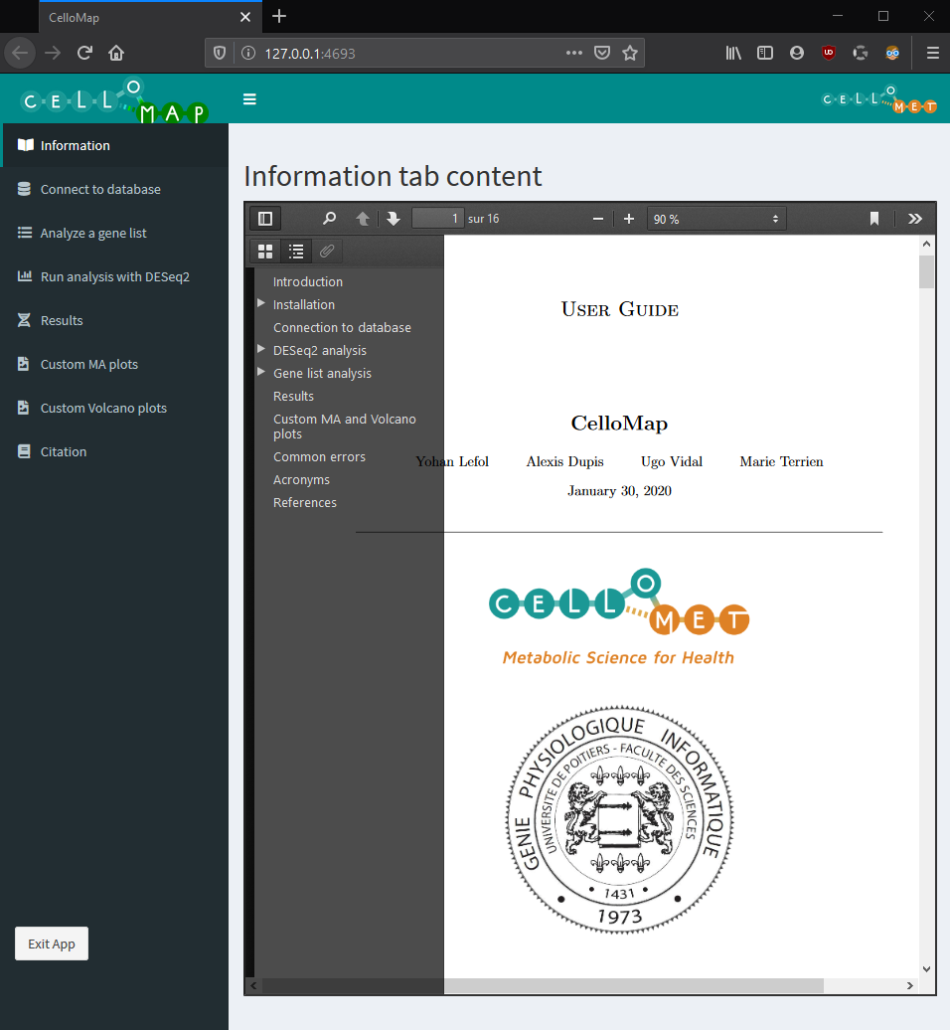
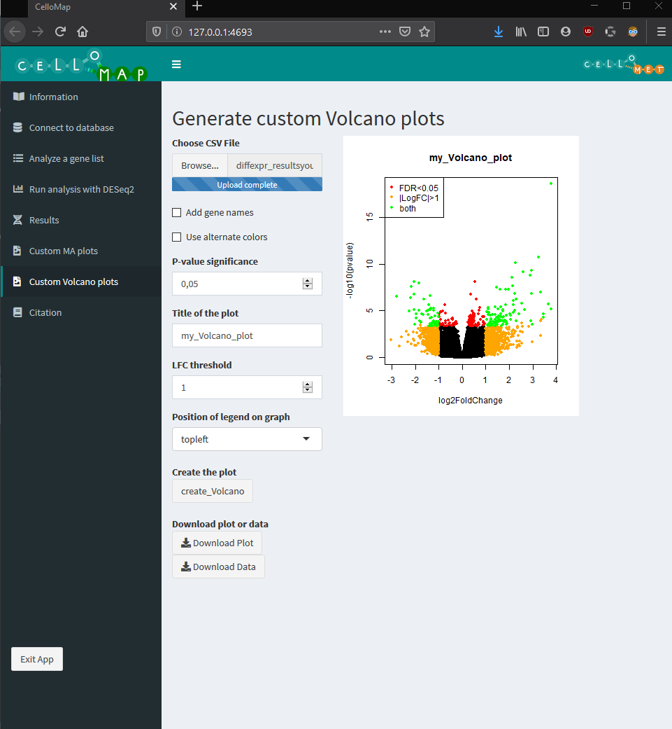
App – Examples
Showcase of two of the tabs
Embeded user guide
Custom creation of volcano plots
And much more

Slide 10
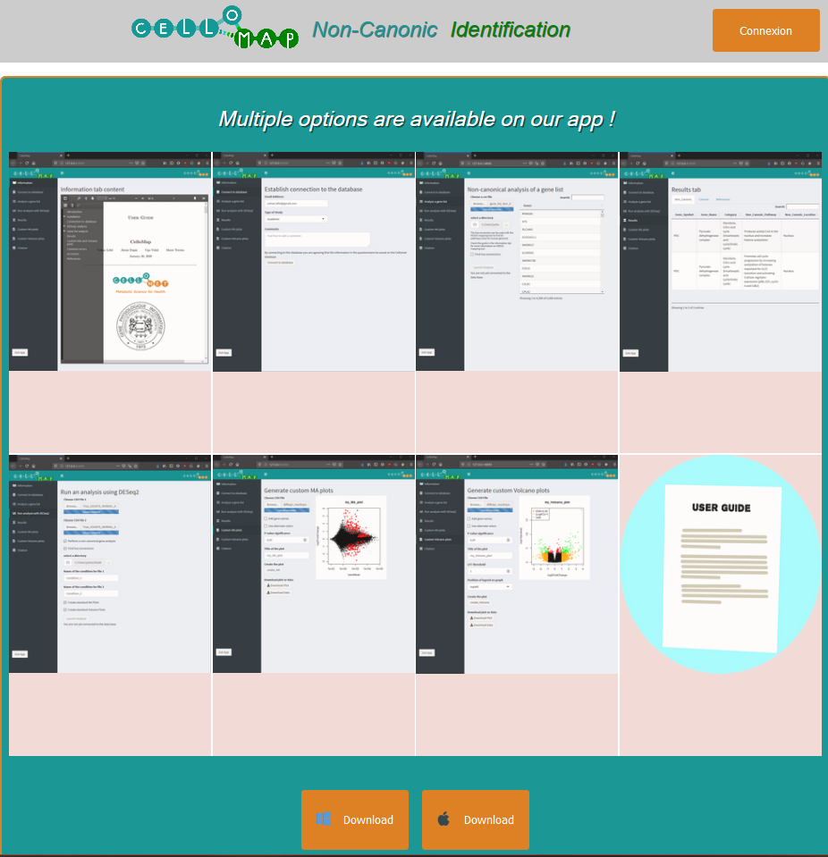
Web – User webpage
App previews
Apple and Windows download
Accessed from cellomet.com
Connexion button for the client
Notes:
The initial page of the CelloMap website, either found independently or accessed via Cellomet.com
This webpage shows a potential user the different aspects of the application, thus showing the different functionalities it presents. Users can also access the user-guide of the application through this page. The guide allows them to have a complete understanding on what the application is, how to install, as well as how to use it.

Slide 11
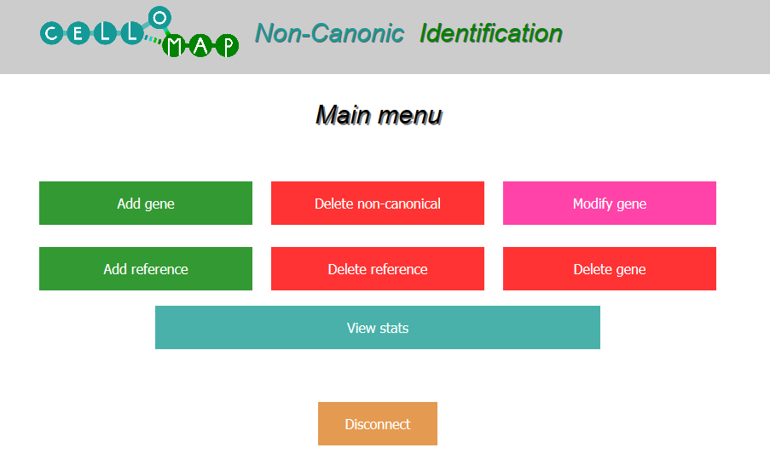
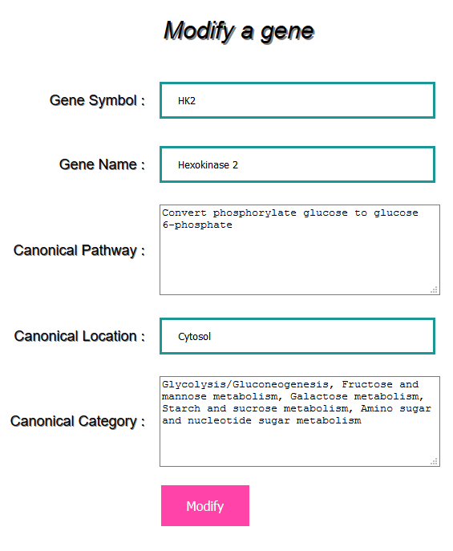
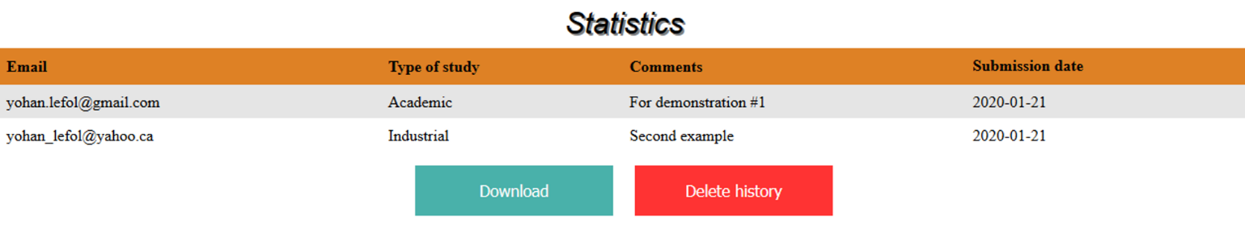
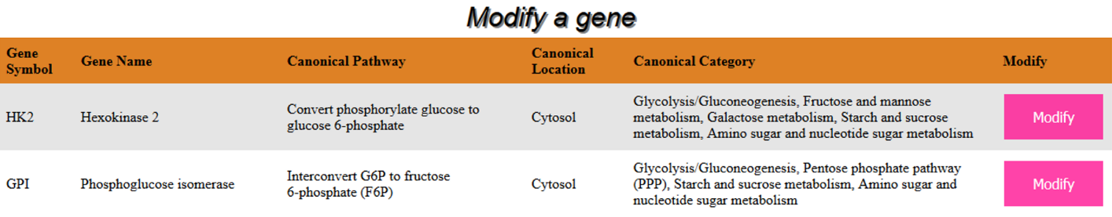
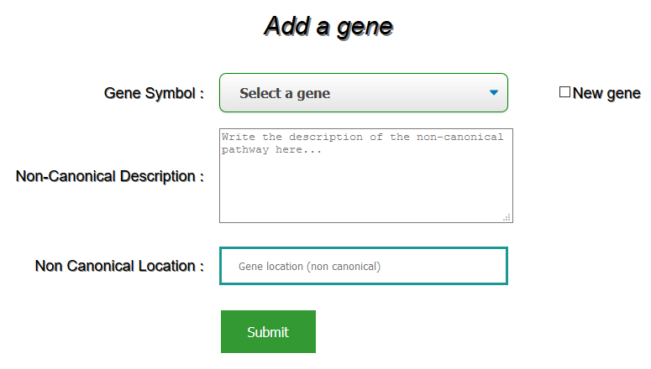
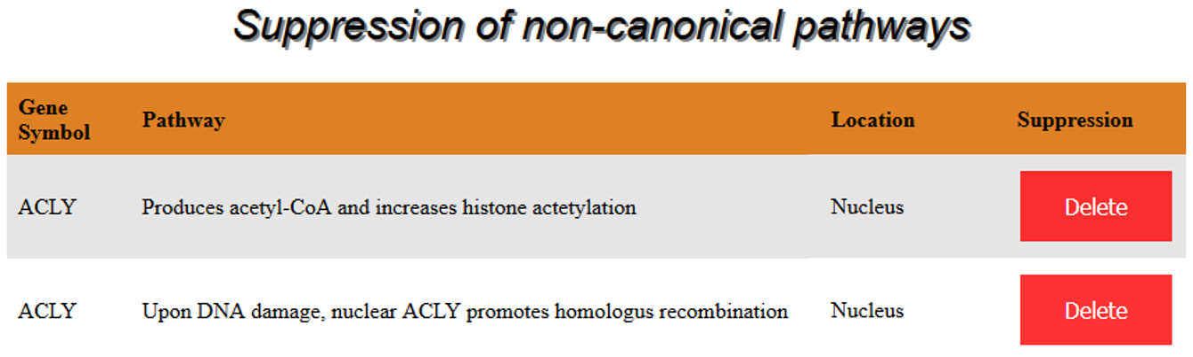
Client’s webpage
Manage database
Add genes
Remove genes
Modify genes
Download survey answers
Notes:
This slide goes over some (not all) of the components for the client’s web page. It is important to state that this can only be accessed using a username and password known only by our client and the team leader.
The take away of this slide is that is it essentially an interface to manage the database in which all of the non-canonic information is located.

Slide 12


Thank you for you attention

