Slide 1

DUPIS Alexis, VIDAL Ugo, TERRIEN Marie, LEFOL Yohan

Slide 2
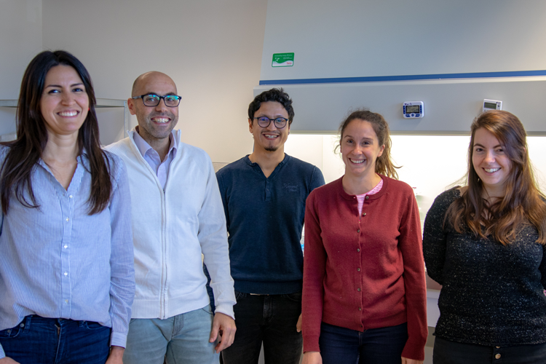
Our client
A contract research organization
Technology and consulting platform
Specialists in metabolic research
Managed by Rodrigue Rossignol

Slide 3

Their need, our project
A bioinformatic research tool
Clear and publishable results
Identification of non-canonical genes
Easily used by scientists
Hosted on Cellomet.com

Slide 4




T
Risk of high demand (server)
Portability to Mac
Lack of control on database
S
Diverse skill set
W
Short deadlines
T
Risk of high demand (server)
O
No competition
Access to expert advise
High utility
Open source packages
Portability to Mac
Lack of control on database
Emerging scientific field

Slide 5
Understand DESeq2
Nov 11 - Nov 22
Yohan Lefol
Write functionnal scripts
Nov 11 – Dec 20
Alexis Dupis
Link all scripts
Dec 9 - Dec 20
Marie Terrien
Create the web interface
Dec 9 - Jan 24
Ugo Vidal
Create local non canonical database
Jan 13 - Jan 24
Format server
Nov 11 - Jan 24
Add the Database on client’s server and implement web design
Jan 13 - Feb 14
Find and explain non-canonical pathways
Nov 11 - Jan 24
Develop exe for Windows and Mac
Dec 9 - Feb 14
Meet with client/End of Project
Feb 18
Nov
Dec
2020
Feb
2020
Today

Slide 6
Tools

Slide 7


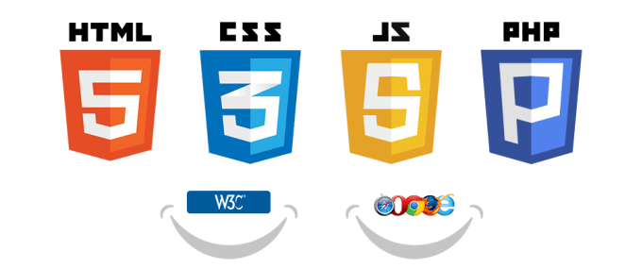







Tools

Slide 8

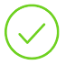

Where are we ?
GitKraken was set up and is functional
4 R scripts functional and tested
Started designing web interface
Convert 4 R scripts in one script and test it
Local database
Complete the Rshiny interface
Strategic reorientation
Add the Database on client’s server
Executable file for windows
Application to database (server)
Finalize the web interface
Create an executable file Mac
Upload everything to the server

Slide 9
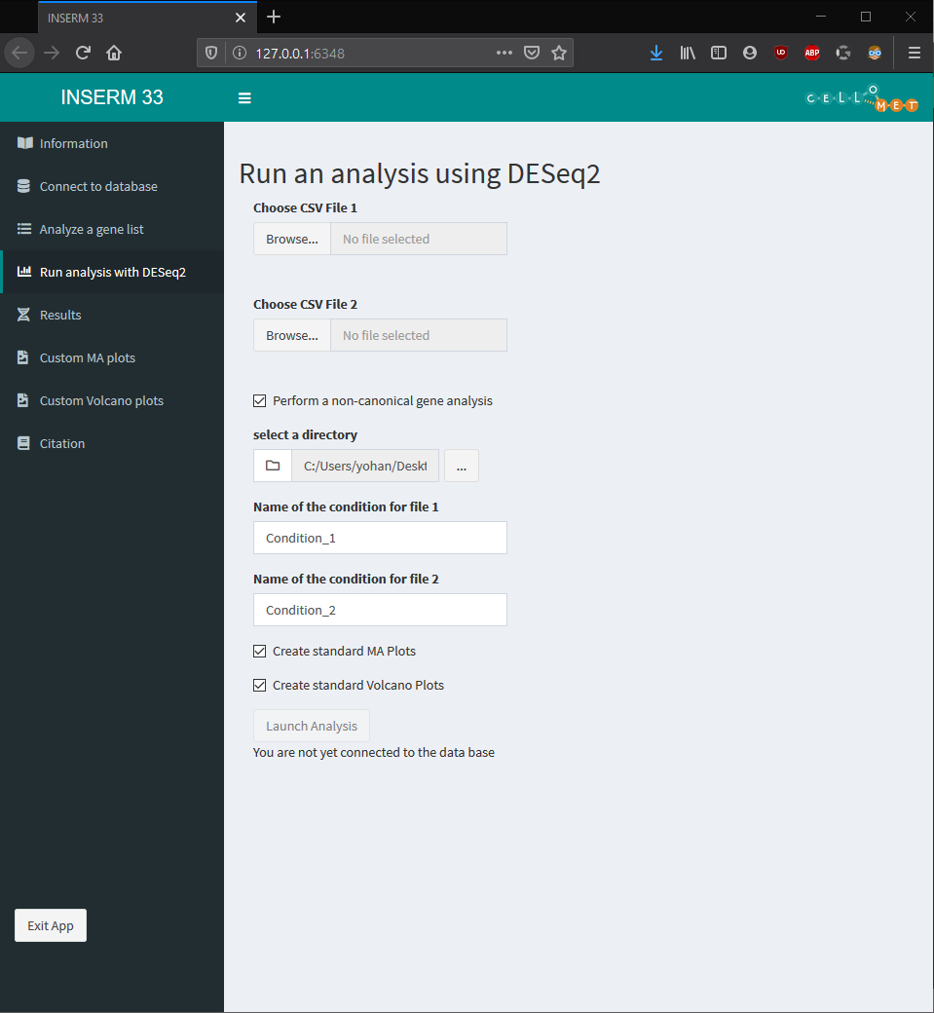
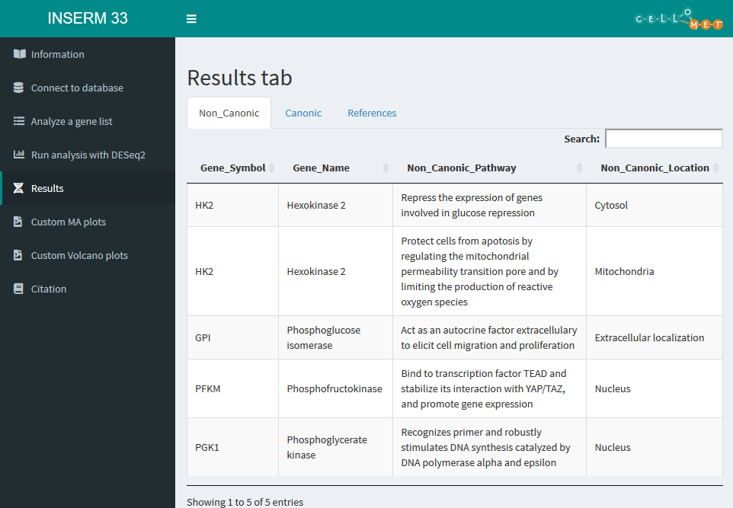
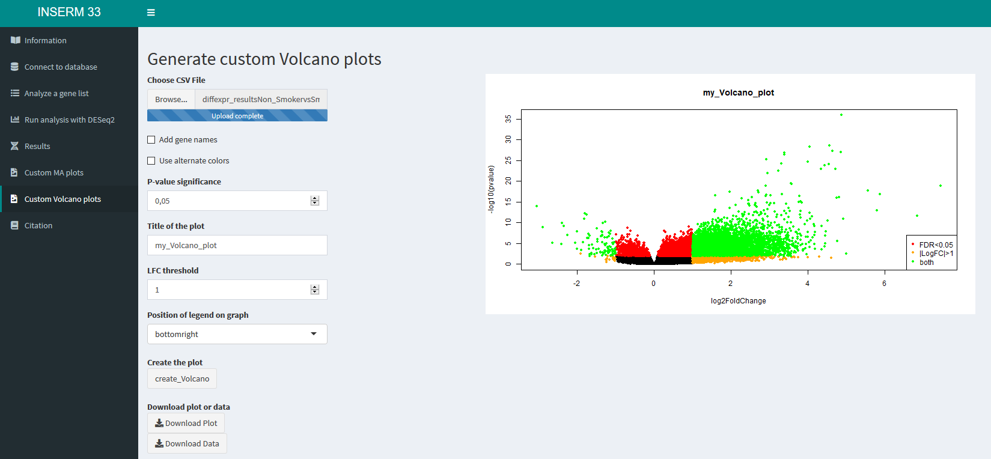

Slide 10
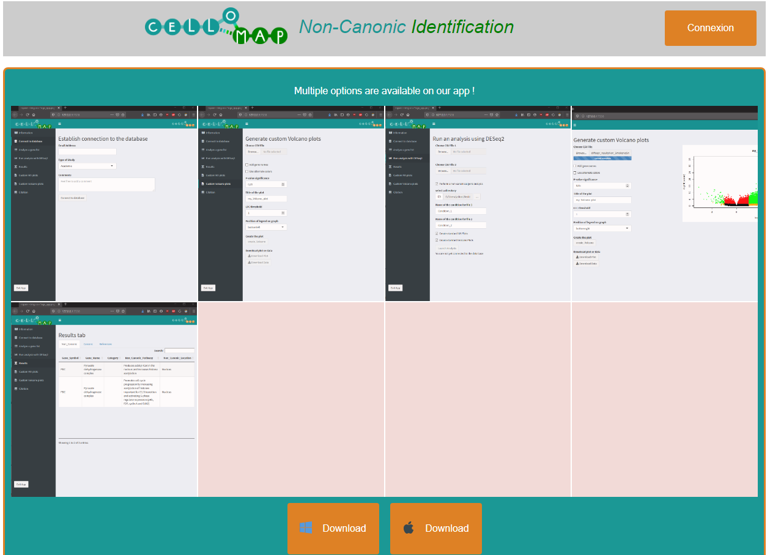

Slide 11
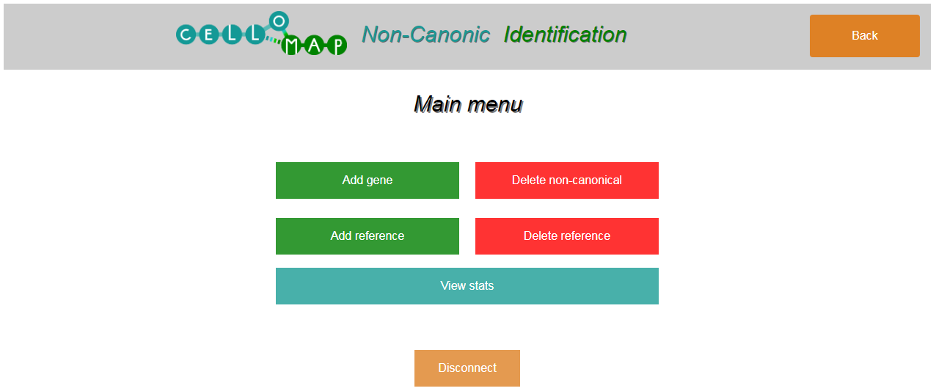
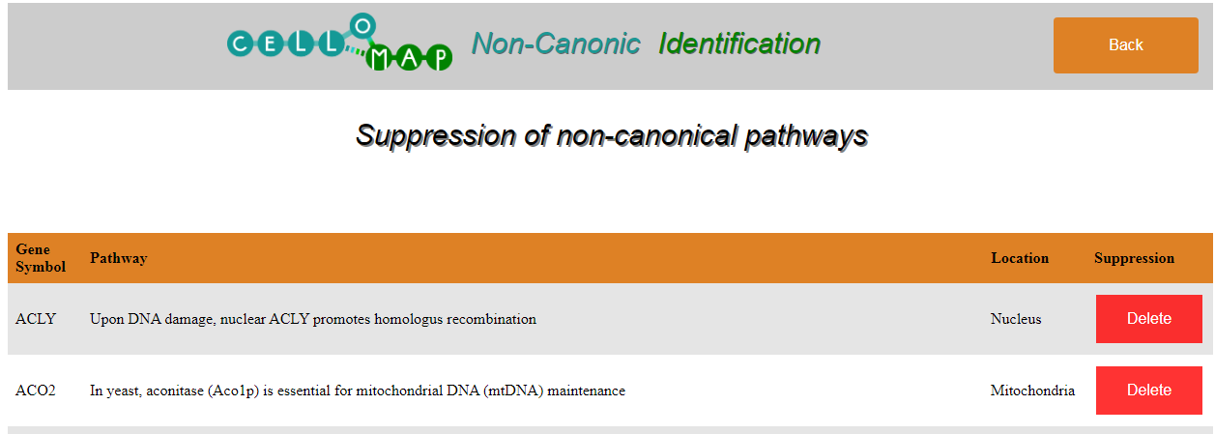

Slide 12
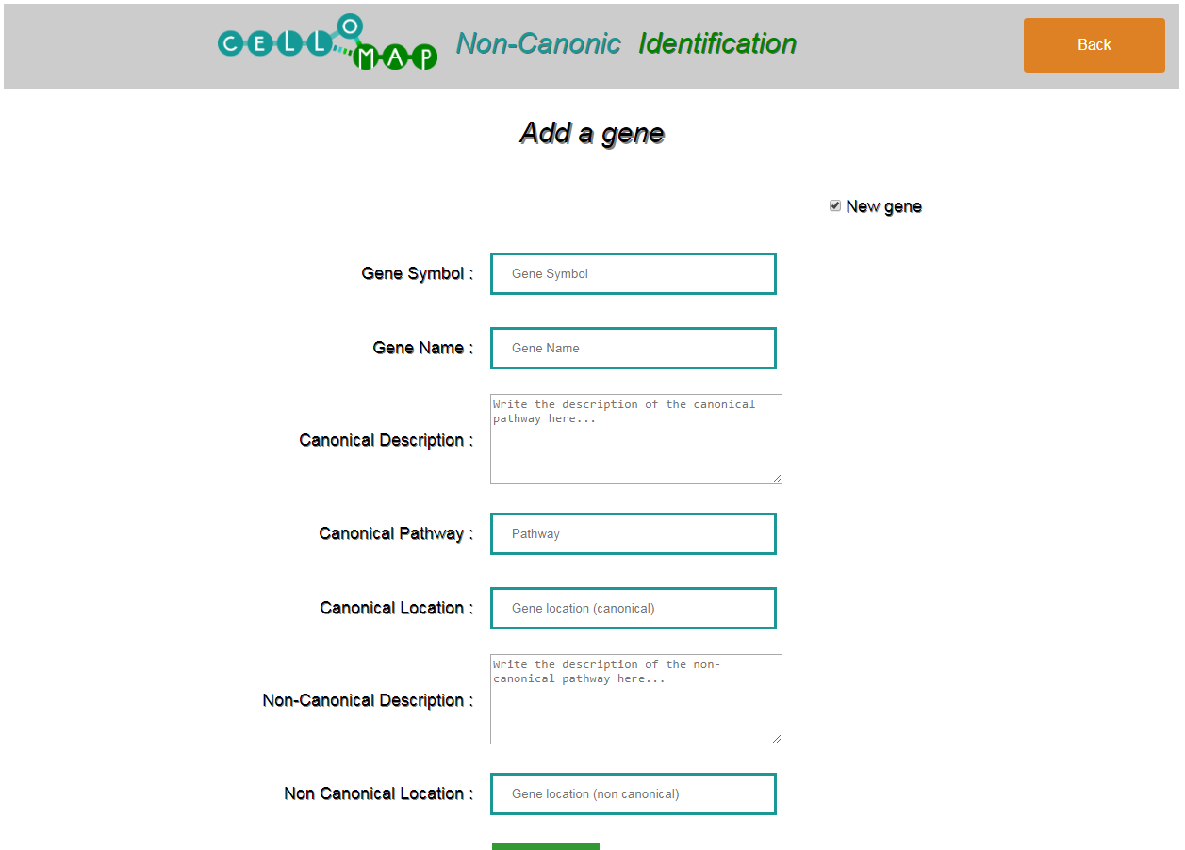
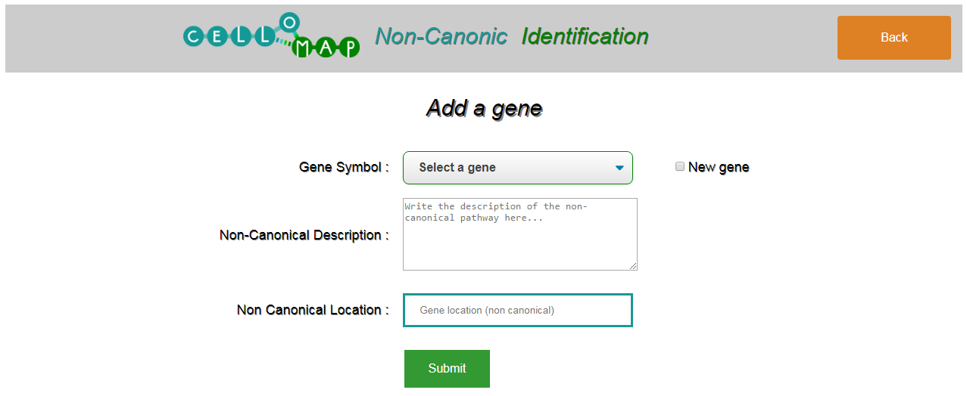

Slide 13
GANTT EDIT PAGE, DON’T DELETE
Understand DESeq2
Nov 11 - Nov 22
Write functionnal scripts
Nov 11 - Dec 20
Link all scripts
Dec 9 - Dec 20
Create the web interface
Dec 9 - Jan 24
Create local non canonical database
Jan 13 - Jan 24
Format server
Nov 11 - Jan 24
Add the Database on client’s server and implement web design
Jan 13 - Feb 14
Find and explain non-canonical pathways
Nov 11 - Jan 24
Develop exe for Windows and Mac
Dec 9 - Feb 14
Meet with client/End of Project
Feb 18
Nov
Dec
2020
Feb
2020
Today

