Slide 1

DUPIS Alexis, VIDAL Ugo, TERRIEN Marie, LEFOL Yohan

Slide 2
Goals
Create a user friendly tool
Results are clear and publishable in scientific publication
Identification of non-canonical genes
Interpretation of results
Host the tool on the client’s website (Cellomet) → Download and data retrieval

Slide 3







T
Risk of high demand (server)
Portability to Mac
Lack of control on database
O
No competition
High utility
Easy to use
S
Diverse skill set
W
Short deadlines
T
Risk of high demand (server)
O
No competition
Access to expert advise
High utility
Open source packages (no budget needed)
Portability to Mac
Lack of control on database
Emerging scientific field
Client infrequently available
Easy to use

Slide 4
Understand DESeq2
Nov 11 - Nov 22
Yohan Lefol
Write functionnal scripts
Nov 11 – Dec 20
Alexis Dupis
Link all scripts
Dec 9 - Dec 20
Marie Terrien
Create the web interface
Dec 9 - Jan 24
Ugo Vidal
Create local non canonical database
Jan 13 - Jan 24
Format server
Nov 11 - Jan 24
Add the Database on client’s server and implement web design
Jan 13 - Feb 14
Find and explain non-canonical pathways
Nov 11 - Jan 24
Develop exe for Windows and Mac
Dec 9 - Feb 14
Meet with client/End of Project
Feb 18
Nov
Dec
2020
Feb
2020
Today

Slide 5







Tools
GitKraken
R statistical programming
Nuxit environment
Web design

Slide 6
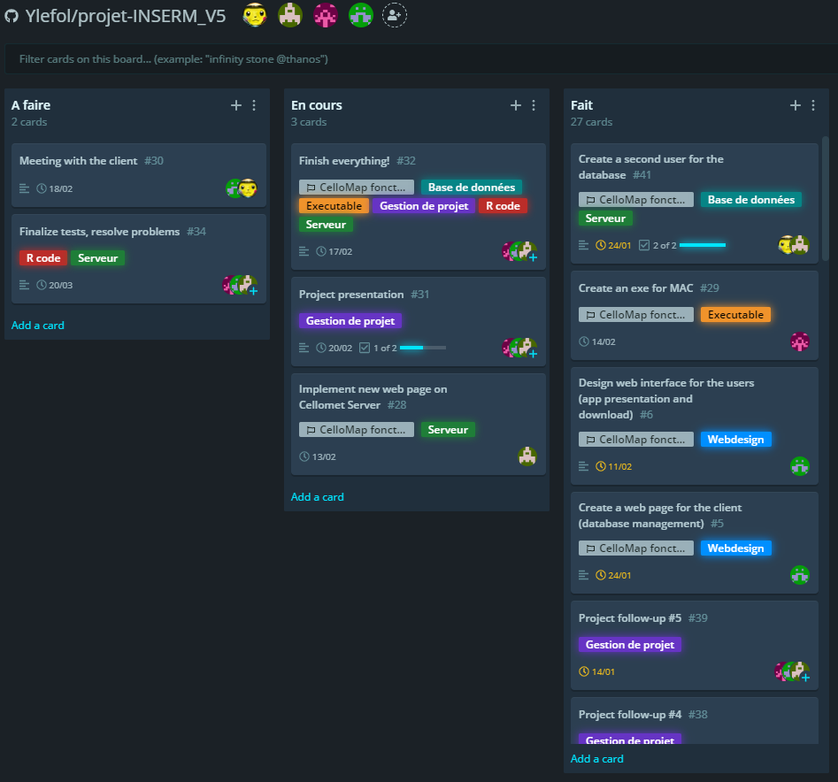
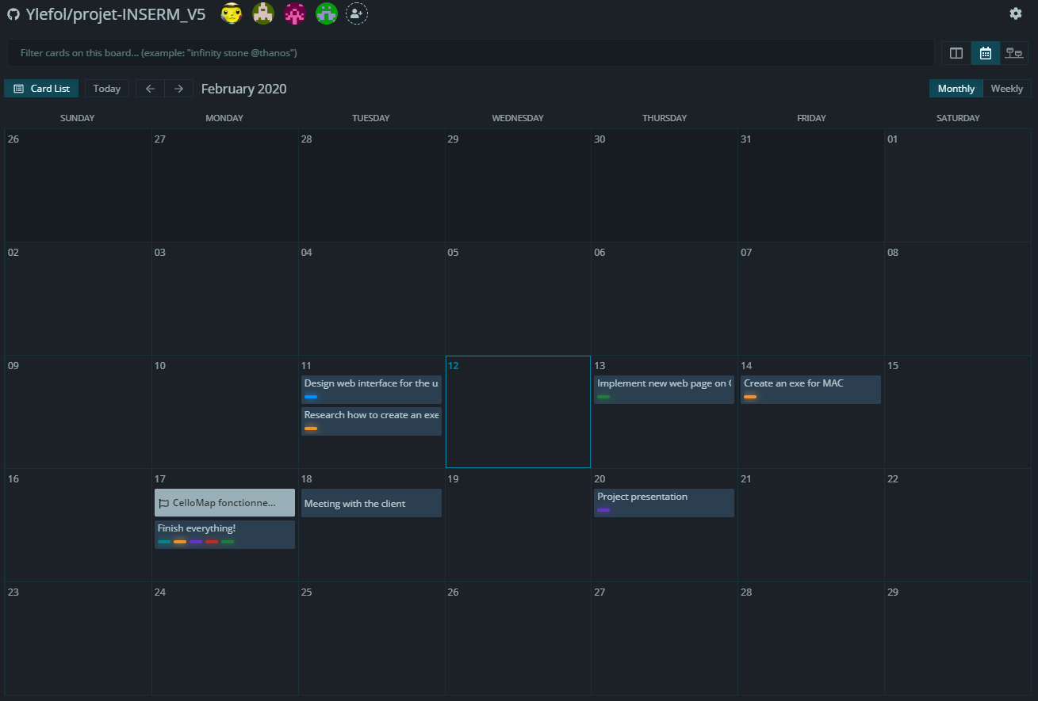
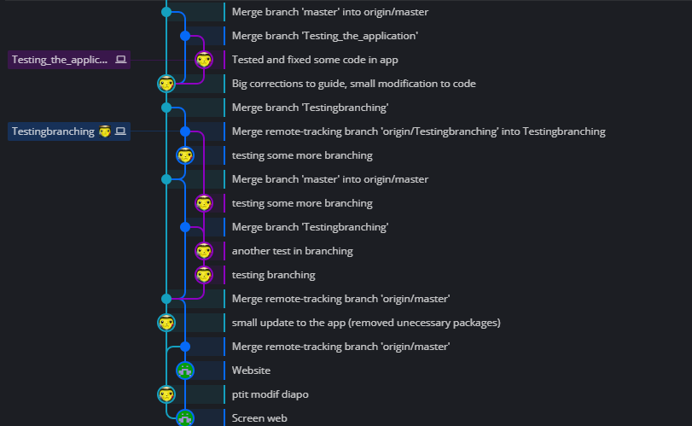
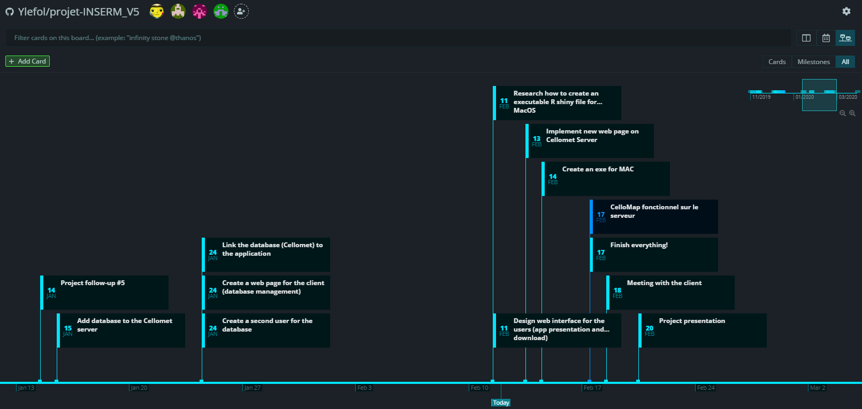
GitKraken
KanBan
Traditional
Calendar
Timeline
Github GUI
Merge conflict finder

Slide 7

What are non-canonical pathways?
Glucose
Glucose production
Binds to and inhibits
Fructose 6P
HIT
PPP
FBP1
FBP2
Glycogen metabolism
Fructose -1,6BP
Clear Cell Renal Cell Carcinoma
~85% of all kidney cancers
Pyruvate

Slide 8

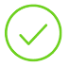

Where are we ?
GitKraken was set up and is functional
4 R scripts functional and tested
Started designing web interface
Convert 4 R scripts in one script and test it
Local database
Complete the Rshiny interface
Strategic reorientation
Add the Database on client’s server
Executable file for windows
Application to database (server)
Finished web interfece
Created executable Mac file
Upload everything to the server

Slide 9
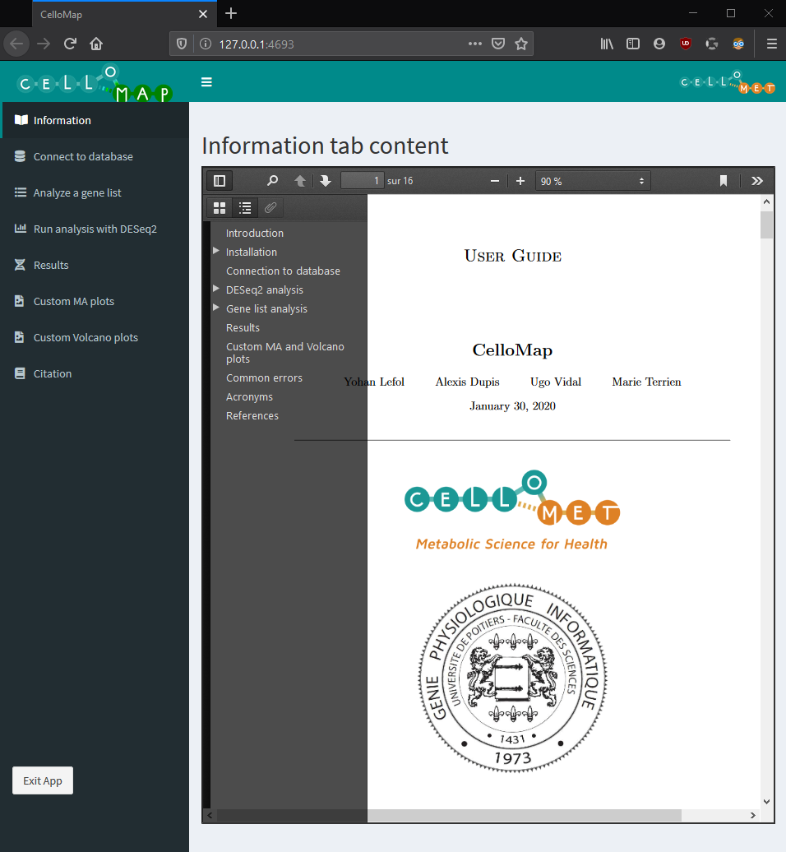
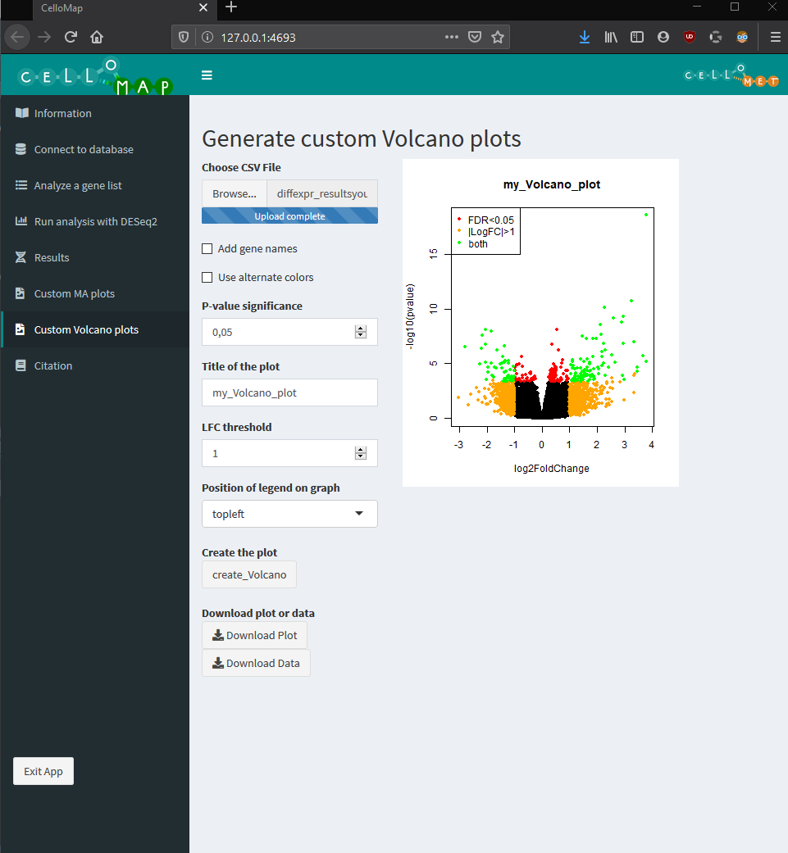

Slide 10
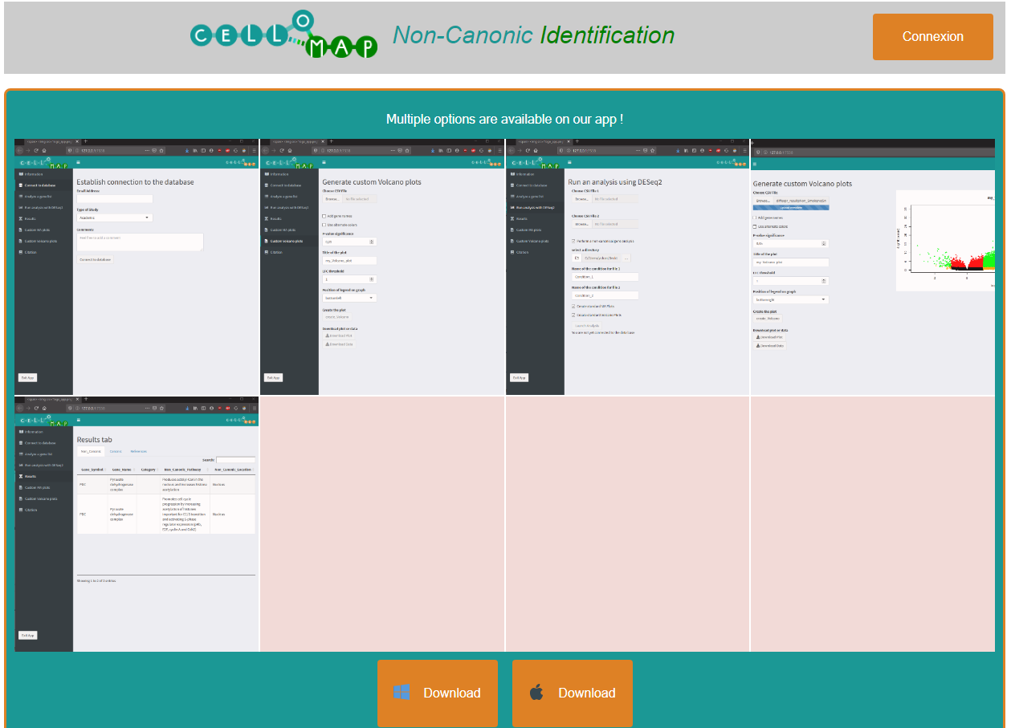
App – User webpage
App previews
Apple and Windows download
Accessed from cellomet.com
Connexion button for the client

Slide 11
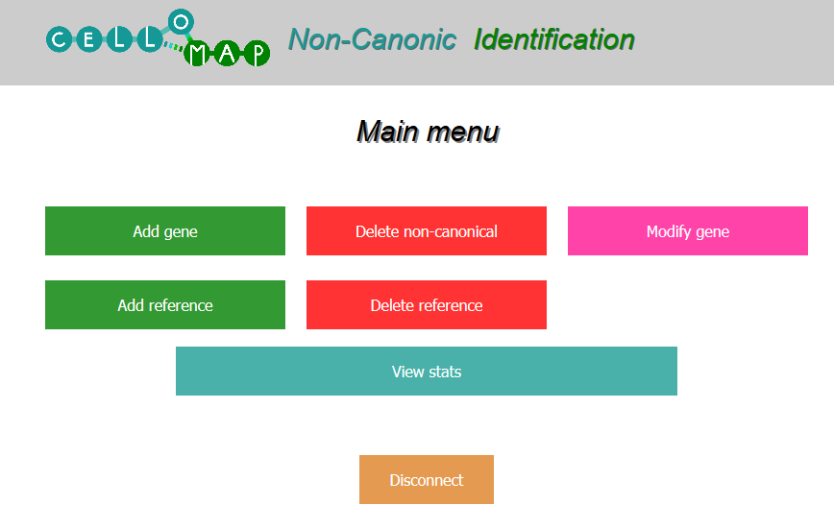
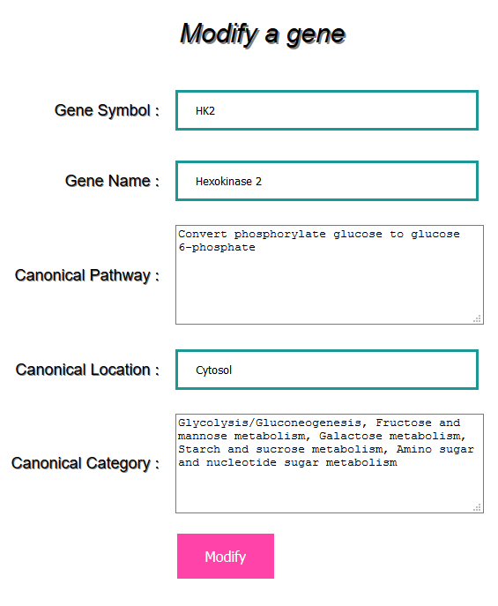
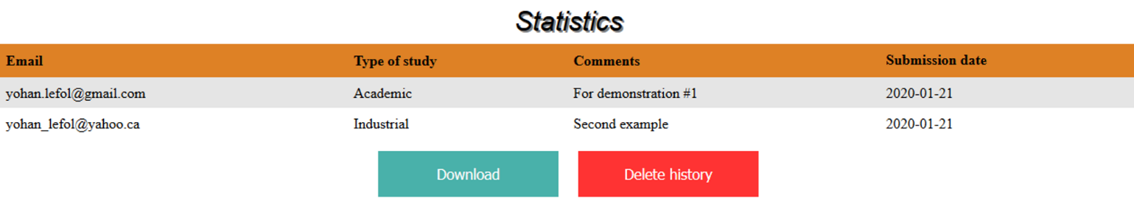
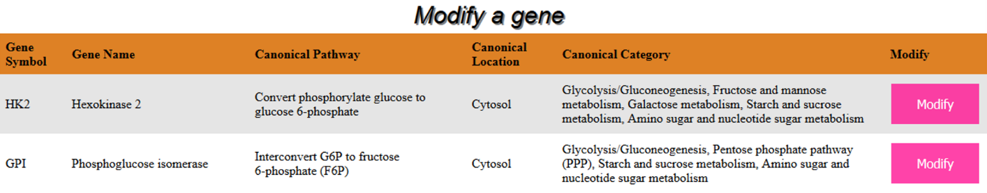
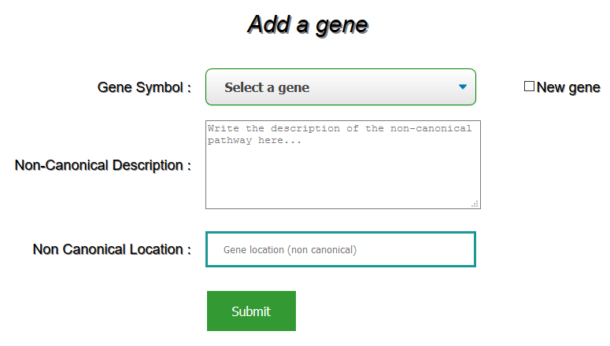
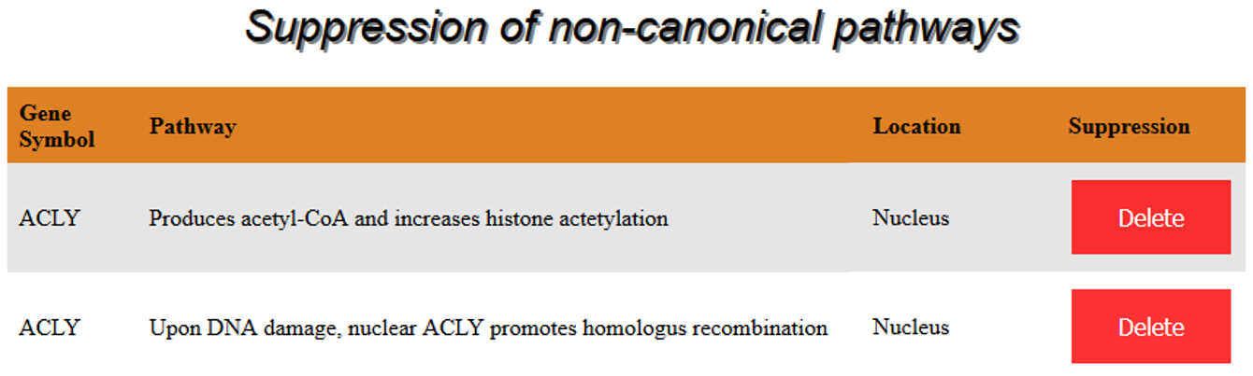
Client’s webpage
Manage database
Add genes
Remove genes
Modify genes
Download survey answers

