Slide 1

DUPIS Alexis, VIDAL Ugo, TERRIEN Marie, LEFOL Yohan

Slide 2
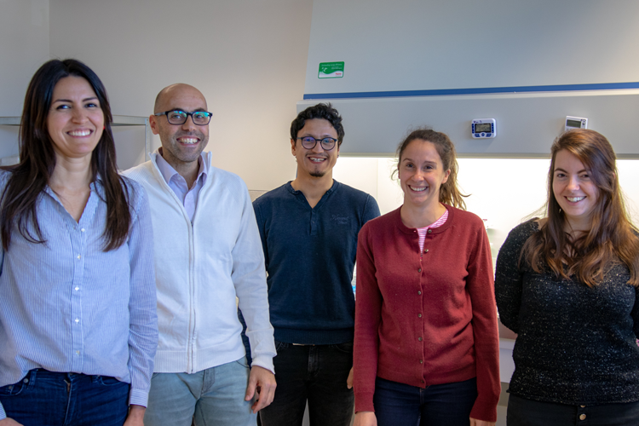
Our client
A contract research organization
Technology and consulting platform
Specialists in metabolic research
Managed by Rodrigue Rossignol

Slide 3

Their need, our project
A bioinformatic research tool
Clear and publishable results
Identification of non-canonical genes
Easily used by scientists

Slide 4
Their need, our project
A bioinformatic research tool
Clear and publishable results
Identification of non-canonical genes
Easily used by scientists

Slide 5
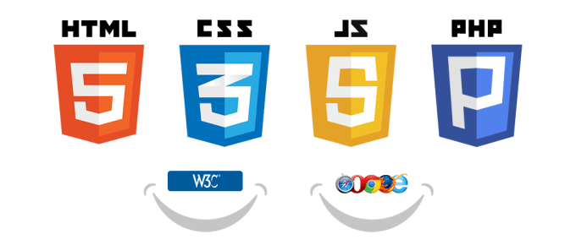





Tools
Teamworking
Project Management (Kanban + timeline)
Programming language for statistical analyses
Packages :
- DESeq2
- Rshiny

Slide 6
Gantt
Understand DESeq2
100%
Nov 11 - Nov 22
Create the web interface
Nov 11 - Dec 20
Write functionnal scripts
100%
Nov 11 - Nov 22
Link all scripts
Dec 9 - Dec 20
Add the Database on client’s server
Jan 13 - Feb 21
Add non-canonical pathways
Jan 13 - Feb 21
Tests and adjustments
Mar 9 - Mar 20
Nov
Dec
2020
Feb
Mar
2020
Today

Slide 7
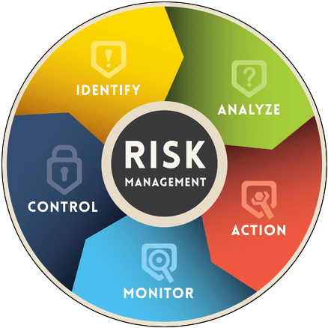
Risk Management
S
Diverse skill set
W
Short deadlines
T
Risk of high demand (server)
O
No competition
Access to expert advise
Not well documented
High utility
Data protection (temporary)
Open source packages

Slide 8

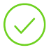

Where are we ?
GitKraken was set up and is functional
4 R scripts functional and tested
Started designing web interface
Convert 4 R scripts in one script and test it
Local database
Complete the Rshiny interface
Strategic reorientation
Add the Database on client’s server
Executable file for windows
Application to database (server)
Finalize the web interface
Create an executable file Mac
Upload everything to the server

Slide 9
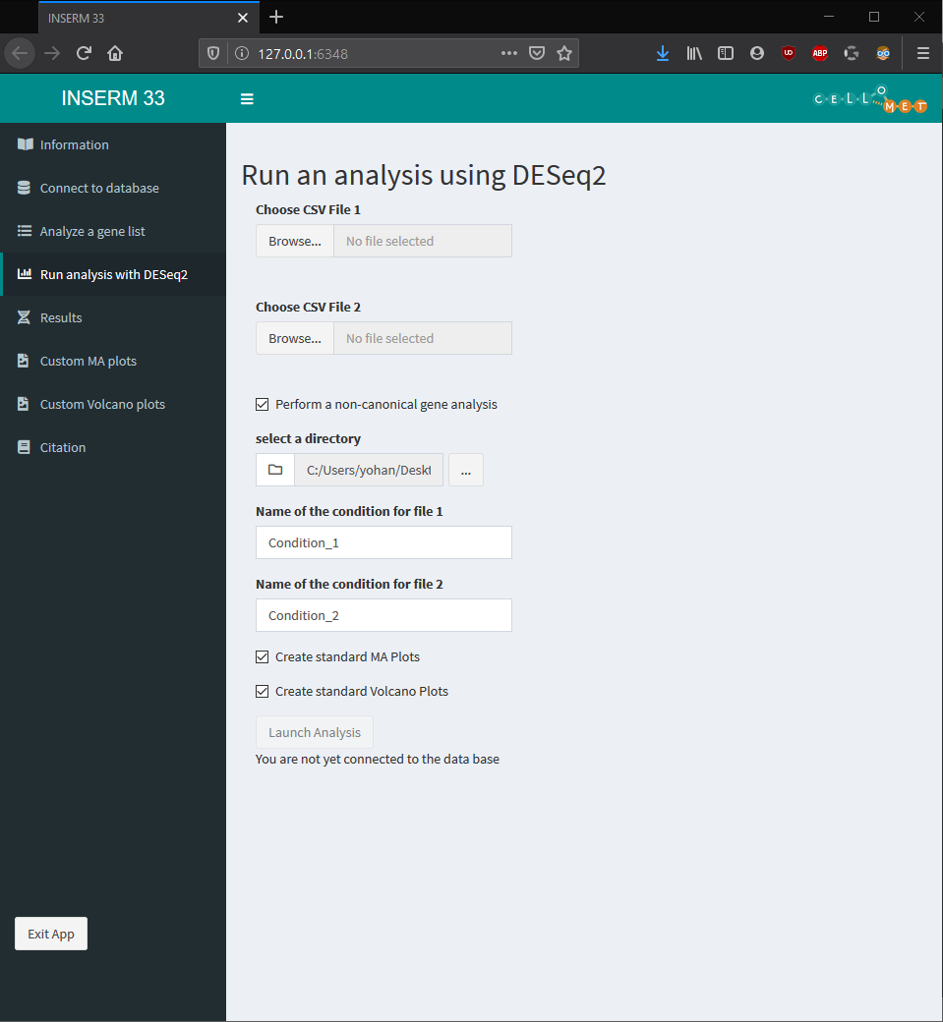
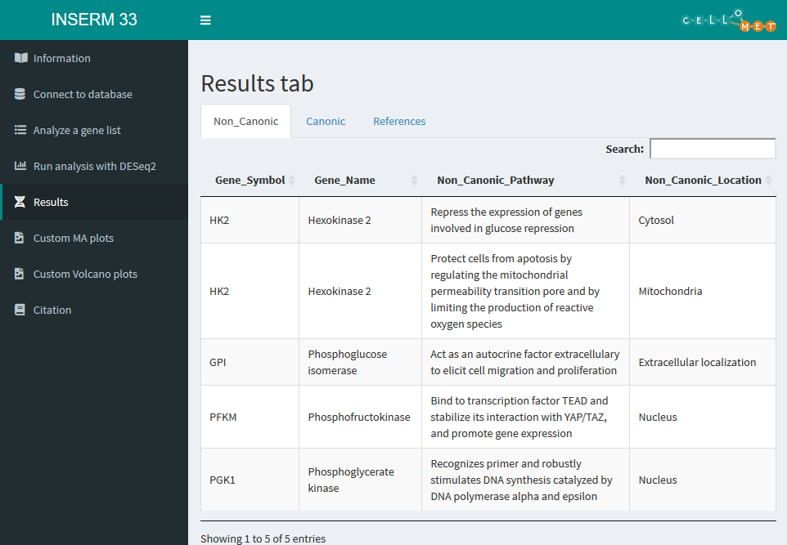
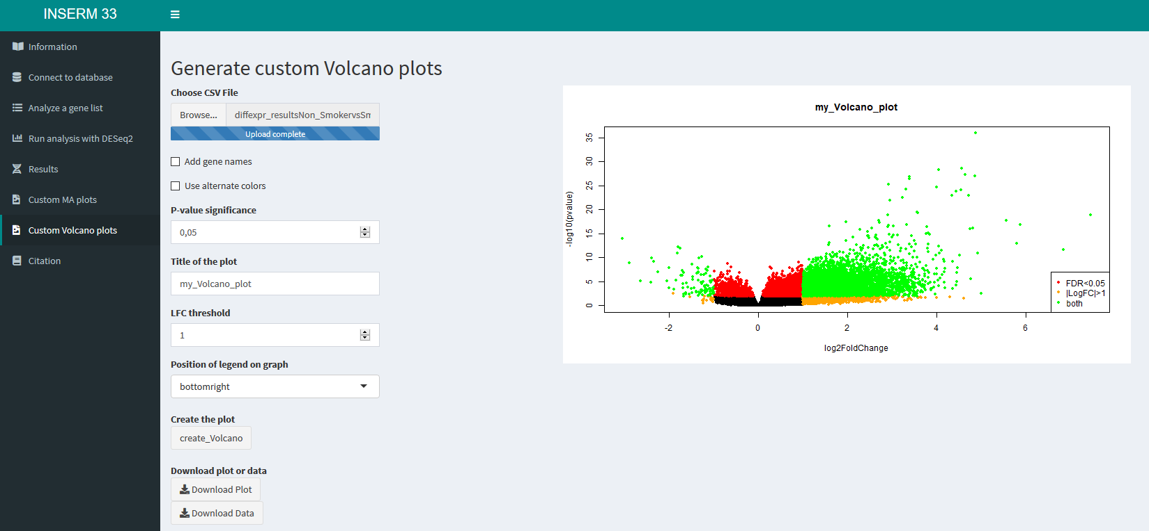

Slide 10
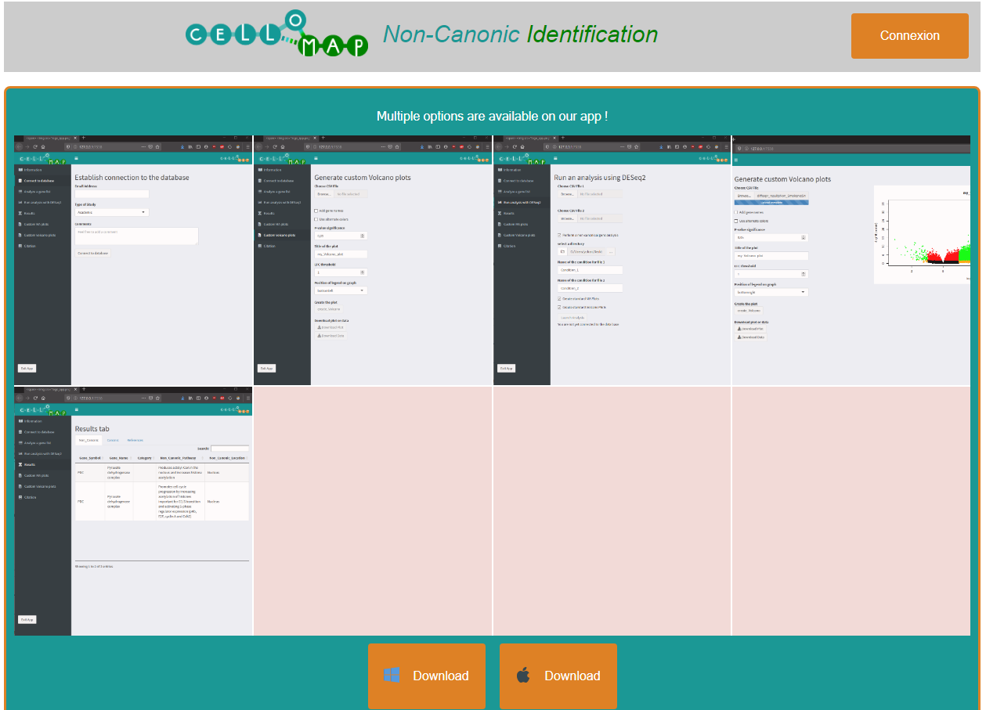

Slide 11
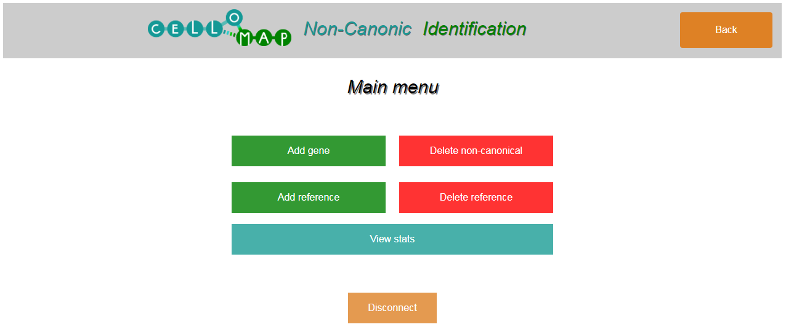
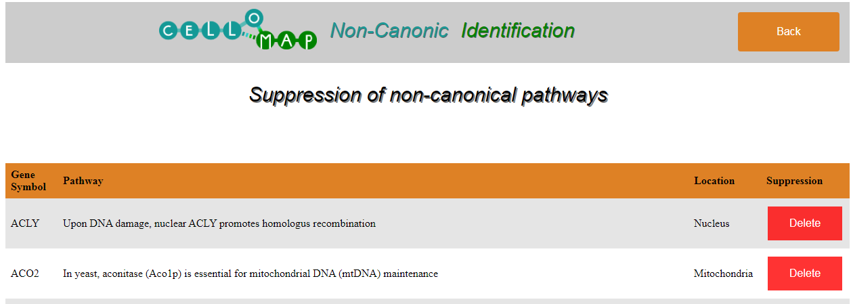

Slide 12
