Slide 1

DUPIS Alexis, VIDAL Ugo, TERRIEN Marie, LEFOL Yohan

Slide 2
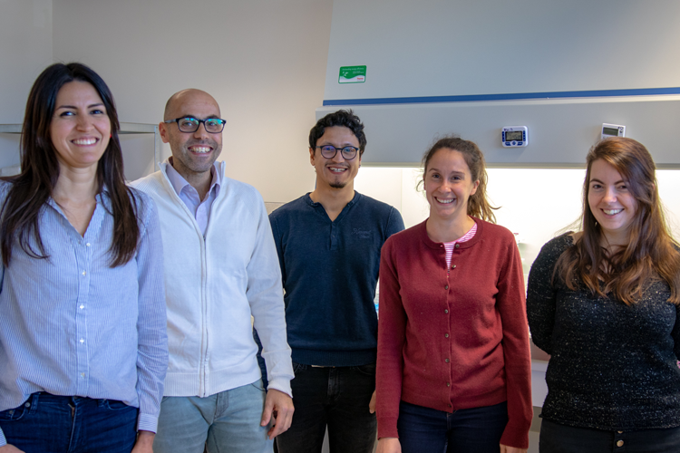
Our client
A contract research organization
Technology and consulting platform
Specialists in metabolic research
Managed by Rodrigue Rossignol

Slide 3

Their need, our project
A bioinformatic research tool
Clear and publishable results
Identification of non-canonical pathways
Easily used by scientists
Hosted on Cellomet.com

Slide 4




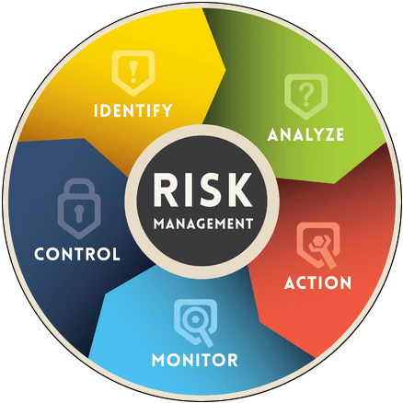


T
Risk of high demand (server)
Portability to Mac
Lack of control on database
O
No competition
High utility
Easy to use
S
Diverse skill set
W
Short deadlines
T
Risk of high demand (server)
O
No competition
Access to expert advise
High utility
Open source packages (no budget needed)
Portability to Mac
Lack of control on database
Emerging scientific field
Client infrequently available
Easy to use

Slide 5
Understand DESeq2
Nov 11 - Nov 22
Yohan Lefol
Write functionnal scripts
Nov 11 – Dec 20
Alexis Dupis
Link all scripts
Dec 9 - Dec 20
Marie Terrien
Create the web interface
Dec 9 - Jan 24
Ugo Vidal
Create local non canonical database
Jan 13 - Jan 24
Format server
Nov 11 - Jan 24
Add the Database on client’s server and implement web design
Jan 13 - Feb 14
Find and explain non-canonical pathways
Nov 11 - Jan 24
Develop exe for Windows and Mac
Dec 9 - Feb 14
Meet with client/End of Project
Feb 18
Nov
Dec
2020
Feb
2020
Today

Slide 6







Tools
GitKraken
R statistical programming
Nuxit environment
Web design

Slide 7
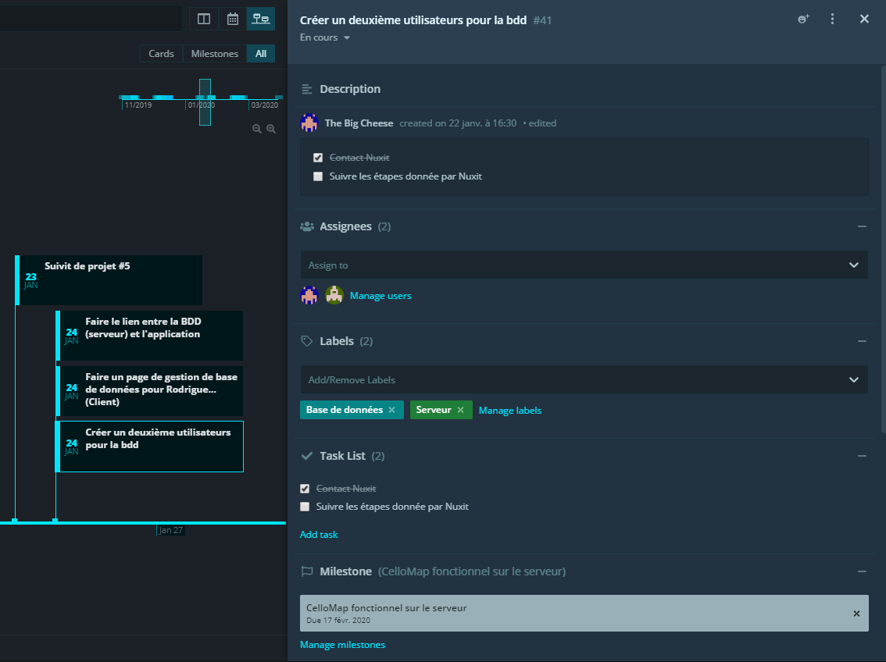
Project management
Strong use of gitKraken’s KanBan
Established project specifications (cahiers des charges)
Meeting every Monday
Close proximity in the work environment
Independant and reactive

Slide 8

What are non-canonical pathways?
Glucose
Glucose production
Binds to and inhibits
Fructose 6P
HIT
PPP
FBP1
FBP2
Glycogen metabolism
Fructose -1,6BP
Clear Cell Renal Cell Carcinoma
~85% of all kidney cancers
Pyruvate

Slide 9
Our results
A webpage linked to Cellomet allowing users to download the app
A fully functionnal non-canonical gene analysis tool
A extensive and comprehensive user guide
A simplified interaction with other bioinformatic tools
A webpage allowing the client to modify all aspects of a database

Slide 10
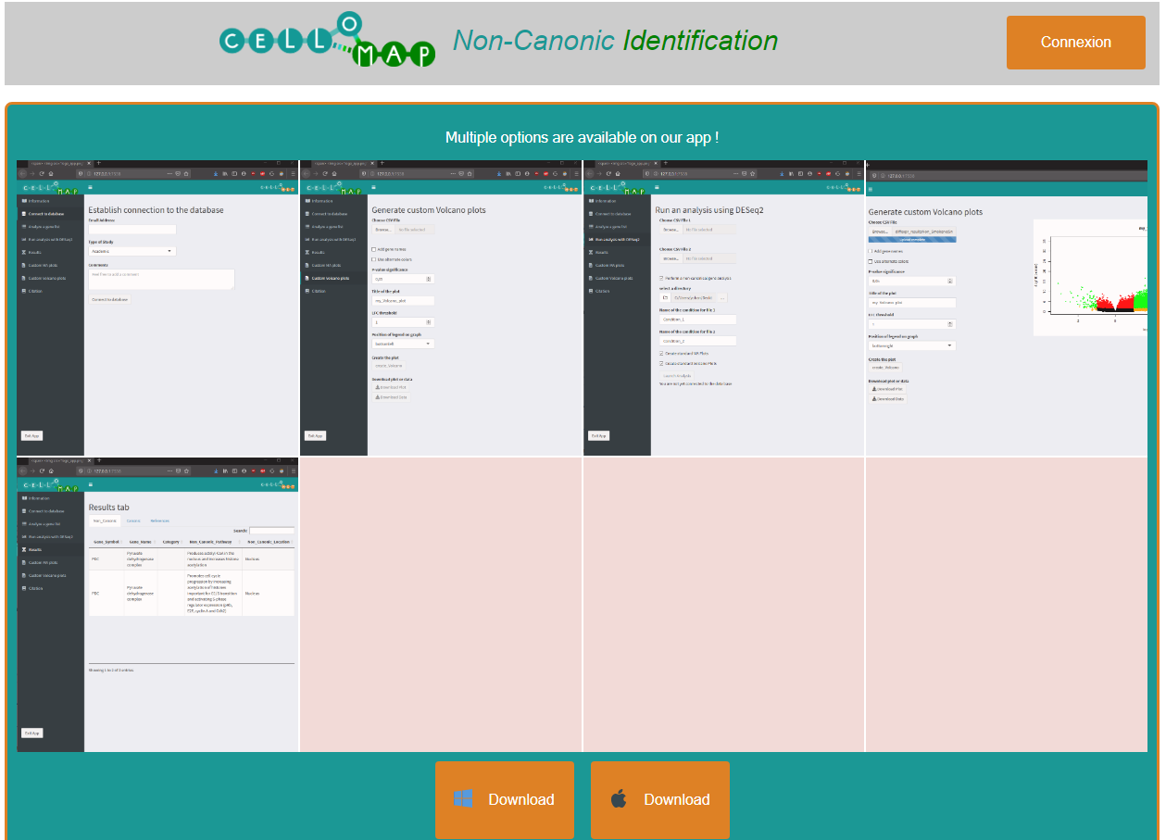
App – User webpage
App previews
Apple and Windows download
Accessed from cellomet.com
Connexion button for the client

Slide 11
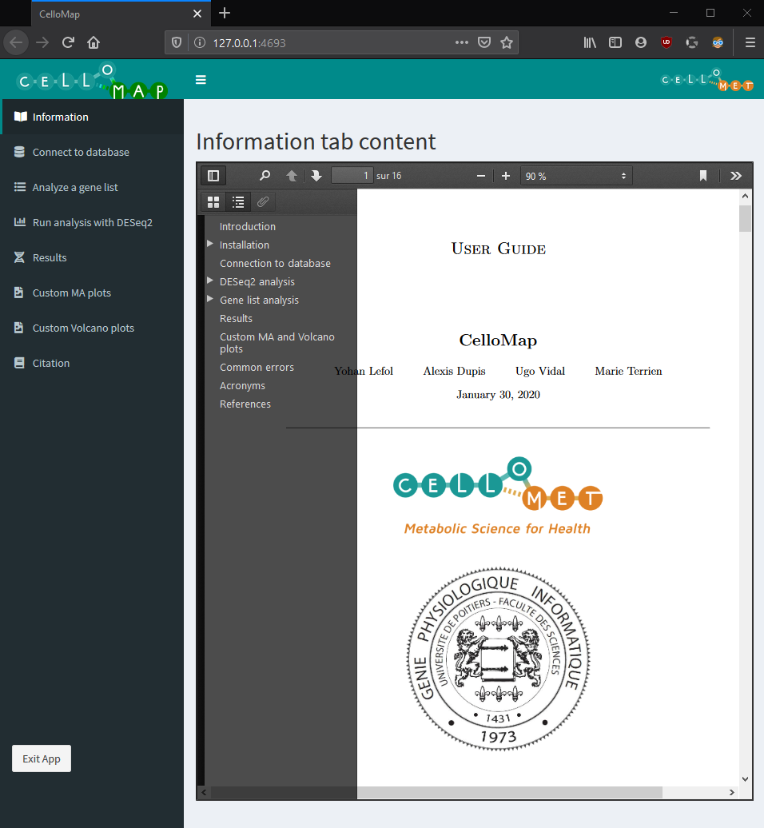
App – User guide
Installation
How to use the application
Result interpretation
Common errors

Slide 12


App Workflow
Custom MA plot
Custom significant gene list
Custom Volcano plot
Differential gene expressions
DESeq2
Non-canonic results
Differential expressions for significant genes
Non-canonic analysis
MERAV
Significant gene list
hsa conversions
KEGG Mapper

Slide 13
App Hierarchy
Launcher.R
Simplifies the launch
Calls all libraries and source files
UI, functions, and actions handled seperately
Images gifs and pdfs located in seperate folder
App.R
Functions.R
App.R
Server.R
WWW
(image/gif/pdf)

Slide 14
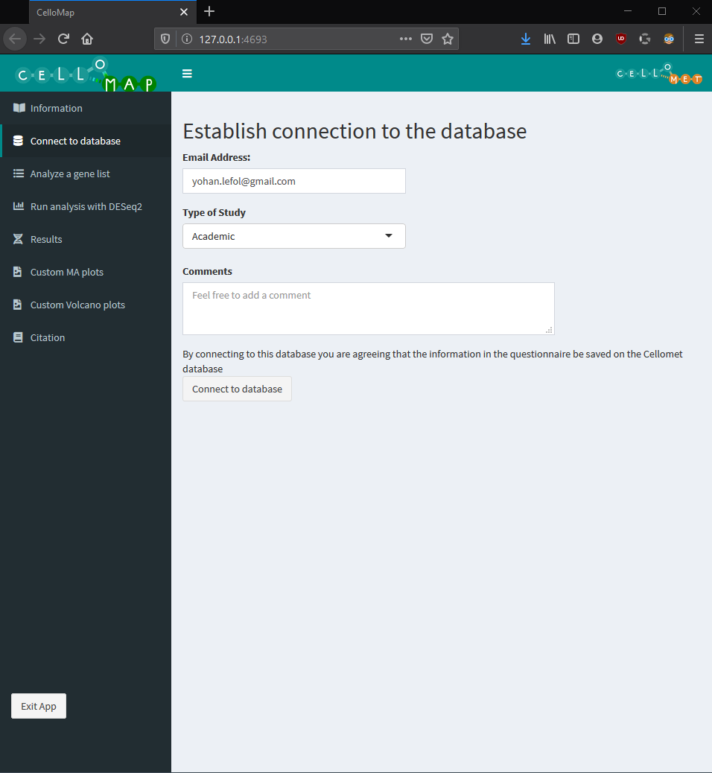
App – Database
Quick and simple
Secure connection
Resets after every analysis
Survey saved for the client
DB connection
Non-canonic analysis

Slide 15
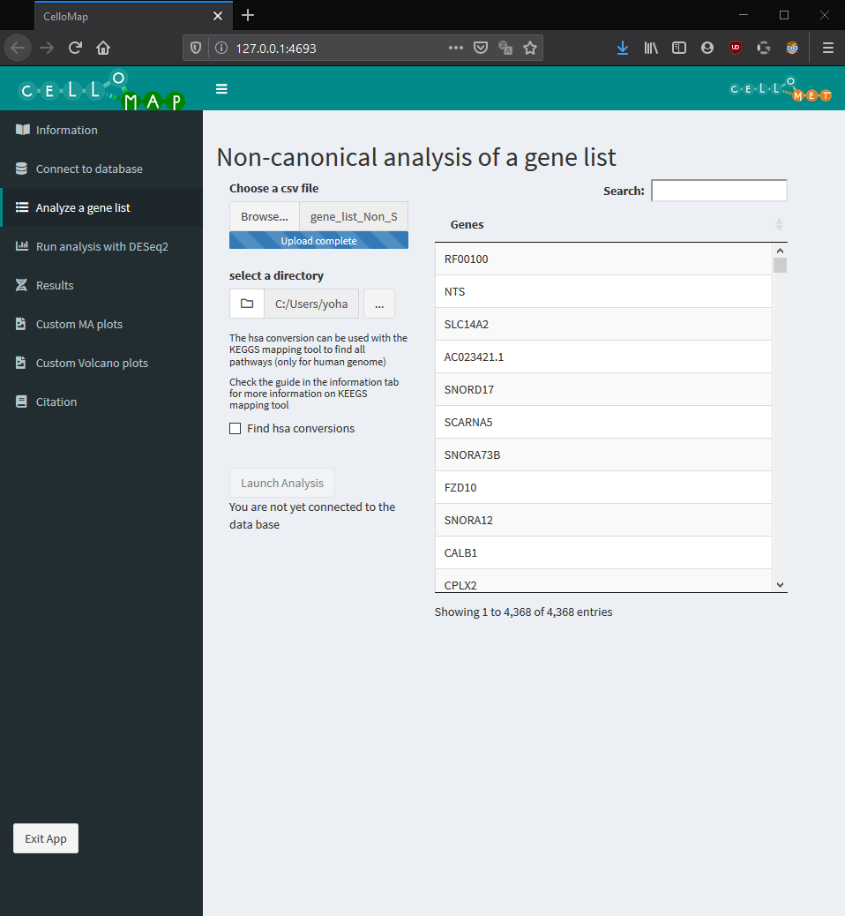
Differential expressions for significant genes
App – Gene list
Easy to use
Confirmation table
Enables KEGG Mapper
Significant gene list
Non-canonic analysis
Non-canonic results
hsa conversions

Slide 16
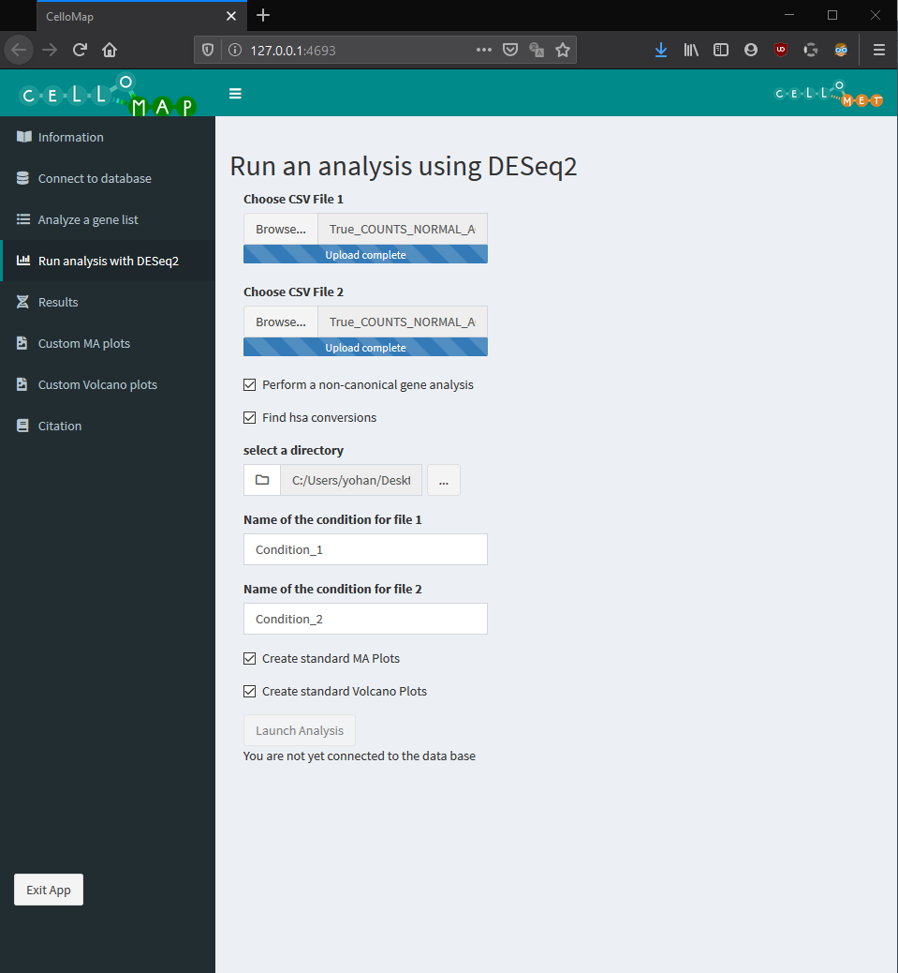
App – DESeq2
DESeq2
Differential expression analysis
Obtains significant genes
Links to other analyses
Differential gene expressions
Differential expressions for significant genes
Significant gene list

Slide 17
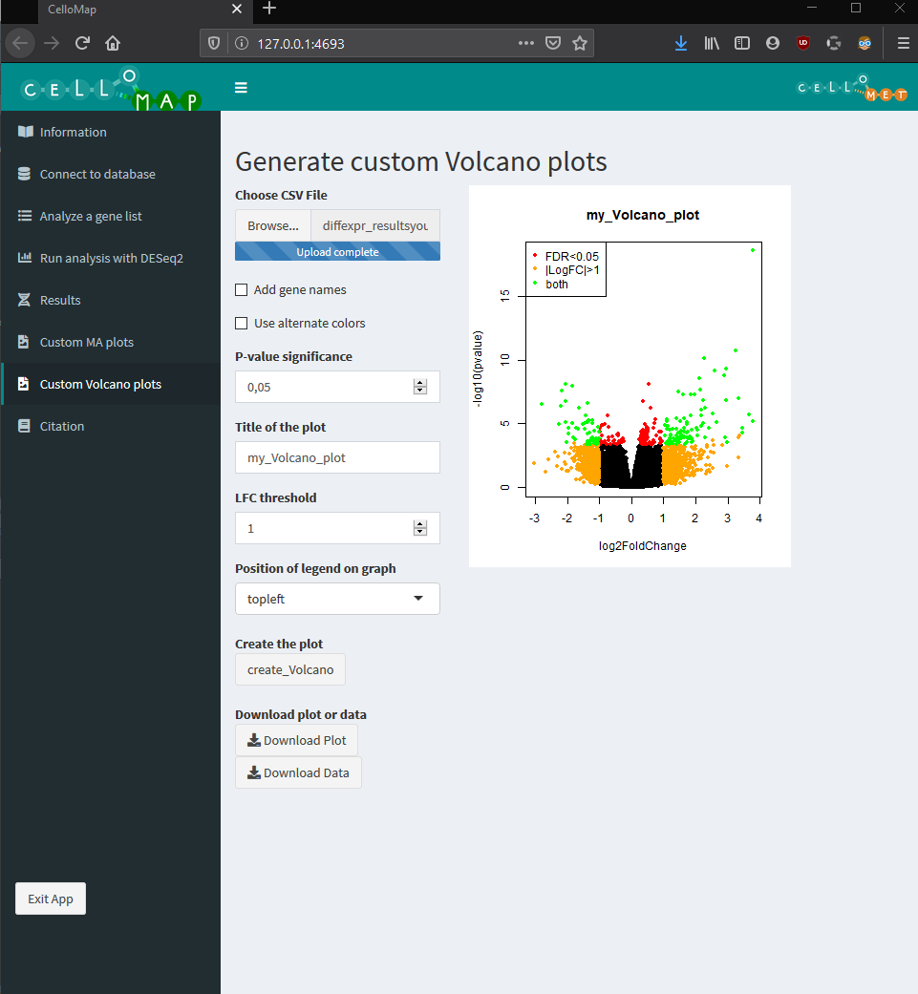
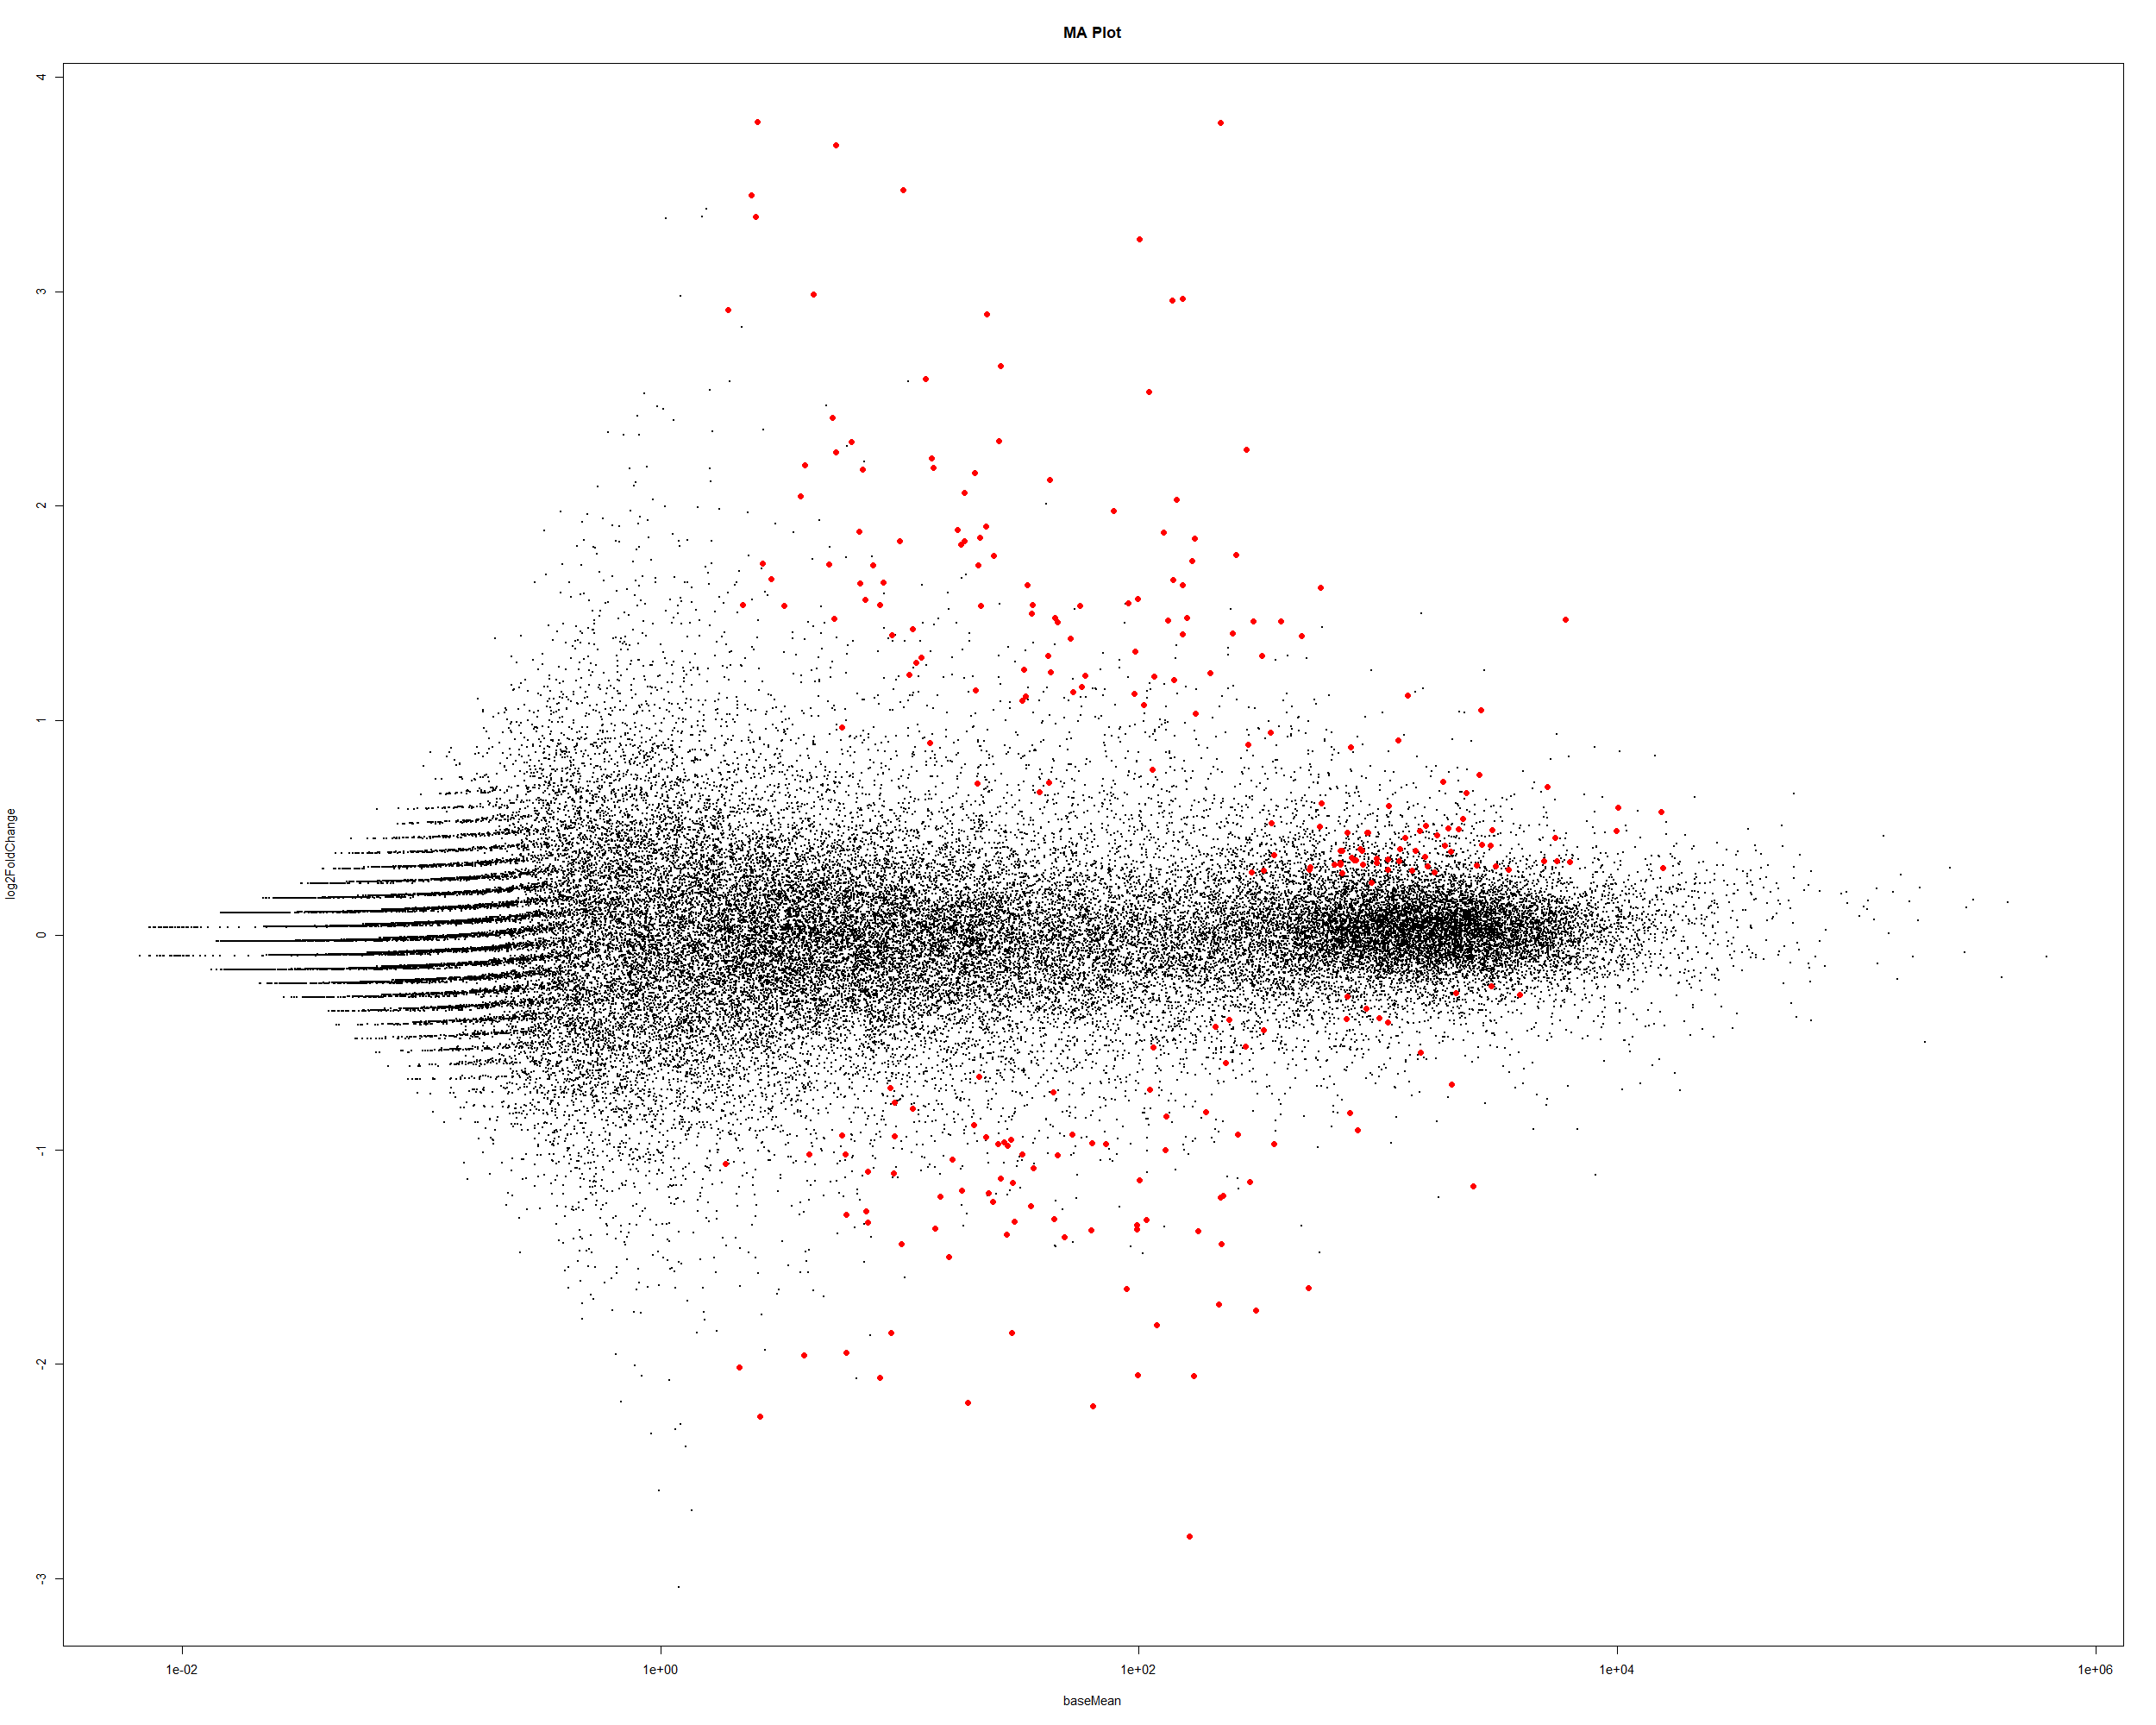
App – Custom fig.
Differential gene expressions
Strong customizability
Produces clear figures
Obtains significant genes per custom parameters
Also exists for MA plots
Custom Volcano plot
Custom significant gene list

Slide 18
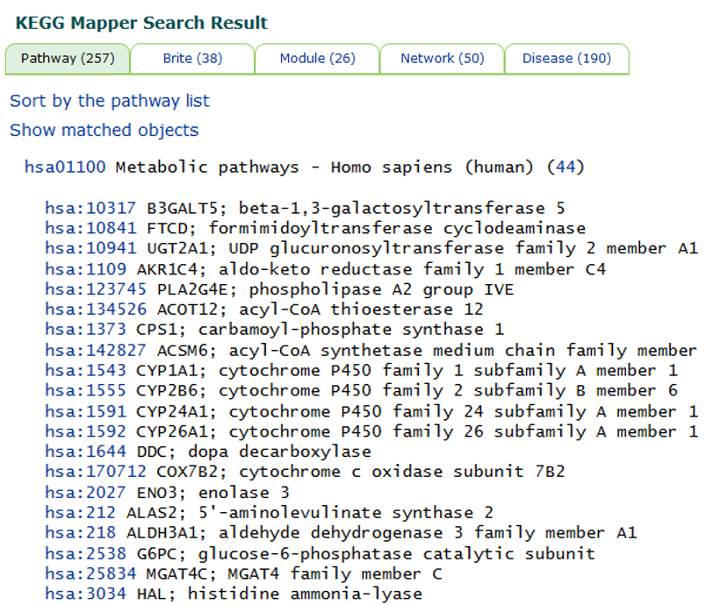
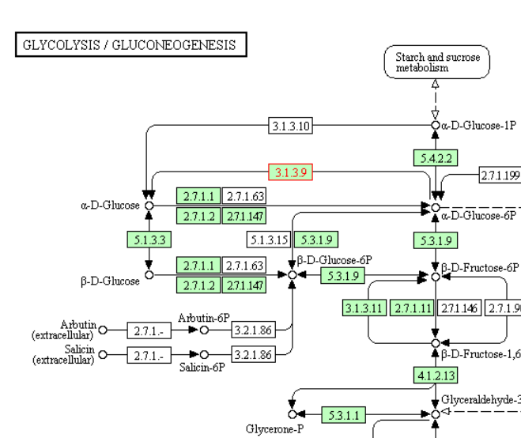
KEGG Mapper
Pathway mapping
Organism specific (hsa)
All types of pathways
Several databases
Clear identification of target gene
hsa conversions
KEGG Mapper

Slide 19
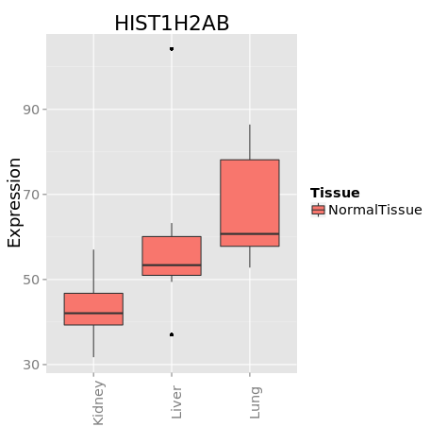
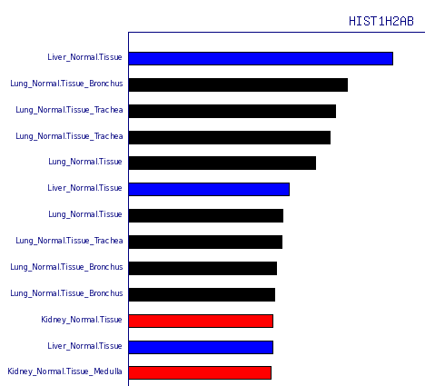
MERAV
Custom significant gene list
Gene expression analysis
Search using one or several genes
Hundreds of cell lines
Comparative analyses
Significant gene list
MERAV

Slide 20
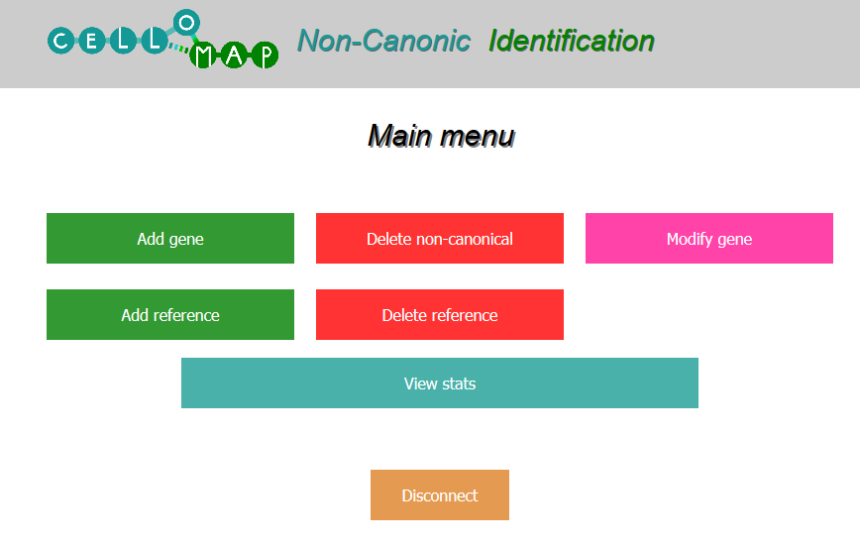
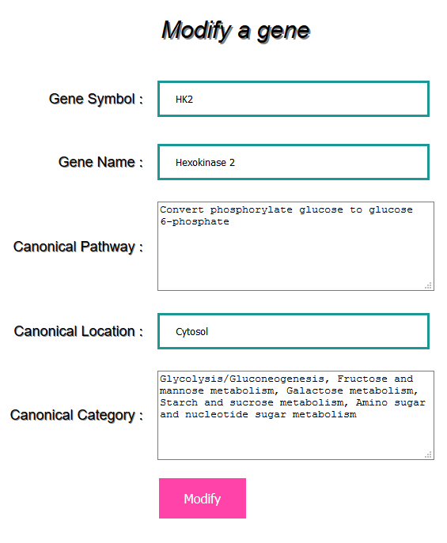
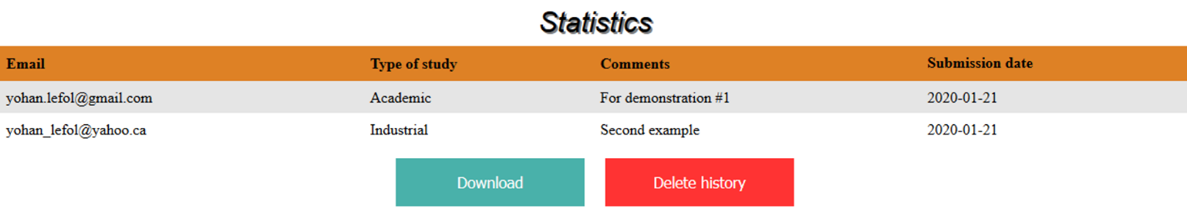
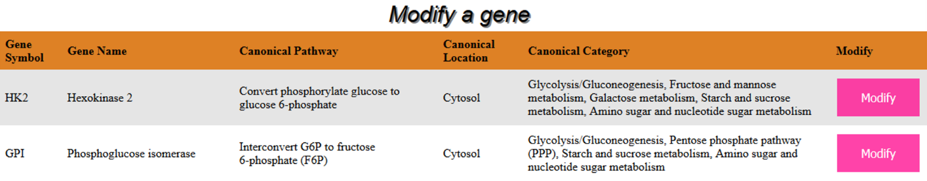
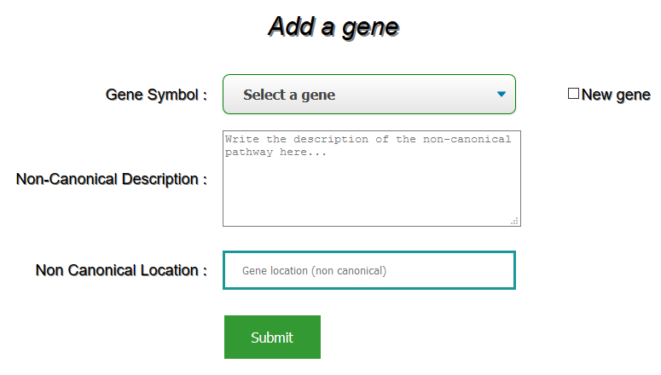
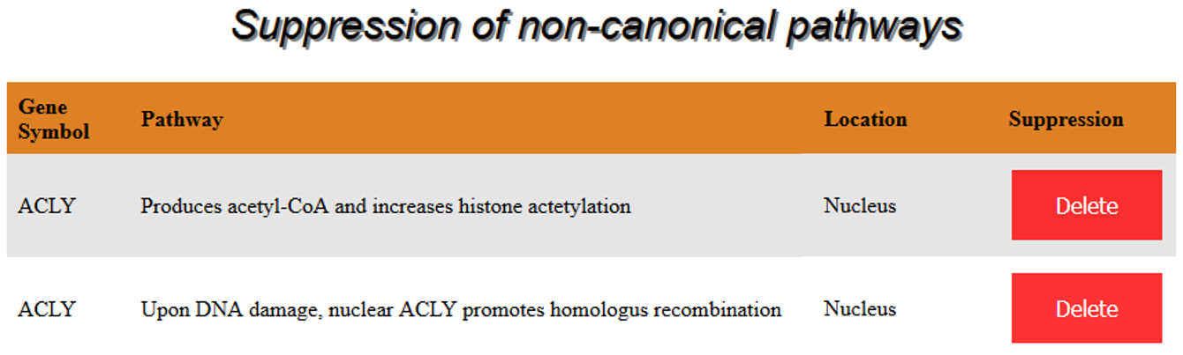
Client’s webpage
Manage database
Add genes
Remove genes
Modify genes
Download survey answers

Slide 21
GANTT EDIT PAGE, DON’T DELETE
Understand DESeq2
Nov 11 - Nov 22
Write functionnal scripts
Nov 11 - Dec 20
Link all scripts
Dec 9 - Dec 20
Create the web interface
Dec 9 - Jan 24
Create local non canonical database
Jan 13 - Jan 24
Format server
Nov 11 - Jan 24
Add the Database on client’s server and implement web design
Jan 13 - Feb 14
Find and explain non-canonical pathways
Nov 11 - Jan 24
Develop exe for Windows and Mac
Dec 9 - Feb 14
Meet with client/End of Project
Feb 18
Nov
Dec
2020
Feb
2020
Today

