Slide 1
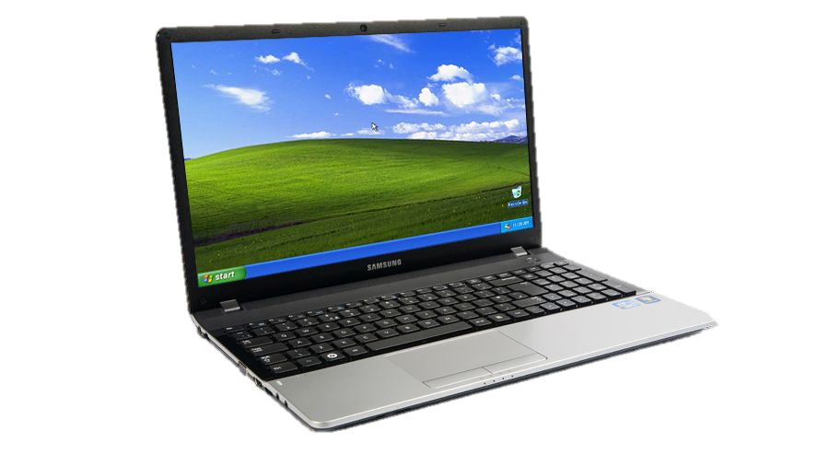
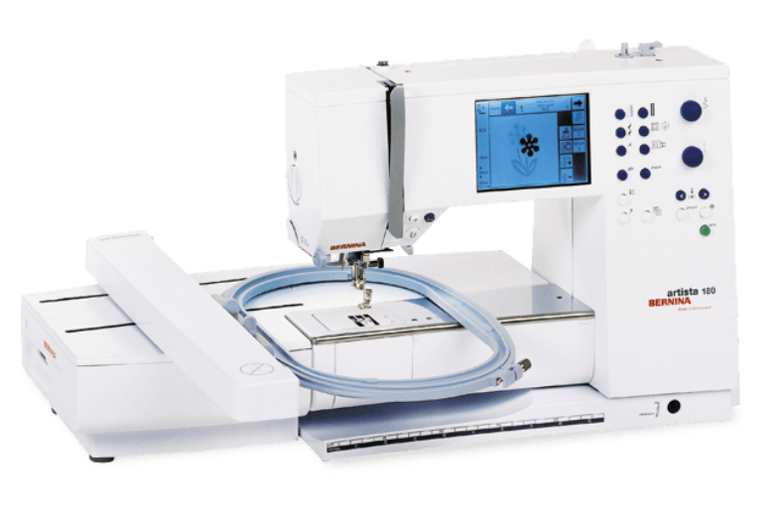
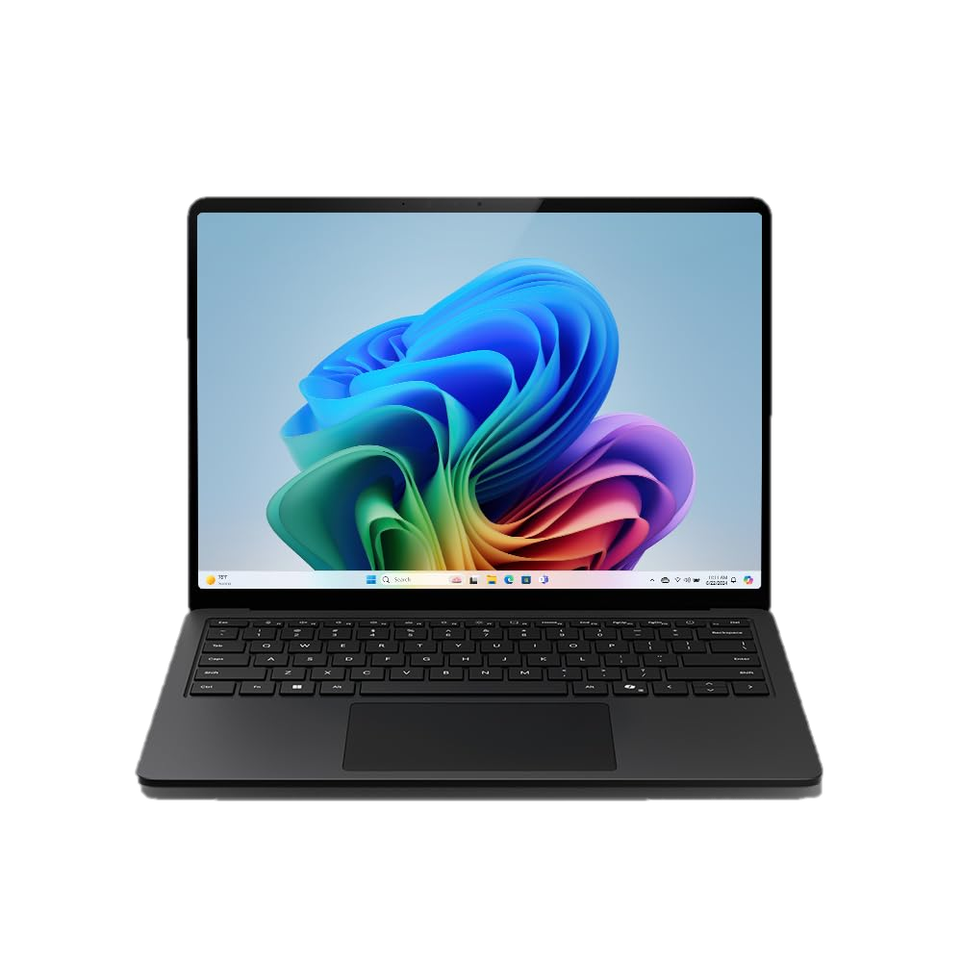
Windows XP
Artista 180
Null-Modem
USB-to-Serial
USB-to-Serial
Modern Computer

