Slide 1
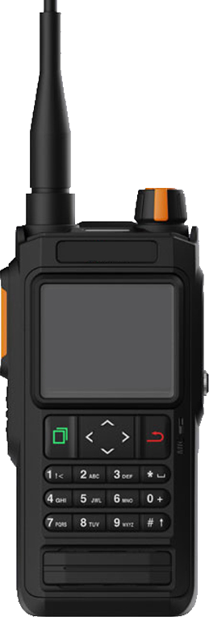
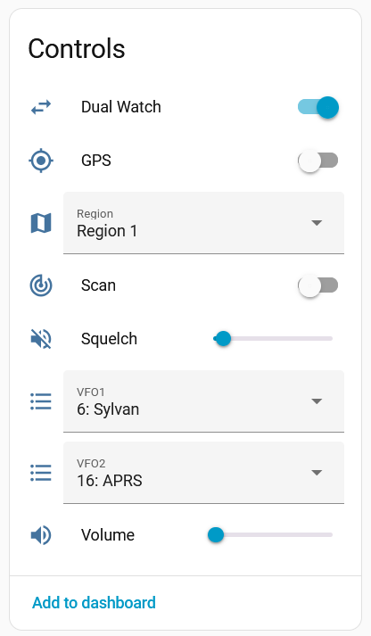
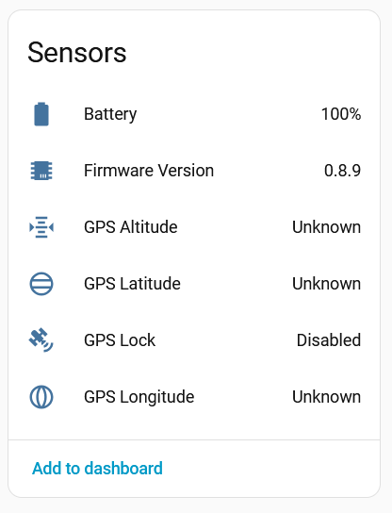

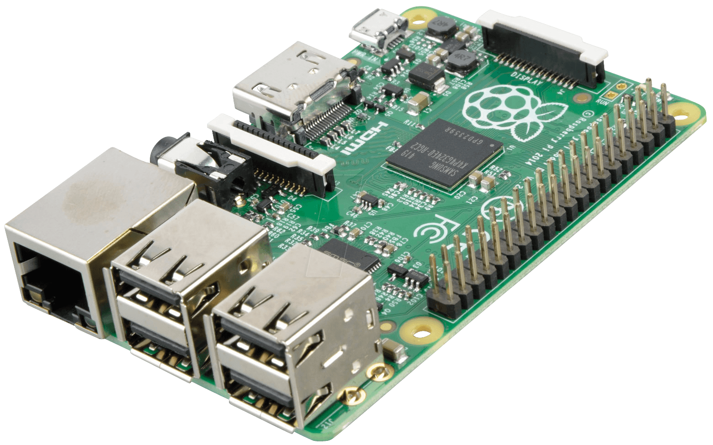


Raspberry Pi paired using Bluetooth
Control radio settings from Home Assistant
Communicates to Home Assistant using MQTT

Slide 2
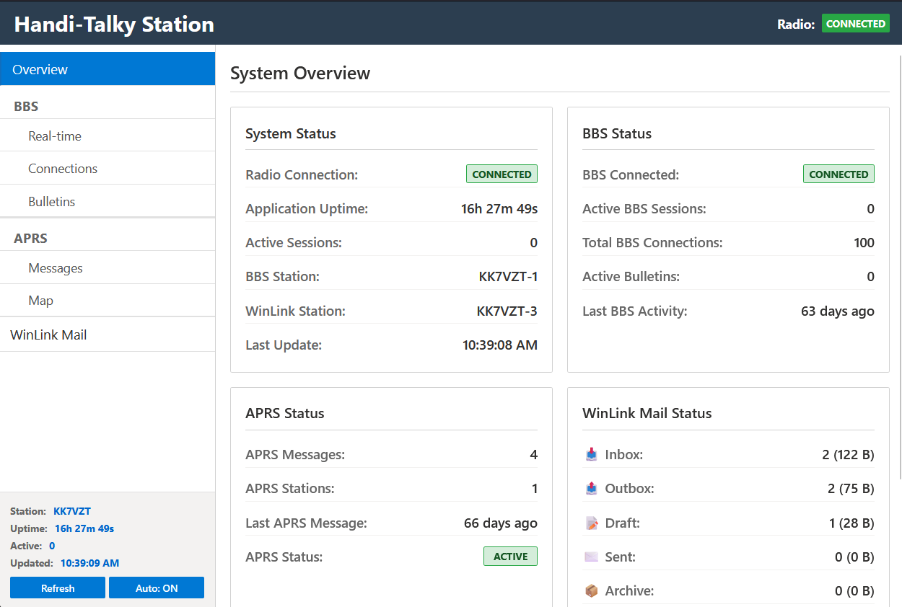
Get live station data using the local web portal
Raspberry Pi paired using Bluetooth
Configure
supported
modules
Files
Games
BBS
Bulletins
APRS
Winlink
Control radio settings and monitor the station from Home Assistant
Communicates to Home Assistant using MQTT

Slide 3
