Slide 1
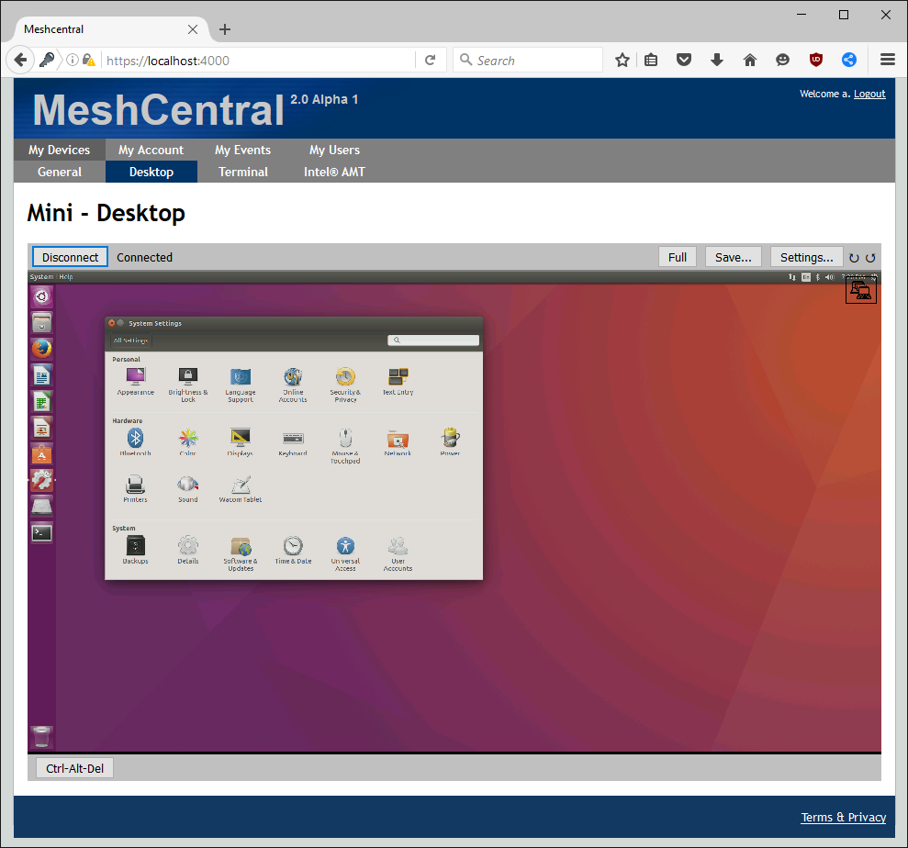
MeshCentral ^{2.0}

Slide 2

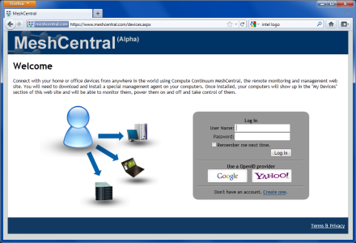
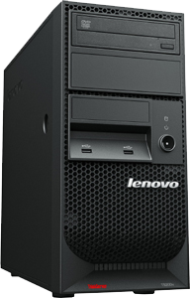
A simple idea: Web access to all devices, anywhere
Notes:
We are just catching up to the industry. For this feature, may not talk about “Intel AMT” but just say this is a web manageable Intel platform. The fact that Intel AMT powers this is not relevant to users.

Slide 3
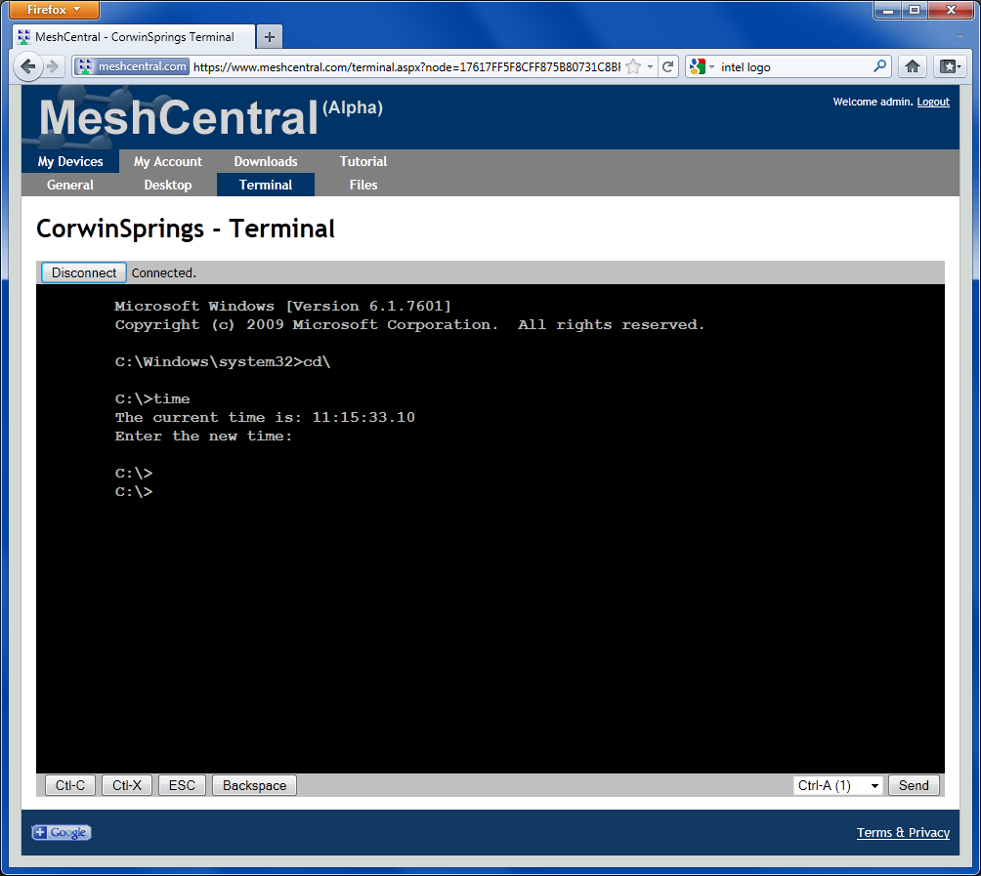
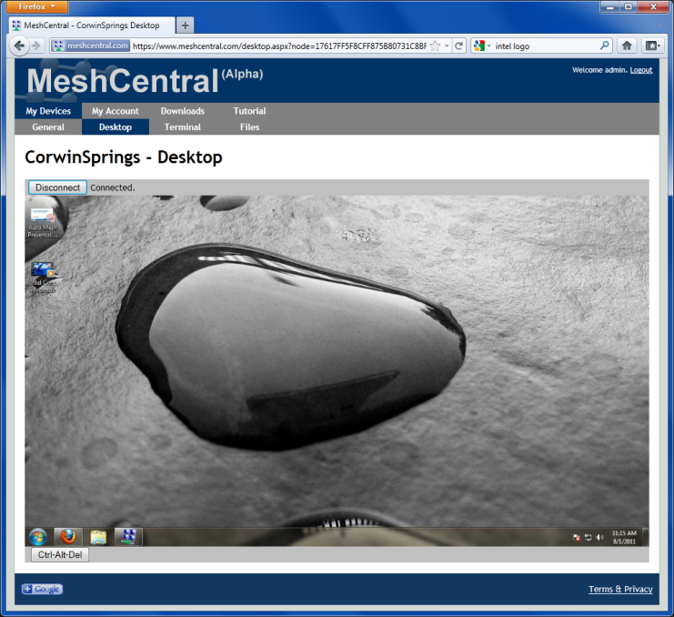
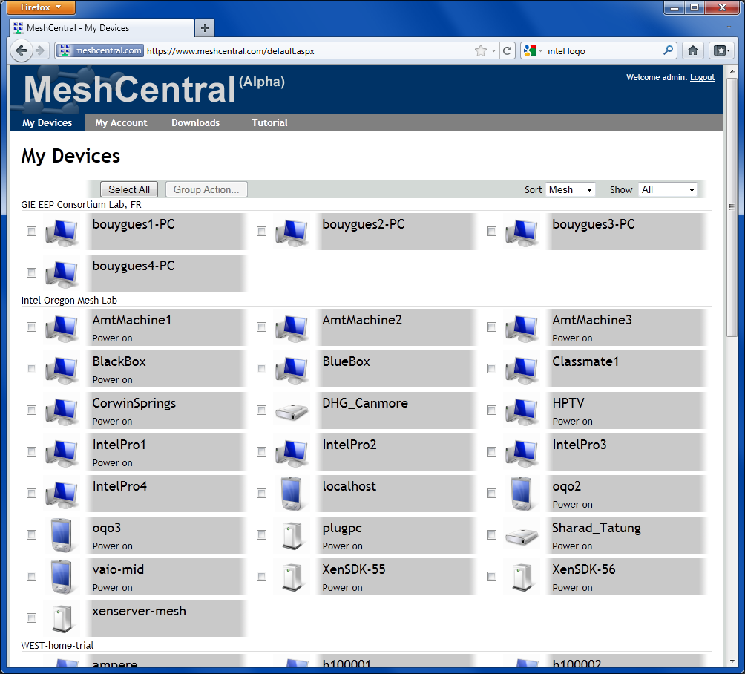
Usages, same as the original
Remote desktop
Remote terminal access
Remote file access
Remote web access
Remote power control
General monitoring
Notes:
We are just catching up to the industry. For this feature, may not talk about “Intel AMT” but just say this is a web manageable Intel platform. The fact that Intel AMT powers this is not relevant to users.

Slide 4
Radically different design compared to the original MeshCentral. Now based on the latest web technologies.
 | MeshCentral | MeshCentral 2.0
Backend Framework | .NET + ASP.net + IIS + MSMQ | Node.JS
Database | Microsoft SQL Server MeshCentral DB Schema | NeDB or MongoDB No DB Schema
Operating System | Microsoft Windows | Windows, Linux, OSX
Server Computer | Intel NUC or better | Intel Edison or better
Web UI Design | Mixed: ASP.net + Web Application Not Real-time | Fully Web Application All Real-time
Server Installation | Multiple packages Installer + Platform Manager | One Package, Self-installing

Slide 5
When it comes to Intel® AMT, Mesh Commander and Interceptor are key parts of MeshCentral^{2.0}. MPS and Monitoring components are the next components to be added.
Administrator
MeshCentral 2.0
Computer
Browser
Node.JS
Operating System
Web App
HTTP Server Web Socket Server
Mesh Agent
Mesh Commander
Intel® AMT Monitor
Intel® AMT
Intel® AMT Interceptor
Intel® AMT MPS
DB

Slide 6
Benefits Summary
Easy to install, just extract & run.
Easy to upgrade, one package.
Runs on any computer, including IoT.
Live user interface, one web socket interface.
Smaller code base for same features.
Improved messaging system.
Integration with Commander & Interceptor.

