Slide 1
Session 11
Hibernate
Introduction

Slide 2
Contents
Introduction to Hibernate
Hibernate Architecture
Components of Hibernate
Installation
O/R Mapping using Annotations

Slide 3
Brief History
An Object/Relational Mapping (O/R M) API for Java
Open Source (LGPL)
Today a part of RedHat
Principal author: Gavin King
Other Major Figure: Christian Bauer
Current version is 4.3
Notes:
Lowest Level frameworks are the Java APIs

Slide 4
Introduction to Hibernate
Hibernate is a Java-based middleware designed to complete the Object-Relational (O/R) mapping model.
Application
Persist java objects to the database tables based on O/R mapping
Hibernate
Database Server
By using Hibernate, the most complex parts of many O/R mapping mechanisms (i.e writing SQL code) can be simplified significantly.
Notes:
Lowest Level frameworks are the Java APIs

Slide 5
Introduction (Cont.)
Hibernate use POJO classes and xml to persist
- simple classes
- complex classes (including)
- composition
- inheritance
- collections
All Java objects that will be persisted must follow the JavaBean specification.
Hibernate supports a varity of open-source and commercial database servers.
Hibernate supports basic SQL, but it has own HQL (Hibernate Query Language).
Notes:
Lowest Level frameworks are the Java APIs

Slide 6
Hibernate Architecture
Application Classes
Hibernate
Configuration
Query
Transaction
SessionFactory
Session
JDBC
JNDI
JTA
Database Server
Notes:
Lowest Level frameworks are the Java APIs

Slide 7
Components of Hibernate
Hibernate Configuration
  a class, Configuration, which is critical to launching Hibernate and is used to create SessionFactory
  two key components
    hibernate.cfg.xml : for database connection
    Object/relational mappings
      using Java 5 annotations (via the Java Persistence 2 annotations)
      using the Hibernate legacy XML files approach known as hbm.xml
Notes:
Lowest Level frameworks are the Java APIs

Slide 8
SessionFactory
  a singleton class, SessionFactory, configures Hibernate for the application using the supplied configuration file, and allows Session object to be instantiated for persisting and loading objects to/from the database.SessionFactory object is heavyweight;
  (Take care to create only one SessionFactory object per application.)
  Session object is lightweight.

Slide 9
Components (cont.)
  Session interface
    designed to be instantiated each time an interaction is needed with the database.
    When a Session object is instantiated, a connection is made to the database.
    After persisting or loading from the database, the Session object is closed.
Query and Transaction interfaces
  Query interface : lets you query the database for objects instead of having to rely solely on an object’s identifier.
  Transaction interface : lets you make sure that all the operations on persisted objects occur in a transaction supported by either JDBC or JTA.
Notes:
Lowest Level frameworks are the Java APIs

Slide 10
Installation
http://www.hibernate.org
  Download Hibernate Core Binary release.
Requirements
  JDK 1.5 or later

Slide 11
Installation
Copy these jar files from “required” folder to the WEB-INF/lib of your application.
  antlr-2.7.7
  dom4j-1.6.1
  hibernate-commons-annotations-4.0.4.Final
  hibernate-core-4.3.5.Final
  hibernate-jpa-2.1-api-1.0.0.Final
  jandex-1.1.0.Final
  javassist-3.18.1-GA
  jboss-logging-3.1.3.GA
  jboss-logging-annotations-1.2.0.Beta1
  jboss-transaction-api_1.2_spec-1.0.0.Final
Notes:
Lowest Level frameworks are the Java APIs

Slide 12
Development Steps
Developing Entity class with annotations
Creating hibernate.cfg.xml configuration file under WEB-INF\src directory
Developing code to persist or load
(In Struts, it can be in Action/Model classes.)
4. Deploying
Notes:
Lowest Level frameworks are the Java APIs

Slide 13
Entity
An entity is a lightweight persistence domain object.
Typically an entity represents a table in a relational database, and each entity instance corresponds to a row in that table.
The primary programming artifact of an entity is the entity class
Notes:
• Persistent object
– Typically in the model.
• Typically (but not necessarily) one entity per table and one instance per row in that table.
• Either fields or properties (JavaBeans style) are persisted.
• O/R mapping with annotations to map objects to underlying relational data store.

Slide 14
Entity in Java Persistence Layer
The persistent state of an entity is represented either through persistent fields or persistent properties.
These fields or properties use object/relatinal mapping annotations to map the entities and entity relationships to the relational data in the underlying data store.
Identify persistable entities and define their relationships using annotations.
Java compiler recognizes and uses annotations to save you work.
Using annotations, the compiler can generate additional classes for you and perform compile time error checking.

Slide 15
O/R Mapping

Slide 16
O/R Mapping
The process of specifying the bindings between an object model and a database schema.
Mapping
  Basic O/R Mapping
  Component Mapping
  Collection Mapping
  Association Mapping
  Inheritance Mapping

Slide 17
Basic O/R Mapping

Slide 18
@Entity
declares the class as an entity bean
@Id
declares the identifier property of the entity bean
@Table (name)
define the table name for your entity bean mapping
@Column (name, nullable, length, unique, table)
define column used for a property mapping
@Transient
define property not to persist (default: all property will be persisted)
@Enumerated
define ordinal or String to persist (default: ordinal)

Slide 19
@Temporal
define DATE or TIME or TIMESTAMP to persist (default:TIMESTAMP)
@EmbeddedId
define a composite primary key inside an entity
@IdClass
define a composite primary key inside an entity
@GeneratedValue
mark an id property as generated

Slide 20
Entity declaration
An entity class must follow these requirements:
  The class must be annotated with the javax.persistence.Entity annotation.
  The class must have a public or protected, no-argument constructor. The class may have other constructors.
  The class must not be declared final. No methods or persistent instance variables must be declared final.
  The class can be abstract or concrete class and must have a primary key
  If an entity instance be passed by value as a detached object, such as through a session bean’s remote business interface (HttpSession) or RMI call, the class must implement the Serializable interface.
Notes:
• Ordinary java class annotated with the javax.persistence.Entity annotation.
• public or protected, noargument constructor.
– May have other constructors as well.
• Must not be declared final. Nor methods or persistent instance variables may be declared final.

Slide 21
Entity declaration (Cont’d)
  Persistent instance’s variables must be declared private, protected, or package-private, and can only be accessed directly by the entity class’s methods.
  Clients must access the entity’s state through accessor or business methods.
Notes:
Entities may extend both entity and non-entity classes, and non-entity classes may extend entity classes.

Slide 22
Entity declaration (Cont’d)
Any class or POJO can be converted to an entity with very few modifications.
Example: Customer.java
  Instance variables are private and are accessed by clients through appropriately named getter and setter methods.
  Annotations specify entity metadata.
  They are not an intrinsic part of an entity but describe how an entity is persisted.

Slide 23
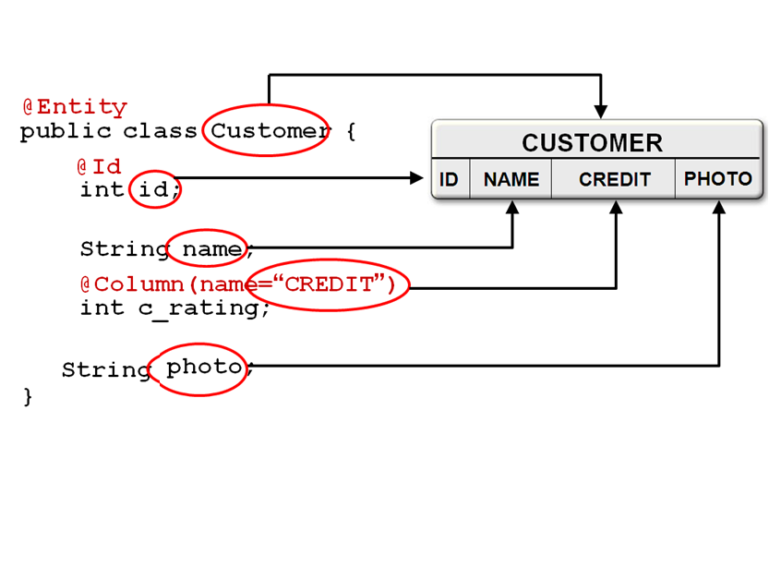
Object/Relational Mapping

Slide 24
Example Cont’d
Each entity has a unique object identifier.
E.g:
  A customer entity might be identified by a customer number.
  The unique identifier, or primary key, enables clients to locate a particular entity instance.
  Every entity must have a primary key. An entity may have either a simple or a composite primary key.
  Simple primary keys use the javax.persistence.Id annotation to denote the primary key property or field.

Slide 25
Identity
Every entity has a persistence identity
  Uniquely identifies that entity
  Maps to primary key in the database
Identity can be application or database generated
Must be defined on the ROOT of entity hierarchy or mapped superclass
Notes:
The unique identifier, or primary key, enables clients to locate a particular entity instance. Every entity must have a primary key. An entity may have either a simple or a composite primary key.
Simple primary keys use the @Id annotation to denote the primary key property or field.

Slide 26
Property-based annotation
The @Id annotation specifies the primary key of the Customer entity.
The id attribute is a primary key candidate.
A property-based annotation must be placed immediately before the corresponding getter method, here, getId() and not the setter method.
Where property-based annotations are used, the persistence engine uses the getter and setter methods to access and set the entity state.
Note:
You cannot apply mapping annotations to both fields and properties in a single entity.

Slide 27
Property-based annotation (Cont’d)
The fields or properties of an entity must be Serializable.
Entities may either use persistent fields or persistent properties.
If the mapping annotations are applied to the entity’s instance variables, the entity uses persistent fields.
If the mapping annotations are applied to the entity’s getter methods for JavaBeans-style properties, the entity uses persistent properties.

Slide 28
Property-based annotation (Cont’d)
If the entity uses persistent properties, the entity must follow the method conventions of JavaBeans components.
JavaBeans-style properties use getter and setter methods that are typically named after the entity class’s instance variable names.
For every persistent property
  property of type of the entity, there is a getter method getProperty and setter method setProperty.
  If the property is a boolean, you may use isProperty instead of getProperty.
E.g; if a Customer entity uses persistent properties, and has a pirvate instance variable called firstName, the class defines a getFirstName and setFirstName method for retrieving and setting the state of the firstName instance variable.

Slide 29
Example: Four Different Annotations
Player.java
Uses four different annotations:
  Entity
  Id
  GeneratedValue
  Transient

Slide 30
@Entity
public class Player implements Serializable{
private Long id;
private String firstName;
private String lastName;
pirvate int jerseyNumber;
private String lastSpokenWords;
public Player(){ }
@Id
@GeneratedValue
public int getId(){ return id; }
public void setId(int id) { this.id=id;}
// setters and getters for firstName and lastName
}
Implemnts Serializable and has a default constructor
A key automatically is generated if you add the GeneratedValue annotation

Slide 31
/**
*Return the last words spoken by this player.
* We don’t want to persist that!
*/
@Transient
public String getLastSpokenWords (){
return lastSpokenWords;
}
public void setLastSpokenWords(String lastWords){
lastSpokenWords=lastWords;
}
// some code excluded for brevity
}
LastSpokenWords will not be persisted

Slide 32
Example (Cont’d)
The entity’s primary key is the id property and is correctly marked with the Id annotation.
Primarky keys can be auto-generated values.
Behavior for auto-generated ids is not completely specified, but the reference implementation will generate a key automatically if you add the GeneratedValue annotation to the primarky key:
  @Id
  @GeneratedValue (strategy = GenerationType.AUTO)
  public Long getId() {…..}

Slide 33
Primary key
The primary key , or the property or field of a composite primary key, must be one of the following Java language types:
  Java primitive types
  Java primitive wrapper types
  java.lang.String
  java.util.Date (the temporal type should be DATE in JPA annotation)
  java.sql.Date
Floating point types should never be used in primary keys.
If you use a generated primary key, only integral types will be portable.
javax.persistence.Id is used.
Notes:
JPA, Primary Keys
• Each entity has a unique object identifier, a
primary key.
• A simple (noncomposite)
primary key must
correspond to a single persistent field or property
of the entity class.
– The Id annotation is used to denote a simple primary
key.
You can specify composite keys in two different ways, using an @IdClass annotation or an @EmbeddedId annotation.

Slide 34
Types of Identity
  @Id – single field/property in entity class
  @GeneratedValue
  GenerationType.AUTO
@Id @GeneratedValue(strategy=GenerationType.AUTO)
// Generation Strategy IDENTITY (or) SEQUENCE (or) TABLE will be chosen by provider
private int id;
Notes:
Every Entity has a persistent Identity this maps to a primary key in the database. This can be a single field or property annoted with @Id.. For a new application it can be easy to use generated Id, there is a choice of strategies for generation.
to define a primary-key class ( composite keys) use the @IdClass annotation
A different way to define primary-key classes and composite keys is to embed the primary-key class directly in your bean class. The @EmbeddedId annotation is used for this purpose in conjunction with the @Embeddable

Slide 35
Types of Identity Con’t
GenerationType.SEQUENCE
@Id
@SequenceGenerator(name=“stuseq”,sequenceName=“stuSeq” allocationSize=1)
// Sequence named stuSeq must already exists in DB
@GeneratedValue(strategy=GeneratioinType.SEQUENCE,generator=“stuseq”)
private int id;
create sequence stuSeq
start with 1
increment by 1;
Notes:
Every Entity has a persistent Identity this maps to a primary key in the database. This can be a single field or property annoted with @Id.. For a new application it can be easy to use generated Id, there is a choice of strategies for generation.
to define a primary-key class ( composite keys) use the @IdClass annotation
A different way to define primary-key classes and composite keys is to embed the primary-key class directly in your bean class. The @EmbeddedId annotation is used for this purpose in conjunction with the @Embeddable

Slide 36
Types of Identity Con’t
GenerationType.TABLE
@Id
@TableGenerator(name=“stutab”,table=“my_tab” allocationSize=1 pkColumnName=“seqName”,pkColumnValue=“stuSeq”,
valueColumnName=“seqValue”)
// Table named my_tab must already exists in DB with required columns
@GeneratedValue(strategy=GeneratioinType.TABLE,generator=“stutab”)
private int id;
Notes:
Every Entity has a persistent Identity this maps to a primary key in the database. This can be a single field or property annoted with @Id.. For a new application it can be easy to use generated Id, there is a choice of strategies for generation.
to define a primary-key class ( composite keys) use the @IdClass annotation
A different way to define primary-key classes and composite keys is to embed the primary-key class directly in your bean class. The @EmbeddedId annotation is used for this purpose in conjunction with the @Embeddable

Slide 37
Types of Identity Con’t
CREATE TABLE my_table
(
seqName VARCHAR2(30) NOT NULL,
seqValue number(10) NOT NULL,
PRIMARY KEY(seqName)
);
INSERT INTO my_table VALUES (‘stuSeq', 0);

Slide 38
Composite Primary Keys
Typically used when mapping from databases where the primary key is comprised of several columns.
must be defined in a primary key class.
are denoted using the javax.persistence.EmbeddedId and javax.persistence.IdClass annotations.

Slide 39
Types of Identity Con’t
User defined:
  @EmbeddedId-corresponds to multiple id field in entity class
@EmbeddedId
private CustomerPK pk;
@Embeddable
public class CustomerPK implements Serializable {
private int cno;
private String cname;
//Getters and Setters
}
Class must be
@Embeddable
Notes:
Every Entity has a persistent Identity this maps to a primary key in the database. This can be a single field or property annoted with @Id.. For a new application it can be easy to use generated Id, there is a choice of strategies for generation.
to define a primary-key class ( composite keys) use the @IdClass annotation
A different way to define primary-key classes and composite keys is to embed the primary-key class directly in your bean class. The @EmbeddedId annotation is used for this purpose in conjunction with the @Embeddable

Slide 40
Types of Identity Con’t
  @IdClass – corresponds to multiple id field in entity class
@Entity
@IdClass(CustomerPK.class)
public class Customer implements Serializable {
@Id private int cno;
@Id private String cname;
public class CustomerPK implements Serializable {
private int cno;
private String cname;
//Getters and Setters
}
Notes:
Every Entity has a persistent Identity this maps to a primary key in the database. This can be a single field or property annoted with @Id.. For a new application it can be easy to use generated Id, there is a choice of strategies for generation.
to define a primary-key class ( composite keys) use the @IdClass annotation
A different way to define primary-key classes and composite keys is to embed the primary-key class directly in your bean class. The @EmbeddedId annotation is used for this purpose in conjunction with the @Embeddable

Slide 41
Configuration Properties

Slide 42
Hibernate Configuration Properties
PropertyName | Description
hibernate.dialect | The dialect tells Hibernate how to construct SQL and DDL statements for a specific server.
hibernate.connection.driver_class | This is the JDBC (Java Database Connectivity) driver class that is used to connect to the database server.
hibernate.connection.url | The URL that provides the location of the specific database or schema for the application.
hibernate.connection.username | The username that the application will connect to the database server as.
hibernate.connection.password | The password of the user that the application will connect to the database server as.
hibernate.connection.pool_size | maximum number of pooled connections

Slide 43
Hibernate Configuration Properties Con’t
PropertyName | Description
hibernate.hbm2ddl.auto | Determines whether Hibernate will issue DDL commands to the database server to manage data structures. The values can be validate—the structures are only validated; create: the structures are created; update: the database is updated to match the model; and create-drop: the data structures are created when the session factory is created and dropped when the session factory is destroyed.
hibernate.connection.url | The URL that provides the location of the specific database or schema for the application.
hibernate.show_sql | Logs the SQL being issued to the database.
hibernate.format_sql | Formats the SQL being logged into a format that is easier to read.
Notes:
For a list of all the possible configuration options, see the Hibernate documentation at
http://www.hibernate.org/hib_docs/reference/en/html/session-configuration.html.
Caution Sometimes tables and table columns will not be modified correctly (due to existing constraints),
so when using hibernate.hbm2ddl.auto with a value of update, you may need to drop the entire database
or schema regularly. Alternatively, the create-drop option can be used.

Slide 44
Anatomy of Example
Example : Persisting or loading User objects to/from the database server.
To do list :
Developing Customer.java class with annotations
Creating hibernate.cfg.xml configuration file under WEB-INF\src directory
Developing code to persist or load
(In Struts, it can be in Action/Model classes.)
Deploying
Testing
Notes:
Lowest Level frameworks are the Java APIs

Slide 45
import javax.persistence.Entity;
import javax.persistence.Id;
import java.io.*;
@Entity @Table(name="NewCustomer")
public class Customer implements Serializable{
private int id;
private String userName;
private String password;
private String re_password;
private String email;
private String address;
public Customer(){ }
@Id
@GeneratedValue @Column(name="user_id")
public int getId(){ return id; }
@Transient
public String getRe_password(){ return re_password;}
// Other getters and setters
}
Annotates class Customer as an entity
Implemnts Serializable (Optional) and has a default constructor
Primary key property-based annotation
Notes:
Implementing Serializable interface is optional because Hibernte based JPA can manage this entity to persist into database.

Slide 46
Creating hibernate.cfg.xml configuration file
<?xml version="1.0" encoding="UTF-8"?>
<!DOCTYPE hibernate-configuration PUBLIC
"-//Hibernate/Hibernate Configuration DTD 3.0//EN"
"http://hibernate.sourceforge.net/hibernate-configuration-3.0.dtd">
<hibernate-configuration>
<session-factory>
<property name=“hibernate.dialect">org.hibernate.dialect.OracleDialect</property>
<property name="hibernate.connection.driver_class">
oracle.jdbc.OracleDriver</property>
<property name="hibernate.connection.url">
jdbc:oracle:thin:@server3.imceits.mm:1521:orcl </property>
<property name="hibernate.connection.pool_size">10</property>
Notes:
Lowest Level frameworks are the Java APIs

Slide 47
hibernate.cfg.xml (cont.)
<property name="hibernate.connection.username">DBusername</property>
<property name="hibernate.connection.password">password</property>
<property name="hibernate.hbm2ddl.auto">update</property>
<property name=“hibernate.show_sql">true</property>
<mapping class=“Customer"/>
</session-factory>
</hibernate-configuration>
Notes:
Lowest Level frameworks are the Java APIs

Slide 48
Retrieving and persisting objects
Loading SessionFactory
Opening Session
Retrieving/Persisting objects
Closing Session
Notes:
Lowest Level frameworks are the Java APIs

Slide 49
HibernateUtil.java for Loading SessionFactory
import org.hibernate.*;
import org.hibernate.cfg.*;
public class HibernateUtil
{ private static final SessionFactory sessionFactory;
static {
try {
Configuration cfg = new AnnotationConfiguration();
sessionFactory = cfg.configure().buildSessionFactory();
} catch (Throwable ex)
{ ex.printStackTrace(System.out);
throw new ExceptionInInitializerError(ex);
}
}
public static Session getSession() throws HibernateException
{ return sessionFactory.openSession();
}}

Slide 50
1. Opening Session
Persisting objects
Session session = HibernateUtil.getSession();
2. Begin Transaction
Transaction tx=session.beginTransaction();
3. Persisting
session.save(obj);
4. EndingTransaction
tx.commit();
5. Closing Session
session.close();
Notes:
Lowest Level frameworks are the Java APIs

Slide 51
Hibernate Session API
void persist(Object entity)- Make a transient instance persistent.
Serializable save(Object entity)-Persist the given transient instance and return the generated identifier.
void delete(Object entity) -Remove a persistent instance from the datastore.
void refresh(Object entity)-Re-read the state of the given instance from the underlying database.
Object merge(Object entity)-Copy the state of the given object onto the persistent object with the same identifier and return the persistent instance
Void update (Object entity) - Update the persistent instance with the identifier of the given detached instance.

Slide 52
Object get(Class entityClass,Serializable id)- Return the persistent instance of the given entity class with the given identifier, or null if there is no such persistent instance.
boolean contains(Object entity)- Check if this instance is associated with this Session.
void flush()- Force this session to flush.
void clear( )- Completely clear the session.
Connection close ( ) -End the session by releasing the JDBC connection and cleaning up.
boolean isOpen( ) - Check if the session is still open.

Slide 53
Example with complementary code
Customer u=new Customer();
u.setUserName(“ma ma”);
u.setPassword(“123456”);
u.setRe_password(“123456”);
u.setEmail(“abc@gmail.com”);
u.setAddress(“abc Road, Yangon”);
Transaction tx=null;
Session session=null;
try
{
session = HibernateUtil.getSession();
tx=session.beginTransaction();
session.save(u);
tx.commit();
System.out.println(“User information added");
}
catch(Exception ex)
{
if(tx!=null)
tx.rollback();
System.out.println(ex.getMessage());
}
finally
{
session.close();
}

Slide 54
Retrieving objects
Transaction tx=null;
Session session=null;
try
{
session = HibernateUtil.getSession();
tx=session.beginTransaction();
Customer c =(Customer)session.get (Customer.class, cid);
System.out.println(“c.getUserName());
System.out.println(“c.getPassword());
System.out.println(“c.getEmail());
System.out.println(“c.getAddress());
tx.commit();
}
catch(Exception ex)
{
if(tx!=null)
tx.rollback();
System.out.println(ex.getMessage());
}
finally
{
session.close();
}
Notes:
Lowest Level frameworks are the Java APIs

Slide 55
Entity Instance's Life cycle
Entity instances are in one of four states:
Transient- An object is transient if it has been instantiated using the new operator, and it is not associated with Hibernate Session. It has no persistent representation in the database and no identifier value has been assigned.
Persistent-A persistence instance has a representation in the database and an identifier value. It is in the scope of a Session. Hibernate will detect any changes made to an object in persistent state and synchronize the state with the database when the unit of work completes.
Notes:
• New entity instances have no persistent identity and are not yet associated with a persistence context.
• Managed entity instances have a persistent identity and are associated with a persistence context.
• Detached entity instances have a persistent identify and are not currently associated with a persistence context.
• Removed entity instances have a persistent identity, are associated with a persistent context, and are scheduled for removal from the data store.

Slide 56
Entity Instance's Life cycle Con’t
Detached- A detached instance is an object that has been persistent, but its Session has been closed. The reference to the object is still valid, and the detached instance might even be modified in this state. A detached instance can be reattached to a new Session at a later point in time, making it (and all the modification) persistent again.
Removed- When the persistent object is deleted from the database ,it is reached into the removed state. At this state java instance exist but any changes made to the object are not saved to the database. It is ignored by hibernate.

Slide 57
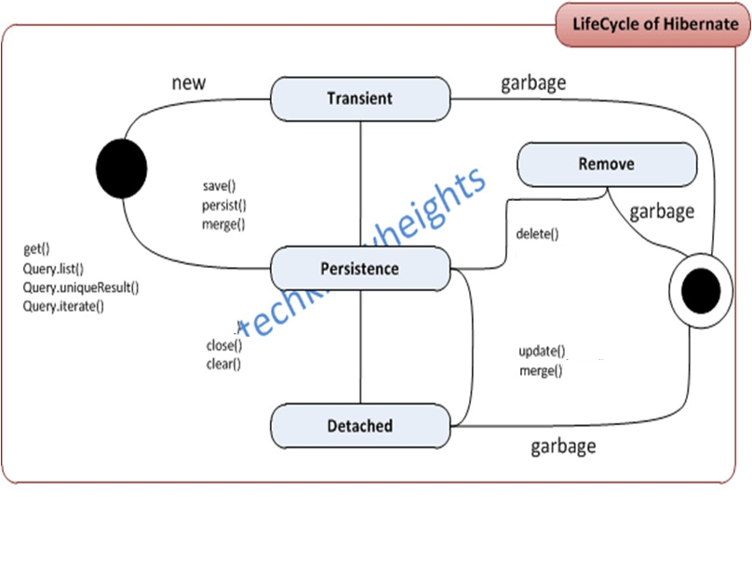
Entity Lifecycle Con’t

Slide 58
Thank you!

