Slide 1
Session-1
J2EE
Java Server Side Programming

Slide 2
Contents
What is J2EE?
Evolution of Enterprise Application Development Frameworks
J2EE Components and Container Architecture
J2EE APIs and Technologies
How to get started

Slide 3
What is J2EE?
Open and standard based platform for
  developing,
  deploying and
  managing
    n-tier,
    Web-enabled,
    server-centric,
    component-based enterprise applications

Slide 4
Issues of Enterprise Computing
Challenges
Robustness
Object-oriented design
Scalability and performance
Avoid complexity
Maintainable and extensible
Just on time
Easy to test
Promote reuse
Support for multiple client types
portability
Key Technologies
J2SE™
J2EE™
JMS
Servlet
JSP
Connector
Data Binding
XML
XSLT
Products
App Servers
Web Servers
Components
Databases
Object to DB Tools
Legacy Systems
Databases
TP Monitors
EIS Systems
J2EE is specifically designed to address all these issues.
Notes:
Java Message Service
Executive Information System
Taking a big step back, a Web server serves pages for viewing in a Web browser, while an application server provides methods that client applications can call. A little more precisely, you can say that:
A Web server exclusively handles HTTP requests, whereas an application server serves business logic to application programs through any number of protocols.

Slide 5
About Enterprise Applications
Things that make up an enterprise application :
  Presentation logic
  Business logic
  Data access logic (and data model)
  System services
The evolution of enterprise application framework reflects
  How flexibly you want to make changes
  How the system services are provided by the framework

Slide 6
Evolution of Enterprise Application Frameworks
Single tier
Two tier
Three tier
  RPC based
  Remote object based
Three tier (HTML browser and Web server)

Slide 7


Single Tier (Mainframe-based)
Dumb terminals are directly connected to mainframe
Centralized model (as opposed distributed model)
Presentation, business logic, and data access are intertwined in one monolithic mainframe application

Slide 8
Single Tier (Cont.)
Pros:
  No client side management is required
  Data consistency is easy to achieve
Cons:
  Functionality (presentation, data model, business logic) intertwined, difficult for updates and maintenance and code reuse

Slide 9
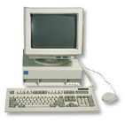
Two Tier
Database
SQL Request
SQL Response
Fat clients talking to back end database
  SQL queries sent, raw data returned
Presentation, Business logic and Data Model processing logic in client application

Slide 10
Two Tier (Cont.)
Pros:
  DB product independence (compared to single-tier model)
Cons:
  Presentation, data model, business logic are intertwined (at client side), difficult for updates and maintenance
  Data Model is “tightly coupled” to every client: If DB Schema changes, all clients break
  Updates have to be deployed to all clients making System maintenance nightmare
  DB connection for every client, thus difficult to scale
  Raw data transferred to client for processing causes high network traffic

Slide 11

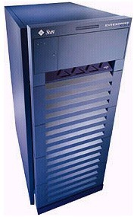
Three Tier (RPC based)
Database
RPC Request
SQL Request
RPC Response
SQL Response
Thinner client: business & data model separated from presentation
  Business logic and data access logic reside in middle tier server while client handles presentation
Middle tier server is now required to handle system services
  Concurrency control, threading, transaction, security, persistence, multiplexing, performance, etc.

Slide 12
Three Tier (Cont.)
Pro:
  Business logic can change more flexibly than 2-tier model
    Most business logic reside in the middle-tier server
Cons:
  Complexity is introduced in the middle-tier server
  Client and middle-tier server is more tightly coupled (than the three-tier object based model)
  Code is not really reusable (compared to object model based)

Slide 13
Three Tier (Remote Object based)
Database
Object Request
SQL Request
Object Response
SQL Response
Business logic and data model captured in objects
  Business logic and data model are now described in “abstraction” (interface language)
Object models used: CORBA, RMI, DCOM
  Interface language in CORBA is IDL
  Interface language in RMI is Java interface
Notes:
DCOM= Distributed Component Object Model
IDL=Interface Definition Language

Slide 14
Three Tier (Remote Object based)
Pro:
  More loosely coupled than RPC model
  Code could be more reusable
Cons:
  Complexity in the middle-tier still need to be addressed

Slide 15
Three-Tier (Web Server)
Web Server
Database
HTML Request
SQL Request
HTML Response
SQL Response
Browser handles presentation logic
Browser talks Web server via HTTP protocol
Business logic and data model are handled by “dynamic contents generation” technologies (CGI, Servlet/JSP, ASP)

Slide 16
Three-Tier (Web Server)
Pro:
  Ubiquitous client types
  Zero client management
  Support various client devices
    J2ME-enabled cell-phones
Cons:
  Complexity in the middle-tier still need to be addressed

Slide 17
Trends
Moving from single-tier or two-tier to multitier architecture
Moving from monolithic model to object-based application model
Moving from application-based client to HTML-based client

Slide 18
Outstanding Issues & Solution
Complexity at the middle tier server still remains
Duplicate system services still need to be provided for the majority of enterprise applications
  Concurrency control, Transactions
  Load-balancing, Security
  Resource management, Connection pooling
How to solve this problem?
  Commonly shared container that handles the above system services
  Proprietary versus Open-standard based

Slide 19
Open and Standard Solution
Use "component and container" model in which container provides system services in a well-defined and as industry standard
J2EE is that standard , provides portability of code because it is based on Java technology and standard-based Java programming APIs

Slide 20
J2EE Architecture

Slide 21
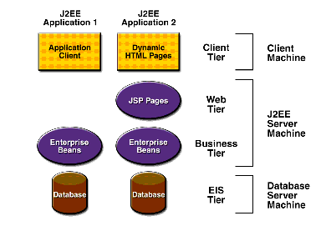
Multilayered Applications

Slide 22
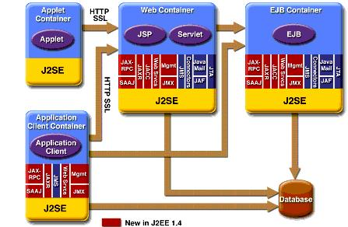
J2EE Architecture

Slide 23
Introducing J2EE Components

Slide 24
J2EE Components
J2EE specifies both the service APIs for building the application and the infrastructure for managing the application.
  J2EE Runtime
    A runtime infrastructure for managing and hosting applications. All runtime applications are located in this server.
  J2EE APIs and Technologies
    A set of Java APIs describes the programming model for J2EE application.

Slide 25
J2EE APIs and Technologies
Basic Requirement
J2SE SDK & JVM
  To run J2EE SDK and provides core APIs for writing J2EE components, core development tools.
J2EE (SDK) APIs

Slide 26
J2EE APIs and Technologies
J2EE (SDK) APIs
Enterprise Java Beans (EJB) 2.1
Java Servlet Technology 2.3
Java Server Pages (JSP) 2.1
JavaServer Faces (JSF)
Java Message Service (JMS) 1.1
Java Transaction API (JTA) 1.0
Java Mail API 1.3
Java Beans Activation Framework 1.0
Java API for XML (JAXP) 1.3
Java API for XML-based RPC (JAX-RPC) 1.5
SOAP with Attachment API for Java (SAAJ) 1.2
Java API for XML Registers (JAXR) 1.0
J2EE Connector API
JDBC 2.0
Java Naming and Directory Interface (JNDI)
Java Authentication and Authorization Service (JAAS) 1.3

Slide 27
Introducing J2EE Containers

Slide 28
J2EE Containers
EJB Container
Web Container
Application Client Container
Applet Container

Slide 29
Containers Types
Client Machine
J2EE Server
Browser
Web Container
Servlet
JSP
Application Client Container
Application Client
DB
EJB Container
Enterprise Bean
Enterprise Bean

Slide 30
Introducing J2EE Technologies

Slide 31
Types of J2EE Technologies
Component Technologies
Services Technologies
Communication Technologies

Slide 32
Introducing J2EE Component Technologies

Slide 33
1. Web Component
Concerning respond to HTTP requests
Web components are in the form of either Servlet or JSP
Web components run in a Web container
  Tomcat and Resin are popular web containers
  All J2EE compliant app servers provide web containers
Web container provides system services to Web components
  Request dispatching, security, and life cycle management

Slide 34
Servlet
Java™ objects which extend the functionality of a HTTP server
Dynamic contents generation
Better alternative to CGI, NSAPI, ISAPI, etc.
  Efficient
  Platform and server independent
  Session management
  Java-based

Slide 35
JSP (Java Server Page)
Enables separation of business logic from presentation
  Presentation is in the form of HTML or XML/XSLT
  Business logic is implemented as Java Beans or custom tags
  Better maintainability, reusability
Extensible via custom tags
Builds on Servlet technology

Slide 36
2. Enterprise Java Bean (EJB) Component
J2EE’s business logic resides in EJB
Easy development and deployment of Java technology-based application that are:
  transactional,
  distributed,
  multi-tier,
  portable,
  scalable,
  secure,
  etc…

Slide 37
3. XML
Defines how we manage, transport, process, and view data (as well as metadata)
cross-platform, extensible, text-based standard for representing data.
J2EE provides a number of APIs for developers working with XML:
  Java API for XML Procerssing (JAXP)
  Java API for XML Binding (JAXB)
  Java API for XML Registers (JAXR)
  Java API for XML Messaging (JAXM)
  Java API for XML-based Remote Procedure Calls (JAX-RPC)

Slide 38
Introducing J2EE Service Technologies

Slide 39
Service Technologies
Java Transaction API and Service
JDBC
JNDI
Java Mail
JMS
JAAS

Slide 40
JMS (Java Message Service)
Messaging systems (MOM- Message Oriented Middleware) provide
  De-coupled communication
  Asynchronous communication
  Plays a role of centralized post office
Benefits of Messaging systems
  Flexible, Reliable, Scalable communication systems
Point-to-Point, Publish and Subscribe
JMS defines standard Java APIs to messaging systems

Slide 41
JAAS (Java Authentication & Authorization Service)
Authentication
Pluggable authentication framework
  Userid/password
  Smartcard
  Kerberos
  Biometric
Application portability regardless of authentication schemes underneath
  JAAS provides authentication scheme independent API
  Authentication schemes are specified Login configuration file, which will be read by JAAS

Slide 42
JAAS (Java Authentication & Authorization Service)
Authorization
Without JAAS, Java platform security are based on
  Where the code originated
  Who signed the code
The JAAS API augments this with
  Who’s running the code
User-based authorization is now possible

Slide 43
Introducing J2EE Communication Technologies

Slide 44
Communication Technologies
Internet Protocol
  HTTP
  TCP/IP
  SSL
  OMG Protocols
Remote Object Protocol
  RMI and RMI-IIOP
  Messaging
  Data Formats
  Java IDL

Slide 45
Building Web Applications

Slide 46
Web Application & Components
Web Application is a deployable package
  Web components (Servlets and JSP's)
  Static resource files such as images
  Helper classes
  Libraries
  Deployment descriptor (web.xml file)
Web Application can be represented as
– A hierarchy of directories and files (unpacked form) or
– *.WAR file reflecting the same hierarchy (packed form)

Slide 47
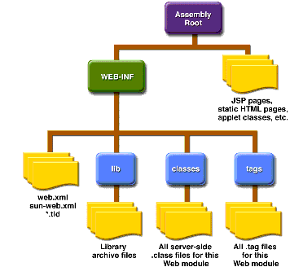
Web Application Layout

Slide 48
Web Application Development and Deployment Steps

Slide 49
Web Application Development and Deployment Steps
Write (and compile) the Web component code (Servlet or JSP) and helper classes referenced by the web component code
Create any static resources (for example, images or HTML pages)
Create deployment descriptor (web.xml)
Build the Web application (*.war file or deployment-ready directory)
Deploy the web application into a Web container
  Web clients are now ready to access them via URN

Slide 50
1. Write and compile the Web component code
Create development tree structure
Write either servlet code or JSP pages along with related helper code
IDE (i.e. Eclipse, NetBeans) handles all these chores

Slide 51
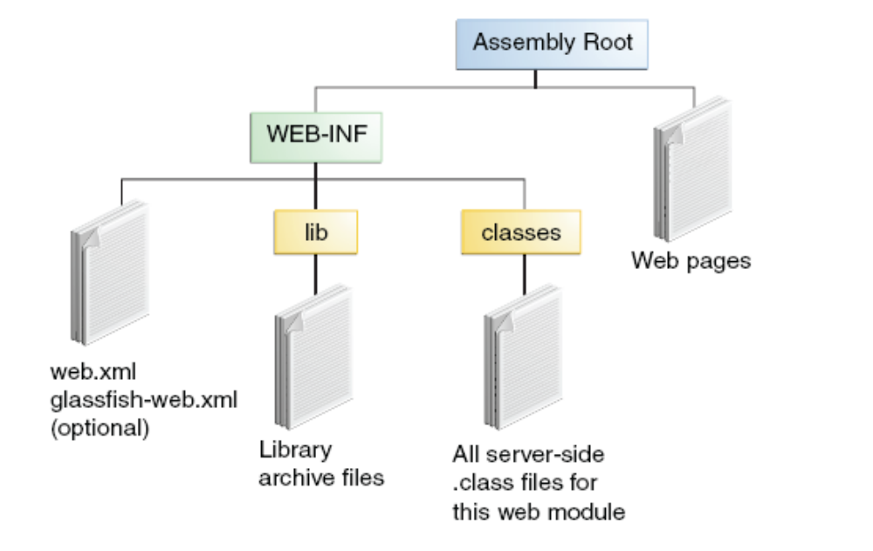
Development Tree Structure

Slide 52
2. Create any static resources
HTML pages
  Custom pages
  Login pages
  Error pages
Image files that are used by HTML pages or JSP pages
  Example: pic.gif

Slide 53
3. Create deployment descriptor (web.xml)
Deployment descriptor contains deployment time runtime instructions to the Web container
  URL that the client uses to access the web component
Every web application has to have it

Slide 54
4. Build the Web application
either *.WAR file or unpacked form of *.WAR file
Build process is made of
  create build directory (if it is not present) and its subdirectories
  compile Java code into build/WEB-INF/classes directory
    Java classes reside under ./WEB-INF/classes directory
  copy web.xml file into build/WEB-INF directory
  copy image files into build directory

Slide 55
5. Deploy Web application
Deploy the application over deployment platform such as Sun Java System App Server or Tomcat
From a browser, go to URN of the Web application

Slide 56
Configuring Web Application via web.xml

Slide 57
Web Applications Deployment Descriptor (web.xml)
helps in managing the deployment configuration of web applications.
stored in the /WEB-INF directory of the application.
purposes:
  Initialization of parameters for Servlets and web applications
  Servlet/JSP definitions
  Servlet/JSP mappings
  MIME types (Multi-purpose Internet Mail Extensions)
  Security

Slide 58
Contents Deployment Descriptor
Prolog
Alias Paths
Context and Initialization Parameters
Event Listeners
Filter Mappings
Error Mappings
Reference to Environment Entries, Resource environment entries, or Resources

Slide 59
web.xml (Cont.)
Case sensitive
Order sensitive (in the following order)
  icon, display-name, description, distributable
  context-param, filter, filter-mapping
  listener, servlet, servlet-mapping, session-config
  mime-mapping, welcome-file-list
  error-page, taglib, resource-env-ref, resource-ref
  security-constraint, login-config, security-role

Slide 60
Prolog (of web.xml)
<?xml version="1.0" encoding="ISO-8859-1"?>
<!DOCTYPE web-app PUBLIC "-//Sun Microsystems, Inc.//DTD Web Application 2.3//EN" "http://java.sun.com/dtd/ webapp _2 _3 .dtd">

Slide 61
Alias Paths (of web.xml)
When a request is received by Servlet container, it must determine which Web component in a which web application should handle the request.
It does so by mapping the URL path contained in the request to a Web component.
A URL path contains the context root and alias path
  http://<host>:8080/context_root/alias_path
Alias Path can be in the form of either
  /alias-string (for servlet) or
  /*.jsp (for JSP)

Slide 62
Alias Paths (of web.xml)
<web-app>
<servlet>
<servlet-name>MyServlet</servlet-name>
<servlet-class>MyServlet</servlet-class>
</servlet>
<servlet-mapping>
<servlet-name>MyServlet</servlet-name>
<url-pattern>/servlet1</url-pattern>
</servlet-mapping>
<welcome-file-list>
<welcome-file>test.html</welcome-file>
</welcome-file-list>
</web-app>

Slide 63
Context and Initialization Parameters
Represents application context
Can be shared among Web components in a WAR file
  <web-app>
  ...
  <context-param>
  <param-name>
  javax.servlet.jsp.jstl.fmt.localizationContext
  </param-name>
  <param-value>messages.BookstoreMessages</param-value>
  </context-param>
  ...
  </web-app>

Slide 64
Event Listeners (of web.xml)
Receives servlet life-cycle events
<listener>
<listener-class>listeners.ContextListener</listener-class>
</listener>

Slide 65
Filter Mappings
Specify which filters are applied to a request, and in what order
<filter>
<filter-name>OrderFilter<filter-name>
<filter-class>filters.OrderFilter<filter-class>
</filter>
<filter-mapping>
<filter-name>OrderFilter</filter-name>
<url-pattern>/receipt</url-pattern>
</filter-mapping>

Slide 66
Error Mappings
Maps status code returned in an HTTP response to a Java programming language exception returned by any Web component and a Web resource
<error-page>
<exception-type>exception.OrderException</exception-type>
<location>/errorpage.html</location>
</error-page>

Slide 67
Example web.xml of hello2
<?xml version="1.0" encoding="UTF-8"?>
<web-app xmlns="http://java.sun.com/xml/ns/j2ee" version="2.4“ xmlns:xsi="http://www.w3.org/2001/XMLSchema-instance" xsi:schemaLocation="http://java.sun.com/xml/ns/j2ee http://java.sun.com/xml/ns/j2ee/web-app_2_4.xsd">
<display-name>hello2</display-name>
<servlet>
<servlet-name>GreetingServlet</servlet-name>
<servlet-class>servlets.GreetingServlet</servlet-class>
</servlet>
<servlet>
<servlet-name>ResponseServlet</servlet-name>
<servlet-class>servlets.ResponseServlet</servlet-class>
</servlet>
<servlet-mapping>
<servlet-name>GreetingServlet</servlet-name>
<url-pattern>/greeting</url-pattern>
</servlet-mapping>
<servlet-mapping>
<servlet-name>ResponseServlet</servlet-name>
<url-pattern>/response</url-pattern>
</servlet-mapping>
</web-app>

Slide 68
Summary
J2EE is the platform of choice for development and deployment of n-tier, web-based, transactional, component based enterprise applications
J2EE is standard-based architecture
J2EE is all about community
J2EE evolves according to the needs of the industry

Slide 69
Thank you!

