Slide 1
Session 3:
Servlet Session Tracking

Slide 2
Contents
Servlet Session Tracking
Cookie API
Session API

Slide 3
Session Tracking
  Session tracking is a mechanism that servlets use to maintain state about a series of requests from the same user (that is, requests originating from the same browser) across some period of time.
  Sessions are shared among the servlets accessed by a client.
  This is convenient for applications made up of multiple servlets.
  For example, a Bookstore system uses session tracking to keep track of the books being ordered by a user.

Slide 4
Why do we need session tracking?
  HTTP is a stateless protocol:
    it doesn't provides a way for a server to recognize which client is using what part of the application.
  Great number of web-oriented application requires that application has to keep track of the clients performing actions, and thus can't be supported without an additional API.
  To support the software that needs keep track of the state, Java Servlet technology provides an API for managing sessions and allows several mechanisms for implementing sessions.

Slide 5
Three ways for session tracking
  Hidden Form Fields
    fields are added to an HTML form which are not displayed in the client's request.
    e.g., <input type ="hidden" name = "name" value=“***“>
  Cookies
    By default the server creates a cookie and the cookie get stored on the client machine.
    The cookie is sent back to the server when the user sends a new request. By this cookie, the server is able to identify the user. In this way the session is maintained. Cookie is nothing but a name- value pair, which is stored on the client machine.
  URL Rewriting
    A session object is created when the first request goes to the server.
    Then server creates a token which will be used to maintain the session.
    The token is transmitted to the client by the response object and gets stored on the client machine.

Slide 6
What are cookies?
A cookie is a message given to a Web browser by a Web server.
The browser stores the message in a text file. The message is then sent back to the server each time the browser requests a page from the server.
Purpose
  to identify users and possibly prepare customized Web pages for them.
Example
  When you enter a Web site using cookies, you may be asked to fill out a form providing such information as your name and interests.
  This information is packaged into a cookie and sent to your Web browser which stores it for later use.
  The next time you go to the same Web site, your browser will send the cookie to the Web server.
  The server can use this information to present you with custom Web pages.
  So, for example, instead of seeing just a generic welcome page you might see a welcome page with your name on it.

Slide 7
Cookie API

Slide 8
Cookies
Creating Cookies
Cookie Attributes
Reading Cookies
  Session & Persistent Cookies
Examples
  Repeat Visitor
  Tracking User Access Counts
  Remembering User Preferences

Slide 9
Creating Cookies
Three steps to creating a new cookie:
  Create a new Cookie Object
    Cookie cookie = new Cookie (name, value);
  Set any cookie attributes
    cookie.setMaxAge (60);
  Add your cookie to the response object:
    response.addCookie (cookie)

Slide 10
1. Cookie Constructor
You create a new cookie by calling the Cookie constructor and specifying:
  Name
  Value
Example:
  Cookie cookie = new Cookie (“school”, “NYU”);
Neither the name nor the value should contain whitespace or any of the following characters:
  [ ] ( ) = , “ / ? @ ;

Slide 11
2. Set Cookie Attributes
Before adding your cookie to the response object, you can set any of its attributes.
Attributes include:
  Name/Value
  Domain
  Maximum Age
  Path
  Version

Slide 12
Cookie Name
public String getName();
public void setName (String name);
You rarely call setName() directly, as you specify the name in the cookie constructor.
getName() is useful for reading in cookies.

Slide 13
Cookie Value
public String getValue();
public void setValue (String value);
You rarely call setValue() directly, as you specify the name in the cookie constructor.
getValue() is useful for reading in cookies.

Slide 14
Domain Attributes
public String getDomain ();
public void setDomain(String domain);
Normally, the browser only returns cookies to the exact same host that sent them.
You can use setDomain() to instruct the browser to send cookies to other hosts within the same domain.

Slide 15
Domain Example
Example: Cookies sent from a servlet at bali.vacations.com would not be forwarded to mexico.vacations.com.
If you do want to the cookie to be accessible to both hosts, set the domain to the highest level:
  cookie.setDomain (“.vacations.com”);
Note that you are always required to include at least two dots. Hence, you must specify .vacations.com, not just vacations.com

Slide 16
Cookie Age
public int getMaxAge ();
public void setMaxAge (int lifetime);
In general there are two types of cookies:
  Session Cookies: Temporary cookies that expire when the user exits the browser.
  Persistent Cookies: Cookies that do not expire when the user exits the browser. These cookies stay around until their expiration date, or the user explicitly deletes them.

Slide 17
Cookie Expiration
The setMaxAge() method tells the browser how long (in seconds) until the cookie expires.
Possible values:
  negative value (default): creates a session cookie that is deleted when the user exits the browser.
  0: instructs the browser to delete the cookie.
  positive value: any number of seconds.
    e.g., to create a cookie that lasts for one hour, setMaxAge (3600);

Slide 18
Path
public String getPath();
public void setPath (String path);
By default, the browser will only return a cookie to URLs in or below the directory that created the cookie.

Slide 19
Path Example
Example: If you create a cookie at
http://ecommerce.site.com/toys.html then:
  The browser will send the cookie back to
  http://ecommerce.site.com/toys.html
  The browser will not send the cookie back to
  http://ecommerce.site.com/cds
If you want the cookie to be sent to all pages, set the path to /
  Cookie.setPath (“/”);
  Very common, widely used practice.

Slide 20
Cookie Version
public int getVersion ();
public void setVersion (int version);
By default, the Servlet API will create Version 0 cookies.
Via the setVersion() method you can specify version 1. But, since this is not widely implemented, stick with the default.

Slide 21
Security
public int getSecure ();
public void setSecure (boolean);
If you set Secure to true, the browser will only return the cookie when connecting over an encrypted connection.
By default, cookies are set to non-secure.

Slide 22
Comments
public int getComment ();
public void setComment (String)
Comments: you can specify a cookie comment via the setComment() method. But, comments are only supported in Version 1 cookies.
Hence, no one really uses these methods.

Slide 23
3. Add Cookies to Response
Once you have created your cookie, and set any attributes, you add it to the response object.
By adding it to the response object, your cookie is transmitted back to the browser.
Example:
  Cookie school = new Cookie (“school”, “NYU”);
  school.setMaxAge (3600);
  response.addCookie (school);

Slide 24
Reading Cookies

Slide 25
Reading Cookies
To create cookies, add them to the response object.
To read incoming cookies, get them from the request object.
HttpServletRequest has a getCookies() method.
  Returns an array of cookie objects. This includes all cookies sent by the browser.
  Returns a zero-length array if there are no cookies.

Slide 26
Reading Cookies
Once you have an array of cookies, you can iterate through the array and extract the one(s) you want.
Our next few examples illustrate how this is done.

Slide 27
Session & Persistent Cookies
Session Cookies
  these are temporary and are erased when you close your browser at the end of your surfing session.
  The next time you visit that particular site it will not recognise you and will treat you as a completely new visitor as there is nothing in your browser to let the site know that you have visited before.
Persistent Cookies
  these remain on your hard drive until you erase them or they expire.
  How long a cookie remains on your browser depends on how long the visited website has programmed the cookie to last .

Slide 28
Understanding Examples

Slide 29
Example 1: RepeatVisitor.java
This servlet checks for a unique cookie, named “repeatVisitor”
  If the cookie is present, servlet says “Welcome Back”
  Otherwise, servlet says “Welcome New User”.
public class RepeatVisitors extends HttpServlet {
public void doGet(HttpServletRequest request, HttpServletResponse response)
throws ServletException, IOException
{
boolean newUser = true;
Cookie[ ] cookies = request.getCookies();
if (cookies != null)
{
for(Cookie c: cookies)
{
if ((c.getName().equals("repeatVisitor")) &&(c.getValue().equals("yes")))
{
newUser = false;
break;
}
}
}

Slide 30
RepeatVisitor (Cont.)
String title=null;
if (newUser)
{
Cookie returnVisitorCookie =new Cookie("repeatVisitor", "yes");
returnVisitorCookie.setMaxAge(60*60*24*365);
response.addCookie(returnVisitorCookie);
title="Welcome New User";
}
else
{
title = "Welcome Back";
}
response.setContentType("text/html");
PrintWriter out = response.getWriter();
out.println("<H1>" + title + "<H1>");
}
public void doPost(HttpServletRequest request,HttpServletResponse response)
throws ServletException, IOException
{
doGet(request,response);
}
}

Slide 31
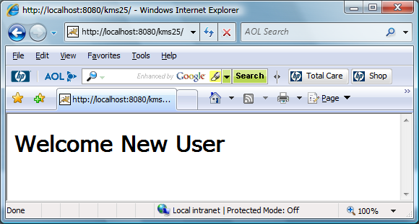
First Time Visit

Slide 32
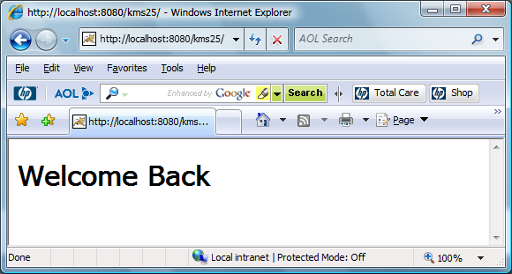
Next Time Visits

Slide 33
Example 2: ClientAccessCount
We created a simple Counter servlet that keeps track of the number of “hits”.
Now, we want to display the number of hits for each user.
This is relatively simple to do. We just create a counter cookie, and increment the counter cookie at each visit.
public class ClientAccessCounts extends HttpServlet {
public void doGet(HttpServletRequest request,HttpServletResponse response) throws ServletException, IOException {
String countString=“0";
Cookie[ ] cookies = request.getCookies();
if (cookies != null) {
for(Cookie cookie: cookies) {
if (cookie.getName().equals("accessCount"))
countString=cookie.getValue();
}
}
int count=0;
try {
count = Integer.parseInt(countString)+1;
} catch(NumberFormatException nfe) { }
Cookie c = new Cookie("accessCount",String.valueOf(count));
response.addCookie(c);

Slide 34
ClientAccessCount(cont.)
response.setContentType("text/html");
PrintWriter out = response.getWriter();
out.println("<HTML>\n");
out.println("<HEAD><TITLE> <H1>Access Count Servlet </H1> </TITLE>");
out.println("<BODY BGCOLOR=\"#FDF5E6\">\n<CENTER>\n");
out.println("<H2>This is visit number " + count + " by this browser.</H2>\n");
}
}

Slide 35
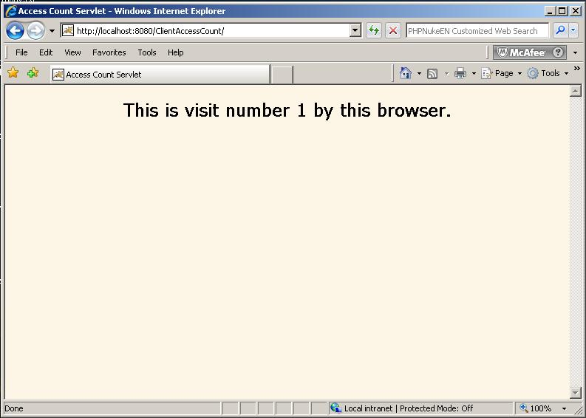
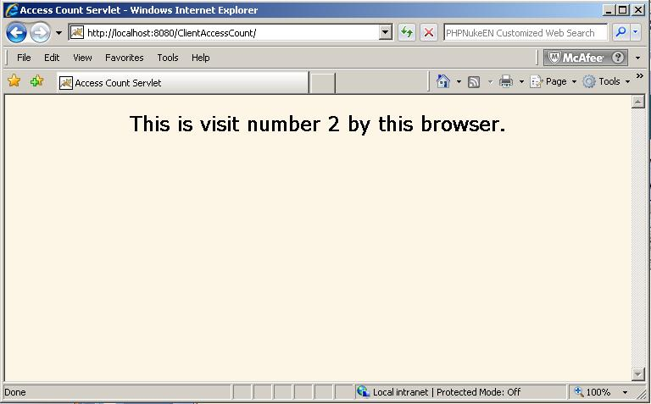
ClientAccessCount(cont.)

Slide 36
Example 3: Remembering User Preferences
RegistrationForm servlet
  Uses cookie values to prepopulate form field values
  Uses default values if no cookies are found
RegistrationServlet servlet
  Creates cookies based on request parameters received
  Displays values if all parameters are present
  Redirects to form if any parameter is missing

Slide 37
RegistrationForm servlet
import javax.servlet.*;
import javax.servlet.http.*;
import java.io.*;
public class RegistrationForm extends HttpServlet {
public void doGet(HttpServletRequest request, HttpServletResponse response)
throws ServletException, IOException {
String firstName = "“;
String lastName = "“;
String emailAddress = "“;
Cookie[] cookies = request.getCookies();
if (cookies != null) {
for(Cookie cookie: cookies) {
if (cookie.getName().equals("firstName"))
firstName=cookie.getValue();
else if (cookie.getName().equals("lastName"))
lastName=cookie.getValue();
else if (cookie.getName().equals("emailAddress"))
emailAddress=cookie.getValue();
}
}

Slide 38
RegistrationForm servlet (Cont.)
response.setContentType("text/html");
PrintWriter out = response.getWriter();
out.println("<HTML>");
out.println("<HEAD> <CENTER> <TITLE> Please Register </TITLE> </CENTER></HEAD>");
out.println("<BODY><CENTER>");
out.println("<H2> Please Register </H2><BR/>");
out.println("<FORM method='GET' ACTION=\"registrationServlet\">");
out.println("<TABLE>" +
"<TR>" +
"<TD>FirstName : </TD> " +
"<TD><INPUT Type=\"text\" name=\"firstName\" value=" + firstName + "> </TD>" +
"</TR>" +
"<TR>" +
"<TD>Last Name&nbsp : </TD>" +
"<TD><INPUT Type=\"text\" name=\"lastName\" value=" + lastName + "> </TD>" +
"</TR>" +
"<TR>" +
"<TD>Email : </TD>" +
"<TD> <INPUT Type=\"text\" name=\"emailAddress\" value=" + emailAddress + "> </TD>" +
"</TR>" +
"</TABLE>" +
"<BR/><INPUT Type=\"submit\" name=\"submit\"> ");

Slide 39
RegistrationForm servlet(Cont.)
out.println("</FORM>");
out.println("</CENTER></BODY>");
out.println("</HTML>");
}
}

Slide 40
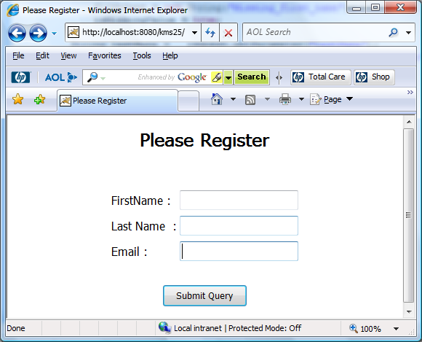
Remembering User Preferences (cont.)

Slide 41
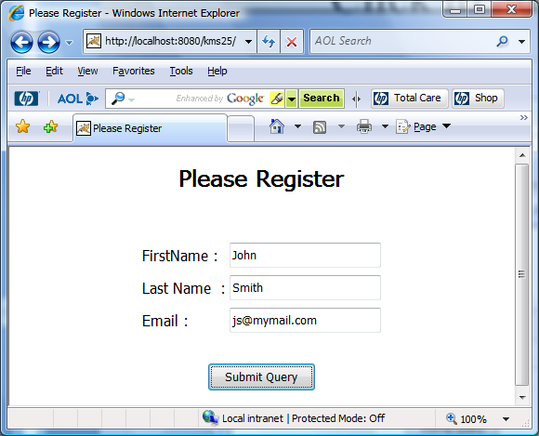
Remembering User Preferences (cont.)

Slide 42
RegistrationServlet.java
import javax.servlet.*;
import javax.servlet.http.*;
import java.io.*;
public class RegistrationServlet extends HttpServlet {
public void doGet(HttpServletRequest request,HttpServletResponse response)
throws ServletException, IOException {
boolean isMissingValue = false;
String firstName =request.getParameter("firstName");
if (firstName.equals("") || firstName.equals("Missing_first_name"))
{
firstName = new String("Missing_first_name");
isMissingValue = true;
}
String lastName =request.getParameter("lastName");
if (lastName.equals("")|| lastName.equals("Missing_last_name"))
{
lastName = new String("Missing_last_name");
isMissingValue = true;
}

Slide 43
RegistrationServlet.java (cont.)
String email = request.getParameter("emailAddress");
if (email.equals("")|| email.equals("Missing_email")) {
email = new String("Missing_email");
isMissingValue = true;
}
Cookie c1 =new Cookie("firstName“,firstName);
c1.setMaxAge(60);
response.addCookie(c1);
Cookie c2 = new Cookie("lastName", lastName);
response.addCookie(c2);
c2.setMaxAge(60);
Cookie c3 = new Cookie("emailAddress",email);
response.addCookie(c3);
c3.setMaxAge(60);
String formAddress ="./register";

Slide 44
RegistrationServlet.java (cont.)
if (isMissingValue) {
response.sendRedirect(formAddress);
}
else
{
response.setContentType("text/html");
PrintWriter out = response.getWriter();
out.println("<HTML>");
out.println("<HEAD> <CENTER> <TITLE> thanks </TITLE> </CENTER></HEAD>");
out.println("<BODY><CENTER>");
out.println("<H2> Thanks for registration! </H2><BR/>");
out.println("<LI> First Name : " + firstName);
out.println("<LI> Last Name : " + lastName);
out.println("<LI> Email : " + email);
out.println("</CENTER> </BODY>");
out.println("</HTML>");
}
}
}

Slide 45
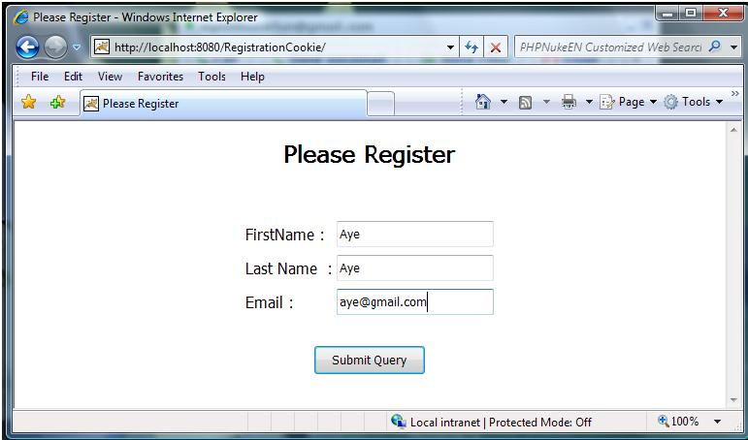
Remembering User Preferences (cont.)

Slide 46
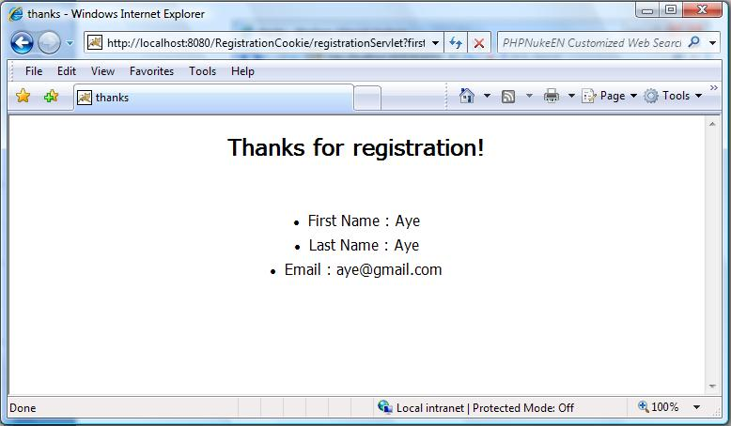
Remembering User Preferences (cont.)

Slide 47
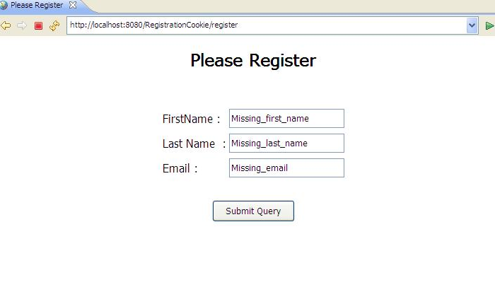

Slide 48
Session API

Slide 49
Session
Using the Java Session API
  Overview of what the Session API provides
  Extracting Data from the Session
  Extracting Session Information
  Adding Data to the Session
Example:
  Repeat Visitor with accessCount
  Shopping Cart System

Slide 50
Overview of Session API Functionality

Slide 51
Overview of Session API
Servlets include a built-in Session API.
Enables you to very easily create applications that depend on individual user data.
For example:
  Shopping Carts
  Personalization Services
  Maintaining state about the user’s preferences.

Slide 52
Using the Session API
Steps to using the Java Session API
  Get the Session object from the HttpRequest object.
  Extract Data from the user’s Session Object
  Extract information about the session object, e.g. when was the session created?
  Add data to the user’s Session Object.

Slide 53
Getting a Session Object
To get the user’s session object, call the getSession() method of the HttpServletRequest class.
Example:
  HttpSession session = request.getSession();
If user already has a session, the existing session is returned. If no session exists, a new one is created and returned.
If you want to know if this is a new session, call the Session isNew() method.

Slide 54
Getting a Session Object
If you want to disable creation of new sessions, pass false to the getSession() method.
For example:
  HttpSession session = request.getSession(false);
If no current session exists, you will now get back a null object.

Slide 55
Behind the Scenes
When you call getSession() there is a lot going on behind the scenes.
  Each user is automatically assigned a unique session ID.
How does this sessionID get to the user?
  Option 1: If the browser supports cookies, the servlet will automatically create a session cookie, and store the session ID within the cookie. (In Tomcat, the cookie is called: JSESSIONID)
  Option 2: If the browser does not support cookies, the servlet will try to extract the session ID from the URL.

Slide 56
Extracting Data from the Session

Slide 57
Extracting Data From Session
The Session object works like a Hash Map that enables you to store any type of Java object.
You can therefore store any number of keys and their associated values.
To extract an existing object, use the getAttribute() method.

Slide 58
Extracting Data from Session
The getAttribute () method will return an Object type, so you will need to perform a type cast.
Example:
  Integer accessCount =
  (Integer)session.getAttribute("accessCount");

Slide 59
Extracting Data from Session
Tip:
  If you want to get a list of all “keys” associated with a Session, use the getAttributeNames() method.
  This method returns an Enumeration of all Attribute names.

Slide 60
Additional Session Info.
The Session API includes methods for determining Session specific information.
public String getId();
  returns the unique session ID associated with this user, e.g. gj9xswvw9p
public boolean isNew();
  indicates if the session was just created.
public long getCreationTime();
  indicates when the session was first created.
public long getLastAccessedTime();
  indicates when the session was last sent from the client.

Slide 61
Additional Methods
public int getMaxInactiveInterval()
  Determine the length of time (in seconds) that a session should go without access before being automatically invalidated.
public void setMaxInactiveInterval (int seconds)
  Sets the length of time (in seconds) that a session should go without access before being automatically invalidated.
  A negative value specifies that the session should never time out.

Slide 62
Adding Data to the Session

Slide 63
Adding Data To Session
To add data to a session, use the setAttribute() or putValue() methods, and specify the key name and value.
  e.g.,
  session.setAttribute("accessCount", accessCount);
To remove a value, you can use the removeAttribute (String name) method.

Slide 64
Terminating Sessions
public void invalidate()
  If the user does not return to a servlet for XX minutes*, the session is automatically invalidated and deleted.
  If you want to manually invalidate the session, you can call invalidate().
  * For the exact number of minutes before automatic expiration, check the getMaxInactiveInterval() method.

Slide 65
URL Rewriting
If a browser does not support cookies, you need some other way to maintain the user’s session ID.
The Servlet API takes care of this for you by automatically appending the session ID to URLs if the browser does not support cookies.
To automatically append the session ID, use the encodeURL() method.

Slide 66
URL Rewriting
Example:
  String url = response.encodeURL (originalURL);
Remember that if you do this, every single URL must include the sessionID.
Since this is hard to ensure, lots of sites (e.g. Yahoo require cookies.)

Slide 67
Understanding Examples

Slide 68
Example 1: RepeatVisitor & accessCount
Our example tracks the number of visits for each unique visitor.
  If this is a first time visit, the servlet creates an accessCount Integer variable and assigns it to the Session.
  If the user has visited before, the servlet extracts the accessCount variable, increments it, and assigns it to the Session.
  Servlet also displays basic information regarding the session, including: creation time and time of last access.

Slide 69
RepeatVisitor (Cont.)
import java.io.*;
import javax.servlet.*;
import javax.servlet.http.*;
import java.util.*;
public class ShowSession extends HttpServlet
{
public void doGet(HttpServletRequest request,HttpServletResponse response) throws
ServletException,IOException
{
String title = "Session Tracking Example";
HttpSession session = request.getSession(true);
String heading;
Integer accessCount = (Integer)session.getAttribute("accessCount");
if (accessCount == null) {
accessCount = new Integer(0);
heading = "Welcome, Newcomer";
} else {
heading = "Welcome Back";
accessCount = new Integer(accessCount.intValue() + 1);
}
session.setAttribute("accessCount", accessCount);

Slide 70
RepeatVisitor (Cont.)
response.setContentType("text/html");
PrintWriter out = response.getWriter();
out.println("<HTML>");
out.println("<HEAD> <CENTER> <TITLE>" + title + "</TITLE> </CENTER> </HTML>");
out.println("<BODY BGCOLOR=\"#FDF5E6\">\n" +
"<H1 ALIGN=\"CENTER\">" + heading + "</H1>\n" +
"<H2>Information on Your Session:</H2>\n" +
"<TABLE BORDER=1 ALIGN=\"CENTER\">\n" +
"<TR BGCOLOR=\"#FFAD00\">\n" + " <TH>Info Type<TH>Value\n" + "<TR>\n" +
" <TD>ID\n" + " <TD>" + session.getId() + "\n" + "<TR>\n" +
" <TD>Creation Time\n" +
" <TD>" + new Date(session.getCreationTime()) + "\n" +
"<TR>\n" + " <TD>Time of Last Access\n" +
" <TD>" + new Date(session.getLastAccessedTime()) + "\n" +
"<TR>\n" + " <TD>Number of Previous Accesses\n" +
" <TD>" + accessCount + "\n" +
"</TR>"+
"</TABLE>\n" +
"</BODY></HTML>");
}
}

Slide 71
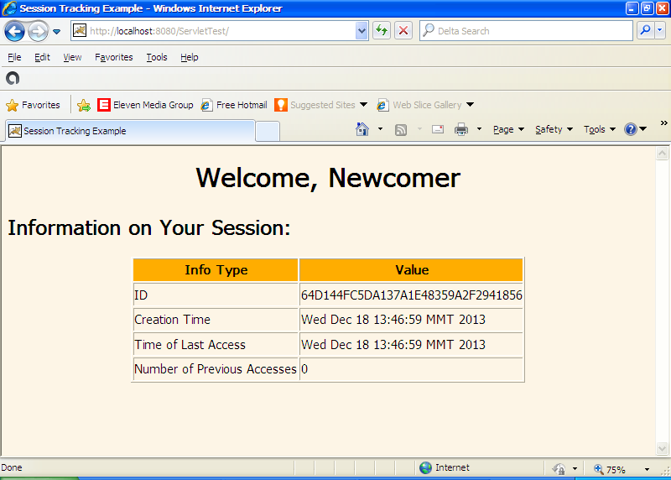
First Time Visit

Slide 72
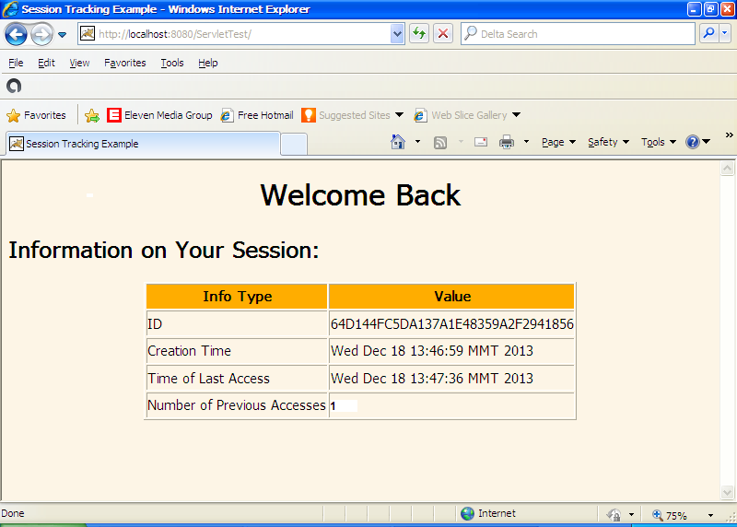
Next Time Visits

Slide 73
Example 2 : Shopping Cart
Provides a simple shopping cart.
Stores an ArrayList is the session; session attribute is called, “previousItems”
Each time you add a new item, the item is added to the ArrayList.

Slide 74
OrderForm.html
<html>
<head><center><title> Order Form </title></center></head>
<body>
<div align=“center”>
<h3> Order Form </h3><br>
<form method="get" action="stest">
New Item to Order &nbsp;
<input type="text" name="newItem"><br><br>
<input type="submit" value="Order and Show All Purchases"><br>
</form>
</div>
</body>
</html>

Slide 75
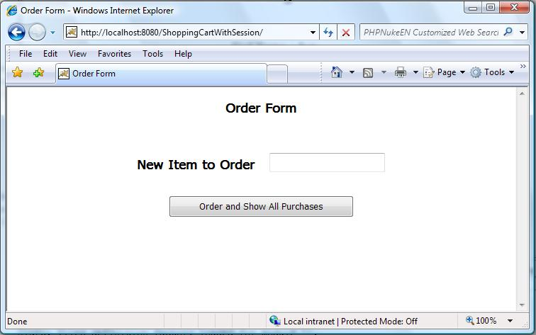
OrderForm.html (Cont.)

Slide 76
ShowItems.java
import java.io.*;
import javax.servlet.*;
import javax.servlet.http.*;
import java.util.*;
public class ShowItems extends HttpServlet {
public void doGet(HttpServletRequest request, HttpServletResponse response)throws ServletException, IOException {
HttpSession session = request.getSession();
ArrayList<String> previousItems =(ArrayList<String>)
session.getAttribute("previousItems");
if (previousItems == null) {
previousItems = new ArrayList<String>();
}
String newItem = request.getParameter("newItem");
if ((newItem != null) && !newItem.trim().equals(""))
previousItems.add(newItem);
session.setAttribute("previousItems", previousItems);

Slide 77
ShowItems.java (Cont.)
response.setContentType("text/html");
PrintWriter out = response.getWriter();
String title = "Items Purchased";
out.println( "<HTML>\n" + "<HEAD><TITLE>" + title + "</TITLE></HEAD>\n" +"<BODY BGCOLOR=\"#FDF5E6\">\n" + "<H1>" + title + "</H1>");
if (previousItems.size() == 0)
out.println("<I>No items</I>");
else {
out.println("<UL>");
for(String item : previousItems) {
out.println(" <LI>" + item);
}
out.println("</UL>");
}
out.println("</BODY></HTML>");
} }

Slide 78
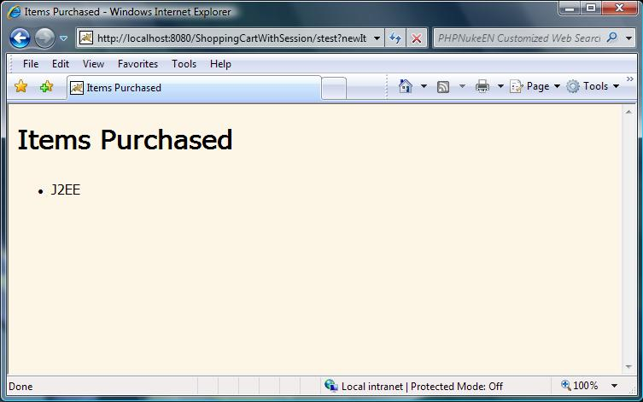

Slide 79
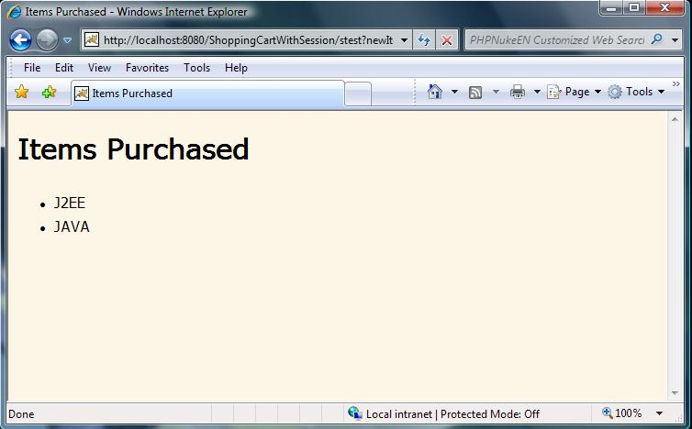

Slide 80
Thank You!

