Slide 1
Session- 5
MVC Pattern and Framework

Slide 2
Contents
What are Frameworks?
Introduction of MVC pattern/framework
Evolution of Web Application design architecture
  Model 1
  Model 2
  Application frameworks

Slide 3
What are frameworks?
Components/tools used to create applications.
Tried and tested.
Fulfill a specific need.
Easy interface.
Extensible.
May be based on established Design Patterns.
Notes:
Lowest Level frameworks are the Java APIs

Slide 4
Why do we need frameworks?
In today’s economy, clients expect more for less.
With a standard set of building blocks available, we can concentrate on the implementation of the business logic.
It allows for either a shortened development timeframe or the ability to deliver more functionality.
Cost – Schedule – Quality
Notes:
Frameworks can help with the cost / schedule.
Cost can be lowered by using junior developers that are trained in the frameworks.

Slide 5
Advantages from the use of frameworks
Allows faster prototyping
Improved application quality
  Fewer opportunities to introduce defects.
Easier learning curve for new developers:
  Simplified APIs & better documentation
  Experienced peers for available for support
  Examples exists displaying proper usage
Consistent design across applications
Easier for the maintenance activity.

Slide 6
MVC Framework
The goal of a Model-View-Controller framework is to achieve decoupling among the software components that are responsible for encapsulating business functions, rendering the content and controlling the navigation or flow.

Slide 7
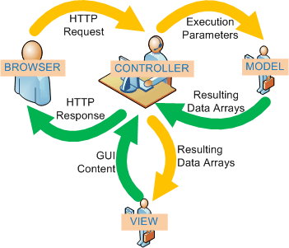
MVC Pattern
Notes:
Frameworks can help with the cost / schedule.
Cost can be lowered by using junior developers that are trained in the frameworks.

Slide 8
Three Logical Layers in a Web Application
Model (Business process layer)
  Models the data and behaviour behind the business process
  Responsible for actually doing
    Performing DB queries
    Calculating the business process
    Processing orders
  Encapsulate of data and behaviour which are independent of presentation
Notes:
Frameworks can help with the cost / schedule.
Cost can be lowered by using junior developers that are trained in the frameworks.

Slide 9
Three Logical Layers in a Web Application
View (Presentation layer)
  Display information according to client types
  Display result of business logic (Model)
  Not concerned with how the information was obtained, or from where (since that is the responsibility of Model)
Notes:
Frameworks can help with the cost / schedule.
Cost can be lowered by using junior developers that are trained in the frameworks.

Slide 10
Three Logical Layers in a Web Application
Controller (Control layer)
  Serves as the logical connection between the user's interaction and the business services on the back.
  Responsible for making decisions among multiple presentations
    e.g. User's language, locale or access level dictates a different presentation.
  A request enters the application through the control layer, it will decide how the request should be handled and what information should be returned
Notes:
Frameworks can help with the cost / schedule.
Cost can be lowered by using junior developers that are trained in the frameworks.

Slide 11
Web Applications
It is often advantageous to treat each layer as an independent portion of your application.
Do not confuse logical separation of responsibilities with actual separation of components.
Some of the layers can be combined into single components to reduce application complexity.
Notes:
Frameworks can help with the cost / schedule.
Cost can be lowered by using junior developers that are trained in the frameworks.

Slide 12
Evolution of Web Application Design Architecture
Notes:
Frameworks can help with the cost / schedule.
Cost can be lowered by using junior developers that are trained in the frameworks.

Slide 13
Evolution of MVC Architecture
No MVC
MVC Model 1 (Page-centric)
MVC Model 2 (Servlet-centric)
Web application frameworks
  Struts
Notes:
Frameworks can help with the cost / schedule.
Cost can be lowered by using junior developers that are trained in the frameworks.

Slide 14
Model 1 (Page-Centric Architecture)
Notes:
Frameworks can help with the cost / schedule.
Cost can be lowered by using junior developers that are trained in the frameworks.

Slide 15
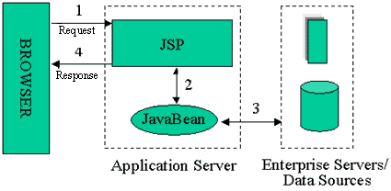
Model 1
Web browser directly accessing Web-tier JSP pages
The JSP pages access Web-tier JavaBeans that represent the application model

Slide 16
Model 1 Con’t
Composed of a series of interrelated JSP pages
  JSP pages handle all aspects of the application - presentation, control, and business process
Business process logic and control decisions are hard coded inside JSP pages
  in the form of JavaBeans, scriptlets, expression
Notes:
Frameworks can help with the cost / schedule.
Cost can be lowered by using junior developers that are trained in the frameworks.

Slide 17
Model 1 Con’t
The next view to display is determined by
  Hyperlinks selected in the source document
  Request parameters
Application control is decentralized
  Current page being displayed determines the next page to display
Each JSP page or servlet processes its own inputs
  Parameters from GET or POST

Slide 18
Model 1 (When to Use?)
Provide a more lightweight design for small, static applications
Applications which
  Have very simple page flow
  Have little need for centralized security control or logging
  Changes little over time
Notes:
*
07/16/96
(c) 2006 National Academy for Software Development - http://academy.devbg.org*
<number>##
SPEL – Simplest Possible EL
SEL – Simple EL
JSP EL не е подходящ - Immediate evaluation, read-only
Влиза в JSP - JSP EL или SEL (JSP 2.0)
JSP's EL made retrieving values and resolving variables easier. Rather than using <jsp:useBean> and <jsp:getProperty>, a developer could simply use ${bean.property}

Slide 19
Model 2 (Servlet-Centric Architecture)
Notes:
Frameworks can help with the cost / schedule.
Cost can be lowered by using junior developers that are trained in the frameworks.

Slide 20
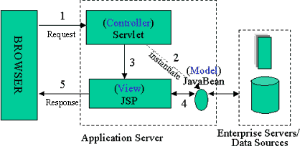
Model 2 (MVC)
Introduces a controller servlet between the browser and the JSP pages or servlet content being delivered
Views do not refer to each other directly

Slide 21
Controller Servlet
Centralizes logic for
  Dispatching of requests to the next view based on the request URL
  Input parameters
  Application state
Handles view selection
  Decouples JSP pages and servlets from one another
Provides
  Single point of control for security and logging
  Encapsulation of incoming data into a form usable by the back-end MVC model

Slide 22
Model 2 - Advantages
Easier to maintain and extend
There are many ready frameworks so we do not have to write our own
  Struts
  Tapestry
  Spring Web Flow
  WebWork
  JavaServer Faces
  … and many others

Slide 23
Web Application Framewrok
Notes:
Frameworks can help with the cost / schedule.
Cost can be lowered by using junior developers that are trained in the frameworks.

Slide 24
Web Application Frameworks
Based on MVC Model 2 architecture.
Web-tier applications share common set of functionality
  Dispatching HTTP requests
  Invoking model methods
  Selecting and assembling views
Provide classes and interfaces that can be used/extended by developers.
Notes:
Frameworks can help with the cost / schedule.
Cost can be lowered by using junior developers that are trained in the frameworks.

Slide 25
Why Web Application Framework?
De-coupling of presentation tier and business logic into separate components
Provides a central point of control
Provides rich set of features
Facilitates unit-testing and maintenance
Availability of compatible tools
Provides stability
Enjoys community-supports
Simplifies internationalization
Simplifies input validation
Notes:
Frameworks can help with the cost / schedule.
Cost can be lowered by using junior developers that are trained in the frameworks.

Slide 26
Why Web Application Framework?
Frameworks have evolved with Java Server technology.
JSP/Servlets are still hard to use.
Frameworks define re-usable components to make this job easier.
A good framework defines how components work to create a usable application.
Notes:
Frameworks can help with the cost / schedule.
Cost can be lowered by using junior developers that are trained in the frameworks.

Slide 27
Web Application Frameworks
Apache Struts
JavaServer Faces (JSR-127)
  A server side user interface component framework for JavaTM technology-based web applications
Echo
Tapestry
Notes:
Frameworks can help with the cost / schedule.
Cost can be lowered by using junior developers that are trained in the frameworks.

Slide 28
Thank you!

