Slide 1
Session 6
Introduction to Struts 2

Slide 2
Contents
What is Struts 2?
Why Struts 2?
Installing Struts 2
How do Struts 2 Work?
Building applications with Struts 2
Understanding Example : HelloWorld Application
Notes:
Struts was created by Craig R. McClanahan and
employee of Sun Microsystems and is the primary developer of Struts and Tomcat 4.
Can read about Craig and many other Struts contributors at jakarta.apache.org/
struts/volunteers.html.
The Struts 1.0 release had 17 contributors. With release 1.1 that number has jumped to 50. The project was
named Struts as a reference to the architectural structures in buildings and homes that provide
the internal support. The present version of Struts is 1.1.

Slide 3

What is Struts 2?
Apache Struts 2 is an elegant, extensible framework for creating enterprise-ready Java web applications.
Apache Struts2 was originally known as WebWork 2.
is based upon the OpenSymphony WebWork framework.
is built upon the Servlet API.
Model-View-Controller (MVC) design pattern.
is also called pull-MVC framework because of ‘views’ ability to pull data from action rather than having a separate model.
In Struts 2, ‘actions’ take the part of model rather than controller as in Struts 1.
Notes:
Apache Struts 2 was originally known as WebWork 2. After working independently for several years, the WebWork and Struts communities joined forces to create Struts². This new version of Struts is simpler to use and closer to how Struts was always meant to be.

Slide 4
Installing Struts 2
Prerequisite Softwares:
  Java Development Kit(jdk)
    Jdk 1.5 and above
  Servlet Conatiner
    E.g Apache’s Tomcat
  XML Parser
    Bundled with jdk 1.5
  Servlet API classes (2.4)
    Servlet.jar (included in most servlet containers)
  JSP API classes (2.0) (included in most servlet containers)
  Other packages
    Comes as *.jars

Slide 5
Installing a Struts 2 Binary Distribution
After installed the prerequisite softwares,
Download Binary Distribution from the following site:
  http://struts.apache.org/download.cgi
Unzip the downloaded package.
Unpack struts2-blank.war under struts-2.3.16/apps.
Create a Tomcat project in Eclipse.
Copy all files & directories under (unpacked form of struts2-blank.war) to the project.
Now you are on the way using Struts 2.

Slide 6
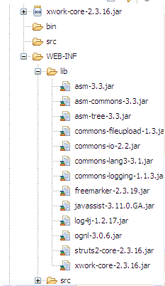
Configure BuildPath with required jar files in
WEB-INF\lib folder

Slide 7
Struts 2 MVC
Web Browser
Client
request
Render page
<<Controller>>
StrutsPrepareAndExecuteFilter
Invoke action
<<Model>
Action
<<view>>
Result
Select result

Slide 8
Request Processing Lifecycle
The request processing lifecycle of Struts 2 framework:
Request is generated by user and sent to Servlet container.
Servlet container invokes StrutsPrepareAndExecuteFilter which in turn determines appropriate action to handle the request.
One by one Interceptors are applied before calling the Action. Interceptors performs tasks such as Logging, Validation, File Upload, Double-submit guard etc.
Action is executed and the Result is generated by Action.
The output of Action is rendered in the view (JSP, Velocity, etc) and the result is returned to the user.

Slide 9
Struts 2 Components
Struts 2 are based on Model-View-Controller (MVC) design pattern.
Controller Component
In Struts 2, there is a servlet filter that inspects each incoming requests to determine which action to call for processing this request.
The filter is StrutsPrepareAndExecuteFilter and it takes the important role of Controller.
This filter is configured inside web.xml file.
As shown in Figure above, the controller’s job is to map requests to actions.
Notes:
So, the processing is broken into three sections:

Slide 10
Struts 2 Components (Cont’d)
View Component
  Present information to users and accept input.
  These correspond to web pages in Struts applications.
  View component of MVC forms the user interface that will render some state of application to the user.
  Generally built using JSP files.
Model Component
  Model part of MVC in any application models some state of the application
  Neither the data model nor the applications business logic by itself can represent the model fully.
  Model is basically the state formed after applying the business logic on the underlying data.
-> Action classes in Struts 2 are the perfect candidate for model.
-> Actions will perform some business logic on data.

Slide 11
Struts 2 Application
One time configuration
  web.xml
Three steps process
  Create view (JSP)
  Create Action Class
  Map Action and view (struts.xml)
Notes:
11/12/08

Slide 12
HelloWorld Struts2 Application

Slide 13
HelloWorld
(web.xml)
<web-app>
<display-name>Struts Blank</display-name>
<filter>
<filter-name>struts2</filter-name>
<filter-class> org.apache.struts2.dispatcher.ng.filter.StrutsPrepareAndExecuteFilter
</filter-class>
</filter>
<filter-mapping>
<filter-name>struts2</filter-name>
<url-pattern>/*</url-pattern>
</filter-mapping>
<welcome-file-list>
<welcome-file>pages/index.jsp</welcome-file>
</welcome-file-list>
</web-app>

Slide 14
Filter Dispatcher
Struts 2 has a filter dispatcher:
  org.apache.struts2.dispatcher.ng.filter.StrutsPrepareAndExecuteFilter
To use it, register it in deployment descriptor (web.xml) file using this filter and filter-mapping.
<filter>
<filter-name>struts2</filter-name>
<filter-class>
org.apache.struts2.dispatcher.ng.filter.StrutsPrepareAndExecuteFilter
</filter-class>
</filter>
<filter-mapping>
<filter-name>struts2</filter-name>
<url-pattern>/*</url-pattern>
</filter-mapping>
Notes:
• Maps URL patterns to the Struts dispatcher
• Most typical pattern is *.action
• Located in WEB-INF/ folder
• Can redirect to the Filter- or ServletDispatcher

Slide 15
HelloWorld
(index.jsp)
<%@ taglib prefix="s" uri="/struts-tags"%>
<s:text name="Hello World from Struts2"/>
<s:form action="hello">
<s:textfield name="name" label="Please enter your name" />
<s:submit value="Say Hello"/>
</s:form>

Slide 16
Understanding elements in index.jsp
Struts tags
<%@ taglib prefix="s" uri="/struts-tags" %>
Identify and load the Struts tag library definitions.
This is the standard JSP syntax to load the tag libraries and make the tags available for use in the file.

Slide 17
Understanding elements in index.jsp
Some elements under struts-tag library
<s:text> - This tag is used to output the locale-specific text from a MessageResources bundle.
name attribute maps the key in resource bundle. If it is not found, name’s value is used.
E.g.,
<s:text name=“label.title”/>

Slide 18
Understanding elements in index.jsp
<s:form> - This tag is used for all HTML form processing in Struts. It ties the form fields to properties in Struts Action class. Each form field will be tied to a corresponding property in Action class.
<s:textfield> - This tag is used inside an <s:form> tag. It ties a text field in the form to a property in Action class.
<s:submit> - This tag is used inside an <s:form> tag. It renders a submit button.

Slide 19
HelloWorld
(HelloWorldAction.java)
public class HelloWorldAction {
private String name;
public String execute() throws Exception {
return "success";
}
public String getName() {
return name;
}
public void setName(String name) {
this.name = name;
}
}

Slide 20
HelloWorld
(struts.xml)
<struts>
<package name="helloworld" extends="struts-default">
<action name="hello" method="execute" class="HelloWorldAction">
<result name="success">/pages/HelloWorld.jsp</result>
</action>
</package>
</struts>

Slide 21
HelloWorld
(HelloWorld.jsp)
<%@ taglib prefix="s" uri="/struts-tags" %>
<body>
Hello World, <s:property value="name"/>
</body>

Slide 22
Understanding elements in HelloWorld.jsp
Some elements under struts-tag library
<s:property> - retrieves the value for specified property from Action context
E.g.,
<s:property value=“name” />
calls the getter getName of the HelloWorldAction

Slide 23
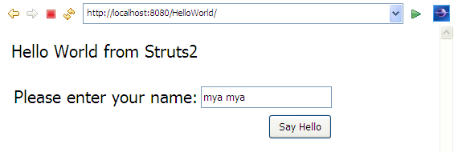
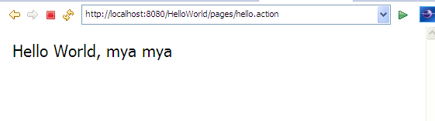
HelloWorld
(Result pages)

Slide 24
Lets see HelloWorldTwo Struts Application!
Basic Ideas
Enabling the user to enter a name to say Hello! <name>.
Not to allow the user to submit the entry form without entering a name.
To understand Controller functionality
To display locale specific text in jsp pages
To add more Controller functionality such as the application should not allow the user to say Hello to some people.

Slide 25
web.xml
Placed in WEB-INF folder
<?xml version="1.0" encoding="UTF-8"?>
<web-app id="WebApp_9" version="2.4" xmlns="http://java.sun.com/xml/ns/j2ee" xmlns:xsi="http://www.w3.org/2001/XMLSchema-instance" xsi:schemaLocation="http://java.sun.com/xml/ns/j2ee http://java.sun.com/xml/ns/j2ee/web-app_2_4.xsd">
<display-name>Struts Example</display-name>
<filter>
<filter-name>struts2</filter-name>
<filter-class> org.apache.struts2.dispatcher.ng.filter.StrutsPrepareAndExecuteFilter
</filter-class>
</filter>
<filter-mapping>
<filter-name>struts2</filter-name>
<url-pattern>/*</url-pattern>
</filter-mapping>
<welcome-file-list>
<welcome-file>views/ hello.jsp </welcome-file>
</welcome-file-list>
</web-app>
Notes:
11/12/08

Slide 26
View Component- hello.jsp
<%@ page contentType="text/html; charset=UTF-8" %>
<%@ taglib prefix="s" uri="/struts-tags" %>
<html>
<head>
<title><s:text name=“label.title”/></title>
</head>
<body>
<h2><s:text name=“label.heading”/></h2>
<font color=“red”>
<s:actionerror/>
</font>
<s:form action=“/hello” method=“post”>
<s:textfield name=“username” key=“label.user” size=“20”/>
<s:submit key=“label.submit” align=“center”/>
</s:form>
</body>
</html>
Notes:
11/12/08

Slide 27
Understanding elements in hello.jsp
<s:actionerror/> - This tag is used to access and to present the results of Struts’ data validation. Errors detected by other portions of the framework are accessible to the View component via this tag.

Slide 28
MessageResources.properties file
Create the Message Resource Bundle
label.title=Hello World -A First Struts 2 Application
label.heading=Hello World- A First Struts 2 Application
label.user=Please enter a name to say hello to
label.submit= Go!
label.error= Invalid Username! Please try again.
label.welcome= Welcome to Struts2 Application
The message resource bundle to be used is indicated by the value of constant struts.custom.i18n.resources by declaring within struts.xml

Slide 29
Step 3. Action class - HelloAction.java
package myapp;
import com.opensymphony.xwork2.ActionSupport;
  public class HelloAction extends ActionSupport{
private static final String GREETING="Hello,";
private String customGreeting;
    private String username ;
    public String getUsername() {
      return username;
    }
    public void setUsername(String username) {
      this.username = username;
    }
    public String getCustomGreeting() {
    return customGreeting;
    }
    public void setCustomGreeting(String customGreeting) {
    this.customGreeting = customGreeting;
    }
    public String execute() throws Exception {
  // business logic goes here
  }
}
JavaBeans Properties
(getter/setter methods)
Notes:
11/12/08
An action class is an ordinary Java class. It may have properties and methods and must comply with these rules.
A property must have a get and a set methods. Action property names follow the same rules as JavaBeans property names. A property can be of any type, not only String. Data conversion from String to non-String happens automatically.
An action class must have a no-argument constructor. If you don't have a constructor in your action class, the Java compiler will create a no-argument constructor for you. However, if you have a constructor that takes one or more arguments, you must write a no-argument constructor. Or else, Struts will not be able to instantiate the class.
An action class must have at least one method that will be invoked when the action is called.
An action class may be associated with multiple actions. In this case, the action class may provide a different method for each action. For example, a User action class may have login and logout methods that are mapped to the User_login and User_logout actions, respectively.
Since Struts 2, unlike Struts 1, creates a new action instance for every HTTP request, an action class does not have to be thread safe.
Struts 2, unlike Struts 1, by default does not create an HttpSession object. However, a JSP does. Therefore, if you want a completely session free action, add this to the top of all your JSPs:
<%@page session="false"%>

Slide 30
Action classes
From the MVC point of view, Action class acts as a Model.
  executes particular business logic depending on the Request object and the input parameters it receives.
The Struts 2 filter based on the request URI decides which action to instantiate.
After the action to be instantiated is chosen, an instance of that action is created and the execute() method is invoked.
Notes:
All requests pass through the FilterDispatcher filter which instantiates actions and calls them.
Action’s execute() is called if nothing else is specified.
After the call to execute() returns, the request is forwarded to the appropriate view.
It is possible to define different views depending on the outcome of the call to execute().

Slide 31
How the Action class works
An Action class is a class that extends the base class:
com.opensymphony.xwork2.ActionSupport
provide a method in an Action class:
SUCCESS is the default return string returned by execute() method
A framework will call this method after the action’s properties are automatically populated with form data.
Parameters in JSP views are transferred as the properties to the corresponding actions.
Thus in the action class, the properties with the same name as the parameters being transferred by the view, must be provided.
Corresponding getter, setter methods are called automatically by struts 2 framework when needed.
public String execute () throws Exception{
}
Notes:
• Java code executed when a URL is requested
• Must implement the Action interface or extend
ActionSupport
– Provides the execute method
– Must return a result code (SUCCESS, ERROR, INPUT)
– Used to map to results
• Properties set by the request through public set-methods
• Properties made available to the response through
public get-methods

Slide 32
Tasks in HelloAction.java
Business logic level validation
  public String execute() throws Exception {
  if (!username.trim().equals("") && !username.trim().equalsIgnoreCase("virus")) {
  setCustomGreeting(GREETING +getUsername());
  return SUCCESS;
  }
  else {
  addActionError(getText(“label.error"));
  return ERROR;
  }
  }
  The key to message resource bundle.
  getText() method gets value for it.

Slide 33

Tasks in HelloAction.java
Selecting the Appropriate View Component
An action class must have at least one result to tell Struts what to do after it executes the action method.
The action method may return different results depending on user inputs.
Some return strings constants are already provided
  SUCCESS=“success”
  INPUT=“input”
  NONE=“none”
  ERROR=“error”
  LOGIN=“login”
return SUCCESS;
return ERROR;
Notes:
There may be multiple results if the action method may return different results depending on user inputs.

Slide 34
The success result for HelloAction
welcome.jsp
<%@ page contentType="text/html; charset=UTF-8"%>
<%@ taglib prefix="s" uri="/struts-tags"%>
<html>
<head>
<title><s:text name="label.title"/></title>
</head>
<body>
<div align=“center”>
<h3><s:text name="label.welcome"/></h3>
<h2><s:property value="customGreeting"/>...!</h2>
</div>
</body>
</html>

Slide 35
struts.xml
<?xml version="1.0" encoding="UTF-8" ?>
<!DOCTYPE struts PUBLIC
"-//Apache Software Foundation//DTD Struts Configuration 2.0//EN"
"http://struts.apache.org/dtds/struts-2.0.dtd">
<struts>
<constant name="struts.enable.DynamicMethodInvocation" value=“false" />
<constant name="struts.devMode" value=“true" />
<constant name="struts.custom.i18n.resources" value="MessageResources"/>
<package name=“default” namespace=“/” extends="struts-default">
<action name=“hello" method=“execute” class=“myapp.HelloAction”>
<result name=“success”>/views/welcome.jsp</result>
<result name=“error”>/views/hello.jsp</result>
</action>
</package>
</struts>
Notes:
11/12/08
The struts.xml file is read when Struts starts. In development mode, Struts checks the timestamp of this file every time it processes a request and will reload it if it has changed since the last time it was loaded. As a result, if you are in development mode and you change the struts.xml file, you don't need to restart your web container. Saving you time.
development mode
The first things that a filter dispatcher does is verify the request URI and determine what action to invoke and which Java action class to instantiate.
For matching URIs with action classes, Struts uses a configuration file named struts.xml.
All actions in the application are defined in this file.
Each action has a name that directly corresponds to the URI used to invoke the action.
Each action declaration may specify the fully qualified name of an action class, if any.
You may also specify the action method name unless its name is execute, the default method name Struts will assume in the absence of an explicit one.

Slide 36
struts.xml (selecting appropriate View)
<!-- ============= Action Mapping Definitions =============-->
<action name=“hello" method="execute" class=“myapp.HelloAction">
<result name="success">/views/welcome.jsp</result>
<result name="error">/views/hello.jsp</result>
</action>
In struts 2, it is possible to have any name for method that would be providing business logic
In above context myapp.HelloAction is action class.
Checking for tow types of result returned by this action.
If the returned result is “success” then the page welcome.jsp is displayed.
If the returned result is “error” then the page hello.jsp is displayed.
Notes:
The class name of the Action class. Its method execute() is called if nothing else is specified.
Different result codes can be mapped to different results
This action is reached with the url http://localhost/login.action.
All requests pass through the FilterDispatcher filter which instantiates actions and calls them.
Action’s execute() is called if nothing else is specified.
Actions are automatically populated with form data.
After the call to LoginAction.execute() returns, the http request is forwarded to /views/welcome.jsp.
It is possible to define different views depending on the outcome of the call to execute().

Slide 37
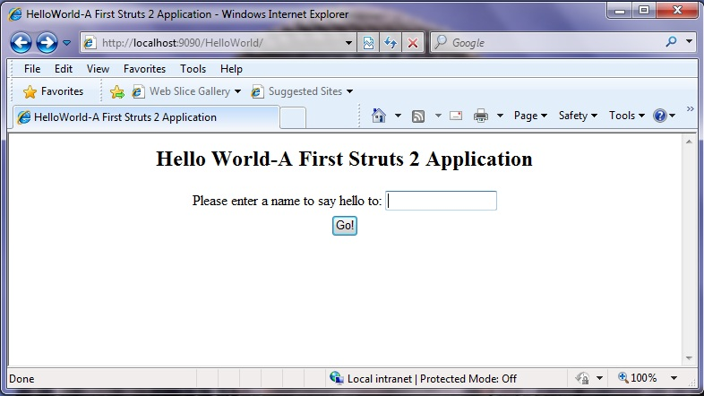
HelloWorld Application

Slide 38
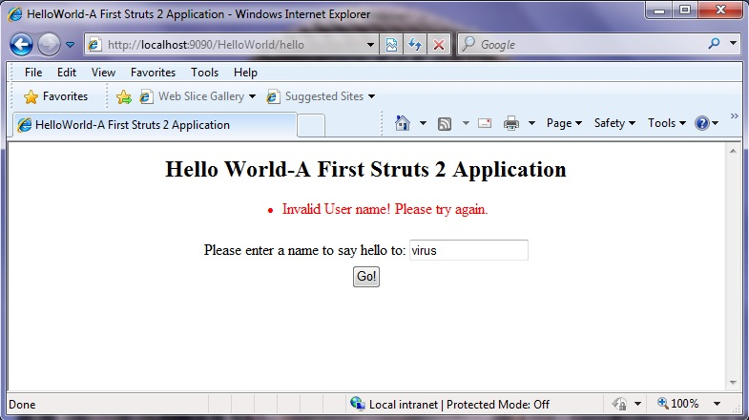
HelloWorld Application

Slide 39
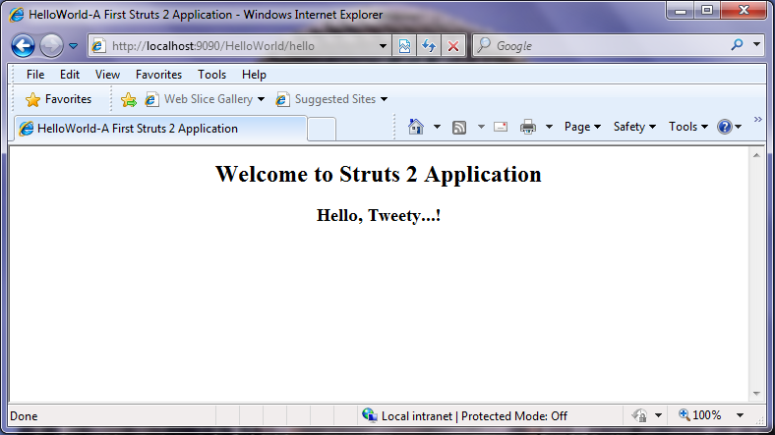
HelloWorld Application

Slide 40
Thank you!

