Slide 1
Session 7
Struts 2 Architecture

Slide 2
Struts 2 Architecture
Struts 2 is a very elegant and flexible front controller framework based on many standard technologies like Java Filters, Java Beans, ResourceBundles, XML etc.
Struts and webwork has joined together to develop the Struts 2 Framework.
Struts 2 Framework is very extensible and elegant for the development of enterprise web application of any size.
Front Controlle r

Slide 3
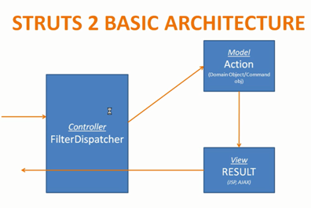

Slide 4
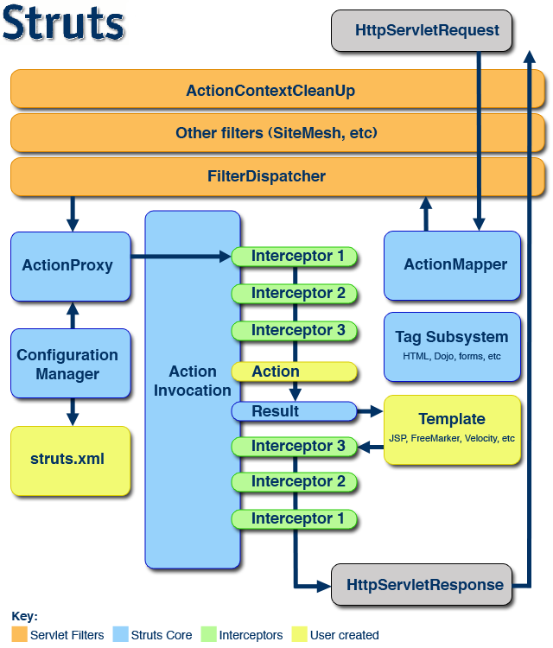
Struts 2 –
Behind the scenes
Notes:
The ActionMapper interface provides a mapping between HTTP requests and action invocation requests and vice-versa.
When given an HttpServletRequest, the ActionMapper may return null if no action invocation request matches, or it may return an ActionMapping that describes an action invocation for the framework to try.
The ActionMapper is not required to guarantee that the ActionMapping returned be a real action or otherwise ensure a valid request. Accordingly, most ActionMappers do not need to consult the Struts configuration just to determine if a request should be mapped.
Just as requests can be mapped from HTTP to an action invocation, the opposite is true as well. However, because HTTP requests (when shown in HTTP responses) must be in String form, a String is returned rather than an actual request object.

Slide 5
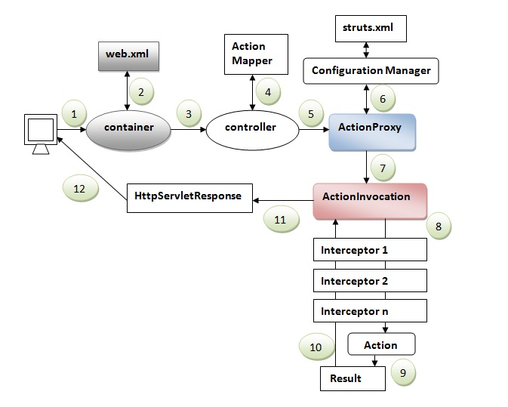
Struts 2 Standard Flow

Slide 6
Struts 2 – Behind the scenes
The normal lifecycle of struts begins when the request is sent from client. This results invoke the servlet container which in turn is passed through standard filter chain.
The FilterDispatcher filter is called which consults the ActionMapper to determine whether an Action should be invoked.
If ActionMapper finds an Action to be invoked, the FilterDispatcher delegates control to ActionProxy.
ActionProxy reads the configuration file such as struts.xml. ActionProxy creates an instance of ActionInvocation class and delegates the control.
ActionInvocation is responsible for command pattern implementation. It invokes the Interceptors one by one (if required) and then invoke the Action.
Once the Action returns, the ActionInvocation is responsible for looking up the proper result associated with the Action result code mapped in struts.xml.
The Interceptors are executed again in reverse order and the response is returned to the Filter (In most cases to FilterDispatcher). And the result is then sent to the servlet container which in turns send it back to client.

Slide 7
Struts 2 – Behind the scenes (cont’d)
HttpServletRequest – Request goes to servlet container
Filters - various filters are applied
FilterDispatcher – required filter dispacher is called
ActionMapper –dispatcher consults mapper to invoke action or not
ActionProxy – control is passed to proxy and it consults configuration manager for appropriate action and settings and then creates invocation
ActionInvocation – calls interceptors before calling the Action
Interceptors – interceptors do preActions
ActionExecution – Action method is called
ResultsPreparation – result is rendered depending upon the action method response
Interceptors – interceptors are called in reverse order for postActions
Filters – response is passed through filters
HttpServletResponse – response is given to client
Notes:
The ActionMapper interface provides a mapping between HTTP requests and action invocation requests and vice-versa.
When given an HttpServletRequest, the ActionMapper may return null if no action invocation request matches, or it may return an ActionMapping that describes an action invocation for the framework to try.
The ActionMapper is not required to guarantee that the ActionMapping returned be a real action or otherwise ensure a valid request. Accordingly, most ActionMappers do not need to consult the Struts configuration just to determine if a request should be mapped.
Just as requests can be mapped from HTTP to an action invocation, the opposite is true as well. However, because HTTP requests (when shown in HTTP responses) must be in String form, a String is returned rather than an actual request object.

Slide 8
Struts 2 Core Components

Slide 9
Struts 2 Core Components
Struts2 is a pull-MVC (or MVC2) framework; this is slightly different from a traditional MVC framework in that the action takes the role of the model rather than the controller.
The Model-View-Controller pattern in Struts2 is realized with five core components – actions, interceptors, value stack / OGNL, result/ result types , view technologies.
Notes:
Actions Part of the framework's architecture, Actions provides clean implementation by keeping all the business logic in one place.
Actions serves as a channel of automatic transfer of data from the request to result pages.
Results A UI that represents the user's requirements from the application onto the Web browser.
Interceptors Remove the overhead of Actions and improve performance by implementing common operations, such as validations, logging statements, and error checks, which are common to multiple Actions. Interceptors are called at both post-processing and pre-processing. For one action request, there can be a stack of Interceptors.
ValueStack An object that holds all the data that gets associated during the processing of a request.
View Technologies

Slide 10
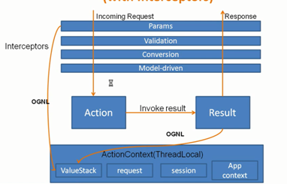
Struts 2 Architecture with Interceptors

Slide 11
Struts: MVC-based Architecture
Above Figures overlay the model, view and controller to the Struts2 high level architecture.
The controller is implemented with a Struts2 dispatch servlet filter as well as interceptors,
The model is implemented with actions,
The view as a combination of result types and results.
The value stack and OGNL provide common thread, linking and enabling integration between the other components.
Notes:
Central controller mediates application flow and delegates appropriate handlers called Action.
Action handlers can use model components.
Model encapsulates business logic or state.
Controller forwarded back through the Controller to the appropriate view.
The forwarding can be determined by consulting a set of mappings in the configuration file, which provides a loose coupling between the View and Model.

Slide 12
ValueStack
a storage area that holds all of the data associated with the processing of a request.
Struts 2 keeps it in a convenient, central location—the ValueStack.
Struts 2 uses the ValueStack as a storage area for all application domain data that will be needed during the processing of a request.
Data is moved to the ValueStack in preparation for request processing, it is manipulated there during action execution, and it is read from there when the results render their response pages.
Both interceptors and results can use OGNL to target values on the ValueStack.
Data is stored in a ThreadLocal context called the ActionContext.
Notes:
You could think of it as a piece of scratch paper where the framework does its work while solving the problems of request processing
The tricky, and powerful, thing about the ValueStack and OGNL is that they don’t belong to any of the individual framework components.
The data in the ValueStack follows the request processing through all phases; it slices through the whole length of the framework.
The ValueStack is an Object i.e created by framework of each request to store all the data required in processing of the request all the components participating in request processing
referred a valuestack for storing and obtaining data.
The valuestack object facilitation non-programmatic access to the data of valustack
an expression language called OGNL(Object Graphic navigation language) is provided by framework.

Slide 13

Struts Application: ValueStack
/Web Sever
request
/Struts Application
Value Stack
Action
User
Bean
Request
Attribute
Session
Attribute
Application
Attribute
request
Value Stack
User
Bean
Request
Attribute
Session
Attribute
Application
Attribute
Action

Slide 14
Result
A result is a framework component i.e responsible for invoking JSP page , HTML page ,AJAX , Velocity etc .
Functionality of result is described by Result interface which contain following single method.
public void execute(ActionInvocation action);
This method is invoked by the ActionInvocation when String is return to it either by an interceptor or by the action.

Slide 15
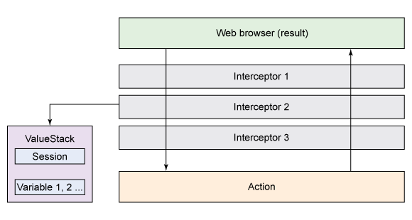
Figure : Struts 2 Action, Interceptors, and Result

Slide 16
Struts 2 Action

Slide 17
What is an Action?
Struts 2 has a single controller that handles all the user requests by invoking appropriate classes containing the required business logic.
These classes are known as Action classes.
Action
  Simple Java object , very similar to POJO class which has execute() method
  POJOs are ordinary java objects which do not implement any interface or extend any other java class and hence, does not depend on other APIs.
  is instantiated one object per request.
Notes:
The most basic unit of work that can be associated with a HTTP request coming from a user.
. Every operation that an application can perform is referred to as an action.
Displaying a Login form, saving a product's details.
It executes particular business logic depending on the Request object and the input parameters it receives.
Creating actions is the most important task in Struts application development
The action class does not need to:
- extend another class
- implement any interfaces

Slide 18
Cont’d
By convention, Actions are invoked by calling the execute() method.
But, any other method that returns a String value can be used instead
  simply by adding the appropriate configuration in the struts.xml file.
Different return types which are provided by the helper interfaces available in Struts 2 framework:
  SUCCESS
  NONE
  ERROR
  INPUT
  LOGIN
String Constants that can be utilized to return values to the framework that in turn help the framework decide the appropriate view.

Slide 19
Roles of Action
In Struts2, an action can be used in a couple of different ways.
Action provides encapsulation
Action helps carry data
Action returns control string for Result Routing

Slide 20
Action provides Encapsulation
One of the prime responsibilities of this role is to hold the business logic.
Actions use the execute() method for this purpose.
This method should only hold the logic of the work associated with the request.
  encapsulates the business logic
In this case, the action would look like this: simple concatenation of two strings
class HelloAction {
public void String execute() throws Exception {
setMessage(“Hi” + getName());
return "success";
}
}
Notes:
The first, and most basic usage of an action, is to perform work with a single result always being returned.
The method that is invoked when this action is processed is the execute() method that encapsulates the business logic:
POJOs are ordinary Java objects which do not implement any interface or extend any other Java class and hence, does not depend on other APIs.

Slide 21
Action helps Carry Data
Second major role is to serve as a data carrier in the framework.
Data is held local to the Action which makes it availabe during the execution of the business logic.
Data can be set and retrieved using a bunch of JavaBeans properties.
The execute () method references the data using these properties.

Slide 22
Data Entry Form And Action
Struts 2 Framework automatically moves the Request parameters from the Form to the JavaBeans properties that have matching names.
Within an application, the link to an action is usually generated by a Struts Tag.
The tag can specify the action by name, and the framework will render the default extension and anything else that is needed.
<s:form action=“hello”>
<s:textfield key=“label.user” name=“username”/>
<s:submit/>
</s:form>
Note: The username parameter from the Form is automatically assigned to the username JavaBeans property in the Action class.

Slide 23
Cont’d
Is as simple as forwarding to a JSP or performs logic that needs to be written in action classes.
Even better way to create actions rather than implementing ‘Action’ interface
  i.e. by extending com.opensymphony.xwork2.ActionSupport class.
ActionSupport class in turn implements
  the ‘Action’ interface and several other interfaces which aids in the task such as validation and localization of text messages.
Note:- As per the Struts 2 documentation, there is no need even to implement ‘Action’ interface. You can simply create POJOs following the same signature as defined by ‘Action’ interface and the framework will understand that this is your action class
Notes:
Actions can be created by implementing the interface com.opensymphony.xwork2.Action and exposing the method execute()
This interface declares the String constants that could be returned by methods of class implementing this interface. Based on the type of constant returned, framework decides on which view is to returned to user.
Below is the list of constants defined by this interface.
ERROR → Action execution was a failure
INPUT → Action execution requires more input in order to succeed.
LOGIN → Action could not execute, since the user is not logged in
NONE → Action execution was successful but could not show a view
The Struts 2 filter based on the request URI decides which action to instantiate. After the action to be instantiated is chosen, an instance of that action is created and the execute() method is invoked.

Slide 24
ValueStack and OGNL
The framework provides the ValueStack for storing all of the domain data during the processing of a request.
The action object itself is placed on the ValueStack.
For request, the form field name attribute is interpreted as an OGNL expression.
The expression is used to target a property on the ValueStack; E.g, username property from our action.
The value from the form field is automatically moved onto that property by the framework.
On the other end, the result JSP pulls data off the customGreeting property by likewise using an OGNL expression, inside a tag, to reference a property on the ValueStack.
Notes:
The mechanics of the ValueStack are such that all properties of the action will then be exposed as top level properties of the ValueStack itself and, thus, accessible via OGNL.

Slide 25
OGNL
OGNL is the tool that allows us to access the data we put in that central repository- ValueStack.
an expression language that allows to reference and manipulate the data on the ValueStack.
Notes:
The framework uses a powerful expression language, OGNL, to reference and manipulate that data from various regions of the framework.

Slide 26
Every action is placed on the ValueStack so that its propeties are exposed to framework-wide OGNL access.
Cont’d
Form Rendered by hello.jsp
<s:form action=“hello”>
<s:textfield name=“username”/>
<s:submit value=“Go!”/>
</s:form>
ValueStack
HelloAction
String username
String customGreeting
welcome.jsp
Welocme to Struts 2 Application
<s:property value=“customGreeting”/>

Slide 27
Actions Return Control String
returns a control string which helps the Struts 2 Filter to decide the Result/View that should be rendered.
The mapping for rendering available components are configured in struts.xml.
Notes:
Action assists the framework in determining which result should render the view.

Slide 28
<?xml version =“1.0” encoding =“UTF-8” ?>
<!DOCTYPE struts PUBLIC
“-//Apache Software Foundation//DTD Struts Configuration 2.0//EN”
“http://struts.apache.org/dtds/struts-2.0.dtd”>
<struts>
<package name=“myApp” namespace=“/” extends=“struts-default”>
<action name=“simpleApp” class=“com.book.myApp.simpleApp”>
<result name=“success”>/simpleView.jsp</result>
<result name=“error”>/simpleError.jsp</result>
</action>
</package>
</struts>
public void String execute() throws Exception {
//some code
return "success";
}

Slide 29
Organizing Action

Slide 30
Organizing Actions
Actions in Struts 2 are organized in packages.
All related actions providing common functionality are grouped into one package.
At the package level, we can declare the attributes like URL namespace to which all the actions in this package will be mapped, interceptors to be applied before and after the actions.
Note: namespace is “/”, which means root of the application, therefore if the name of application is “bankapp” then all action URLs of type http//localhost:8080/bankapp/ will map to this package.
Usually, actions that are global to application are put in the default package.
<package name=“default” namespace=“/” extends=“struts-default”>
<action name=“menu”>
<result>/views/menu.jsp</result>
</action>
</package>

Slide 31
Organizing Actions (Contd.)
<package name=“italianfood” namespace=“/italian” extends=“struts-default”>
<action name=“pizza” class=“food.ServePizza”>
<result type=“success”>/views/showpizza.jsp</result>
<result type=“error”>/views/showmenucard.jsp</result>
</action>
</package>
Note: If the name of application is ‘foo’ then all action URLs of type http://localhost:8080/foo/italian will map to this package.
Notes:
An action may or may not specify an action class.
<action name=“MyAction”>
An action that does not specify an action class will be given an instance of the default actin class.
The ActionSupport class is the default action class.

Slide 32
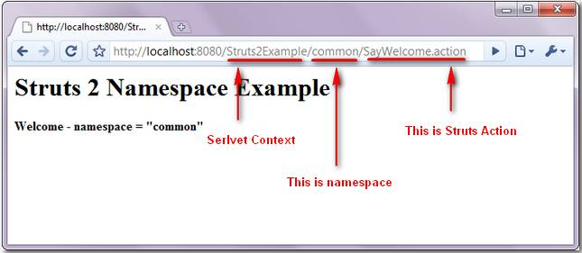
NameSpace Sample

Slide 33
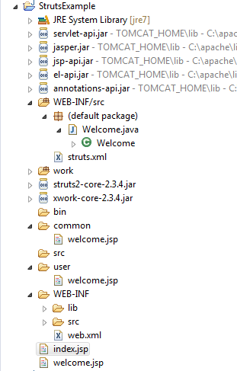
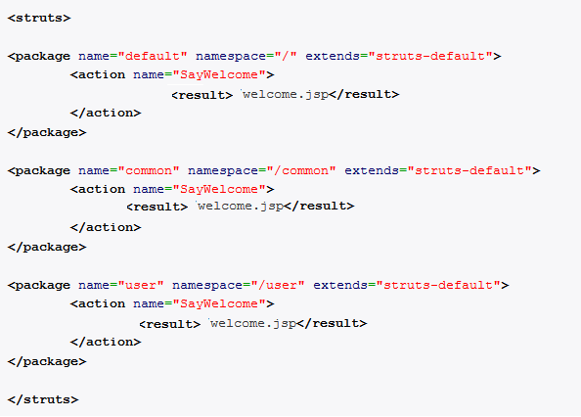
Using NameSpace
URL : http://localhost:8080/Struts2Example/SayWelcome
Will match the root namespace.
URL : http://localhost:8080/Struts2Example/common/SayWelcome
Will match the common namespace.
URL : http://localhost:8080/Struts2Example/user/SayWelcome
Will match the user namespace.
/common
/user
namespace=“/ ”

Slide 34
NameSpaceSample
(index.jsp)
<%@taglib prefix="s" uri="/struts-tags"%>
<s:form action=“/SayWelcome">
<s:submit value="Root Say Hello"/>
</s:form>
<s:form action="common/SayWelcome">
<s:submit value="Common Say Hello"/>
</s:form>
<s:form action="user/SayWelcome">
<s:submit value="User Say Hello"/>
</s:form>

Slide 35
NameSpace Sample
(Welcome.java)
public class Welcome {
public String execute(){
return "success";
}
}

Slide 36
NameSpaceSample
(strut.xml)
<struts>
<package name="default1" namespace="/" extends="struts-default">
<action name="SayWelcome" class="Welcome">
<result>welcome.jsp</result>
</action>
</package>
<package name="default2" namespace="/common" extends="struts-default">
<action name="SayWelcome" class="Welcome">
<result>welcome.jsp</result>
</action>
</package>
<package name="default3" namespace="/user" extends="struts-default">
<action name="SayWelcome" class="Welcome">
<result>welcome.jsp</result>
</action>
</package>
</struts>

Slide 37
Using NameSpace
(welcome.jsp)
/welcome.jsp
<body>
<h3>Welcome to root namespace</h3>
</body>
common/welcome.jsp
<body>
<h3>Welcome to common namespace</h3>
</body>
user/welcome.jsp
<body>
<h3>Welcome to user namespace</h3>
</body>

Slide 38
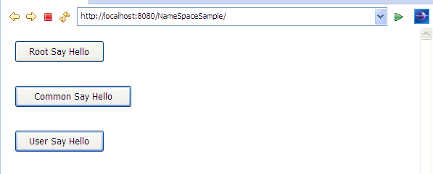
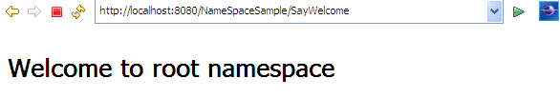
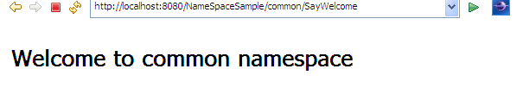
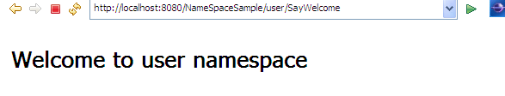
NameSpace Sample

Slide 39
Organizing Actions (Contd.)
This way of organizing packages provide modularity to your application.
The struts.xml file can have default package containing actions that are global to application, then we can have separate xml file for each package.
Thus the package ‘italianfood’ can be saved in some xml file italian.xml which can then be imported within struts.xml using include tag as below:
<struts>
<package >
………………
</package>
<include file=“italian.xml” />
</struts>
Notes:
Struts has been designed with modularity and actions are grouped into packages.
Think packages as modules. A typical struts.xml file can have one or many packages.
A lagre application may have many packages. In order to make the struts.xml file easier to manage for a large application, it is advisable to divide it into smaller files and use include elements to reference the files.
Each file would ideally include a package or relatd packages.
Each module.xml file would have the same DOCTYPE element and struts root element.
Include element->

Slide 40
Namespace Configuration
<package name="default">
<action name="foo" class="mypackage.simpleAction">
<result name="success" type="dispatcher">greeting.jsp</result>
</action>
<action name="bar" class="mypackage.simpleAction">
<result name="success" type="dispatcher">bar1.jsp</result>
</action> </package>
<package name="mypackage1" namespace="/">
<action name="moo" class="mypackage.simpleAction">
<result name="success" type="dispatcher">moo.jsp</result>
</action> </package>
<package name="mypackage2" namespace="/barspace">
<action name="bar" class="mypackage.simpleAction"> <result name="success" type="dispatcher">bar2.jsp</result>
</action> </package>

Slide 41
Namespace Configuration (Contd.)
If a request for /barspace/bar.action is made, the /barspace namespace is searched for the bar action. If found, the bar action is executed, else it will fall back to the default namespace.
(the bar action does exist in the /barspace namespace, so the bar action will be executed )
If a request for /moo.action is made, the root namespace ('/') is searched for a moo action; if a root action is not found, the default namespace is checked.
(the moo action does exist and will be executed )
If a request is made for /foo.action, the root / namespace will be checked. If foo is found, the root action will be selected. Otherwise, the framework will check the default namespace.
(the foo action does not exist in the root namespace, so the default namespace is checked, and the default foo action is executed)
Notes:
Namespaces are not a path!
Namespace are not hierarchical like a file system path. There is one namespace level. For example if the URL /barspace/myspace/bar.action is requested, the framework will first look for namespace /barspace/myspace. If the action does not exist at /barspace/myspace, the search will immediately fall back to the default namespace "". The framework will not parse the namespace into a series of "folders". In the Namespace Example, the bar action in the default namespace would be selected.

Slide 42
struts.xml
  Located in root of classpath
  Struts-default.xml is included automatically
  Base package must extend struts-default
  Maps URLs to action classes
  Maps result codes to results
Notes:
Default configuration files are included in the struts2-core-.jar file.
The struts-default.xml , one of default configuation files, registers the default result types and interceptors.
You can use the default result types and interceptors without registering them in your own struts.xml file, making it cleaner and shorter.
The default.properties file, packaged in the same JAR, contains settings that apply to all Struts applications.
As a result, unless you need to override the default values, you don’t need to have a struts.properties file.

Slide 43
struts.xml
A place where the Struts 2 filter looks for configurations
<?xml version =“1.0” encoding =“UTF-8” ?>
<!DOCTYPE struts PUBLIC
“-//Apache Software Foundation//DTD Struts Configuration 2.0//EN”
“http://struts.apache.org/dtds/struts-2.0.dtd”>
<struts>
<package name=“myApp” namespace=“/” extends=“struts-default” >
<action name=“simpleApp” class=“com.book.myApp.simpleApp”>
<result name=“success”>/simpleView.jsp</result>
<result name=“error”>/simpleError.jsp</result>
</action>
</package>
</struts>
Notes:
Being an XML file, the first element is the XML versioning and encoding information.
This is followed by the Document Type Definition i.e. DTD for the XML.
The DTD provides structural information that the elements in the file should have and is used by XML parsers and editor.
Being an XML file, the first element is the XML versioning and encoding information.
This is followed by the Document Type Definition i.e. DTD for the XML.
The DTD provides structural information that the elements in the file should have and is used by XML parsers and editor.
<package>

Slide 44
Cont’d
  <struts>
  Outermost tag that contains the Struts 2 specific configuration.
  All other tags are held within this tag.
<package>
  The struts.xml file is broken down into logical units called packages.
  is used to group together configurations that share common attributes such as interceptor stacks or URL namespaces.
  Packages group the following into a logical configuration unit:
  Actions, Result types, Interceptors, Interceptor stacks
Notes:
Packages are meant to help group the application’s components based on commonality of function or domain.
A pakcage element must have a name attribute.
The namespace attribute is OPTIONAL and if it is not present, the default value “/” is assumed.
If the namespace attribute has a non-default value, the namespace must be added to the URI that invokes the actions in the package.
For example the URI for invoking an action in a package with a default namespace is this:
/context/actionName.action
To invoke an action in a package with a non-default namespace, you need this URI:
/context/namespace/actionName.action
A package element almost always extends the struts-default package defined in struts-default.xml.
By doing so, all actions in the package can use the result types and interceptors registered in struts-default.xm

Slide 45
  Attributes in <package>
Attribute | Descrpiton
Name (required) | Name of the package
Namespace | Namespace for all actions in package
Extends | Parent package to inherit from
Abstract | If true, this package will only be used to define inheritable components, not actions
Notes:
Abstract: declares package to be abstract (no action configurations required in package)
Attribute Required Description
name yes key to for other packages to reference
extends no inherits package behavior of the package it extends
namespace no see Namespace Configuration
Abstract no declares package to be abstract (no action configurations required in package)

Slide 46
Results
An action method returns a String that determines what result to execute.
An action declaration must contain result elements that each corresponds to a possible return value of the action method.
If, for example, an action method returns either Action.SUCCESS or Action.INPUT, the action declaration must have two result elements like these:
<action ... >
<result name="success"> ... </result>
<result name="input"> ... </result>
</action>
Notes:
<result> tells Struts where you want the action to be forwarded to.
A result element corresponds to the return value of an action method.
Because an action method may return different values for different sitautions, an action element may have serveral result elements, each of which corresponds to a possible return value of the action method.
The name attribute of the result element maps a result with a method return value.
If a method returns a value without a matching result element, Struts will try to find a matching result under the global-results element. If no corresponding result element is found under global-results, an exception will be thrown.

Slide 47
Attributes in <result>
Attribute | Description
name (optional) | The name of the result that matches the output of the action method. For example, if the value of the name attribute is "input," the result will be used if the action method returns "input." The name attribute is optional and its default value is "success."
type (optional) | The result type. The default value is "dispatcher," a result type that forwards to a JSP.
<result name=“success” type=“dispatcher”>/Product.jsp</result>
<result name=“input” type=“dispatcher”>/ProductForm.jsp</result>
( OR)
<result>/Product.jsp</result>
<result name=“input”>/ProductForm.jsp</result>
Notes:
Dispatcher is the most frequently used result type, but it's not the only type available.
The default values of both attributes help you write shorter configuration.
The first result element does not have to contain the name and type attributes as it uses the default values. The second result element needs the name attribute but does not need the type attribute.
Dispatcher is the most frequently used result type, but it's not the only type available.
The default values of both attributes help you write shorter configuration.
The first result element does not have to contain the name and type attributes as it uses the default values. The second result element needs the name attribute but does not need the type attribute.
The type attribute of a result element specifies the result type.
The value of the type attribute must be a result type that is registered in the containing package or a parent package extended by the containing package.
The action in a package that extends struts-default, it is safe to use a Dispatcher result for this action because the Dispatcher result type is defined in struts-default.
If the type attribute is not present, the default result type Dispatcher is assumed.
If the name attribute is omitted, success is implied.

Slide 48
Result Types
Result Type | Description
Chain (chain) | Used for action chaining
Dispatcher (dispatcher) | The default result type, used for JSP forwarding
FreeMarker (freemarker) | Used for FreeMarker integration
HttpHeader (httpheader) | Used to send HTTP headers back to the browser
Redirect (redirect) | Used to redirect to another URL
Redirect Action (redirectAction) | Used to redirect to another action
Stream (stream) | Used to stream an InputStream to the browser
Velocity (velocity) | Used for Velocity integration
XSLT (xslt) | Used for XML/XSLT integration
PlainText (plaintext) | Used to send plain text, normally to show a JSP's source.
Tiles(tiles) | Used to provide Tiles integration
Note: The words in brackets are names used to register the result types in the configuration file.
Notes:
That's right, you must register a result type before you can use it.

Slide 49
Action Interface and ActionSupport Class

Slide 50
The Action Interface
The default entry method to the handler class is defined by the Action interface.
public interface Action {
public String execute() throws Exception;
}
Implementing the Action interface is OPTIONAL.
  If Action is not implemented, the framework will use reflection to look for an execute method.

Slide 51
Cont’d
Provides the common string based return values as CONSTANTS
Enforces that implementing classes provide the default execute() method
public interface Action {
public static final String SUCCESS =“success”;
public static final String NONE=“none”;
public static final String ERROR=“error”;
public static final String INPUT=“input”;
public static final String LOGIN=“login”;
public String execute() thorws Exception;
}
Notes:
A helper interface which exposes the execute() method to the action implementing it.

Slide 52
CONSTANTS
Constants i.e. Common results that can be returned by the execute() method
Results | Description
SUCCESS | The action execution was successful.
NONE | The action execution was successful but do not show a view.
ERROR | The action execution was a failure.
INPUT | The action execution requires more input in order to succeed.
LOGIN | The action could not be executed as the user was not logged in.
Notes:
String ERROR
The action execution was a failure. Show an error view, possibly asking the user to retry entering data.
String INPUT
The action execution require more input in order to succeed. This result is typically used if a form handling action has been executed so as to provide defaults for a form. The form associated with the handler should be shown to the end user. This result is also used if the given input params are invalid, meaning the user should try providing input again.
String LOGIN
The action could not execute, since the user most was not logged in. The login view should be shown.
String NONE
The action execution was successful but do not show a view. This is useful for actions that are handling the view in another fashion like redirect.
String SUCCESS
The action execution was successful. Show result view to the end user.

Slide 53
Use Action Interface
import com.opensymphony.xwork2.Action;
public class HelloWorldAction implements Action{
private String name;
public String execute() throws Exception {
return SUCCESS;
}
public String getName() {
return name;
}
public void setName(String name) {
this.name = name;
}

Slide 54
Action Methods
Some conditions need to create more than one entry point to an Action.
  For example, in the case of a data-access Action, a developer might want separate entry-points for create, retrieve, update, and delete. A different entry point can be specified by the method attribute.
<action name=“delete” class=“example.CrudAction” method=“delete”>
<action name=“create” class=“example.CrudAction” method=“create”>
If there is no execute method, and no other method, specified in the configuration, the framework will throw an exception.
Notes:
Action Names (name attribute)
The name attribute is matched a part of the location requested by a browser (or other HTTP client).
The framework will drop the host and application name and the extension, and match what's in the middle.
Example:
A request for http://www.planetstruts.org/struts2-mailreader/Welcome.do will map to the Welcome action.

Slide 55
The ActionSupport Class
com.opensymphony.xwork2.ActionSupport
Struts will create an instance of this class if an action declaration does not specify an action class.
Implements the Action interface and some more useful interfaces
Provides an implementation of the execute() method, inherited from Action, that simply returns Action.SUCCESS.
It’s more convenient to extend ActionSupport than to implement the Action interface.
There are other methods in ActionSupport that you can override or use.
  validate() if you're writing code for validating user input.
  getText() to look up localized messages in properties files.
Notes:
The ActionSupport class implements the Validatable and ValidationAware interface and some other interface then inherit the functionality of these interface.
The application developer extends ActionSupport class then inherits the all functionality of Validatable ,ValidationAware ,Action and TextProvider interface.
TextProvider:- The TextProvider interface provides methods for obtaining values of properties file as well as methods of loading locale specific properties file.It is used in I18N Action:-The Action interface doesn’t contain any method. It defines only some static final String constants name as è SUCCESS
è FAILURE
è INPUT
è ERROR
Which can be used in action for standard coding.

Slide 56
Cont’d
ActionSupport also implements other interfaces:
  Validateable and ValidationAware interfaces that provide programmatic, annotation-based and declarative XML-based validation
  TextProvider and LocaleProvider interfaces that provide support for localization and internationalization
  Serializable interface used to create classes which enable the transfer of any binary object over a communication channel by transferring all the data of the object in a byte by byte manner

Slide 57
Cont’d
public class ActionSupport implements
Action, Validateable, ValidationAware,
TextProvider, LocaleProvider, Serializable
{
…….
public String execute() throws Exception
{
return SUCCESS;
}
}

Slide 58
Accessing Resources from an Action
can access resources
  ServletContext, HttpSession, HttpServletRequest, and HttpServletResponse objects either through the ServletActionContext object or by implementing Aware interfaces.
  The latter is an implementation of dependency injection and is the recommended way as it will make your action classes easier to test.
Two classes that provide access to the above mentioned resources
  com.opensymphony.xwork2.ActionContext
  org.apache.struts2.ServletActionContext
Notes:
To access the session, you need an action class implementing the SessionAware interface and extending ActionSupport class.

Slide 59
Using ServletActionContext Object
ServletActionContext provides the following static methods:
public static javax.servlet.http.HttpServletRequest getRequest()
public static javax.servlet.http.HttpServletResponse getResponse()
public static javax.servlet.ServletContext getServletContext()
Note: HttpSession object will be created automatically if you use the basicStack or defaultStack interceptor stack.
Notes:
There are two classes that provide access to the above mentioned resources, com.opensymphony.xwork2.ActionContext and org.apache.struts2.ServletActionContext.
The latter wraps the former and is the easier to use between the two. ServletActionContext provides the following static methods that you will often use in your career as a Struts developer. Here are some of them.
Struts2 does'nt allow to directly access HttpServletRequest and HttpServletResponse object. This increases the testability and test stub generating becomes easier. However in some cases we need to directly interact with request and response. Struts2 provides two interface (ServletRequestAware and ServletResponseAware) which helps to get a handle of request and response objects.

Slide 60
Cont’d
public String execute() {
HttpServletRequest request = ServletActionContext.getRequest();
HttpSession session = request.getSession();
if (session.getAttribute("user") == null) {
return LOGIN;
}
else {
// do something return SUCCESS;
}
}
Notes:
//ActionContext ctx=ActionContext.getContext();
//HttpServletRequest request = (HttpServletRequest) ctx.get(ServletActionContext.HTTP_REQUEST);

Slide 61
Implementing ServletRequestAware
public class MyAction implements ServletRequestAware{
HttpServletRequest request;
public void setServletRequest(HttpServletRequest request) { this.request = request;
}
}

Slide 62
Implementing ServletRequestAware
(index.jsp)
<%@taglib prefix="s" uri="/struts-tags" %>
<h3>Testing ServletRequestAware Interface</h3>
<s:form action=“/EmployeeAction1">
<s:textfield name="code" label="Enter Code"/>
<s:textfield name="name" label="Enter Name"/>
<s:textfield name="city" label="Enter City"/>
<s:textfield name="salary" label="Enter Salary" value="0"/>
<s:submit value="Submit"/>
<s:reset value="Reset"></s:reset>
</s:form>

Slide 63
Implementing ServletRequestAware
(EmployeeAction1.java)
import javax.servlet.http.HttpServletRequest;
import org.apache.struts2.interceptor.ServletRequestAware;
import com.opensymphony.xwork2.*;
public class EmployeeAction1 extends ActionSupport implements ServletRequestAware{
HttpServletRequest request;
public void setServletRequest(HttpServletRequest request) {
this.request=request;
}

Slide 64
Implementing ServletRequestAware
(EmployeeAction1.java)
public String execute() throws Exception{
String code=request.getParameter("code");
String name=request.getParameter("name");
String city=request.getParameter("city");
String salary=request.getParameter("salary");
request.setAttribute("code", code);
request.setAttribute("name", name);
request.setAttribute("city", city);
request.setAttribute("salary", salary);
request.setAttribute("msg", "If you got this message, it means it is working");
return SUCCESS;
}}

Slide 65
Implementing ServletRequestAware
(struts.xml)
<struts>
<package name="ServletAware" namespace="/" extends="struts-default">
<action name="EmployeeAction1" method="execute" class="EmployeeAction1">
<result name="success">EmployeeSuccess.jsp</result>
</action>
</package>
</struts>

Slide 66
Implementing ServletRequestAware
(EmployeeSuccess.jsp)
<%@taglib prefix="s" uri="/struts-tags" %>
<h3>Employee Details are from Request Object</h3>
<hr>
<s:property value="#request.msg"/><br>
Code:<s:property value="#request.code"/><br>
Name:<s:property value="#request.name"/><br>
City:<s:property value="#request.city"/><br>
Salary:<s:property value="#request.salary"/><br>
<hr>
<a href="index.jsp">Try Again</a>

Slide 67
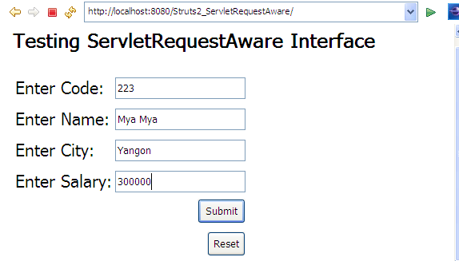
Implementing ServletRequestAware

Slide 68
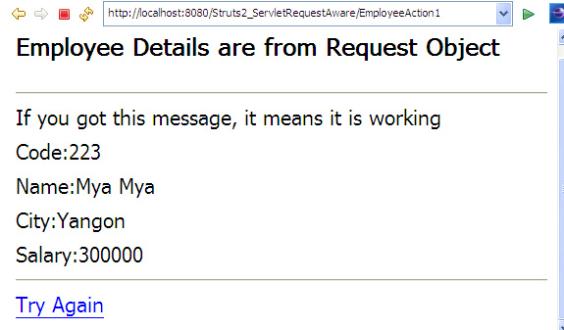
Implementing ServletRequestAware

Slide 69
Implementing Model Driven Interface
To create a ModelDriven Action , action class implements ModelDriven Interface and includes modelDriven interceptor.
The modelDriven Interceptor is already included in the default stack.
Action class implements ModelDriven Interface, declared getModel() method to return the userDetails’ objects.
When the form data is submitted to this action, it will transfers the form data into the userDetail properties automatically.

Slide 70
Implementing Model Driven Interface
(index.jsp)
<%@ taglib prefix="s" uri="/struts-tags"%>
<s:form action="EmployeeAction1" method="post" namespace="/" >
<s:textfield name="name" label=“EName” size="20" />
<s:textfield name="code“ label=“Code” size="20" />
<s:submit value="submit" />
</s:form>

Slide 71
Implementing Model Driven Interface
(Employee.java)
public class Employee {
private String code;
private String name;
public String getCode() {
return code;}
public void setCode(String code) {
this.code = code;}
public String getName() {
return name;}
public void setName(String name) {
this.name = name;}
}

Slide 72
Implementing Model Driven Intaface
(EmployeeAction.java)
public class EmployeeAction1 extends ActionSupport implements ModelDriven
{
public String execute() throws Exception {
return SUCCESS;
}
@Override
public Object getModel() {
return new Employee();
}
}

Slide 73
Implementing Model Driven Intaface
(EmployeeSuccess.jsp and struts.xml)
<%@ taglib prefix="s" uri="/struts-tags"%>
Code:<s:property value="code"/>
<br>Name:<s:property value="name"/>
<hr><a href="index.jsp">Try Again</a>
<struts>
<package name="ModelDriver" namespace="/" extends="struts-default">
<action name="EmployeeAction1" method="execute"
class="EmployeeAction1">
<result name="success">EmployeeSuccess.jsp</result>
</action>
</package>
</struts>

Slide 74
Domain Object as Java Beans Property
To use an application domain object as the FormBeans property, the params interceptor helps in automatically transferring the form property values to the application domain object and retrieves the values back in the jsp page using OGNL expression language.
Transferring the data to the domain object is automatically done by the params interceptor.
Create a domain object as a Java Beans property and the corresponding getter and setter methods.
The framework automatically initializes the domain object and transfers the form data.

Slide 75
Domain Object as Java Beans Property
(index.jsp)
<%@ taglib prefix="s" uri="/struts-tags"%>
<s:form action="EmployeeAction1" method="post" namespace="/" >
<s:textfield name=“e.name" label=“EName” size="20" />
<s:textfield name=“e.code“ label=“Code” size="20" />
<s:submit value="submit" />
</s:form>

Slide 76
Domain Object as Java Beans Property
(Employee.java)
public class Employee {
private String name;
private String code;
public String getCode() {
return code;}
public void setCode(String code) {
this.code = code;}
public String getName() {
return name;}
public void setName(String name) {
this.name = name;}
}

Slide 77
Domain Object as Java Beans Property
(EmployeeAction.java)
public class EmployeeAction1 extends ActionSupport
{
Employee e;
public Employee getE() {
return e;}
public void setE(Employee e) {
this.e = e;
}
public String execute() throws Exception {
return SUCCESS;
}}

Slide 78
Domain Object as Java Beans Property
(EmployeeSuccess.jsp and struts.xml)
<%@ taglib prefix="s" uri="/struts-tags"%>
Code:<s:property value=“e.code"/>
<br>Name:<s:property value=“e.name"/>
<hr><a href="index.jsp">Try Again</a>
<struts>
<package name=“DomainObject" namespace="/" extends="struts-default">
<action name="EmployeeAction1" method="execute"
class="EmployeeAction1">
<result name="success">EmployeeSuccess.jsp</result>
</action>
</package>
</struts>

Slide 79
Interceptors
The Struts2 framework provide a mechanism of controlling request data before invoking action class and after invoking action, they give service between the controller and action .
Perform tasks such as Logging, Validation, File Upload, Double-submit guard etc.
Remove the overhead of Actions and improve performance by implementing common operations, such as validations, logging statements, and error checks, which are common to multiple Actions.
Interceptors are called at both post-processing and pre-processing. For one action request, there can be a stack of Interceptors.

Slide 80
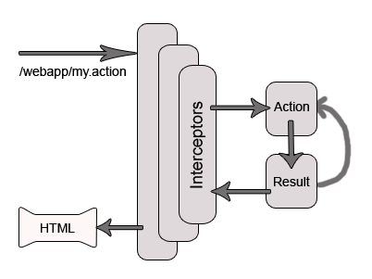
Struts 2 high level overview of request processing:

Slide 81
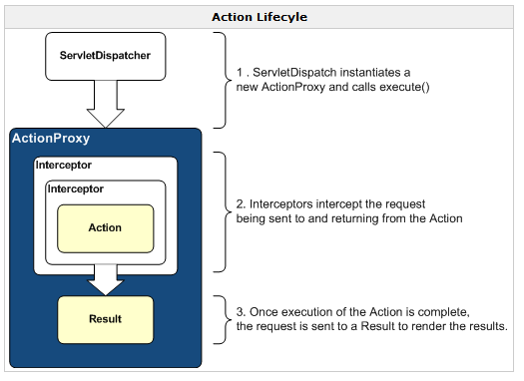
Struts 2 high level overview of request processing:

Slide 82
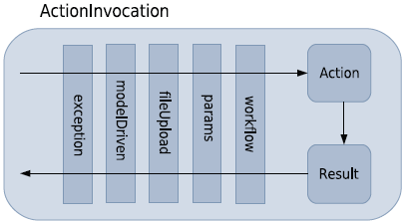
Some Interceptors in defaultStack
ActionInvocation encapsulates the execution of an action with its associated interceptors and results.
This important class orchestrates the entire execution of an action, including the sequential firing of the associated interceptor stack.
If your package extends struts-default, your package inherit these interceptor stack
Notes:
Figure above shows some interceptors in default-stack that would be taking part in execution of action.
When the framework receives request for some action, it doesn’t immediately calls that action.
Instead, framework will create an ActionInvocation object which encapsulates the behaviour of all the interceptors that would take part in the processing of this action and as well as the action itself.
A typical flow on receiving a request:
The framework calls upon the corresponding ActionInvocation object which first calls the interceptors involved,
then call the action that would generate the result and
finally the interceptors are called again in reverse order so that each interceptor gets a chance to work on result.

Slide 83
FileUpload Interceptor
The struts-default package contains a declaration of the fileUpload interceptor
This interceptor is then added to the default-Stack so that all packages extending the struts-default package will automatically have this interceptor acting on their actions.
The fileUpload interceptor creates a special version of the automatic data transfer
Mechanisms
In the defaultstack , the fileUpload interceptor comes just before the
params interceptor.
When the fileUpload interceptor executes, it processes a multipart request and transforms the file itself, along with some metadata, into request parameters that are added by this fileUpload interceptor.
Notes:
A utility class to handle multipart/form-data requests, the kind of requests that support file uploads.

Slide 84
Params and Workflow Interceptors
Two important interceptors participating in the processing of request
params interceptor has the responsibility of grabbing the request parameters.
workflow interceptor makes sure that there is no validation errors.
Since, params interceptor has already fired before workflow interceptor, framework already has access to request parameters and thus validation could be performed on these parameters.
workflow interceptor has the ability to change the normal flow.
Example:
  In case validation fails then the workflow interceptor stops execution of any further interceptors and action. This interceptor will generate its own result & return control by giving chance to other interceptors to work in reverse order.
Notes:
The params interceptor, also part of the defaultStack, was responsible for moving all of the request parameters onto the action object wherever the action provided a JavaBeans property that matched the request parameter’s name.

Slide 85
Workflow Interceptor
This interceptor is responsible for invoking the validation.
The validating action properties define by the action and changing the workflow of request processing if any validation failed.

Slide 86
Workflow Interceptor(cont’d)
The WorkFlow interceptor required that action implements following two interfaces:
Validatable:
  provides a single method name validate() that is define by the application developer to validate action properties.
  public void validate();

Slide 87
Workflow Interceptor(cont’d)
2.ValidationAware:
  This interface provides a method for handling error message and other message to be display along with fields on a form.
  Commonly used method in ValidationAware interface:-
public void addActionError(String errorMessage);
public void addActionMessage(String message);
public void addFieldError(String fieldname,String fieldMessage);
public void addFieldMessage(String fieldname,String fieldMessage);

Slide 88
Validation and Workflow interceptor
If any of the validation is violated, a method that adds an error message is called.
The workflow interceptor will check to see whether any error messages were generated by the validation logic.
If it finds errors, then the workflow interceptor will alter the workflow of the request.
It’ll immediately abort the request processing and return the user back to the input form, where the appropriate error messages will be displayed on the form.
Notes:
After all the validation logic has executed, control returns to the workflow interceptor. Note that there is no return value on the validate() method. The secret, as we’ll see, is in the error messages that our validation generates.

Slide 89
Interceptor Parameter Overriding
Method 1: the whole default stack is copied and the parameter then changed accordingly.
<action name="myAction" class="myActionClass">
……………
<interceptor-ref name="modelDriven"/>
<interceptor-ref name="fileUpload">
<param name="maximumSize">2097152</param>
<param name="allowedTypes">image/jpeg,image/gif</param>
</interceptor-ref>
<interceptor-ref name="params"/>
<interceptor-ref name="workflow">
……………..
</action>

Slide 90
OR
<action name="myAction" class="myActionClass">
<interceptor-ref name="fileUpload">
<param name="maximumSize">2097152</param>
<param name="allowedTypes">image/jpeg,image/gif</param>
</interceptor-ref>
<interceptor-ref name=" defaultStack "/>
</action>

Slide 91
Interceptor Parameter Overriding
Method 2: In the second method, the interceptor-ref refers to an existing interceptor-stack, namely defaultStack and override parameters. In the param tag,use the syntax
<interceptor-name>.<parameter-name>
<action name="myAction" class="myActionClass">
<interceptor-ref name="defaultStack">
<param name=“fileUpload. maximumSize "> 2097152 </param> <param name="fileUpload. allowedTypes "> image/jpeg,image/gif
</param>
</interceptor-ref>
</action>

Slide 92
Validation

Slide 93
Basic Validation
ActionSupport provides a quick form of basic validation
validation can be factored out of the action’s execution logic through the use of interceptors and interfaces.
ActionSupport implements two interfaces that coordinate with one of the interceptors from the default stack, the DefaultWorkflowInterceptor, to provide basic validation.
For basic validation:
  Extends the struts-default package which inherits the default interceptor stack
  Extends ActionSupprot which implements two interfaces
Notes:
ActionSupport provides a quick form of basic validation
that will serve well in many cases. Moreover, it’s a great case study of how a cross-cutting task such as validation can be factored out of the action’s execution logic

Slide 94
Flow of Basic Validation
The workflow interceptor is declared in struts-default.xml
divert the workflow of the request back to the input page if a validation error is found.
The params interceptor comes before the workflow interceptor.
  will move the request data onto an action object.
Then, the workflow interceptor will help us validate that data
  must fire after the params interceptor has had a chance to move the data on to the action object.
  When the workflow interceptor fires, it’ll first look for a validate() method on the action to invoke.
As with most interceptors, sequence is important.
Notes:
The default interceptor stack that participate in the validation process.
Validate() method is exposed via the com.opensymphony.xwork2.Validateable interface. Technically speaking, Action-Support implements the validate() method, but we have to override its empty implementation with our own specific validation logic.
As with the params interceptor, the workflow interceptor seeks to remove the logic of a cross-cutting task, validation in this case, from the action’s execution logic.

Slide 95
validate()
public void validate(){
if ( getPassword().length() == 0 ){
addFieldError( “password”, getText(“passwd.required” );
}
if ( getUsername().length() == 0 ){
addFieldError(“username”, getText(“username.required” );
}

Slide 96
Storing Error Message
The com.opensymphony.xwork2.ValidationAware interface defines methods for storing and retrieving error messages.
All of these methods and the collections of error messages are already provided by the ActionSupport class.
addFieldError ( String fieldName, String errorMessage )
addActionError ( String errorMessage )

Slide 97
Forwarding View for Error
The ValidationAware interface also specifies methods for testing whether any errors exist.
The workflow interceptor will use these to determine whether it should redirect the workflow back to the input page.
If it finds that errors exist, it’ll look for a result with the name input.
<action name=“register" class=“myapp.RegisterAction">
<result>/pages/welcome.jsp</result>
<result name="input">/pages/index.jsp</result>
</action>
Notes:
In this case, the workflow interceptor, if it finds errors, will automatically forward to the result that points to the Registration.jsp page because its name is "input". And, of course, this JSP page is our input form.

Slide 98
Custom Validation
(index.jsp)
<%@ taglib prefix="s" uri="/struts-tags" %>
<s:form action=“/register">
<s:textfield name="name" label="Name"></s:textfield>
<s:password name="password" label="Password">
</s:password>
<s:submit value="register"></s:submit>
</s:form>

Slide 99
Custom Validation
(web.xml)
<filter>
<filter-name>struts2</filter-name>
<filter-class>org.apache.struts2.dispatcher.ng.filter.StrutsPrepareAndExecuteFilter</filter-class>
</filter>
<filter-mapping>
<filter-name>struts2</filter-name>
<url-pattern>/*</url-pattern>
</filter-mapping>
<welcome-file-list>
<welcome-file>pages/index.jsp</welcome-file>
</welcome-file-list>

Slide 100
Custom Validation
(RegisterAction.java)
import com.opensymphony.xwork2.ActionSupport;
public class RegisterAction extends ActionSupport{
private String name,password;
public void validate( ) {
if(name.length()<1)
addFieldError("name","Name can not be blank");
if(password.length()<6)
addFieldError("password","Password must be greater than 5");
}
public String execute(){
//perform business logic here
return "success";
}

Slide 101
Custom Validation
(RegisterAction.java)
//getters and setters
public String getName() {
return name;
}
public void setName(String name) {
this.name = name;
}
public String getPassword() {
return password;
}
public void setPassword(String password) {
this.password = password;
}
}

Slide 102
Custom Validation
(struts.xml)
<struts>
<package name="customvalidation" namespace="/" extends="struts-default">
<action name=“register" method="execute" class="RegisterAction">
<result name="success">/pages/welcome.jsp</result>
<result name="input">/pages/index.jsp</result>
</action>
</package>
</struts>

Slide 103
Custom Validation
(welcome.jsp)
<%@ taglib prefix="s" uri="/struts-tags" %>
<body>
Name:<s:property value="name"/><br/>
Password:<s:property value="password"/><br/>
</body>

Slide 104
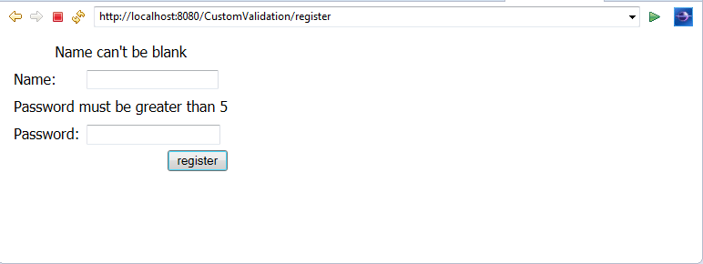
Custom Validation

Slide 105
Using Resource Bundles for Message
Message resource bundles, are commonly implemented with simple properties files.
  To retrieve their messages from a properties file, ActionSupport implements
  com.opensymphony.xwork2.TextProvider interface
    Provides methods return the message associated with that key from the properties file
    TextProvider getText()
Notes:
Action Support implements two interfaces that work together to provide localized message text functionality

Slide 106
Retrieving Error Messages
//MessageResources.properties
username.required=Name can not be blank
password.length= Password must be greater than 5.
public void validate() {
…………
if (name.length() <1 )
addFieldError( "name", getText("username.required") );
if ( password.length()<6 )
addFieldError( "password", getText("password. length") );
………..
Notes:
Instead of String literals, we now retrieve our message text from
ActionSupport’s implementation of TextProvider. We now use the getText() B
method to retrieve our messages from properties files based upon a key. This layer of
separation makes our message text much more manageable. Changing messages
means only editing the properties file; the source code’s semantic keys never need to
be changed.

Slide 107
Retrieving Error Messages
(index.jsp)
<h2>Struts 2 Login Example</h2>
<s:form action=“/login" method="post">
<s:actionerror />
<s:textfield name="username" key="label.username" size="20" />
<s:password name="password" key="label.password" size="20" />
<s:submit method="execute" key="label.login" align="center" />
</s:form>

Slide 108
Retrieving Error Messages
(LoginAction.java)
public class LoginAction extends ActionSupport {
private String username;
private String password;
public String execute() {
if (this.username.equals("user")
&& this.password.equals("user007")) {
return "success";
} else {
addActionError(getText("error.login"));
return "error";
}
}

Slide 109
Retrieving Error Messages
(LoginAction.jsp)
public String getUsername() {
return username;
}
public void setUsername(String username) {
this.username = username;
}
public String getPassword() {
return password;
}
public void setPassword(String password) {
this.password = password;
} }

Slide 110
Retrieving Error Messages
(struts.xml)
<struts>
<constant name="struts.enable.DynamicMethodInvocation"
value="false" />
<constant name="struts.devMode" value="true" />
<constant name="struts.custom.i18n.resources" value="/resources/ApplicationResource" />
<package name="CustomLogin" namespace="/" extends="struts-default">
<action name="login" method="execute" class="LoginAction">
<result name="success">/pages/Welcome.jsp</result>
<result name="error">/pages/index.jsp</result>
</action>
</package>
</struts>

Slide 111
Retrieving Error Messages
(ApplicationResource.properties)
label.username= UserName
label.password= Password
label.login= Login
error.login= UserName / Password Not Matching. Try again..
welcome.jsp
<h2>HELLO !! <font color=blue><s:property value="username" /> </font>!</h2>
<h2><font color=red>WELCOME TO DEVMANUALS</font></h2>

Slide 112
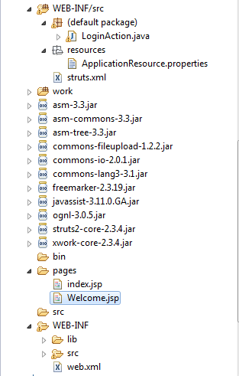
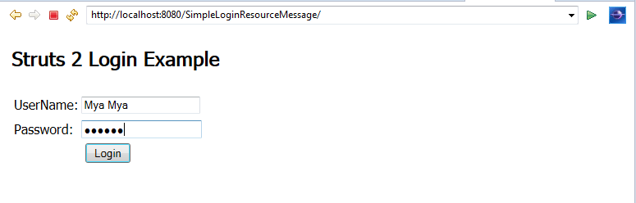
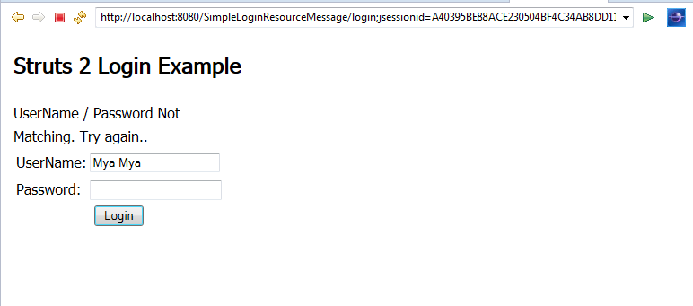
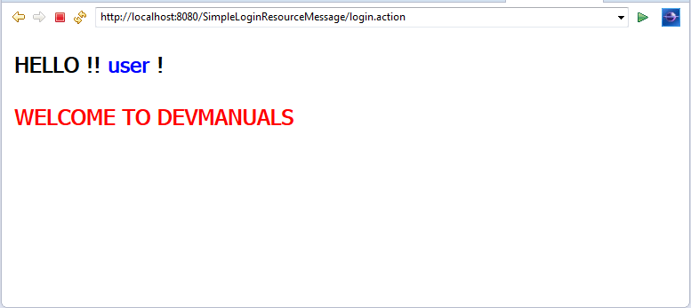
Retrieving Error Messages

Slide 113
Internationalization
ActionSupport also provides a basic internationalization solution for the localizing message text.
To retrieve the user’s locale based upon the locale setting sent in by the browser, ActionSupport implements
ActionSupport’s TextProvider implementation has been checking the locale every time it retrieves a message text by calling the getLocale() method of the LocaleProvider interface.
  TextProvider, a.k.a. ActionSupport, tries to locate a properties file for that locale.
  interface com.opensymphony.xwork2.LocaleProvider {
    public Locale getLocale();
  }
Notes:
Of course, you have to provide the properties file for the locale in question, or it will just serve up the standard English. But it’s simple to provide properties files for all locales that you wish to support.
You could implement your own version of this interface to search somewhere else for the locale, such as in the database. But if the browser setting is good enough for your requirements, you don’t have to do too much to achieve a basic level of internationalization.

Slide 114
Thank you!

