Slide 1

Vibe Coding with Positron
Yingying Tang
1/26/26

Slide 2
What is vibe coding?
You describe what you want in natural language and the AI generates and refines the code
AI: generate, run, refine, debug the code
Human: provide oversight, reasoning, quality control

Slide 3
Positron is not the only vibe coding tool!
Cursor
Claude
Lovable
Replit
Bolt
…But Positron is the sibling of Rstudio
…Positron supports switching between R and Python

Slide 4
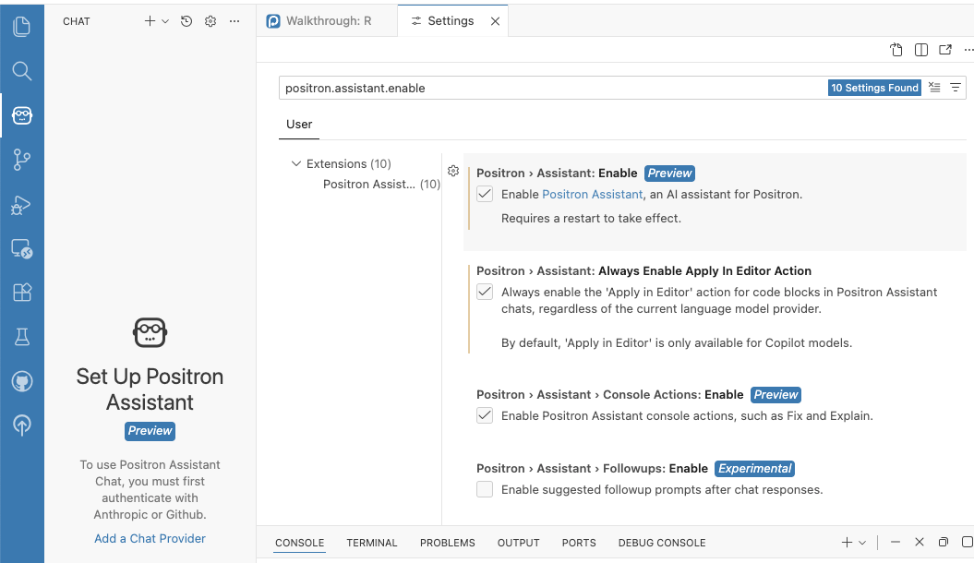
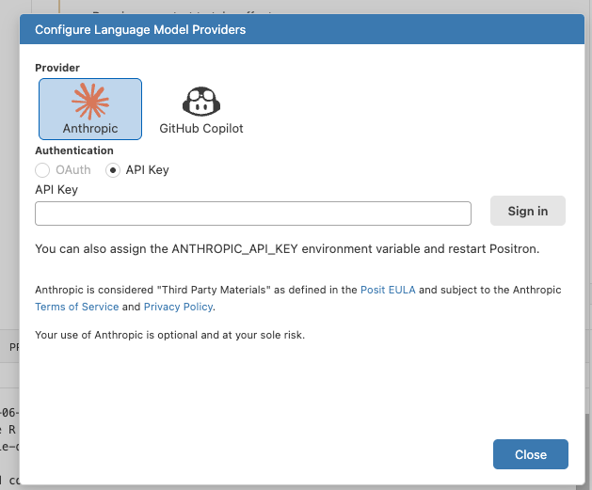
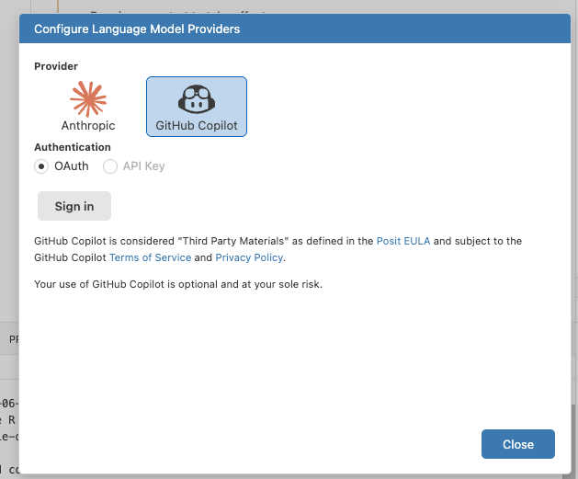

Slide 5
General setup
Layout introduction
How to make sure R is loaded: 1+1
Login to chat box
New file -> R/python

Slide 6
Dataset is the same as last year (and the year before last year…)
Read data

Slide 7
Read data
set working directory to the folder with data
read the only sav file in this path
Navigate to variables part
Notes:
/Users/yt/Library/CloudStorage/OneDrive-Personal/Phd money/statistics committee/2026 workshop

Slide 8
Dataset is the same as last year (and the year before last year…)
Read data
Data wrangling

Slide 9
Data wrangling
Rename:
B1PRSEX → Sex, B4QCESD → Depressive_Symptoms, B4QSA_SA → Social_Anxiety, B4QSC_SC → Self_Control, B4QPS_PS → Perceived_Stress, B1PA58 → Lived_with_Alcoholic, B1SE11L → Parental_Divorce, B1PBWORK → Occupational_Status, B1PRAGE_2019 → Age, B1PB1 → Education
calculate a variable called Emotional_Support_Spouse using the the average score of B4QSUGS, B4QSTGS (need to be reverse coded)
Calculate a variable called Childhood_Maltreatment with all variabels start with B4QCT

Slide 10
Data wrangling
recode sex into 1 -> male, 2 -> female, recode parental divorce 1-> yes, 2 -> no, lived with alcoholic, 1->yes, 2-> no
and pull all renamed items in a new dataset (named m2df_items) together with MIDUSID
create a subset containing people with High School or lower
in m2df_items, describe the frequency of education, with labels

Slide 11
Dataset is the same as last year (and the year before last year…)
Read data
Data wrangling
Some analyses

Slide 12
Correlation
save a word document with APA formatted table, the table need to contain correlation between all variables except id, with stars indicating significance level, put demographic variables last, in the bottom provide N, mean, sd for each variable

Slide 13
Moderation
do a moderation analysis with the effect of childhood maltreatment on emotional support by spouse vary by sex (use interaction term), control for self control, lived with alcoholic, age and occupational status, center variables if necessary
plot simple slope plots for the interaction, use sim_slope

Slide 14
Some advanced analyses before we learn it…
do latent profile analysis with depressive symptoms, social anxiety and self control
Introducing fix: constrain the variance and covariance of each profile to be the same
are those classes differ in demographics?
use random forest algorithm and use all other features to predict depression
do classification version

