Slide 1
Towards a generic dispenser module for laboratory platforms
Lars Yndal Sørensen, ITU

Slide 2
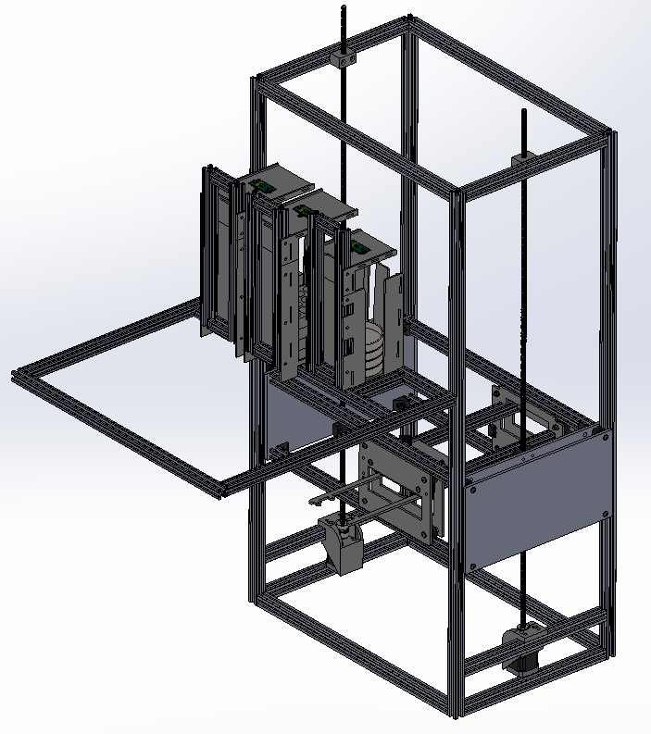
This presentation…
Design goals
Based on currently available solutions
Proposed solution
Demo! :-D
Core parts of the design
Evaluation
Future aspects

Slide 3
Design goals
Modularity Attach/remove module without hassle.
Versatility Different sizes of Petri dishes/multiwell plates.
Usability Easy to add/remove stacks during runtime.
Flexibility Can be attached to most current laboratory platforms.
Increased feedback Detects platform layers automatically.
Repairability Easy to create spare parts - and low cost.
Responsive Control Responses from module, regardless of ongoing motions, etc.

Slide 4
Proposed solution
Demo of:
Calibration
Detecting layer
Detecting dish stack
Defining insertion point
Inserting dish

Slide 5
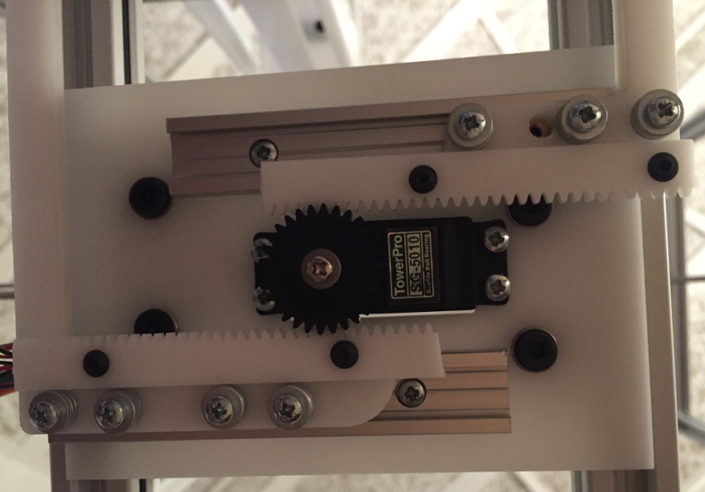
Core parts – the hardware
Arduino Mega vs Teensy
RAMPS vs DIY, speed, cost, size, no reset upon connection
Electrical circuits for stacks
Low use of screws: Self-locking design
Stacks
Self-centering, automatic identification, easy access for user
Gripper
Squeezing
Protects endstops from damage
95% open-source parts
Parallax PING))) and microbarbs are not

Slide 6
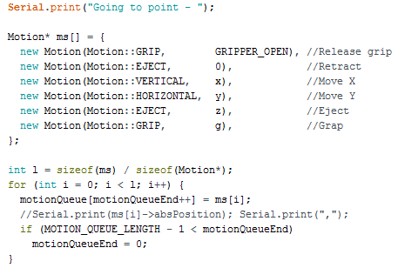
Core parts – the software
Space conserving
Implements acceleration/deceleration
Self-calibrating
Automatic stack detection
Responsive (but not when calibrating!)
Easy to add new motions
Provides useful feedback

Slide 7



Evaluation
Fulfilled design goals:
Modularity No hassle
Versatility Dish sizes and types
Usability Add/remove stacks during runtime
Flexibility Fits most current laboratory platforms
Increased feedback Detects platform layers automatically.
Repairability Easy to create spare parts - and low cost.
Responsive Control Responses from module
6/7 goals achieved!

Slide 8
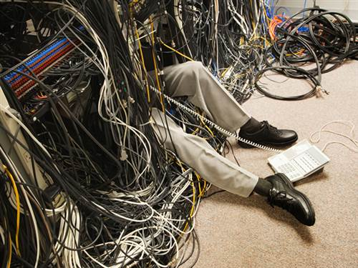
Issues to be addressed
Angle of lead screws
Support blocks for lead screw
Lifting wells (squared objects)
Risk of power drop, when inserting stacks
Small stepper gets hot
Organize the wires!!

Slide 9
Possible improvements
Save calibration data in EEPROM
Concurrent motions
Install electronics more safely (wires + MC)
Ball bearings for supporting the leadscrews
How to grip bottom and top of dish in one go
Design that uses less resources

Slide 10
Future aspects
Used by small to medium companies
Small companies can afford it and it supports different types of sample containers (almost…)
Extendable in size (and has space to add extra equipment)
Used by upcoming/current research projects
Easy to setup for even a small batch of samples

Slide 11
ERRATA
Hall effect sensors tested:
3144 OH14 is the switch and and 49E 11082N is the linear

