Slide 1
Quarterly review
North
South
Grand total
2026-10-03
00127
Action items
Archive the signed report
Contact operations
Notes:
Reference note 1: audited locally.

Slide 2
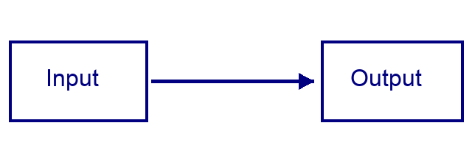
Budget appendix
Region | Amount
North | 1250.50
South | 900.25
Grand total | 2150.75

