Slide 1




Cut the Deadwood Out: Backdoor Purification via Guided Module Substitution
Yao Tong*, Weijun Li*, Xuanli He, Haolan Zhan, Qiongkai Xu
Notes:
Hello everyone, I’m Tong Yao, and today I’ll be presenting our work “Cut the Dead Out: Backdoor Purification via Guided Module Substitution.”
This is a joint work with

Slide 2



Backdoor is an increasingly severe threat ...
(1) Models rely more on web data
Open Source Data
Model
Notes:
Backdoor attacks have become an increasingly serious threat, mainly because modern models rely heavily on web-scale public data for training.

Slide 3

Backdoor is an increasingly severe threat ...
(1) Models rely more on web data
Open Source Data
Model
Poisoning data
Notes:
Such data, often collected from open sources or websites, can easily contain poisoned samples.

Slide 4
Backdoor is an increasingly severe threat ...
(2) Data curation is harder as data grows and backdoors get stealthier
Open Source Data
Model
Poisoning data
Notes:
As datasets grow larger, data curation becomes much harder — for example, just 250 poisoned documents can backdoor models of all sizes, as shown in recent work from Antropic.
Moreover, backdoors are getting stealthier.

Slide 5
Backdoor is an increasingly severe threat ...
(2) Data curation is harder as data grows and backdoors get stealthier
Open Source Data
Model
Accurately identifying all poisoned samples is (increasingly) difficult (Wu et al., 2022; Qi et al., 2021a; Yang et al., 2021b; Tran et al., 2018; He et al., 2023)
Pretraining backdoor detection is often unsatisfactory (Sun et al., 2025; Wang et al., 2023; Qi et al., 2021a)
Poisoning data
Notes:
Recent studies have shown that accurately identifying poisoned samples is increasingly difficult, and pretraining-stage detection is often unreliable.

Slide 6
If a model is found to be backdoored after training, how can we purify it?
Notes:
So, this brings us to a natural and important question:
If a model is already backdoored after training — how can we purify it?

Slide 7
If a model is found to be backdoored after training, how can we purify it?
Training Data
Backdoored Model
[Ideal cases] If deterministic knowledge exists:
If we know the/an exact clean dataset:
retraining (He et al., 2024)
pruning + finetuning (Liu et al., 2018; Zhao et al., 2024b)
unlearning (Li et al., 2023)
If we know the ground-truth backdoor pattern:
unlearning (Min et al., 2024; Li et al., 2021b; Chen et al., 2022)
Notes:
Under ideal conditions, when we have deterministic knowledge, existing literature provides several solutions.
For example:
If we know the exact clean dataset, we can retrain or prune and fine-tune the model.
If we know the ground-truth backdoor pattern, we can apply unlearning techniques.

Slide 8
If a model is found to be backdoored after training, how can we purify it?
Training Data
Backdoored Model
[Ideal cases] If deterministic knowledge exists:
If we know the/an exact clean dataset:
retraining (He et al., 2024)
pruning + finetuning (Liu et al., 2018; Zhao et al., 2024b)
unlearning (Li et al., 2023)
If we know the ground-truth backdoor pattern:
unlearning (Min et al., 2024; Li et al., 2021b; Chen et al., 2022)
What if we have no deterministic knowledge about the dataset?
Do we really need training?
Notes:
But what if we don’t have this knowledge?
And as all these methods require additional optimization or retraining, do we really nee training?

Slide 9
If a model is found to be backdoored after training, how can we purify it?
Training Data
Backdoored Model
[Ideal cases] If deterministic knowledge exists:
If we know the/an exact clean dataset:
retraining (He et al., 2024)
pruning + finetuning (Liu et al., 2018; Zhao et al., 2024b)
unlearning (Li et al., 2023)
If we know the groundtruth backdoor pattern:
unlearning (Min et al., 2024; Li et al., 2021b; Chen et al., 2022)
Given only the training data,
can we effectively purify a backdoored model without training?
Notes:
So we asked a simple but critical question:
If all we have is the original (possibly contaminated) training data — without knowing which samples are 100% clean or poisoned — can we still purify a backdoored model without training?

Slide 10
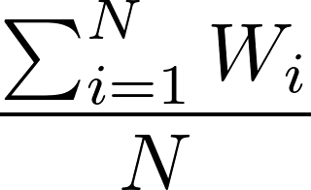


Purifying backdoored models via Guided Model Merging
Prior work: Ad hoc model merging as a backdoor defense (Arora et al., 2024)
Publicly available homogeneous models (e.g., Hugging Face)
Backdoor Influence Diluted
Backdoored Model
Purified Model
Parameter Averaging
...
Notes:
To answer this, we first revisit model merging–based defenses, as proposed in prior work.
They showed that simply merging a backdoored model with several publicly available homogeneous models (for example, from Hugging Face) through parameter averaging can dilute the backdoor influence — resulting in a purified model.
This method is attractive because it’s training-free and robust to model selection.
However, it requires repeatedly testing and adding more proxy models to achieve strong purification — which is not very efficient.
This motivates our new approach: Guided Module Substitution (GMS).

Slide 11
Purifying backdoored models via Guided Model Merging
Our method: Guided Module Substitution (GMS)
Backdoored Model
Purified Model
Single homogeneous model (e.g., Hugging Face)
Notes:
Instead of merging with multiple proxy models, we only need one homogeneous proxy model.

Slide 12
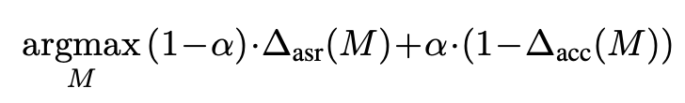
Purifying backdoored models via Guided Model Merging
Module replacement, guided by
Backdoored Model
Purified Model
Single homogeneous model
Notes:
We perform module replacement guided by an objective function that balances backdoor removal and model utility.

Slide 13




Purifying backdoored models via Guided Model Merging
Use simple heuristics to extract proxy datasets.
Training Data
Capture the trade-off between the utility and backdoor removal
Performance drop (victim - merged)
e.g., Confidence-based heuristics
e.g., randm sampling
Notes:
Here’s the idea:
We first extract two proxy datasets from the original training data — one more likely to contain poisoned samples, and one more likely to be clean.
This can be done using simple heuristics such as confidence-based filtering, and just random sampling for proxy clean dataset under the assumption that the overall poison rate is usually not high.

Slide 14


Purifying backdoored models via Guided Model Merging
Each model block is divided into modules
Transformer Example *
Layer Set
Transformer Block L
Module Set
K
Transformer Block L-1
K
Q
...
Q
V
V
Transformer Block 1
O
O
F
F
P
P
Victim Model
* Here, we use a Transformer as an example, but the method is architecture-agnostic.
Notes:
In our method, each model block is divided into modules —
for example, in transfermer, we have weight for Key, Query, Vvalue, output projection, feed-forward weights, and so on.

Slide 15
Purifying backdoored models via Guided Model Merging
Use simple heuristics to extract proxy datasets.
Training Data
Capture the trade-off between the backdoor removal and utility
Performance drop (victim - merged)
e.g., Confidence-based heuristics
e.g., randm sampling
Notes:
Next, we compute a score function that measures the performance change when substituting each module of the model with its counterpart from the proxy model.
This helps us capture the trade-off between backdoor removal and utility preservation.

Slide 16
Purifying backdoored models via Guided Model Merging
Greedy search for a good substitution strategy.
Q
K
V
O
F
P
Victim Model
Proxy Model
Notes:
We iteratively search over these modules

Slide 17
Purifying backdoored models via Guided Model Merging
Greedy search for a good substitution strategy.
Q
K
V
O
F
P
Victim Model
Proxy Model
Notes:
and layers,

Slide 18
Purifying backdoored models via Guided Model Merging
Greedy search for a good substitution strategy.
Highest Score
Q
K
V
O
F
P
Victim Model
Proxy Model
Notes:
to find the substitution that maximizes the purification score —
in other words, removes the most backdoor effect while preserving utility.

Slide 19
Purifying backdoored models via Guided Model Merging
Greedy search for a good substitution strategy.
Q
K
V
O
F
P
Updated Model
Proxy Model
Notes:
We continuously repeat this process

Slide 20
Purifying backdoored models via Guided Model Merging
Greedy search for a good substitution strategy.
Q
K
V
O
F
P
Updated Model
Proxy Model

Slide 21
Purifying backdoored models via Guided Model Merging
Greedy search for a good substitution strategy.
Highest Score
Q
K
V
O
F
P
Updated Model
Proxy Model

Slide 22
Purifying backdoored models via Guided Model Merging
Greedy search for a good substitution strategy.
Q
K
V
O
F
P
Victim Model
Proxy Model
Purified Model
Notes:
until we find the best substitution strategy, which guides how we merge the victim and proxy model.

Slide 23


Purifying backdoored models via Guided Model Merging
Inaccurate proxy data can still capture the trade-off between the utility and backdoor removal
( )
×
Fraction of poison data
>
( )
×
Fraction of poison data
Notes:
Note that GMS works well with imperfect proxy datasets.
as long as the weight assigned to poisoned samples in the proxy-poisoned dataset is higher than that of poisoned samples misclassified into the proxy-clean dataset, the method still captures the right trade-off.

Slide 24
Purifying backdoored models via Guided Model Merging
Use simple heuristics to extract proxy datasets.
Training Data
Can be replaced by more sophisticated methods, e.g.,
Sample diagnosis (Gao et al., 2019; Huang et al., 2022; Guo et al., 2023)
Trigger inversion (Wang et al., 2019, 2022, 2023; Xu et al., 2024)
e.g., Confidence-based heuristics
e.g., randm sampling
Notes:
In our experiments, we use very simple heuristics to extract the proxy datasets, but more advanced methods — such as trigger inversion or Sample dialogue–based filtering — can further improve results.

Slide 25
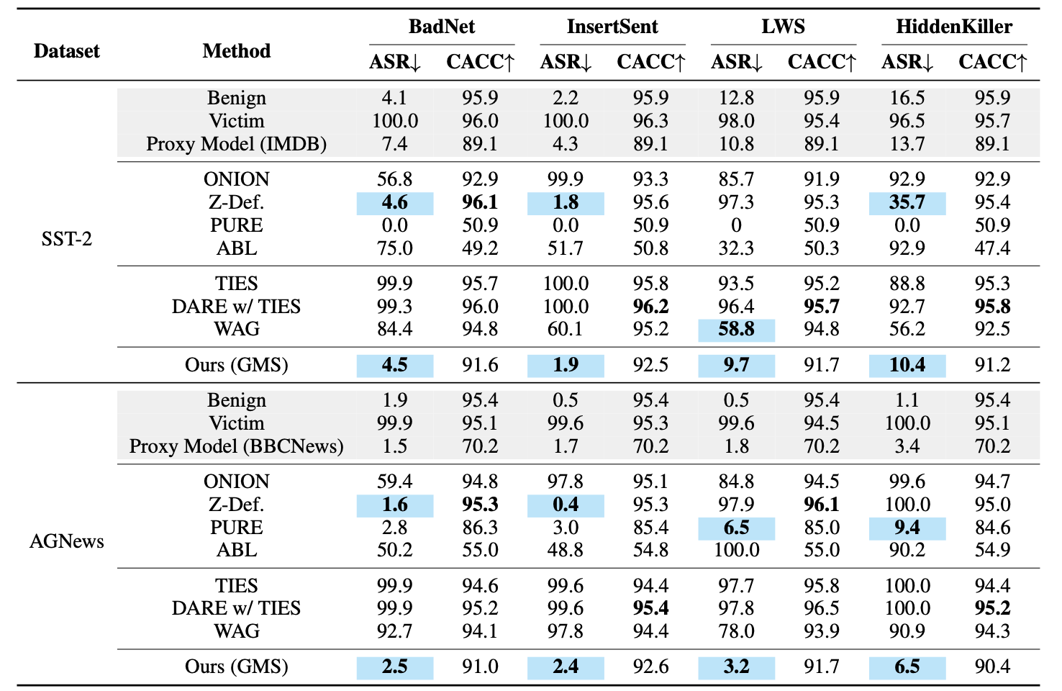
Main Results
Attack Success Rate
Clean Accuracy
Notes:
Just to briefly illustrate the effectiveness of our method — under image classification tasks with sampling without replacement and using maximum mean absolute error as the metrics,

Slide 26
Main Results on the RoBERTa-large model
Our method consistently ranks among the top-2 performers.
Notes:
Just to briefly illustrate the effectiveness of our method — under image classification tasks with sampling without replacement and using maximum mean absolute error as the metrics,

Slide 27
Main Results on the RoBERTa-large model
Especially for the more challenging attacks, GMS shows significant improvements (at least 25%) over all baselines.
More results on other datasets, architectures and backdoor attacks can be found in our paper.
Notes:
Just to briefly illustrate the effectiveness of our method — under image classification tasks with sampling without replacement and using maximum mean absolute error as the metrics,

Slide 28
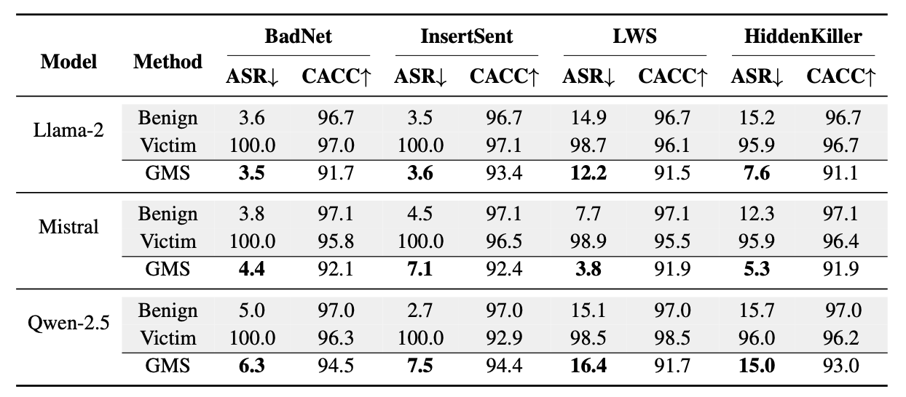
Main Results on LLMs
GMS effectively purifies LLMs (e.g., Llama-2-7B, Mistral-7B, Qwen-2.5-7B) against all backdoor attacks.
Notes:
Just to briefly illustrate the effectiveness of our method — under image classification tasks with sampling without replacement and using maximum mean absolute error as the metrics,

Slide 29
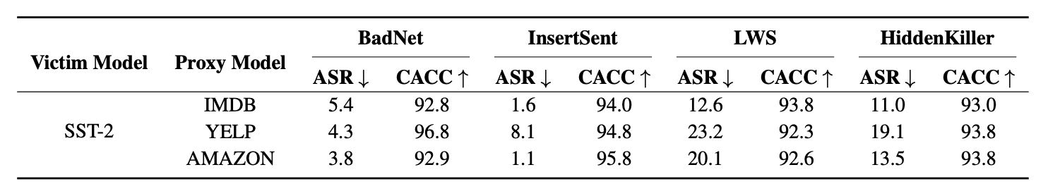
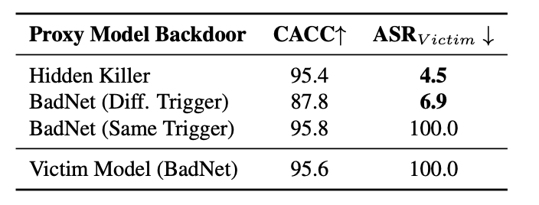
Properties: Proxy-model robustness
GMS is effective with a wide range of proxy models used for merging.
Works as long as the proxy's backdoor is not identical to the victim's (i.e., same attack, same trigger).
Even a backdoored model can be used as a proxy model for merging.
Notes:
Just to briefly illustrate the effectiveness of our method — under image classification tasks with sampling without replacement and using maximum mean absolute error as the metrics,

Slide 30
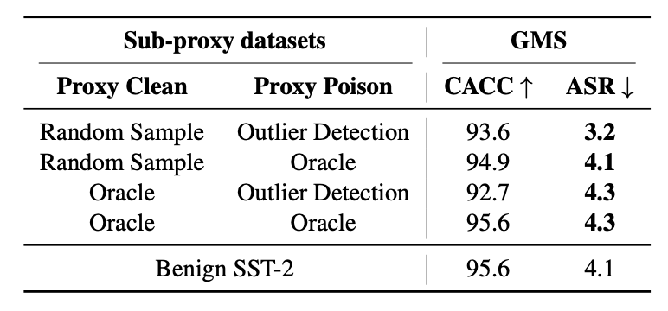
Properties: Proxy-dataset robustness
Works better with more accurate proxy datasets, so can complement existing backdoor filtering methods.
However, GMS can still work well with suboptimal, heuristic proxy dataset extraction.
Notes:
Just to briefly illustrate the effectiveness of our method — under image classification tasks with sampling without replacement and using maximum mean absolute error as the metrics,

Slide 31
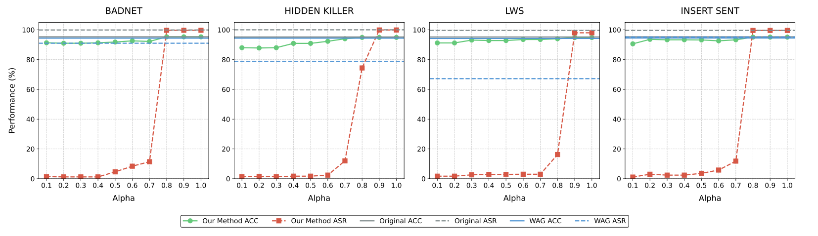
Properties: Insensitive to hyperparameter choices
For all attacks, GMS is effective across a wide range of α values (0.1–0.7).
Notes:
Just to briefly illustrate the effectiveness of our method — under image classification tasks with sampling without replacement and using maximum mean absolute error as the metrics,

Slide 32
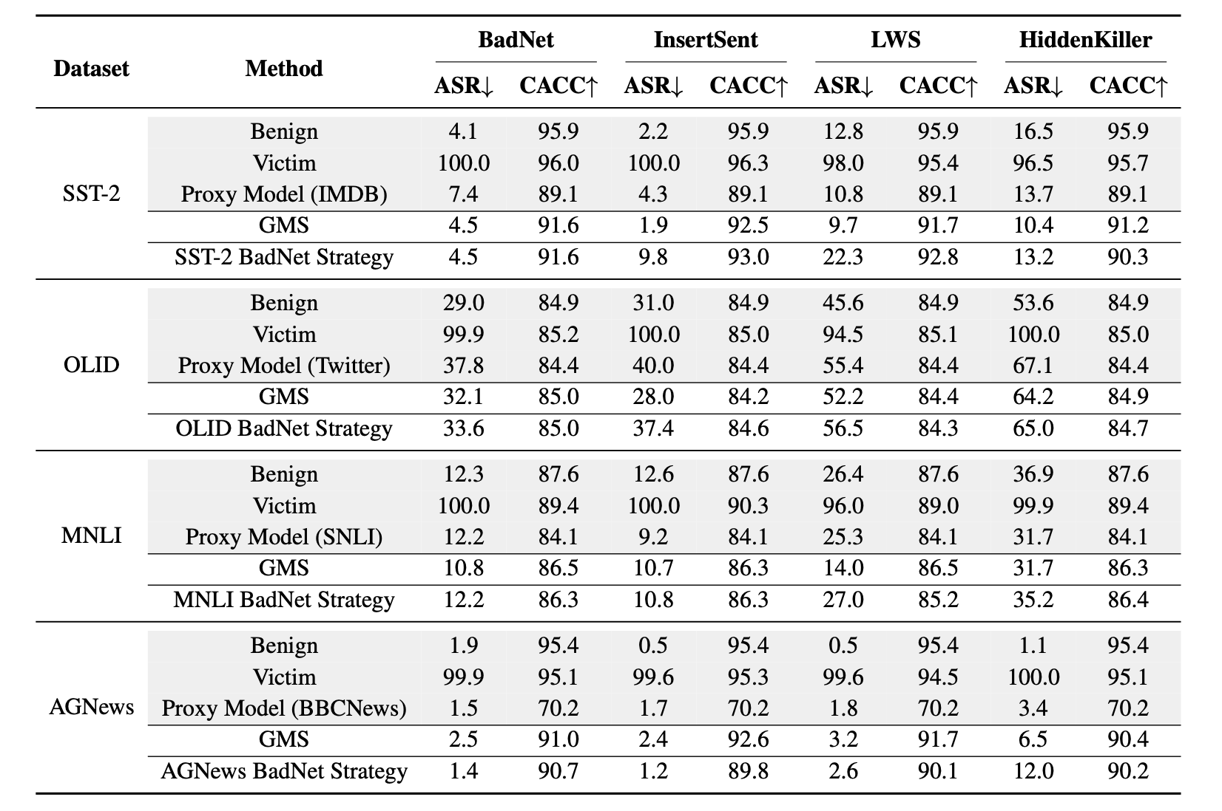
Properties: Transferability of substitution strategies
Apply the substitution strategy from BadNet to defend other attacks.
The BadNet substitution strategy transfers well and can effectively defend against other attacks.
Notes:
Just to briefly illustrate the effectiveness of our method — under image classification tasks with sampling without replacement and using maximum mean absolute error as the metrics,

Slide 33
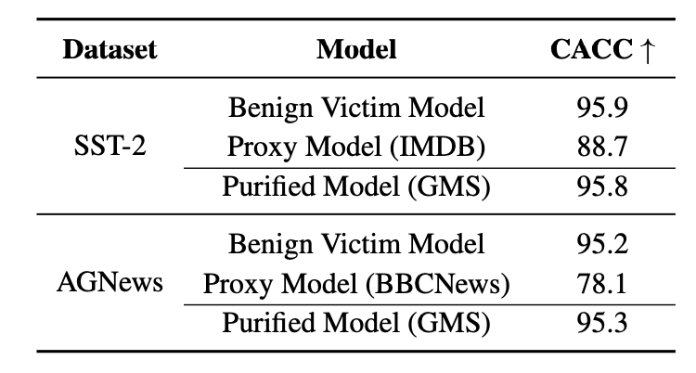
If the victim model is benign ...
It’s just a normal model merging, and GMS preserves the victim’s utility.

Slide 34


Takeaways
🛠️ GitHub
Backdoors are increasingly hard to avoid — filtering alone is not enough.
Guided model merging is a promising direction for purifying backdoored models without training.
GMS shows that guided merging with a single public homogeneous model can be highly effective.
Works effectively across diverse attacks, datasets, and model types (from encoder models to LLMs).
Robust to hyperparameter choices and proxy selections.
Substitution strategy transfers well across attacks.
📄️ Paper
See our paper for more results!

