Slide 1

EDR Evasion Techniques using syscalls
Y N Harish

Slide 2
Who am I
Cyber security professional with 7 years of experience in the finance sector and energy sector.
Roles:
Cyber security analyst
Threat Hunt and Threat Intel Analyst
Incident Responder
Cyber Security Engineer
CEH, CHFI, Splunk Power user, SC 200, AZ 500
https://in.linkedin.com/in/y-n-harish-94812b122

Slide 3
Contents
Introduction
What are windows syscalls?
NTAllocateVirtualMemory vs VirtualAlloc
How EDR works / How Userland Hooking implemented by EDR?
Different types of EDR evasion techniques
Direct syscalls
Indirect syscalls
efficiency of EDRs in detecting evasion techniques
Counter Measures
conclusion

Slide 4





Introduction
EDR evasion is a set of techniques that attackers use to bypass endpoint detection and response (EDR) solutions. EDR solutions are designed to monitor endpoints for malicious activity and to respond to incidents when they occur. However, attackers are constantly developing new techniques to evade EDR solutions.

Slide 5
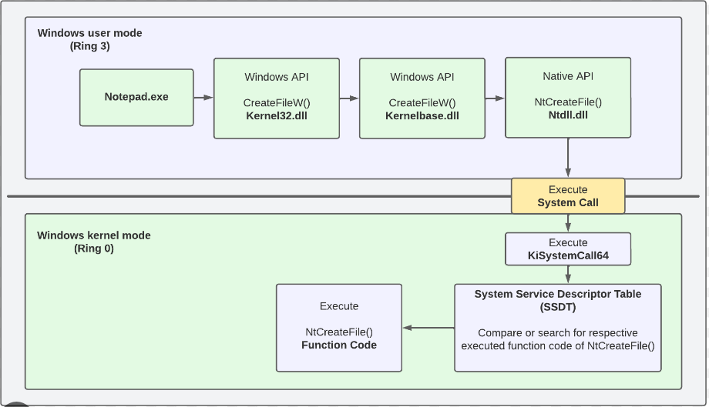
What are Windows Syscalls?
Syscalls are windows internals components that provide a way for Windows programs to interact with operating system for accessing services.
Reading or writing to a file
creating a new process in userland, or allocating memory to programs,
using cryptographic functions in your programs.
*https://redops.at/en/blog/direct-syscalls-a-journey-from-high-to-low

Slide 6
NTAllocateVirtualMemory vs VirtualAlloc in terms of arguments:
Important points:
All syscalls return NTSTATUS value indicate its success or error, but some NtAPIs return NTSTATUS, they are not necessarily syscalls.
These NtAPI syscalls have more advantages over standard Winapi functions.
These syscall functions from ntdll.dll provide more customizability over the parameter passed and arguments that those functions will be accepting, Thus providing a way for evading host-based security solutions.
__kernel_entry NTSYSCALLAPI NTSTATUS NtAllocateVirtualMemory(
LPVOID VirtualAlloc(
[in, optional] LPVOID lpAddress,
[in] SIZE_T dwSize,
[in] DWORD flAllocationType,
[in] DWORD flProtect
);
[in] | HANDLE | ProcessHandle,
[in, out] PVOID |  | *BaseAddress,
[in] | ULONG_PTR | ZeroBits,
[in, out] PSIZE_T |  | RegionSize,
[in] | ULONG | AllocationType,
[in] | ULONG | Protect
NtAllocateVirtualMemory allows you to set custom memory protection flags using the AllocationType and Protect parameters. This enables you to have more control over the protection of the allocated memory.

Slide 7
How EDR works / How Userland Hooking implemented by EDR?
EDR usually detects the malicious call from the program using Hooking Technique :
Userland Hooking
Kernel Mode Hooking
When attackers tries to execute any functions using high level WinAPI , function from ntdll.dll are indirectly triggered , the EDR applies hooks over them to detect for malicious calls.
For eg: By hooking the NtProtectVirtualMemory syscall, the security solution can detect higher-level WinAPI calls such as VirtualProtect , even when it is hidden from the import address table (IAT) of the binary.

Slide 8
Cont..
We can use ntdll functions directly by resolving their addresses from ntdll.dll but they are still hooked by EDR solutions , the way they work is that they use an instruction called syscall(64bit)/sysenter(32bit) to invoke the ntapi function and enter the kernel mode to execute that function, and EDR places its hook right before that instruction.
Thus, Interrupting the execution flow. To overcome this attackers uses SSN (system service number) and do not rely on ntdll.dll to resolve the address of the functions, to execute the functions thus potentially bypassing the hooks set up by EDR.
EDR solutions can search any region of the memory that have execution permission for the malicious Signature. This userland hooks are placed just before the calling of syscalls instruction which is last step in execution in user mode.
Modern EDR places its hook in post-execution after the flow is transferred to the kernel .
Windows other security features prevents the patching of kernel level memory and makes it difficult to place hook inside.
Result in stability issue and cause unexpected behaviour, which is why it's rarely implemented in modern EDRs.

Slide 9

Cont..
Malware starts, Checks for sandbox, exists if found.
Malware allocates memory
Decrypts payload and writes to memory
Launches payload as a new thread
Kernel32.dll
ntdll.dll
VirtualAlloc
WriteProcessMemory
CreateThread
User space
NtAllocateVirtualMemory
NtWriteVirtualMemory
NtCreateThread
EDR
Check and inspect if required
Correlate info
NtAllocateVirtualMemory
NtWriteVirtualMemory
NtCreateThread
Kernel
* https://archive.conference.hitb.org/hitbsecconf2022sin/session/edr-evasion-primer-for-red-teamers/

Slide 10
Different types of EDR evasion techniques
Dynamic Detection / EDR Hooking Bypass
Direct system calls
syswhisper
hell’s gate
hallo’s gate
tartarus gate
Indirect system calls
perun’s fart
API-unhooking

Slide 11
Direct syscalls
The use of Direct Syscalls allows an attacker to execute shellcode on windows operating system in such a way that the system calls is not dependent on ntdll.dll , instead this system call is passed as a stub inside PE’s resource section like .rsc or .txt section in form of the assembly instructions .
Syscalls hooking by EDR can be Evaded by obtaining the syscall function coded in the assembly language and calling that crafted syscall directly from within the assembly file.

Slide 12
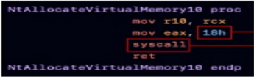
Normal
Direct Syscalls
EDR hooks into NTDLL to analyse and correlate the data
Common API calls go through NTDLL
Implement own syscall in assembly
Call syscall directly and bypass BTDLL hooks
SSN (system service number)
It identifies which syscall executes
The syscall number varies between windows versions
It can be obtained dynamically – conveniently automated by syswhishpers2
Malware
Kernel32.dll
ntdll.dll
Import assembly
ntdll.dll
VirtualAlloc
NtAllocateVirtualMemory
User space
NtAllocateVirtualMemory
NtAllocateVirtualMemory
Can trigger static analysis since the syscall assembly instruction might be flagged
EDR
EDR catches syscall
EDR sees nothing
Kernel
NtAllocateVirtualMemory
NtAllocateVirtualMemory
* https://archive.conference.hitb.org/hitbsecconf2022sin/session/edr-evasion-primer-for-red-teamers/

Slide 13
Indirect syscalls
In indirect syscalls the assembly files are first manually crafted , the difference lies is that in indirect syscalls , syscalls are not used directly , instead we use jmp instruction in its assembly file to jump the function of ntddl.dll .
Thus, code will ultimately be running in address space of ntdll.dll , Thus it won't be flagged suspicious for EDR.

Slide 14
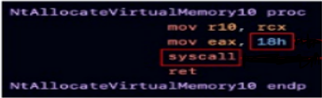

Normal
Direct Syscalls
EDR hooks into NTDLL to analyse and correlate the data
Common API calls go through NTDLL
Implement own syscall in assembly
Call syscall directly and bypass BTDLL hooks
indirect Syscalls
Prepare syscall in assembly (as with direct syscalls)
Then find a syscall instruction in ntdll.dll and jumps to that location
Malware
Kernel32.dll
ntdll.dll
Import assembly
ntdll.dll
Import assembly
ntdll.dll
.
VirtualAlloc
NtAllocateVirtualMemory
NtAllocateVirtualMemory
User space
NtAllocateVirtualMemory
NtAllocateVirtualMemory
Syscall
EDR
EDR catches syscall
EDR sees nothing
EDR sees nothing
Kernel
NtAllocateVirtualMemory
NtAllocateVirtualMemory
NtAllocateVirtualMemory
* https://archive.conference.hitb.org/hitbsecconf2022sin/session/edr-evasion-primer-for-red-teamers/

Slide 15
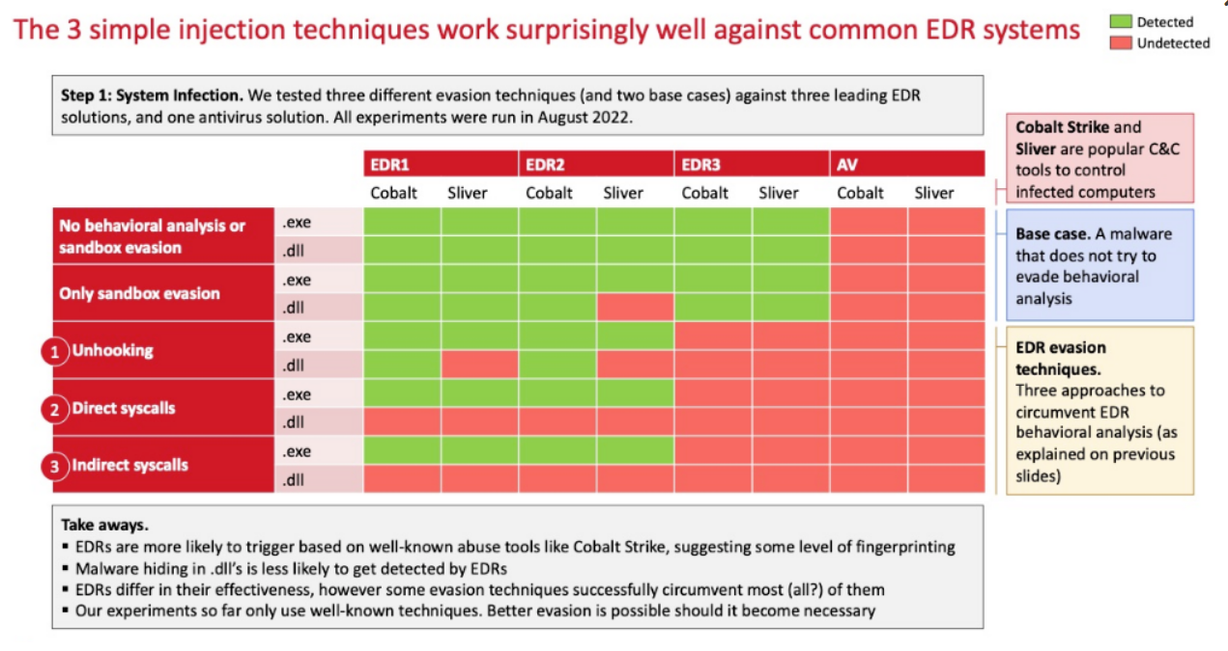
Map showing efficiency of EDR in detecting the attack using the above evasion techniques:
* https://archive.conference.hitb.org/hitbsecconf2022sin/session/edr-evasion-primer-for-red-teamers/

Slide 16
Counter measures
Application allow listing
Controls to block .lnk files
Privilege management controls
Threat hunting
Memory Forensics
Prevent LSASS dumping by running it as protected process light (run as PPL)

Slide 17
Conclusion
Responding to EDR evasion techniques remains an ongoing challenge in cybersecurity. EDR solutions are intended to detect and stop malicious activities; however, attackers continue devising novel tactics for bypassing detection systems to deploy their malicious code without setting off alarms in EDR software.
To effectively address this ongoing challenge, security professionals must have an in-depth knowledge of EDR solutions, Windows syscalls, and EDR evasion techniques. With this understanding in hand, defenders can create countermeasures tailored specifically to EDR evasion attempts.
One drawback of basic EDR solutions is their inferiority to sophisticated/modern EDR solutions with more advanced detection mechanisms that detect evasion techniques; they have mechanisms in place that detect and prevent EDR evasion altogether.

Slide 18
Thank You
https://in.linkedin.com/in/y-n-harish-94812b122

