Slide 1





Slide 2



Our Business Idea

Slide 3

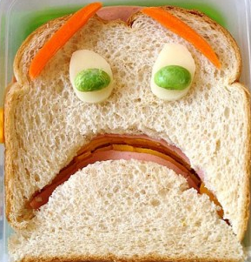
Why ?
Tired of eating out?
Bored with cooking same food?
Want to get creative with your ingredients?
Notes:
Are you tired of eating out?
Bored with eating the same food?
Want to get creative with your food ingredients?

Slide 4

will spice up your food ☺
Notes:
Are you tired of eating out?
Bored with eating the same food?
Want to get creative with your food ingredients?

Slide 5
Timeline
The creation of cookups.org will be a completed over a 9-week timeframe that is divided into a number of phases. At the end of each phase, cookups.org will be a fully functioning web application. However, each successive phase will bring improved functionality, performance, and aesthetics.

Slide 6
Structural Design Phase: 9/26/2014 - 10/4/2014
Investigate deficiencies of similar websites.
Determine all applicable use cases.
Coordinate database functionality with use cases.
Acquire url rights and set up pre-release web page.

Slide 7
Basic Database and UI Development Phase: 10/5/2014 - 10/25/2014
Develop search by ingredients functionality
Link local and external database search results
Develop add recipe functionality
Establish rudimentary menu trees and UI screens
User Accounts

Slide 8
Advanced Functionality and Aesthetics Phase: 10/26/2014 - 11/22/2014
Add search by time requirements, food category, and primary flavor
Implement search result sorting
Establish recipe rating system
Allow recipe modification for user-created recipes
Finalize appearance of UI

Slide 9
Debug and Stress Testing Phase: 11/23/2014 - 12/5/2014
Evaluate performance characteristics
Confirm functionality in all use cases
Stress test database and server functions

