Slide 1
We Are..

Slide 2


Slide 3
and we present to you..

Slide 4


Slide 5
meet our team..

Slide 6
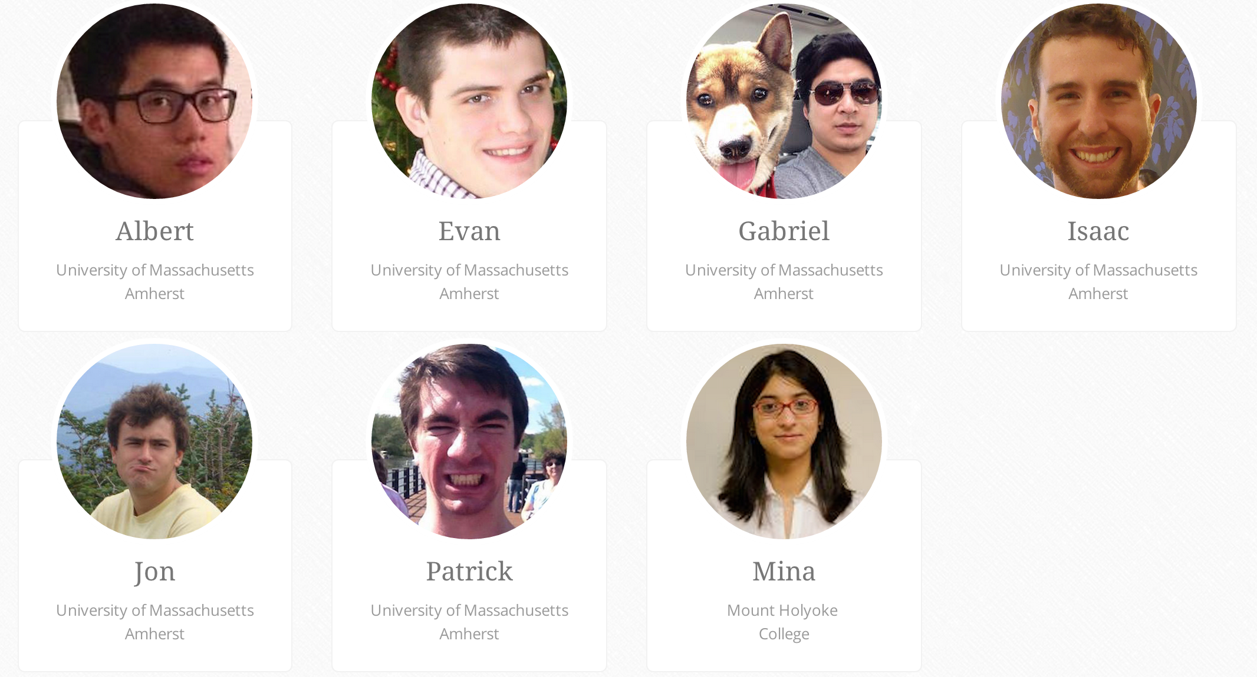

Slide 7
Individual responsibilities
Patrick (Front-end developer)
Customized WrapBootstrap template using HTML/CSS
Team managerial role
Mina (Back-end and front-end developer)
Developed the search form and search results page.
Implemented search recipe functionality with regards to the Yummly API.
Team managerial role.
Isaac (Back-end and front-end developer)
Setup routes
PostgreSQL database work with Jon.

Slide 8
Individual responsibilities
Evan (Front-end developer)
Designed and developed user profile page.
Gabriel
Setup server.
Jon (Backend developer)
Setup PostgreSQL scheme and database to store member information and new recipes.
Implemented search recipe functionality for internal database.
Albert (Front-end developer)
Designed and developed add recipe page

Slide 9
What does CookUps do?

Slide 10
CookUps functionality
Search Recipes
Yummly recipe database
Fields: recipe name, ingredients, calories, maximum preparation time, holiday/season, allergies, dietary restrictions, nutritional information, food course, cuisine preference and flavors.
Internal recipe database created by CookUps members
Fields: recipe name, ingredients and maximum preparation time (limit search fields for internal search so that users do not have to add all other fields)

Slide 11
Member-only functionality
Yummly members
Signup and login
View profile
Add recipes to the internal recipe database
View their personally added recipes

Slide 12
CookUps architecture..

Slide 13
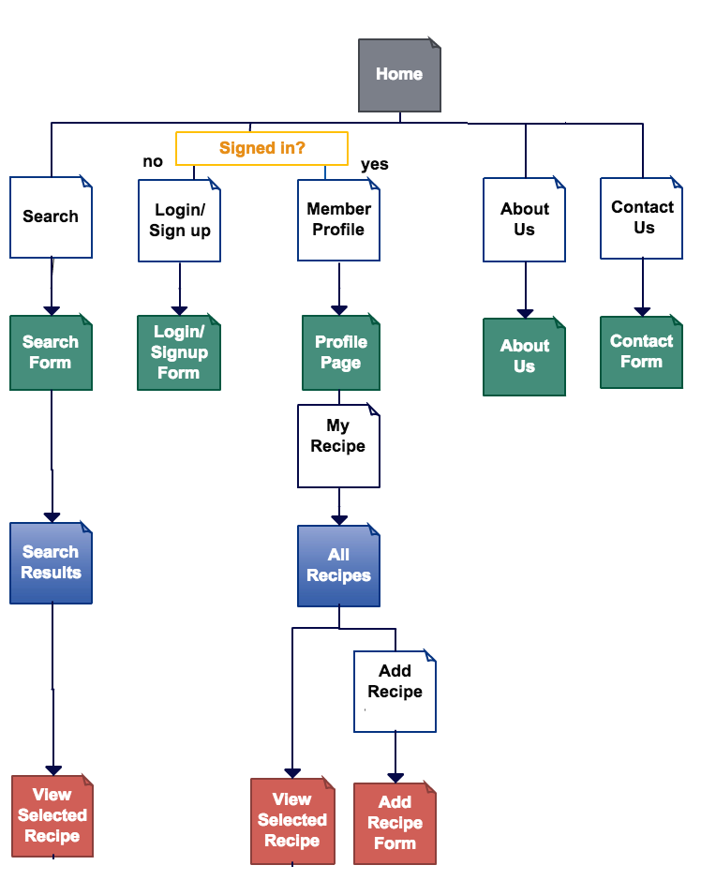
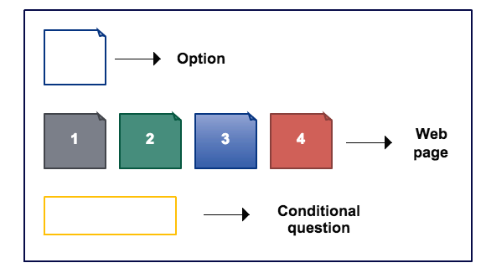

Slide 14
Development challenges..

Slide 15
Challenges
Back-end:
Integrating recipe search results from Yummly API and internal database (successfully resolved)
Front-end:
Making the website interface user-friendly and responsive, especially for optimal viewing experience on desktop and mobile (successfully resolved)
Channeling information from the front-end forms to back-end database (successfully resolved)
Storing and rendering recipe and profile images added by users (In progress)

Slide 16
What will you see in our next version?

Slide 17
Future work
Blog
Share recipe
Rate recipe
Login with your Facebook and/Google + account
Allow member to add image for member profile
Save and display image for member stored recipes

Slide 18
Thank you ☺

